Slide 1

Spots
The App that saves your favourite places
Group #007 :
Baptiste BENET – Jean BARRÉ

Slide 2
What for ?
Target : Large, Adventurous and Busy People
Context : Daily Life or Travels
Need : Keep track of interesting points

Slide 3
How ?
Constraints : User’s Time – Places Referring
Goals : Online / Offline
Smartwatch or not

Slide 4
Solution
How to use
Smartphone app + Smartwatch app
2 clicks : select a category, and press “add point”
Slide between views
Technologies
Android
Fragment Activities
Google Maps API
Google Places API

Slide 5
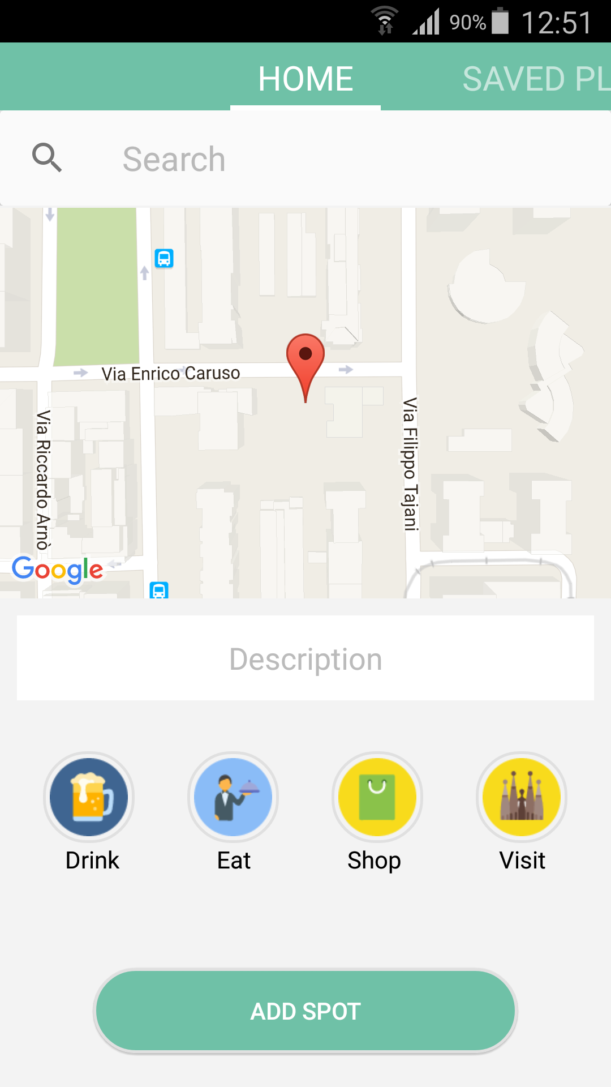
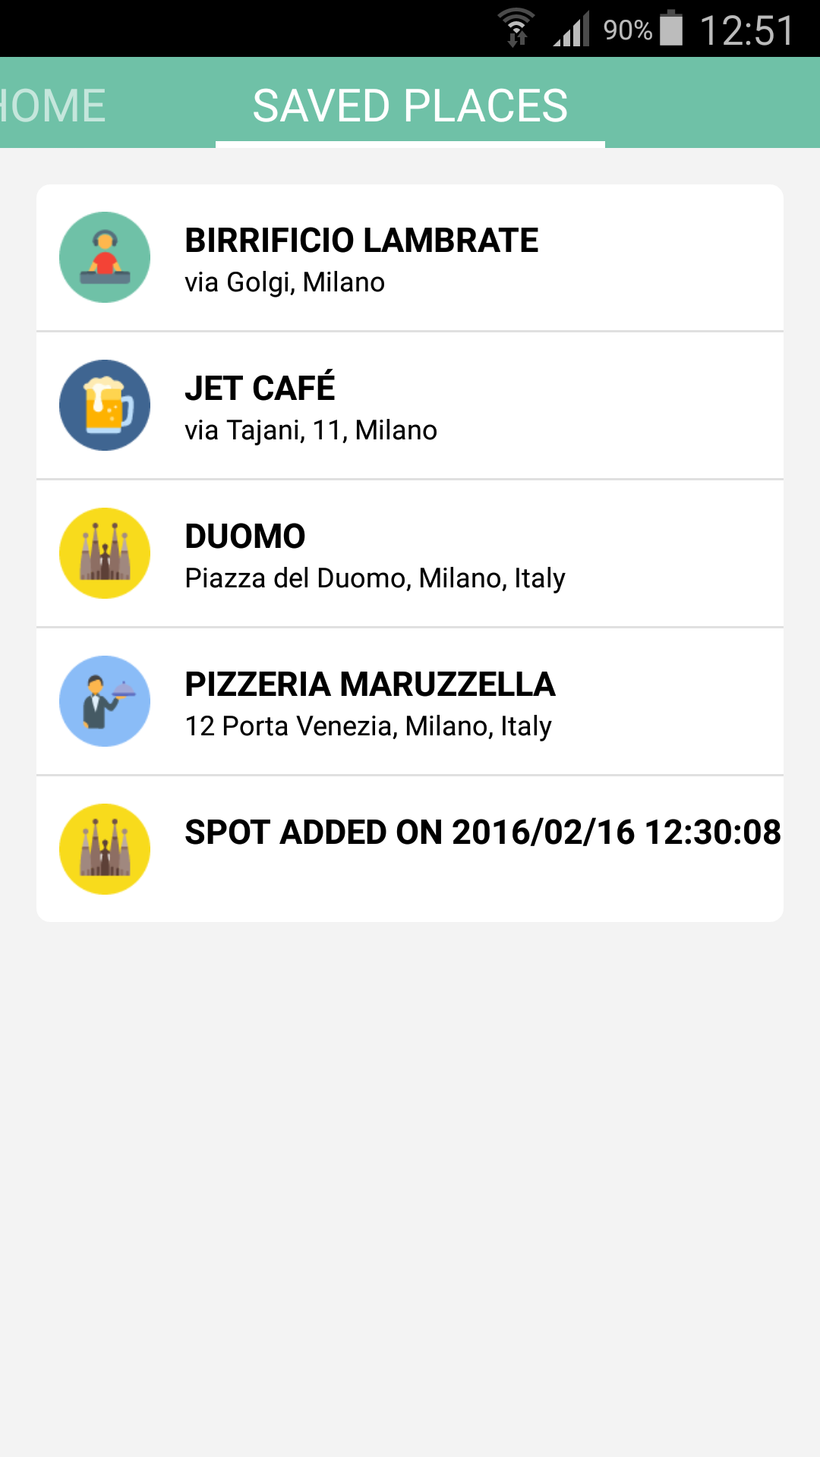
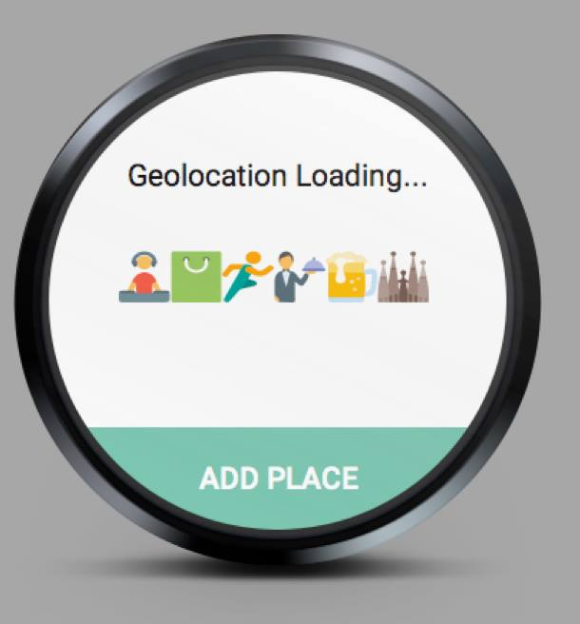
Solution

Slide 6
Value
Competitors?
“Google Maps” users cannot register points offline
“Google Maps” users cannot set categories
“Reperly” UX is too hard to understand + you NEED login…
Our app is:
Offline / Online
Support categories
Is very simple to use

