Slide 1
NCIF Platform Architecture
Data Layer
AWS RDS (Structured data)
AWS S3 (Unstructured data)
AWS EMR (Data Processing )
Backend API Layer
AWS Lambda (Serverless Computing)
API Gateway (Endpoint Management)
AWS S3 (Caching/Temp Results)
Security & Authentication
Amazon Cognito (Authentication)
AWS IAM (Acess Control)
NLP & Machine Learning
Amazon SageMaker (ML Model Training & Deployment)

Slide 2
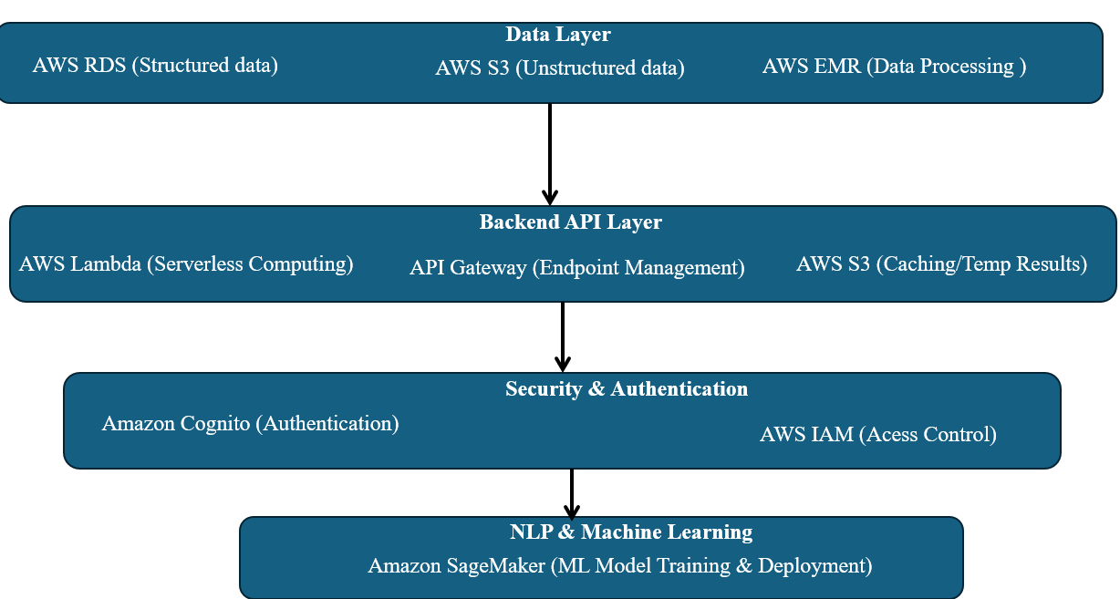
Architectural Breakdown for NCIF Platform
1. Data Layer Strategy
- AWS RDS & AWS S3: data storage
- AWS EMR Spark: Data processing pipeline
* Transforms raw data
* Cleans and standardizes 21 diverse datasets
2. Backend API Architecture
- AWS Lambda: Compute layer
* Dynamically handle data queries
* Auto-scales based on request volume
- API Gateway: (Manages API endpoints, Handles request routing, monitoring and throttling)
- S3 Caching: (Temp. result storage, Reduces database load, Improves query performance)
3. Security Framework
-Amazon Cognito:
* User authentication
* Supports multiple login methods
- AWS IAM (Identity and Access Management):
4. NLP and Machine Learning
- Amazon SageMaker:
* Train custom models
* Deploy machine learning endpoints

Slide 3
Load datasets from AWS S3 into an SQLite database
1. Set Up AWS EMR Cluster with Spark
1.1 Launch AWS EMR Cluster
1.2 Cluster Configuration
2: Read Data from AWS S3
3: Data Transformation with Spark (Normalization and validation of master keys)
4: Save Transformed Data to SQLite
5: Verify Data Integration (confirm the successful load of data into the SQLite database using Python's swlite library)

Slide 4
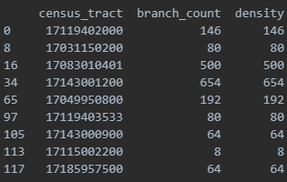
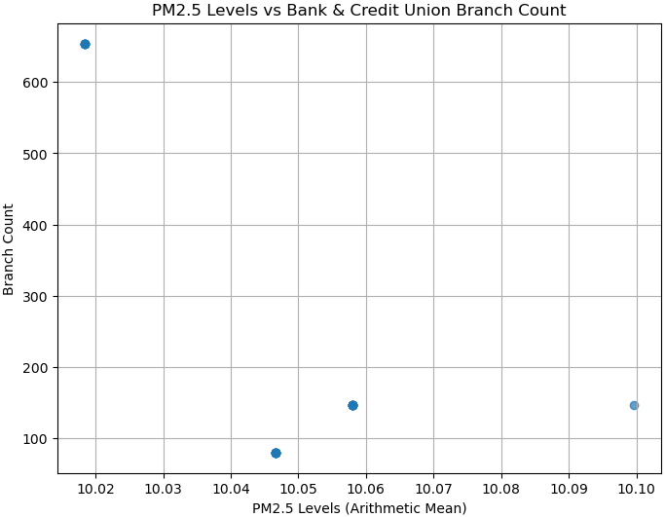
Objectives:
1. Compute the density of bank and credit union branches by census tract.
2. Identify census tracts with PM2.5 > 10 and more than 5 branches of banks and credit unions.
3. Analyze the correlation between PM2.5 levels and branch density.
- **Density Analysis**:
- Branch density by census tract was calculated - Identified key areas with higher branch density.
- **PM2.5 and Branch Count**:
- Census tracts with PM2.5 > 10 and >5 branches were extracted.
- Correlation analysis indicates [insert correlation result, e.g., moderate positive/negative correlation].
- **Visualization**:
- A table lists the census tracts meeting the criteria.
- A scatterplot visualizes the relationship between PM2.5 levels and branch density.

Slide 5
API Creation
API 1 (Data Aggregation): Combines data from different sources (SOD, NCUA, EPA) and computes branch density and air quality categorization.
API 2 (Dynamic Querying): Supports dynamic queries based on user input for filtering data based on conditions such as PM2.5 and branch count.
API 3 (Machine Learning): Predicts PM2.5 levels based on historical pollution data and branch density using a machine learning model.
API 4 (NLP Interface): Uses natural language processing (NLP) to interpret user queries and convert them into SQL queries for fetching data.
By using Flask to build the APIs, spaCy for natural language processing, and SQLite/MySQL/PostgreSQL for database interactions, these APIs can be deployed and serve requests dynamically based on user input.

