Slide 1
Comparison between PCR and RGB Futures

Slide 2
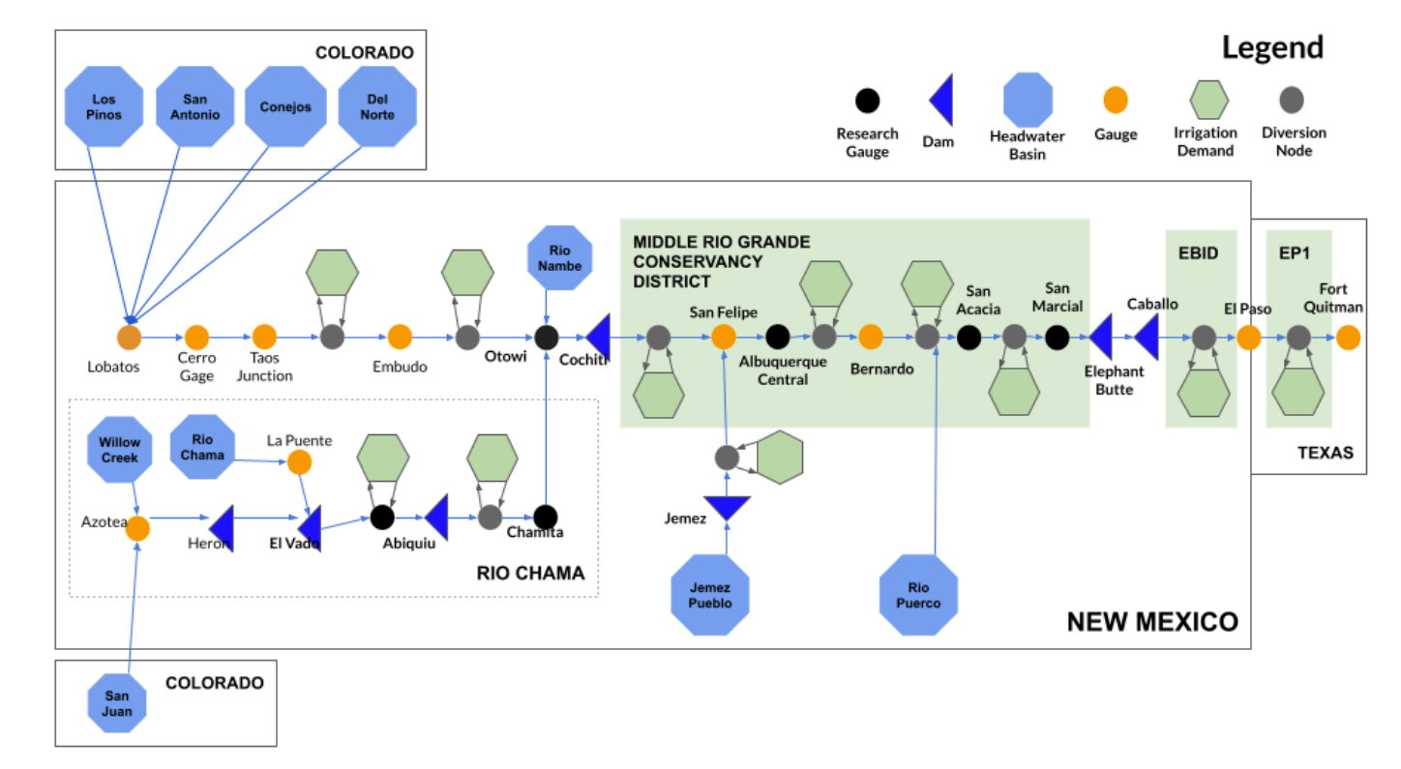
USGS 08317400: Below Cochiti Dam
USGS 08361000: Below Elephant Butte Dam
USGS 08362500: Below Caballo Dam

Slide 3
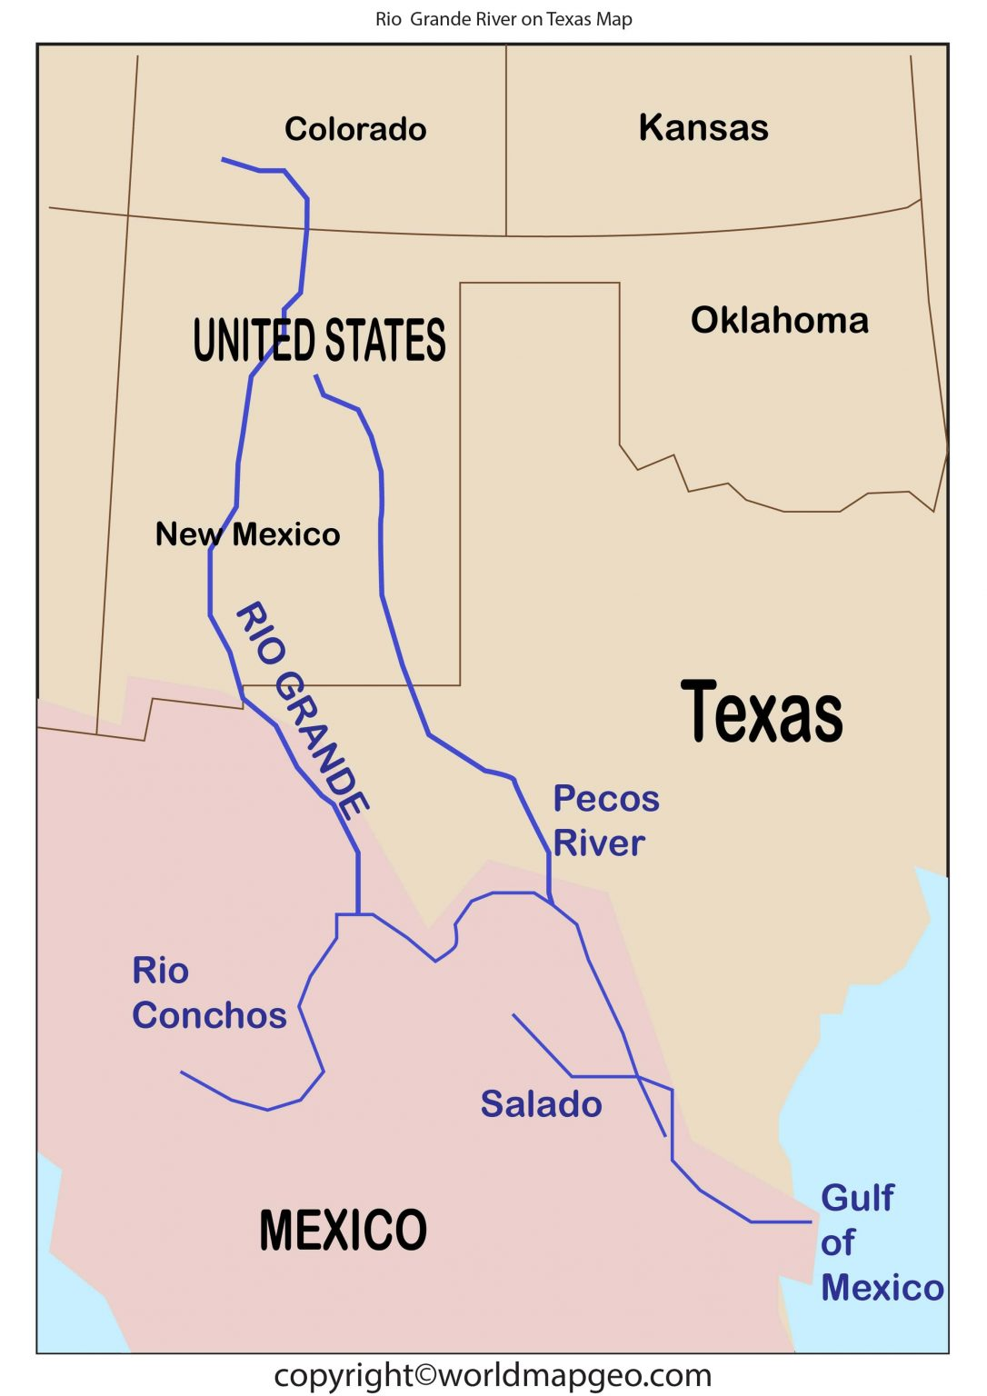
As discussed, assigning the USGS gage to a specfic PCR GLOB grid cell might be challenging.
Two methods:
1. Selecting the grid cell whose center point is the closest to the location from the USGS gage
2. Selecting the grid cell from the direct neighbors surrounding the closest grid cell from the USGS gage. The selected grid cell is the one whose average flow is the closest of the average flow of the USGS gage.
The next slides show that method 1 seems more appropriate. While the difference in average flow is larger when the method 1 is used, the difference in PCR GLOB grid cell flow is such that method 2 is likely to select a grid cell that does not encompass the main RG rive stem.
Long story short, I think PCR GLOB largely over-estimate flows

Slide 4
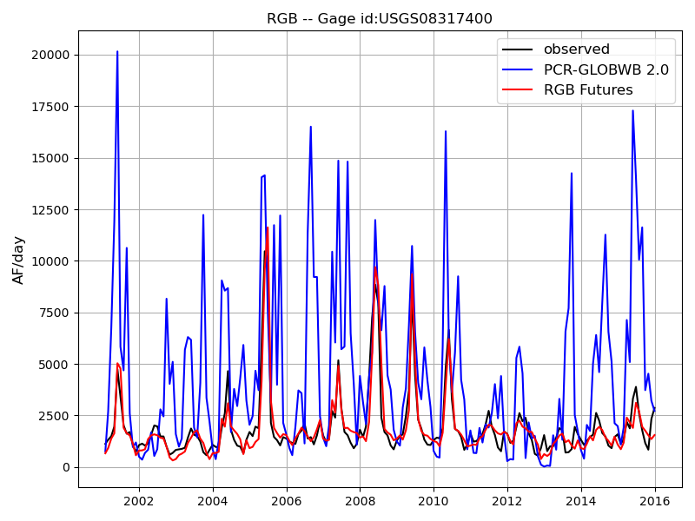
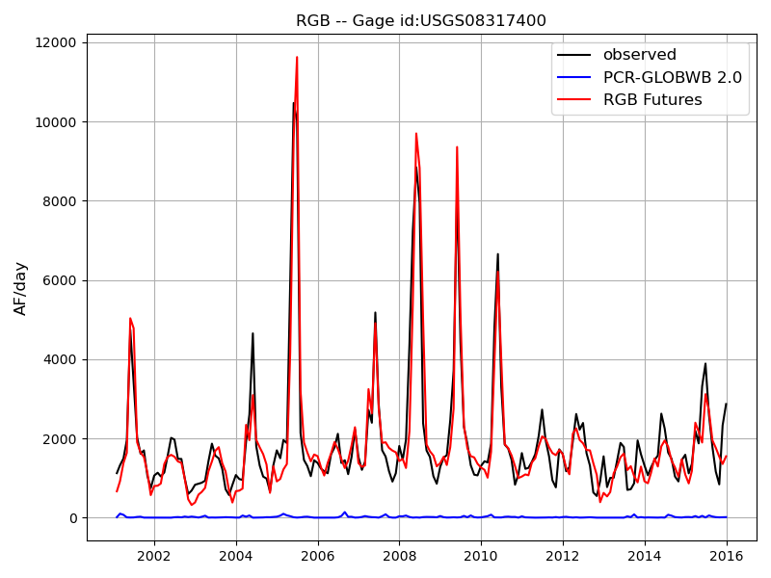
USGS 08317400: Below Cochiti Dam
Closest grid cell (based on lat/lon)
Closest ‘flow average’ from the closest grid cell and direct neighbors
 | min | q5 | q25 | q50 | q75 | q95 | max | mean | std | nash
USGS | 546.7 | 744.3 | 1119.5 | 1494.8 | 1961.0 | 4843.4 | 10465.0 | 1937.5 | 1611.2 | -1000.0
RGB_Futures | 320.0 | 626.7 | 1176.3 | 1523.2 | 1858.9 | 5006.4 | 11623.8 | 1886.7 | 1655.8 | 0.9
PCR_GLOB | 19.1 | 402.4 | 1488.2 | 3296.1 | 6080.5 | 14044.2 | 20156.0 | 4519.9 | 4087.1 | -6.7
 | min | q5 | q25 | q50 | q75 | q95 | max | mean | std | nash
USGS | 546.7 | 744.3 | 1119.5 | 1494.8 | 1961.0 | 4843.4 | 10465.0 | 1937.5 | 1611.2 | -1000.0
RGB_Futures | 320.0 | 626.7 | 1176.3 | 1523.2 | 1858.9 | 5006.4 | 11623.8 | 1886.7 | 1655.8 | 0.9
PCR_GLOB | 0.0 | 0.5 | 2.8 | 9.3 | 20.8 | 56.2 | 141.3 | 16.6 | 21.7 | -1.4

Slide 5
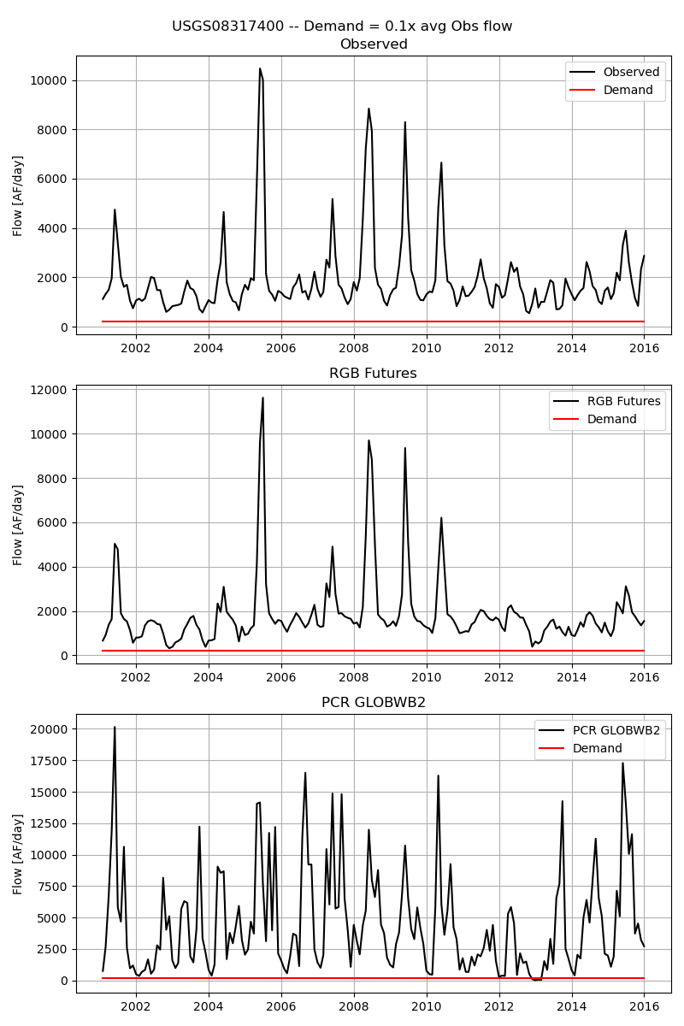

Slide 6
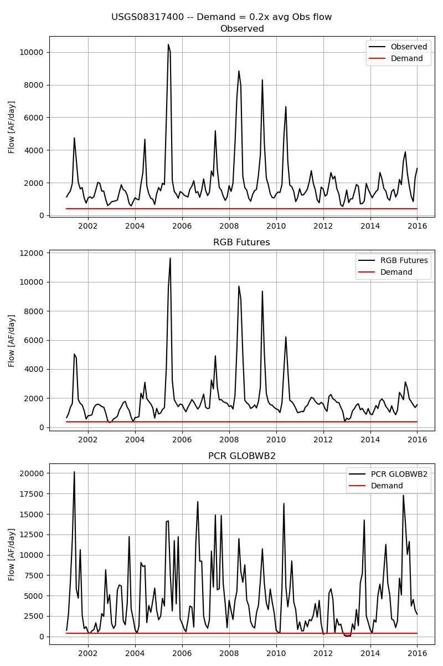

Slide 7
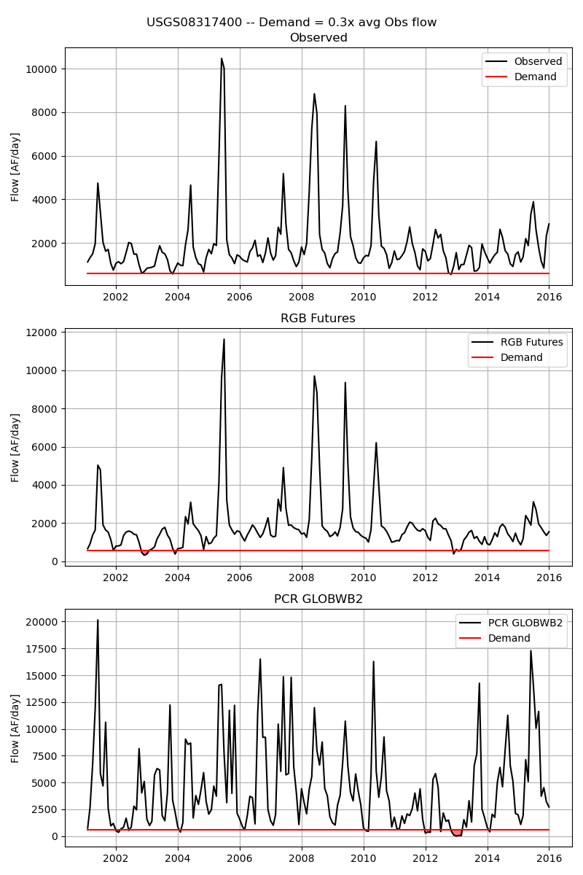

Slide 8
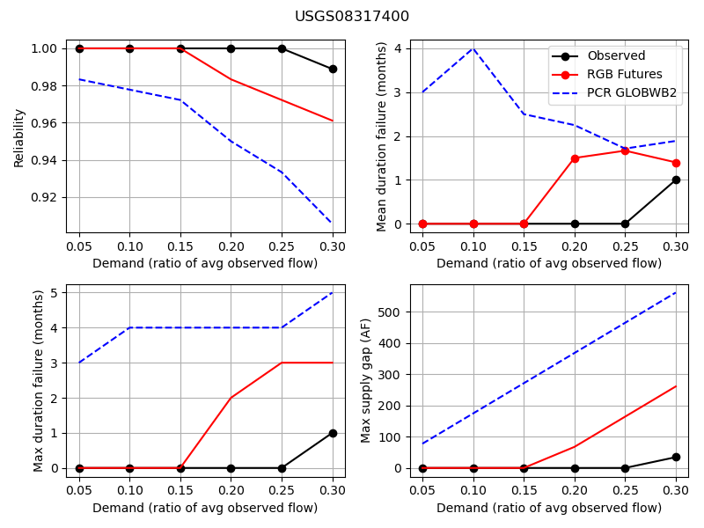

Slide 9
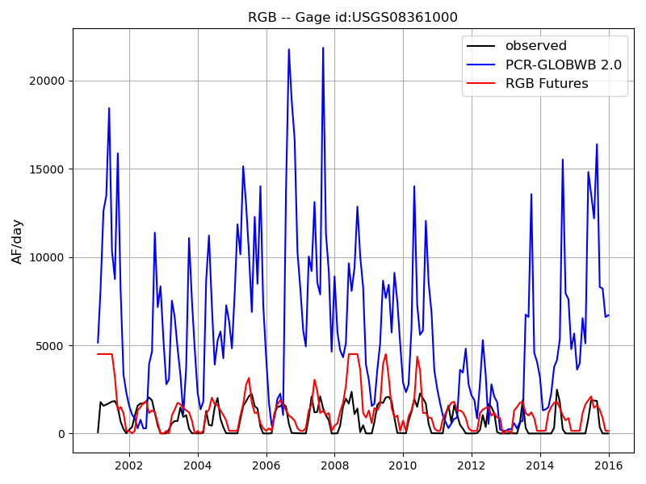
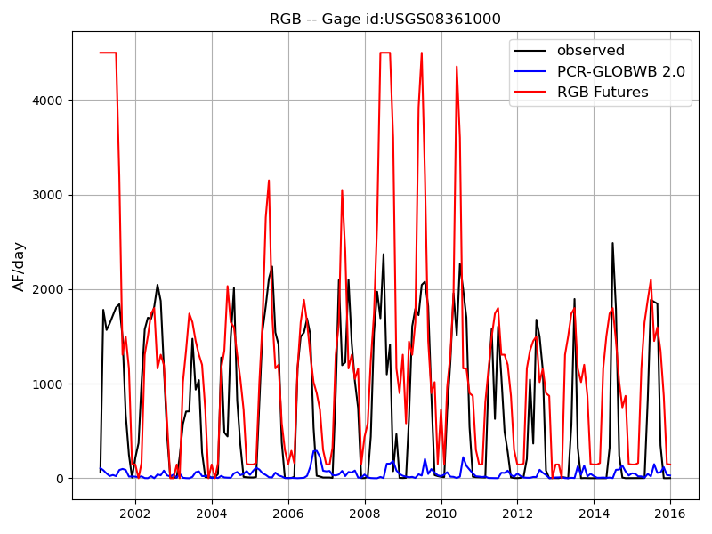
USGS 08361000: Below Elephant Butte Dam
Closest grid cell (based on lat/lon)
Closest ‘flow average’ from the closest grid cell and direct neighbors
 | min | q5 | q25 | q50 | q75 | q95 | max | mean | std | nash
USGS | 0.1 | 0.4 | 7.9 | 447.1 | 1525.1 | 2044.7 | 2487.3 | 740.6 | 775.9
RGB_Futures | 0.0 | 145.2 | 300.0 | 1161.3 | 1650.0 | 4500.0 | 4500.0 | 1290.4 | 1150.3 | -0.8
PCR_GLOB | 149.6 | 303.1 | 2313.2 | 5135.3 | 8502.6 | 14837.5 | 21861.3 | 6095.9 | 4635.0 | -80.8
 | min | q5 | q25 | q50 | q75 | q95 | max | mean | std | nash
USGS | 0.1 | 0.4 | 7.9 | 447.1 | 1525.1 | 2044.7 | 2487.3 | 740.6 | 775.9 | -1000.0
RGB_Futures | 0.0 | 145.2 | 300.0 | 1161.3 | 1650.0 | 4500.0 | 4500.0 | 1290.4 | 1150.3 | -0.8
PCR_GLOB | 0.0 | 1.1 | 7.4 | 24.9 | 59.9 | 135.1 | 290.6 | 43.3 | 51.2 | -0.8

Slide 10
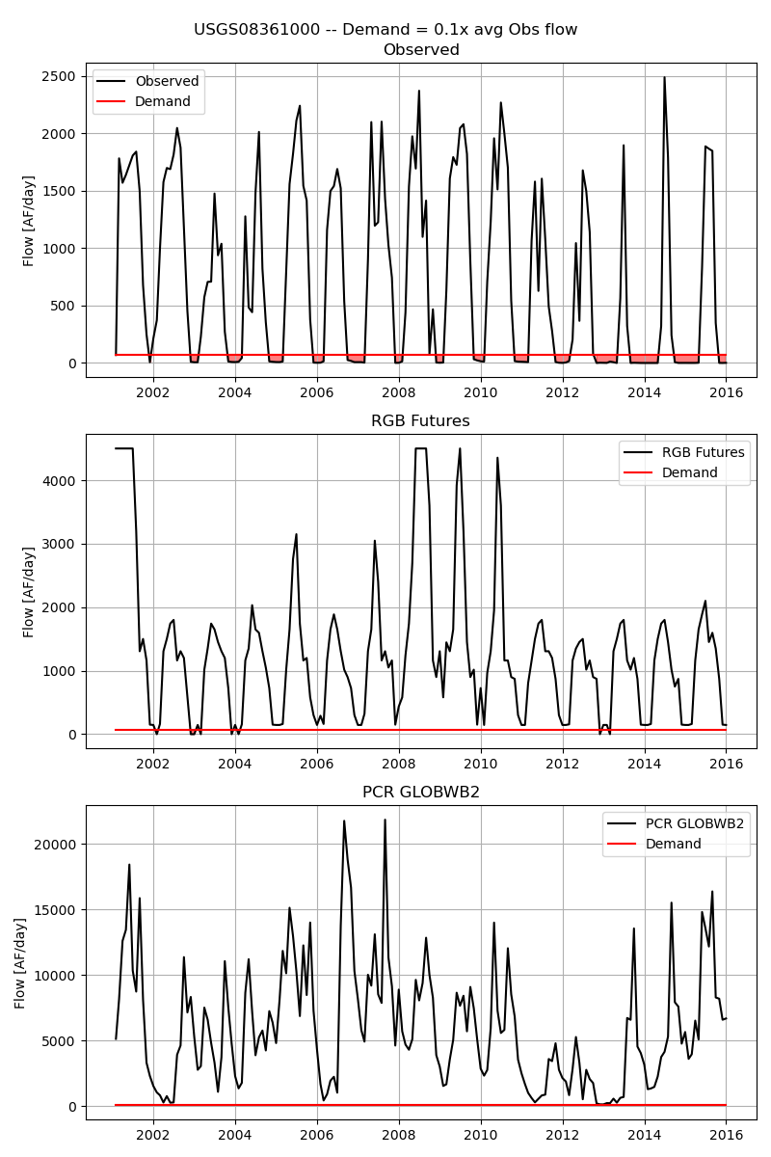

Slide 11
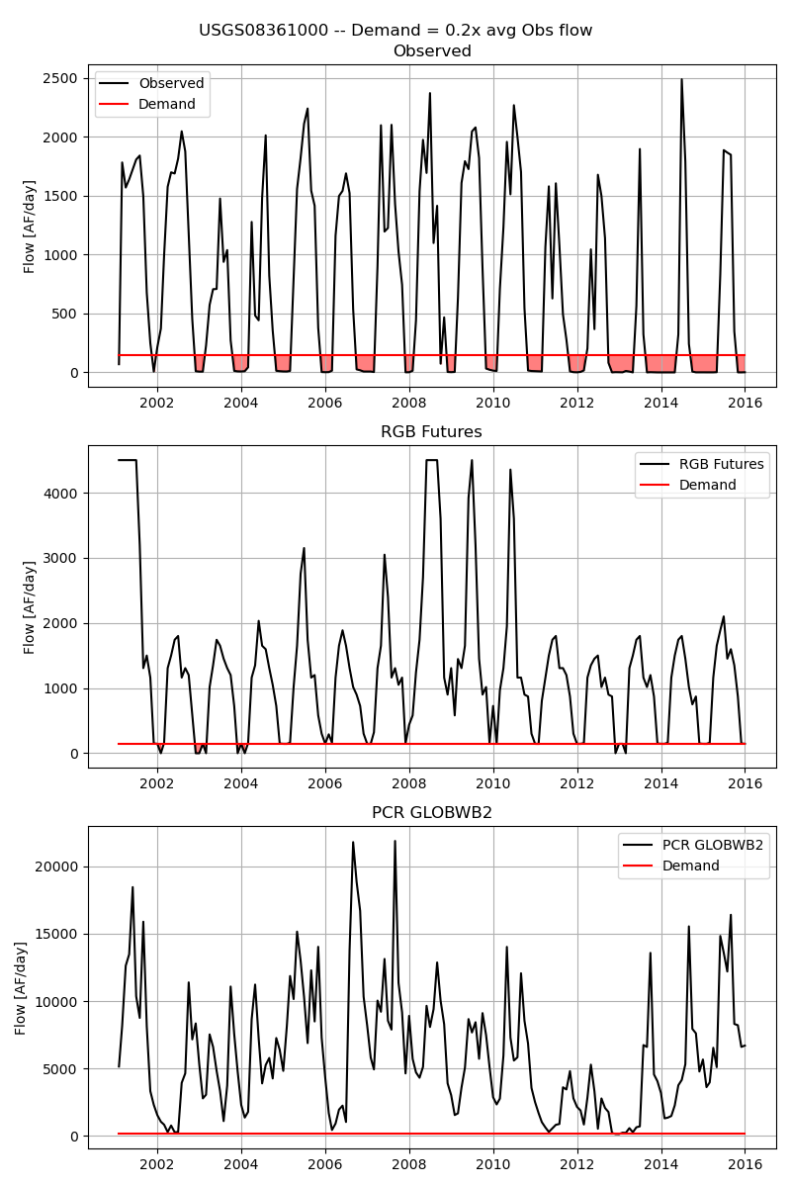

Slide 12
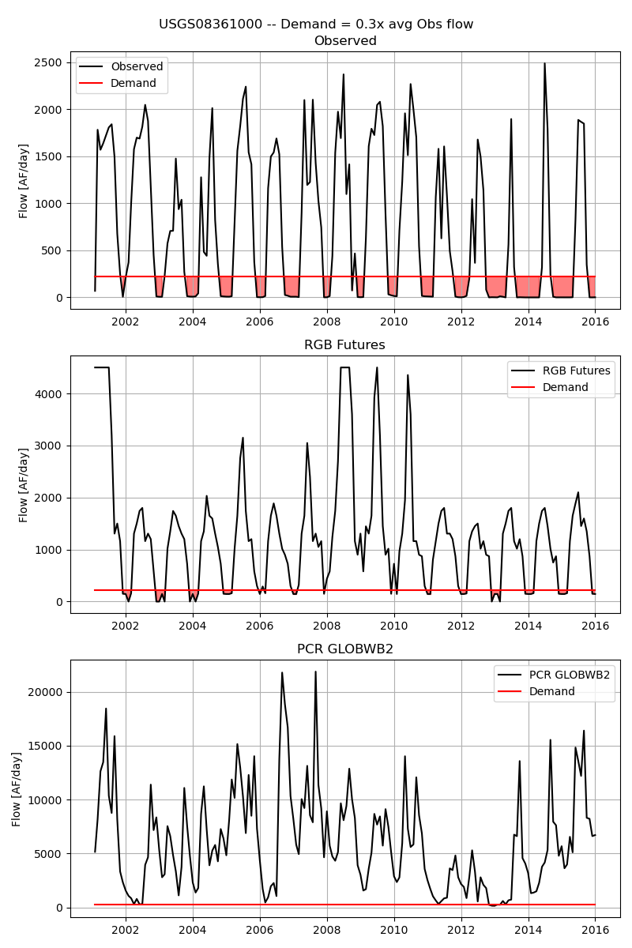

Slide 13
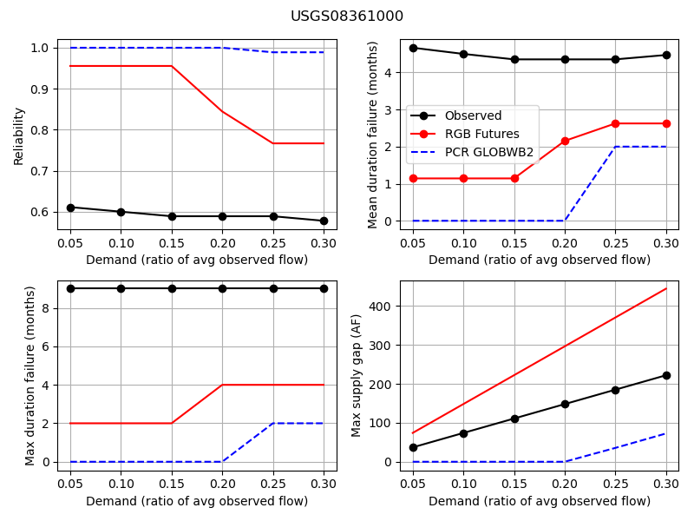

Slide 14
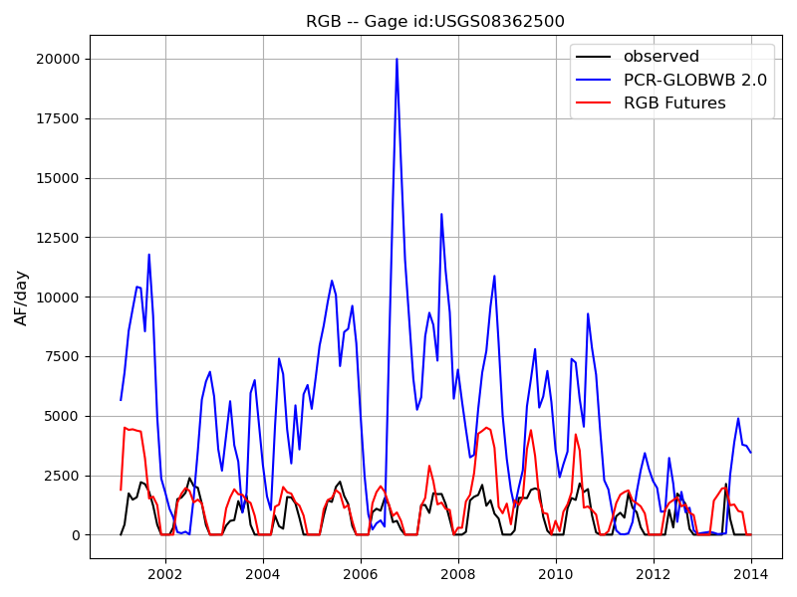
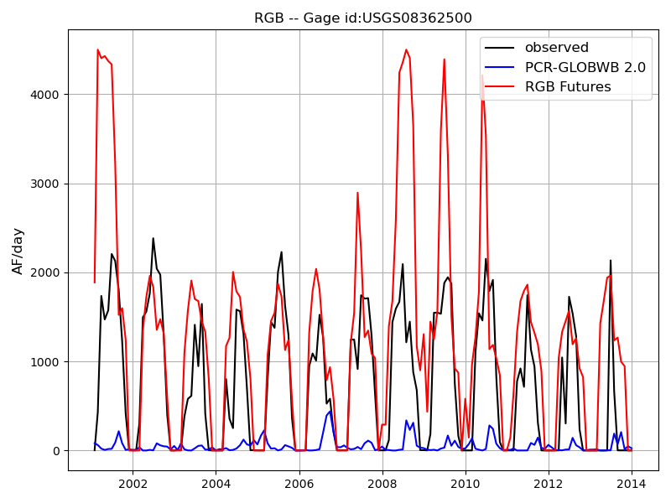
USGS 08362500: Below Caballo Dam
Closest grid cell (based on lat/lon)
Closest ‘flow average’ from the closest grid cell and direct neighbors
 | min | q5 | q25 | q50 | q75 | q95 | max | mean | std | nash
USGS | 0.2 | 0.5 | 1.8 | 579.8 | 1462.5 | 2014.2 | 2383.0 | 747.3 | 750.9
RGB_Futures | 0.0 | 0.0 | 145.2 | 1238.6 | 1677.9 | 4340.9 | 4500.0 | 1281.2 | 1178.1 | -0.9
PCR_GLOB | 9.4 | 59.3 | 1794.5 | 4480.9 | 7119.9 | 10720.5 | 19984.9 | 4804.0 | 3673.6 | -51.5
 | min | q5 | q25 | q50 | q75 | q95 | max | mean | std | nash
USGS | 0.2 | 0.5 | 1.8 | 579.8 | 1462.5 | 2014.2 | 2383.0 | 747.3 | 750.9 | -1000.0
RGB_Futures | 0.0 | 0.0 | 145.2 | 1238.6 | 1677.9 | 4340.9 | 4500.0 | 1281.2 | 1178.1 | -0.9
PCR_GLOB | 0.0 | 0.2 | 6.6 | 21.6 | 60.7 | 219.0 | 439.3 | 51.9 | 77.5 | -0.9

Slide 15
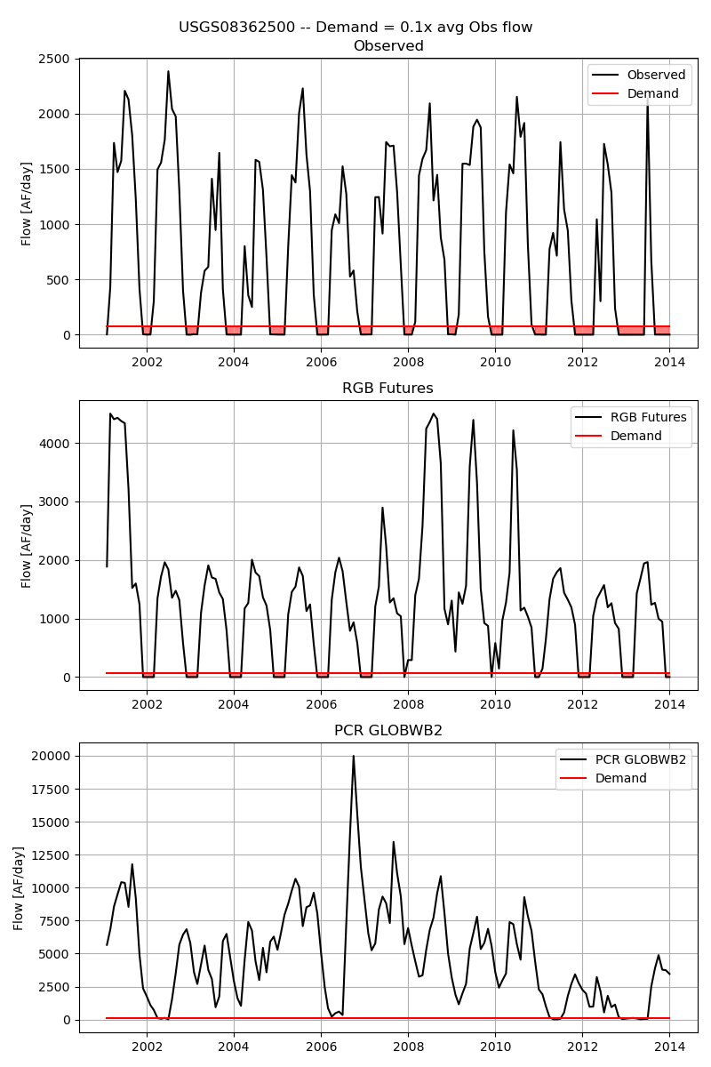

Slide 16
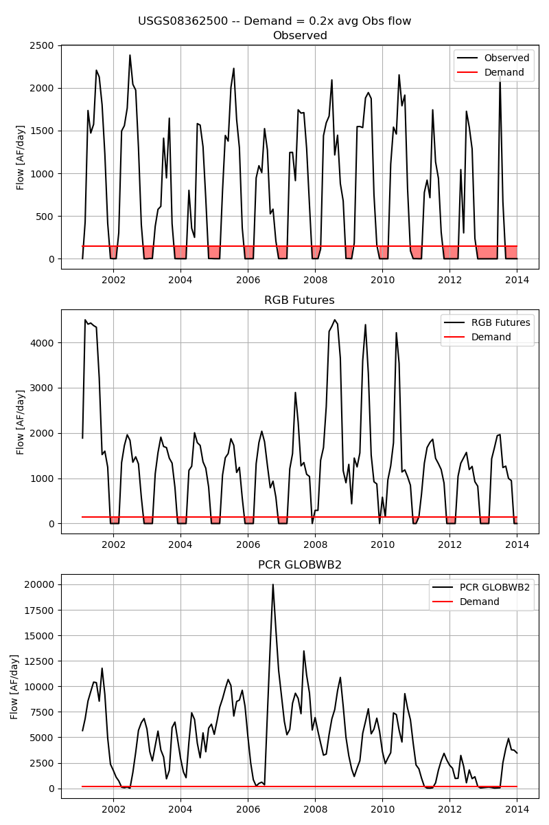

Slide 17
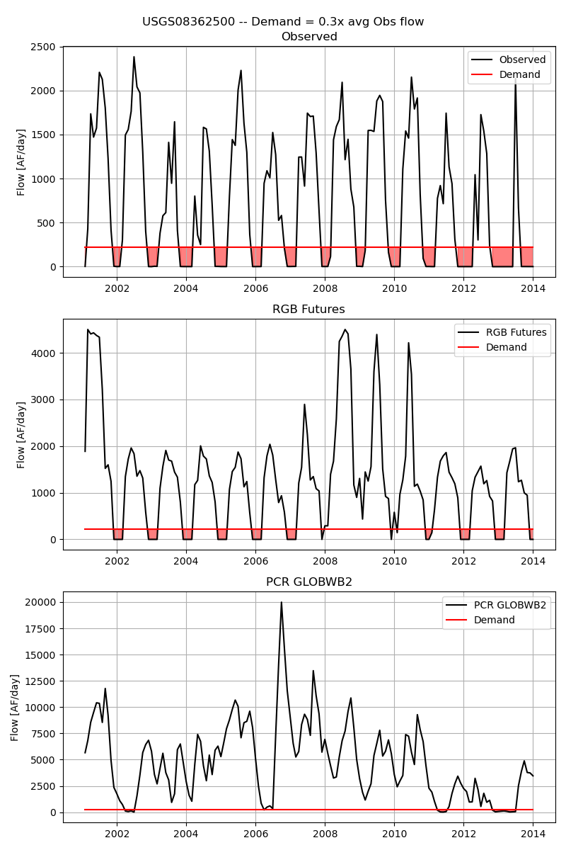

Slide 18
