Slide 1
Comparison between PCR-GLOBWB 2.0 and DPL-HBV
04/26/2024

Slide 2
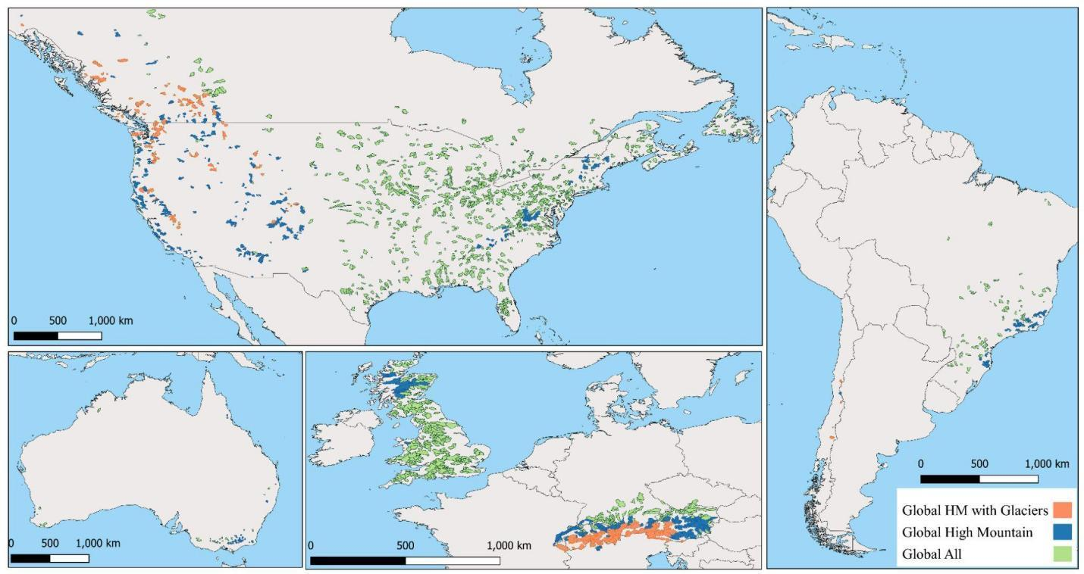
A quick glance at PCR-GLOBWB2.0 performance

Slide 3
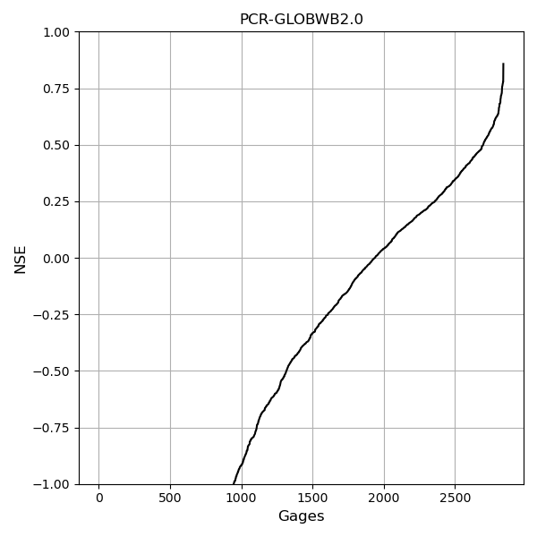
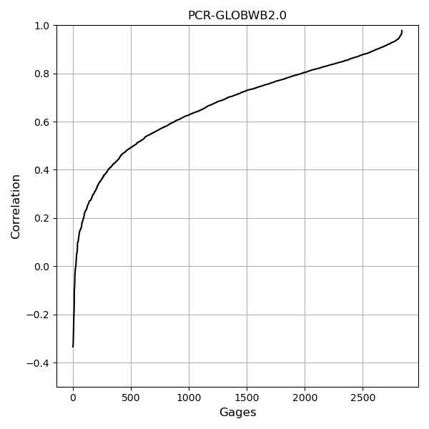
A quick glance at PCR-GLOBWB2.0 performance

Slide 4
Comparison between PCR-GLOBWB2.0 and DPL-HBV (from Maharjan et al. in prep)

Slide 5
The comparison is only made on the glacierized catchment (orange color)

Slide 6
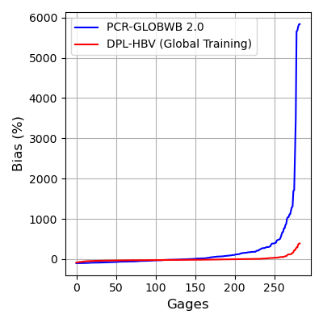
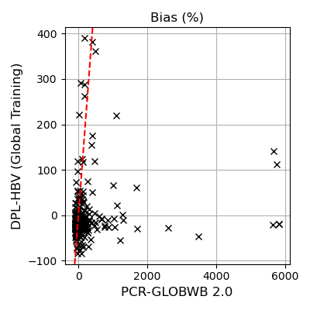
Bias (monthly flow, %)
Quantile | PCR (%) | DPL-HBV (%)
Min | -100 | -84
0.05 | -94 | -49
0.25 | -57 | -27
0.5 | -1 | -16
0.75 | 155 | -0.2
0.98 | 1,044 | 116
max | 5,836 | 390

Slide 7
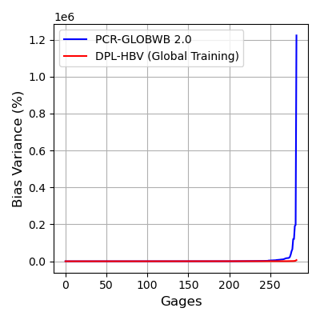
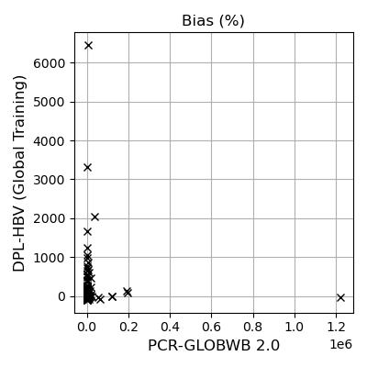
Bias in variance
(monthly flow, %)
Quantile | PCR (%) | DPL-HBV (%)
Min | -100 | -95
0.05 | -99 | -61
0.25 | -83 | -16
0.5 | 41 | 23
0.75 | 586 | 71
0.98 | 14,008 | 552
max | 1,222,751 | 6,447

Slide 8
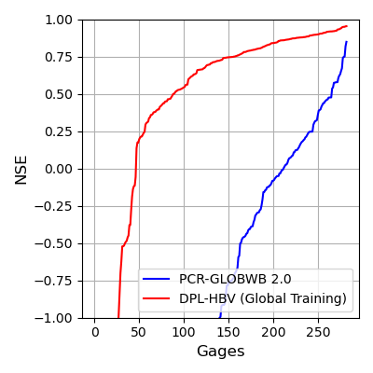
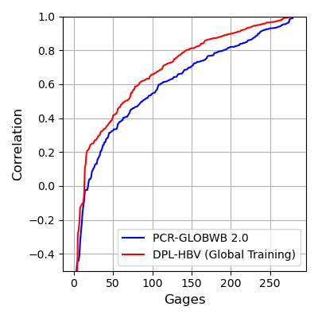
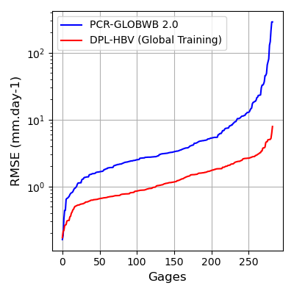
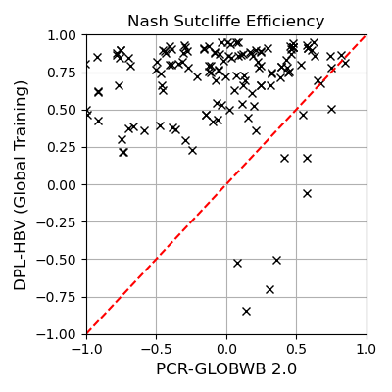
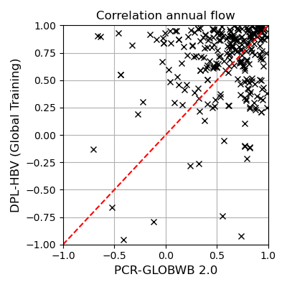
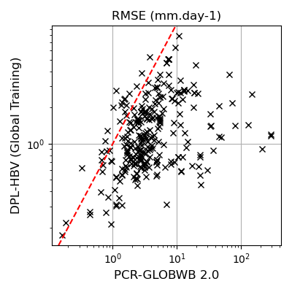
NSE (monthly flow)
Correlation Annual Flow
RMSE monthly flow

Slide 9
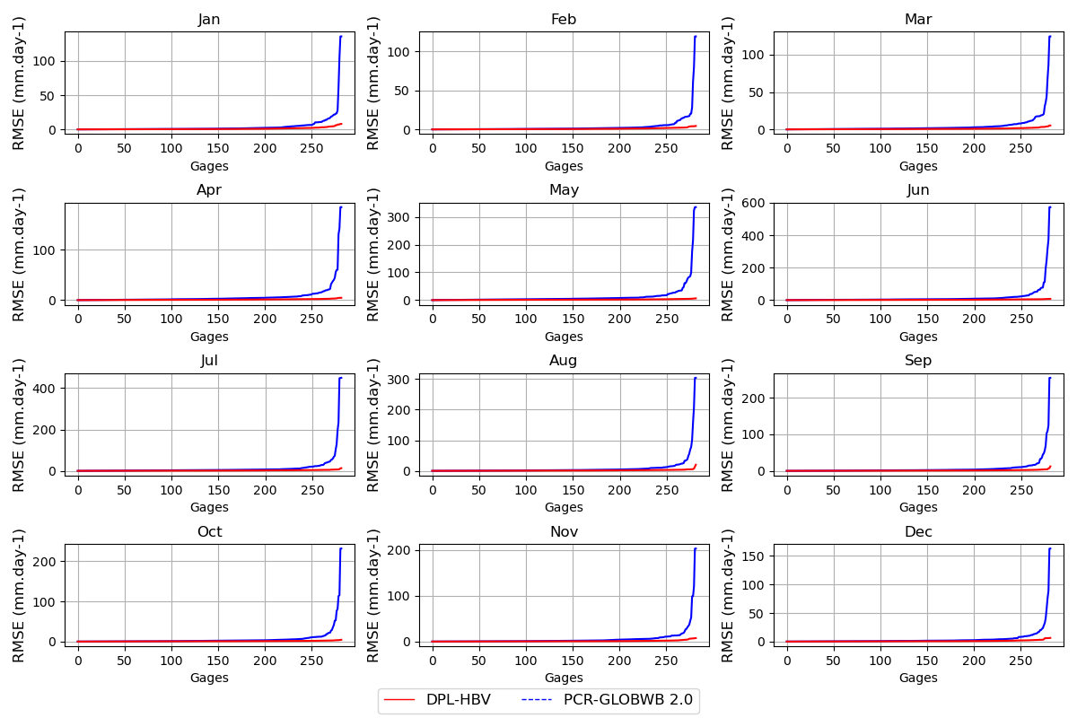
RMSE per calendar month

Slide 10
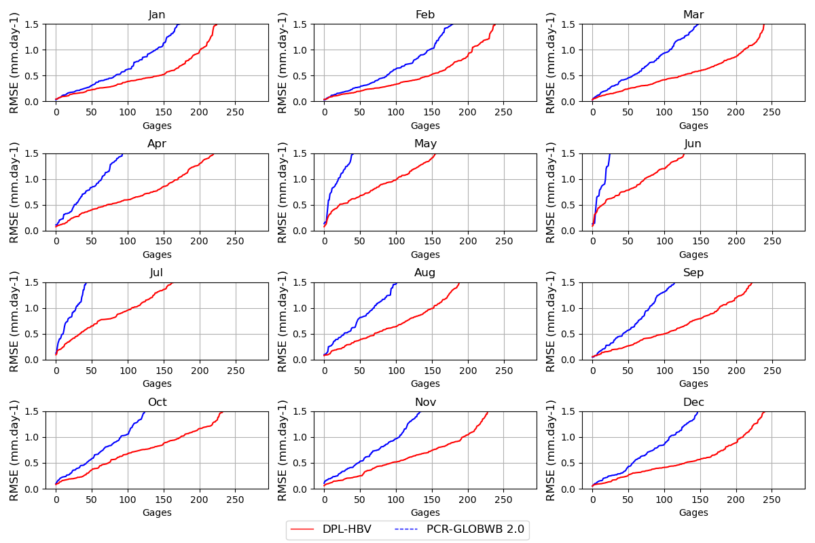
RMSE per calendar month (zoom)

Slide 11
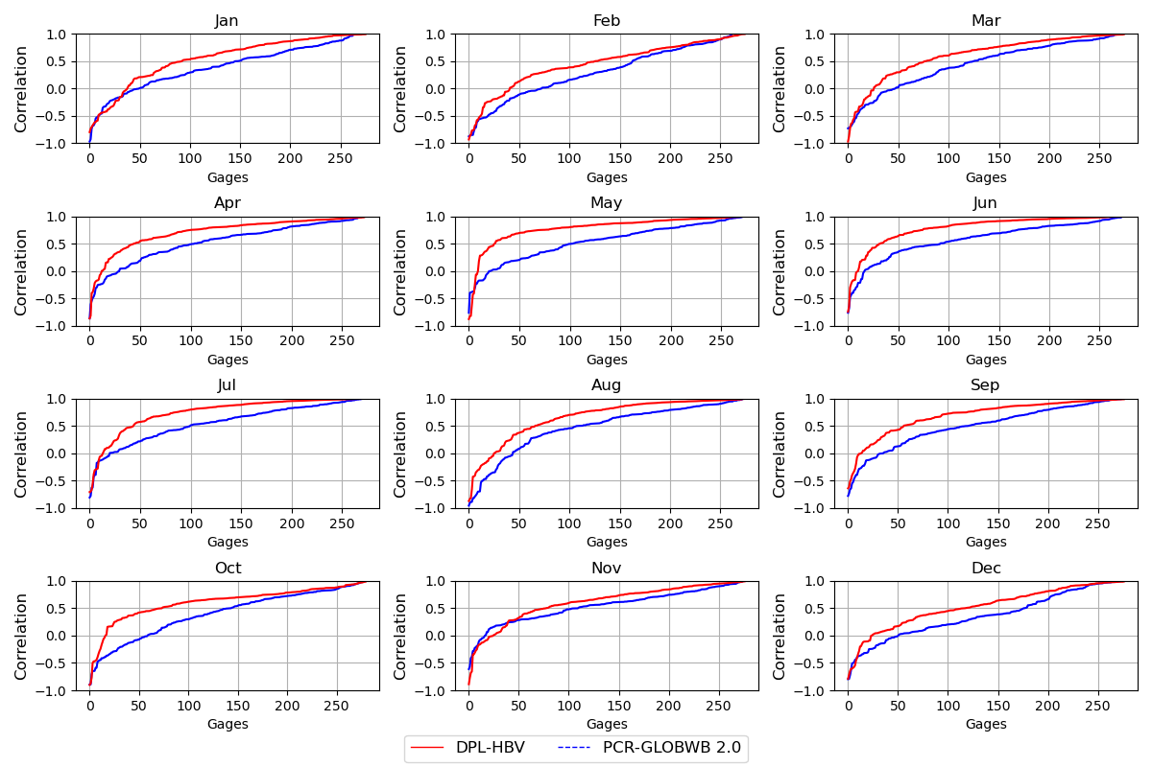
Correlation monthly flow (per calendar month)

Slide 12
Good to have headwater catchment.
Need larger catchments
Using RG – look at headwater and downstream catchments.
Need to show risk. Calculate a drought metric – recurrence intervals
Cumulative low flow

Slide 13
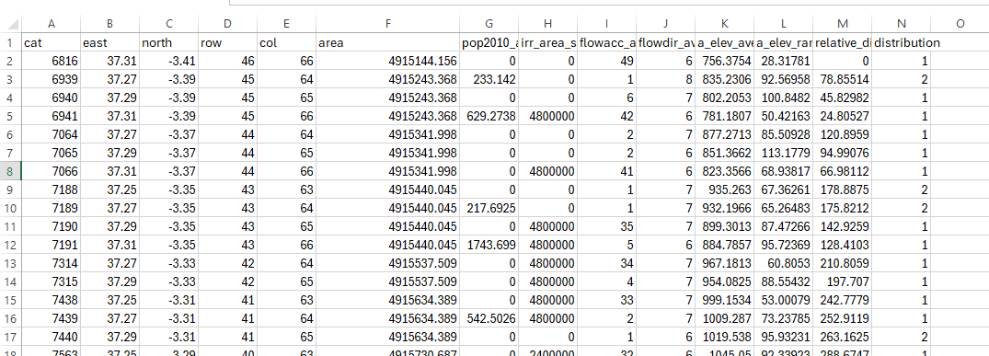
Add USGS gages across US and evaluate PCR over caravan+USGS
Fix the selection issues for PCR (looking at neighbors gages or river network data)
Take on RGB Futures (Chinedum’s version).
Use LSTM (w/ transfer learning) model over RG basins
Try to get simulated reservoir storage from PCR.

