Slide 2
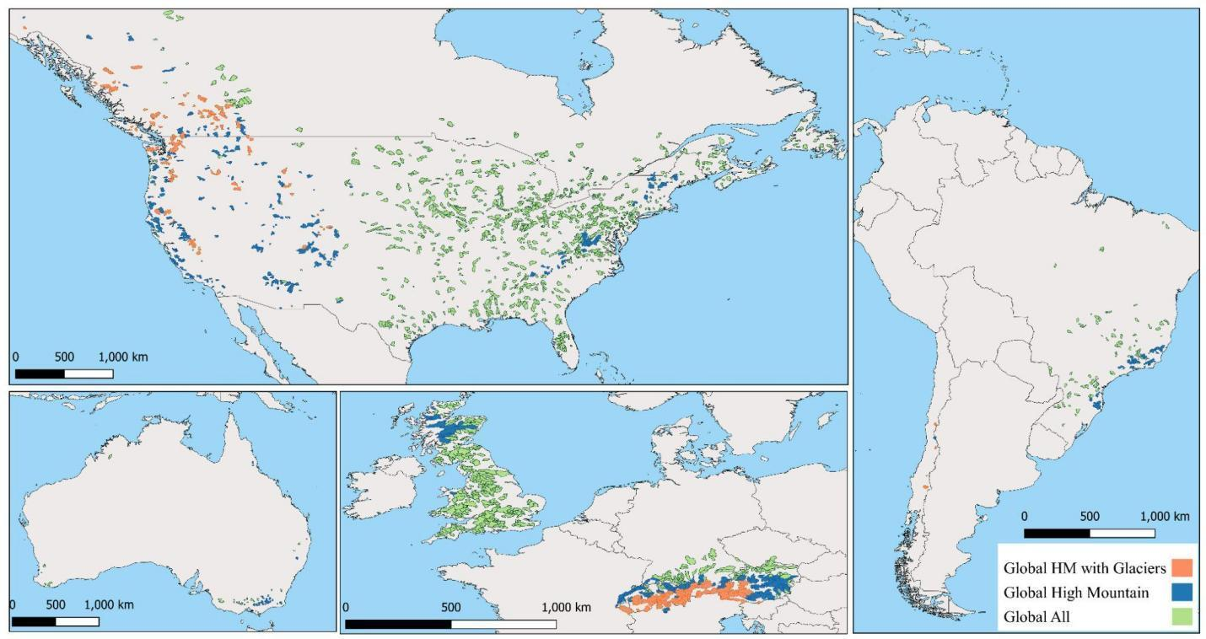
A quick glance at PCR-GLOBWB2.0 performance

Slide 3
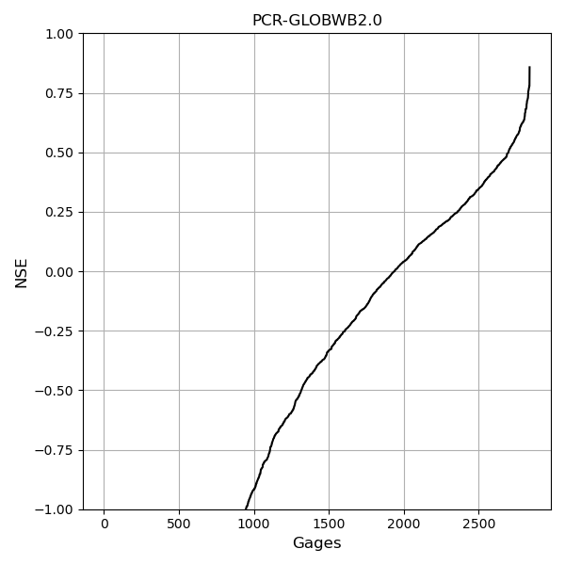
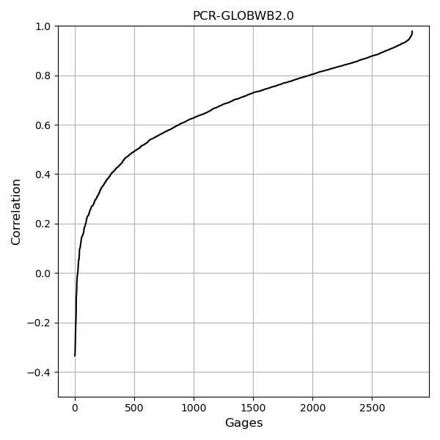
A quick glance at PCR-GLOBWB2.0 performance

Slide 4
Comparison between PCR-GLOBWB2.0 and DPL-HBV (from Maharjan et al. in prep)

Slide 5
The comparison is only made on the glacierized catchment (orange color)

Slide 6
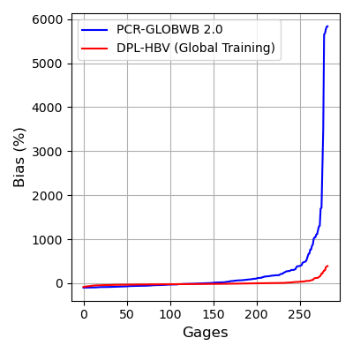
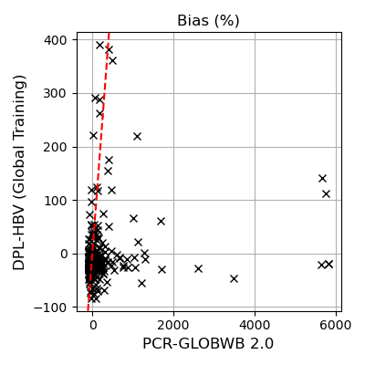
Bias (monthly flow, %)
Quantile | PCR (%) | DPL-HBV (%)
Min | -100 | -84
0.05 | -94 | -49
0.25 | -57 | -27
0.5 | -1 | -16
0.75 | 155 | -0.2
0.98 | 1,044 | 116
max | 5,836 | 390

Slide 7
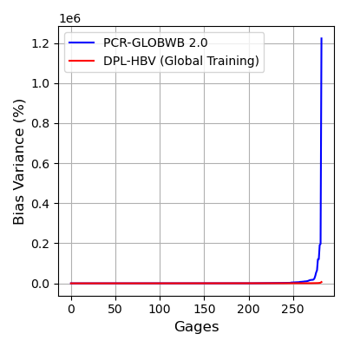
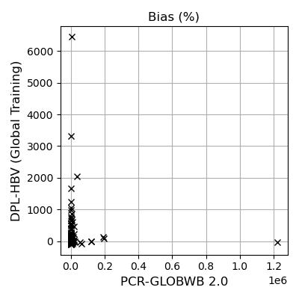
Bias in variance
(monthly flow, %)
Quantile | PCR (%) | DPL-HBV (%)
Min | -100 | -95
0.05 | -99 | -61
0.25 | -83 | -16
0.5 | 41 | 23
0.75 | 586 | 71
0.98 | 14,008 | 552
max | 1,222,751 | 6,447

Slide 8
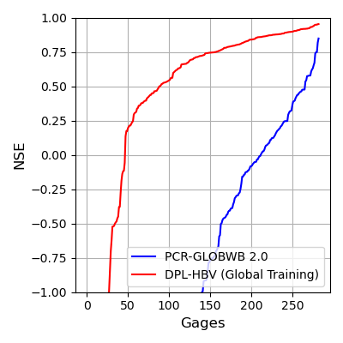
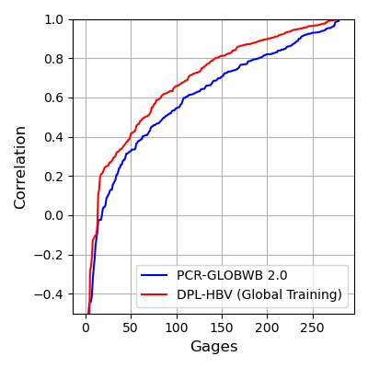
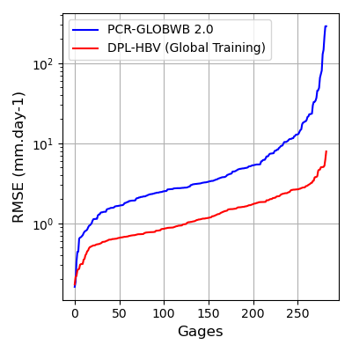
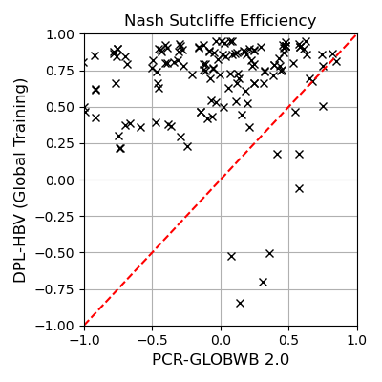
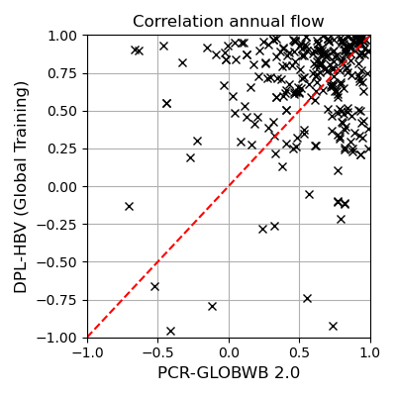
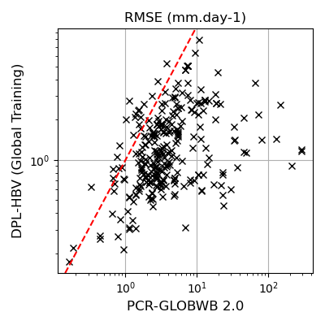
NSE (monthly flow)
Correlation Annual Flow
RMSE monthly flow

Slide 9
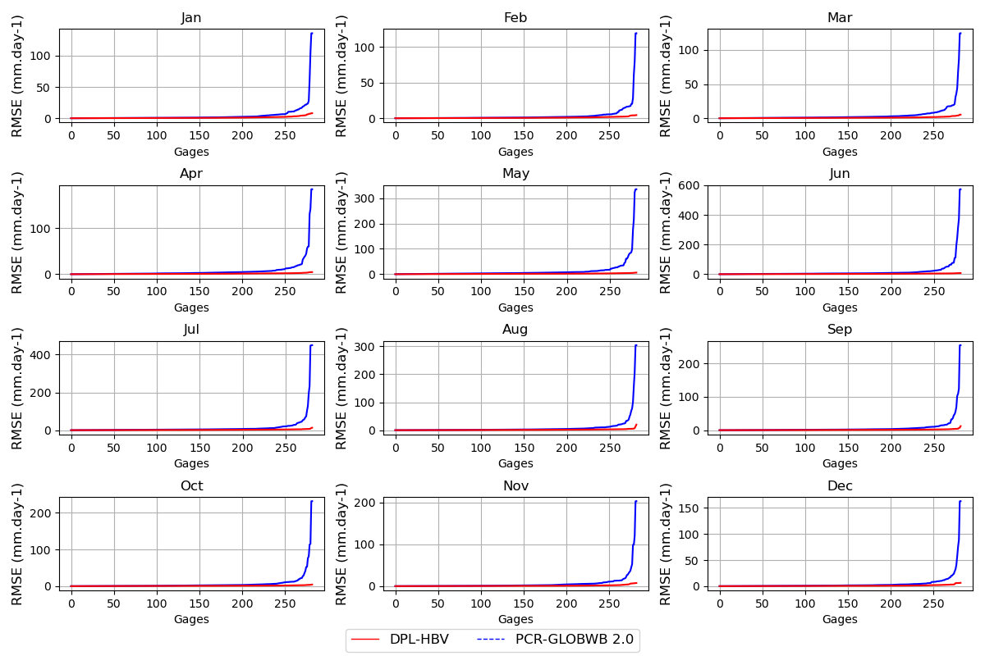
RMSE per calendar month

Slide 10
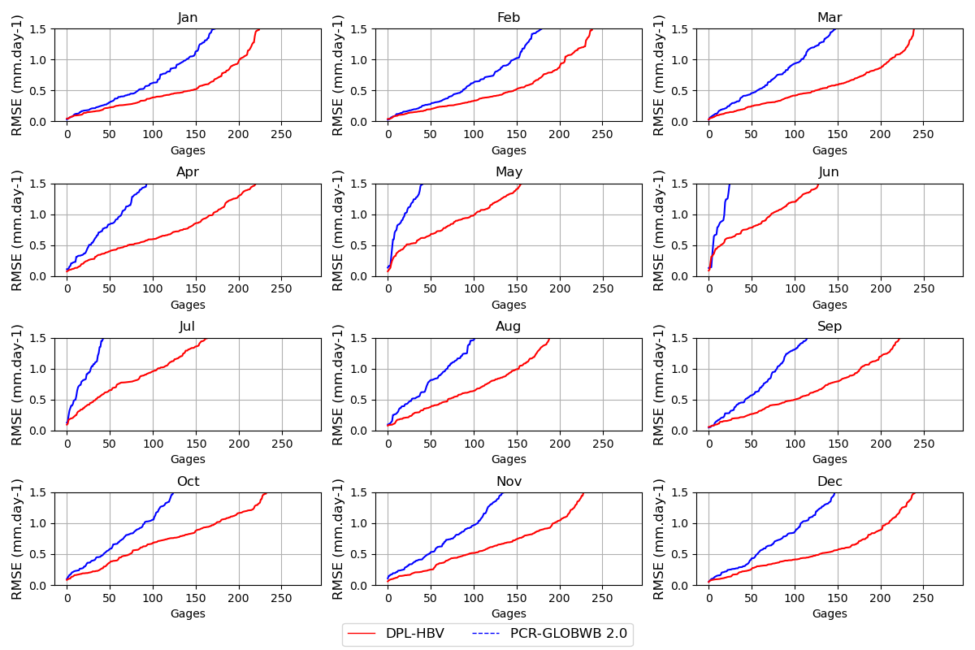
RMSE per calendar month (zoom)

Slide 11
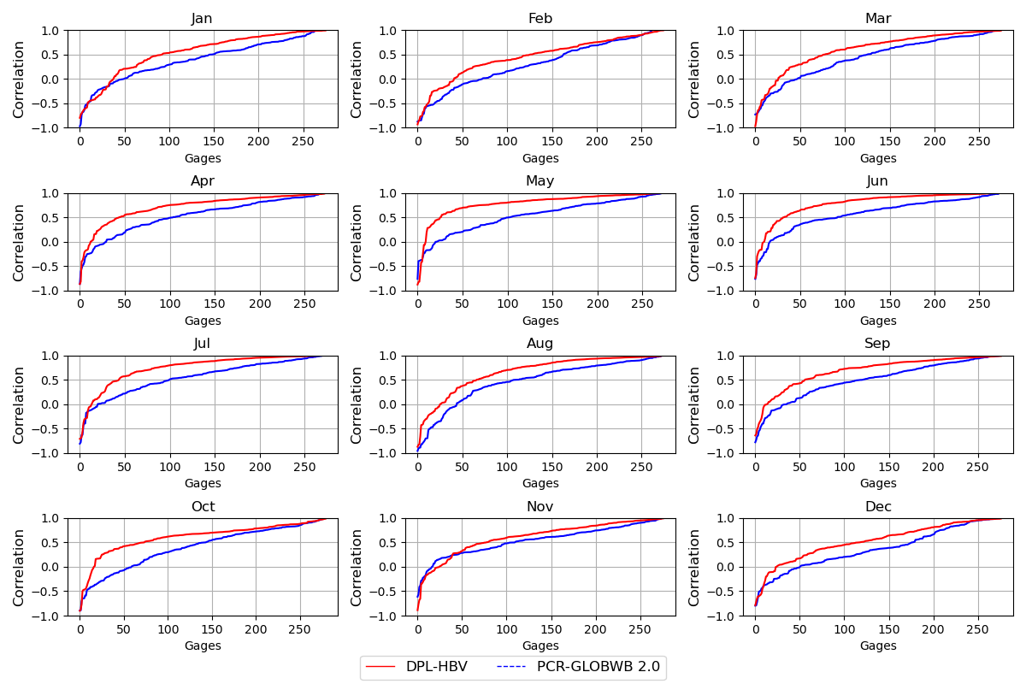
Correlation monthly flow (per calendar month)

