Slide 1
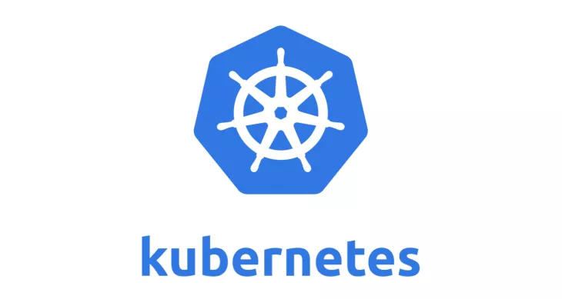
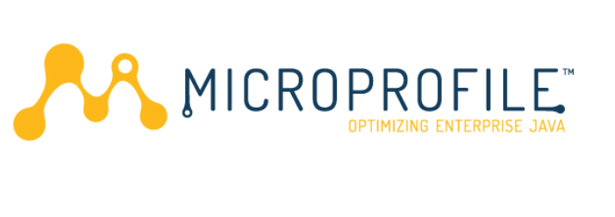
Road to High Availability
Achref Marouani
Baptiste Meynier
Github : https://github.com/BaptisteMeynier

Slide 2
Agenda
Context
Microprofile
Docker
Kubernetes
Live Demo

Slide 3
Context
Companies have to guarantee high availability

Slide 4

Context
Heavy JAVA EE Server
Each environment is different

Slide 5
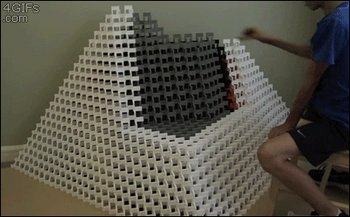
Context
Oracle decided to stop Java EE support

Slide 6

Context
New actors

Slide 7
Microprofile
Fractions
<dependencyManagement>
<dependencies>
<dependency>
<groupId>io.thorntail</groupId>
<artifactId>bom-all</artifactId>
<version>${version.thorntail}</version>
<scope>import</scope>
<type>pom</type>
</dependency>
</dependencies>
</dependencyManagement>
<dependencies>
<!-- FRACTIONS -->
<dependency>
<groupId>io.thorntail</groupId>
<artifactId>bean-validation</artifactId>
</dependency>
<dependency>
<groupId>io.thorntail</groupId>
<artifactId>datasources</artifactId>
</dependency>
<dependency>
<groupId>io.thorntail</groupId>
<artifactId>cdi</artifactId>
</dependency>
...
</dependencies>

Slide 8
Microprofile
Hollow jar
[softeam@DESKTOP]$ java -jar my_hollow.jar my_war.war

Slide 9
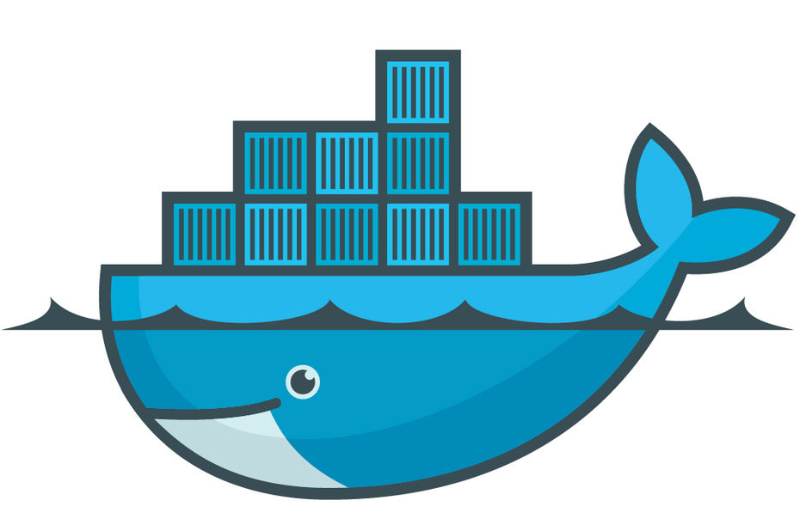
Docker
What is it?
  OpenSource
  Based on linux kernel

Slide 10
Docker
Image
FROM microprofile/server:1.0.0
ADD portfolio-app/target/portfolio-app.war /opt/portfolio-app.war
ADD portfolio-app/src/main/filters/project-defaults.yml /opt/project-defaults.yml
EXPOSE 8080
ENTRYPOINT ["java", "-Xmx64m" "-jar", "/opt/hollow-thorntail.jar", "/opt/portfolio-app.war", "-s", "/opt/project-defaults.yml"]

Slide 11
Docker
Basic commands
### Build image
$ docker build -t microprofile/portfolio:1.0 .
### Launch container
$ docker run -p 8080:8080 -d -i microprofile/portfolio:1.0
### Check containers status
$ docker ps
CONTAINER ID IMAGE COMMAND CREATED STATUS PORTS
1c741289faab microprofile/app:1.0 "java -jar /..." 2 min ago Up 2 mins 0.0.0.0:8080->8080/tcp
### Attach to containers
$ docker exec -it 1c741289faab /bin/sh

Slide 12
What is Kubernetes?
Project that was spun out of Google as an open source container orchestration platform.
Designed from the ground-up as a loosely coupledcollection of components centered around deploying, maintaining and scaling workloads.

Slide 13
What Does Kubernetes do?
Known as the linux kernel of distributed systems.
Abstracts away the underlying hardware of the nodes and provides a uniform interface for workloads to be both deployed and consume the shared pool of resources.
Works as an engine for resolving state by converging actual and the desired state of the system.

Slide 14
Self Healing
Kubernetes will ALWAYS try and steer the cluster to its desired state.
Me: “I want 3 healthy instances of redis to always be running.”
Kubernetes: “Okay, I’ll ensure there are always 3 instances up and running.”
Kubernetes: “Oh look, one has died. I’m going to attempt to spin up a new one.”

Slide 15
Project Stats
Over 49,000 stars on Github
2000+ Contributors to K8s Core
Most discussed Repository by a large margin
60,000+ users in Slack Team

Slide 16
A Couple Key Concepts...
Pods
Services

Slide 17
Pods
Atomic unit or smallest “unit of work”of Kubernetes.
Pods are one or MORE containers that share volumes, a network namespace, and are a part of a single context.

Slide 18
Services
Unified method of accessing the exposed workloads of Pods.
Durable resource :
  static cluster IP
  static namespaced DNS name

Slide 19
Questions?

