Slide 1

Parallel Programming with OpenMP – Part #1

Slide 2
A Programmer’s View of OpenMP
What is OpenMP?
Open specification for Multi-Processing
“Standard” API for defining multi-threaded shared-memory programs
openmp.org – Talks, examples, forums, etc.
OpenMP is a portable, threaded, shared-memory programming specification with “light” syntax
Exact behavior depends on OpenMP implementation!
Requires compiler support (C/C++ or Fortran)
OpenMP will:
Allow a programmer to separate a program into serial regions and parallel regions, rather than T concurrently-executing threads.
Hide stack management
Provide synchronization constructs (syntax)
OpenMP will not:
Parallelize automatically ?!!!
Guarantee speedup ?!!!
Provide freedom from data races ?!!!

Slide 3
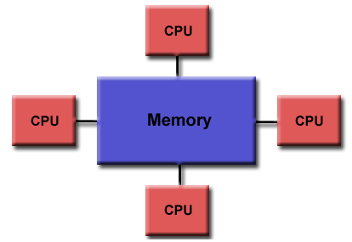
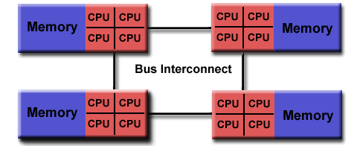
OpenMP Programming Model
OpenMP is designed for multi-processor/multi-core/multi-processing, shared memory machines.
The underlying architecture can be shared memory UMA or NUMA.
Uniform Memory Access (UMA)
Non-Uniform Memory Access (NUMA)
Because OpenMP is designed for shared memory parallel programming:
It is largely limited to single node parallelism.
Typically, the number of processing elements (cores) on a node determine how much parallelism can be implemented.

Slide 4
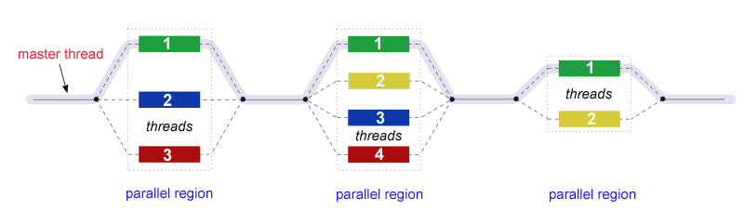
OpenMP is a Thread Based Parallelism:
OpenMP programs accomplish parallelism exclusively through the use of threads.
A thread of execution is the smallest unit of processing that can be scheduled (LWP) by an operating system.
The idea of a subroutine that can be scheduled to run autonomously might help explain what a thread is.
Threads exist within the resources of a single process.
Without the process, they cease to exist.
Typically, the number of threads match the number of machine processors/cores (but not limited ☺).
However, the actual use of threads is up to the application/programmer.

Slide 5
OpenMP Core Syntax
Most of the constructs in OpenMP are compiler directives.
Syntax:
#pragma omp construct [clause [clause]…]
Examples:
#pragma omp parallel
#pragma omp parallel num_threads(4)
Function prototypes and types in the file:
#include <omp.h>
Most OpenMP constructs apply to a “structured block”.
Structured block: a block of one or more statements with one point of entry at the top and one point of exit at the bottom.
No premature exits from the loop allowed (for now)
i.e. No break, return, exit, goto statements
In general, don’t jump outside of any #pragma block

Slide 6
Exercise 1: Hello world
Write a program that prints “hello world”.
Verify that your environment works ?☺
gcc, WSL, or VM
Write a program that prints “hello world” in C; no threads
Verify that your C and GCC environment works ? Tryout OpenMP
Write a multithreaded program that prints “hello world”
Use / tryout the -fopenmp with the gcc compiler
#include <stdio.h>
#include <omp.h>
int main()
{
// Do this part in parallel
printf( "Hello, World!\n" );
return 0;
}
OpenMP include file
(Header file)
$ gcc sample.c -fopenmp

Slide 7
OpenMP: Hello World
#include <stdio.h>
#include <omp.h>
int main()
{
// Do this part in parallel
#pragma omp parallel
{
int ID = omp_get_thread_num();
printf(" Hello(%d) ", ID);
printf(" World(%d) \n", ID);
}
return 0;
}
OpenMP include file
(Header file)
Parallel region with default number of threads
Runtime library function to return a thread ID
End of the Parallel region

Slide 8
OpenMP: Hello World
#include <stdio.h>
#include <omp.h>
int main()
{
omp_set_num_threads(4);
// Do this part in parallel
#pragma omp parallel
{
int ID = omp_get_thread_num();
printf(" Hello(%d) ", ID);
printf(" World(%d) \n", ID);
}
return 0;
}
OpenMP include file
(Header file)
Sets the number of threads for the Parallel Region
Starts the Parallel region with 4 threads
End of the Parallel region
Runtime library function to return a thread ID

Slide 9
OpenMP: Hello World
#include <stdio.h>
#include <omp.h>
int main()
{
omp_set_num_threads(4);
// Do this part in parallel
#pragma omp parallel
{
printf( "Hello, World!\n" );
}
return 0;
}
All OpenMP directives begin: #pragma
printf
printf
printf
printf
OpenMP is used for computationally intensive work on each node (core)

Slide 10
OpenMP Overview
How do threads interact?
OpenMP is a multi-threading, shared address model for parallelism.
Threads communicate by sharing variables (Within the same process).
Note: Any unintended sharing of data may cause race conditions:
race condition occurs when the program’s outcome changes as the threads are scheduled differently.
To control race conditions:
Use synchronization to protect data conflicts.
Synchronization is expensive so:
Change how data is accessed to minimize the need for synchronization.

Slide 11
Summary
In addition to a parallel construct,
You may need the following runtime library routines:
void omp_set_num_threads();
int omp_get_num_threads();
int omp_get_thread_num();

