Slide 1
PARALLEL AND DISTRIBUTED COMPUTING
LECTURE 02

Slide 2
OUTLINE
Flynn’s Taxonomy

Slide 3
TAXONOMY
Taxonomy is method of division , arrangement, classification, categorization of things based on predetermined system.

Slide 4
FLYNN TAXONOMY
Micheal J. Flynn professor at Stanford University
He proposed the Flynn’s Taxonomy, a method of classifying digital computers in 1966
He defined four categories of digital computer
Since the rise of multiprocessing CPU this classification system has been used as a tool in design of modern processors.

Slide 5
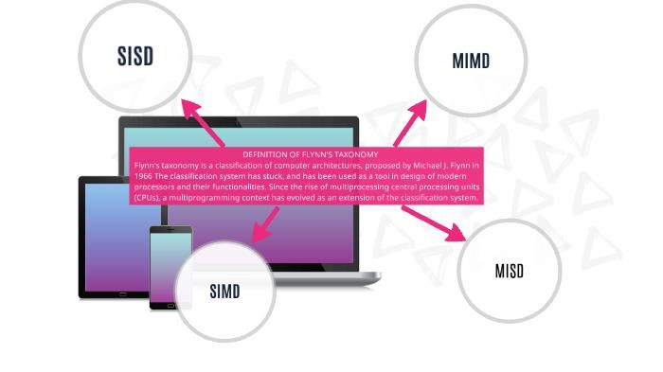
FLYNN TAXONOMY

Slide 6
FLYNN TAXONOMY
This classification based upon the number of concurrent Instructions/streams and data streams available in the architecture.
SISD: Single instruction stream, singe data stream
SIMD: Single instruction stream, multiple data stream
MISD: Multiple instruction stream, singe data stream
MIMD: Multiple instruction stream, multiple data stream

Slide 7
FLYNN TAXONOMY
Instruction Stream: the sequence of instructions from memory to control unit
Data Stream: The sequence of data from memory to control unit.

Slide 8
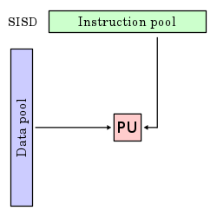
SISD (SINGLE INSTRUCTION STREAM, SINGLE DATA STREAM
Exploits no parallelism in either instructions or data streams
Single control unit, fetches single instruction
i.e. one operation at a time.

Slide 9
SISD (SINGLE INSTRUCTION STREAM, SINGLE DATA STREAM
Requires less power Cheap
No issue of complex communication protocol
Limited speed due to single core Not suitable for larger applications

Slide 10
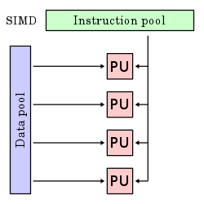
SIMD (SINGLE INSTRUCTION STREAM, MULTIPLE DATA STREAM
Single instruction operates on different data streams
Instructions can be executed sequentially (pipelining) or parallel

Slide 11
Throughput can be increased by increasing cores of processor
Processing speed is higher than SISD
SIMD (SINGLE INSTRUCTION STREAM, MULTIPLE DATA STREAM
Efficient where you need to perform same instructions on large amount of data
Complex communication protocol is required
Cost is higher than SISD Limited to specific application
Uses: GPUs/Scientific Processing

Slide 12
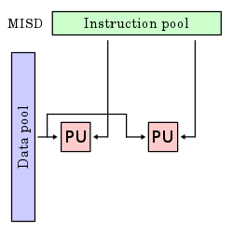
MISD (MULTIPLE INSTRUCTION STREAM, SINGLE DATA STREAM
Multiple instructions operates on only one data stream
Processing units performing different operations by executing different instructions on same data set

Slide 13
MISD (MULTIPLE INSTRUCTION STREAM, SINGLE DATA STREAM
Uncommon architecture which is generally used for fault tolerance.
Operate on same data stream

Slide 14
MISD (MULTIPLE INSTRUCTION STREAM, SINGLE DATA STREAM
Useful where real time fault detection is critical
Limited applications, not available commercially

Slide 15
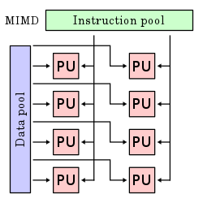
MIMD (MULTIPLE INSTRUCTION STREAM,MULTIPLEDATA STREAM
Multiple instructions operates on only multiple data stream
Processing units performing different operations by executing different instructions on different data set

Slide 16
MIMD (MULTIPLE INSTRUCTION STREAM,MULTIPLEDATA STREAM
Great for situations where multitasking is required.
Much more complicated architecture
Uses: Smart PCs, Laptop, smart phones.

Slide 17
MIMD(MULTIPLE INSTRUCTION STREAM,MULTIPLEDATA STREAM
Categorized into two types:
Share memory MIMD
Distributed memory MIMD

Slide 18
MIMD(MULTIPLE INSTRUCTION STREAM,MULTIPLEDATA STREAM
Share memory MIMD:
Tightly coupled multiprocessor systems, all processors are connected to single global memory and they have access to it.
Modification by one processors is accessible to all other processors.

Slide 19
MIMD(MULTIPLE INSTRUCTION STREAM,MULTIPLEDATA STREAM
Distributed memory MIMD:
Loosely coupled multiprocessor systems, all processors have local memory
Communication is done through interconnection network

Slide 20
Share memory MIMD:
MIMD(MULTIPLE INSTRUCTION STREAM,MULTIPLEDATA STREAM
Distributed memory MIMD:
Complex architecture Easy to extend
Failure doesn’t effect entire system
Easily saleable
Easier to program
Less tolerant to failures Harder to extend
Failure affect entire system Less likely to be scale

