Slide 1

SMART INDIA HACKATHON 2026
TITLE PAGE
PS ID – ISRO-2026 | Problem Statement Title – AI-Powered Burn-In Screening for High-Reliability Semiconductor Components | Theme – AI / Quality & Reliability | PS Category – Software | Team ID – ISRO-AI-QA | Team Name – ISRO Reliability Analytics Team

Slide 2
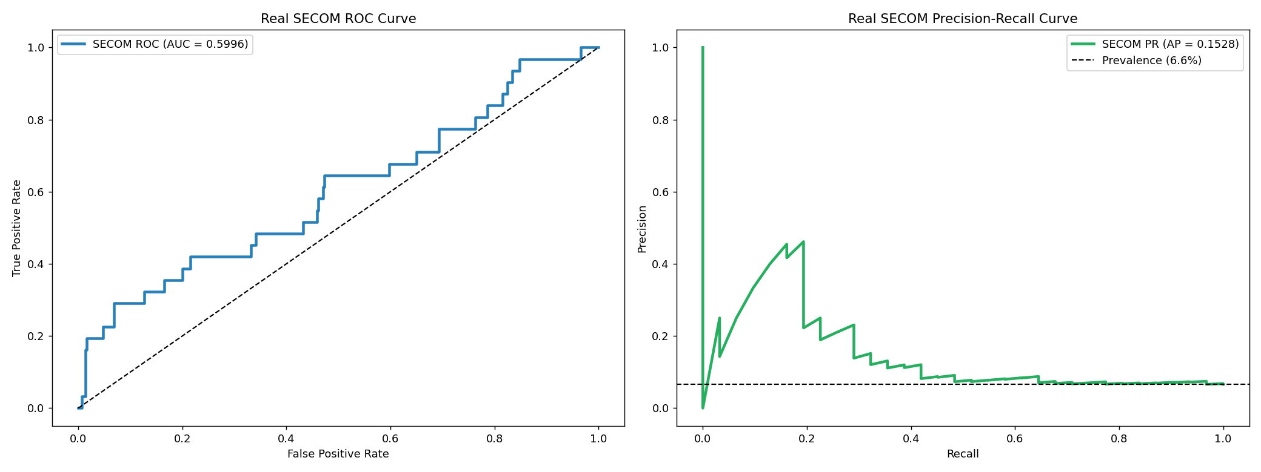
IDEA TITLE
ISRO Reliability Analytics Team
Proposed Solution: AI-driven burn-in screening system for semiconductor reliability
• Detects early lot-level anomalies and latent defects before they escape into high-risk deployment
• Combines contextual anomaly detection with predictive drift forecasting to flag unstable devices at 24h/96h stages
• Provides explainable QA outputs using SHAP and decision rules for engineering sign-off
Why it matters: conventional static limits miss defects that appear normal early but drift catastrophically later in burn-in.

Slide 3
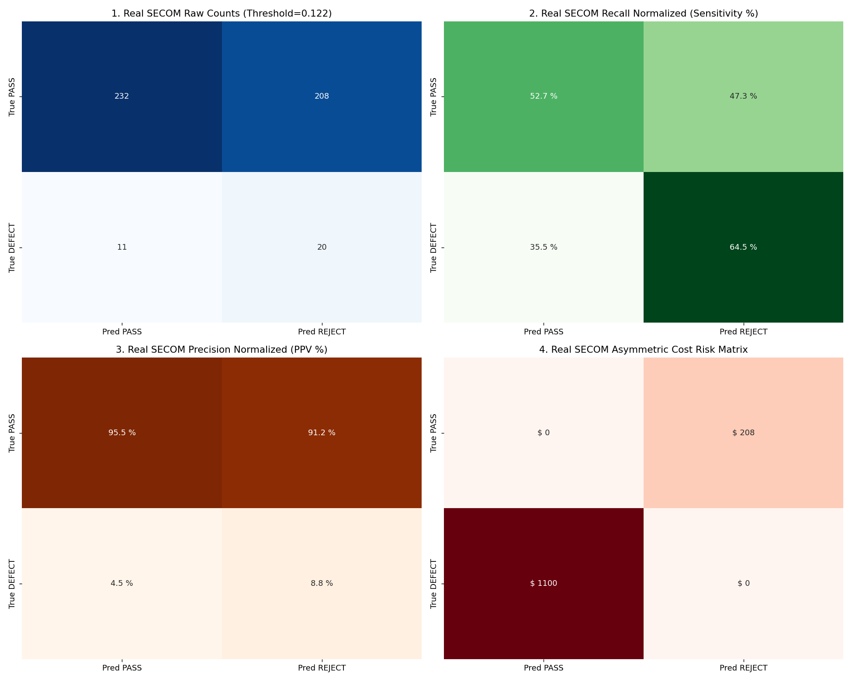
TECHNICAL APPROACH
ISRO Reliability Analytics Team
Technologies used: Python, scikit-learn, XGBoost, SHAP, Matplotlib, Seaborn, pandas, NumPy
Methodology:
• Feature engineering: Δ0–24h drift, % drift, lot-normalized Z-score, stress interaction signals
• Module A: Mahalanobis + Isolation Forest + LOF ensemble for contextual anomaly detection
• Module B: Gradient boosting with MAE + Bayesian uncertainty for 168h degradation prediction
• Decision layer: cost-sensitive Fβ thresholding and audit-ready QA disposition report

Slide 4
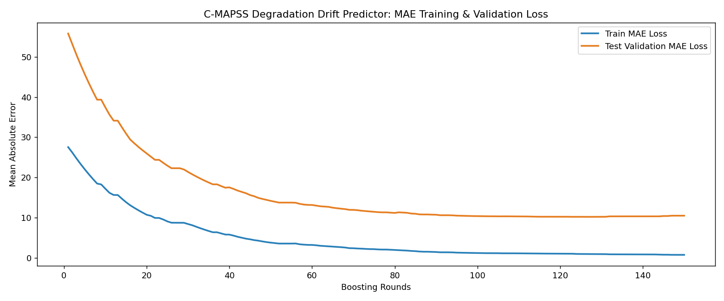
FEASIBILITY AND VIABILITY
ISRO Reliability Analytics Team
Feasibility:
• Uses standard industrial data pipelines and open-source ML libraries
• Works on burn-in production logs and wafer-level sensor data
• No special hardware required; deployment is software-based with manufacturing integration
Challenges and mitigation:
• Class imbalance → cost-sensitive scoring and recall-focused thresholding
• Lot-to-lot drift → contextual normalization and drift features
• Explainability need → SHAP + rule-based QA summaries

Slide 5
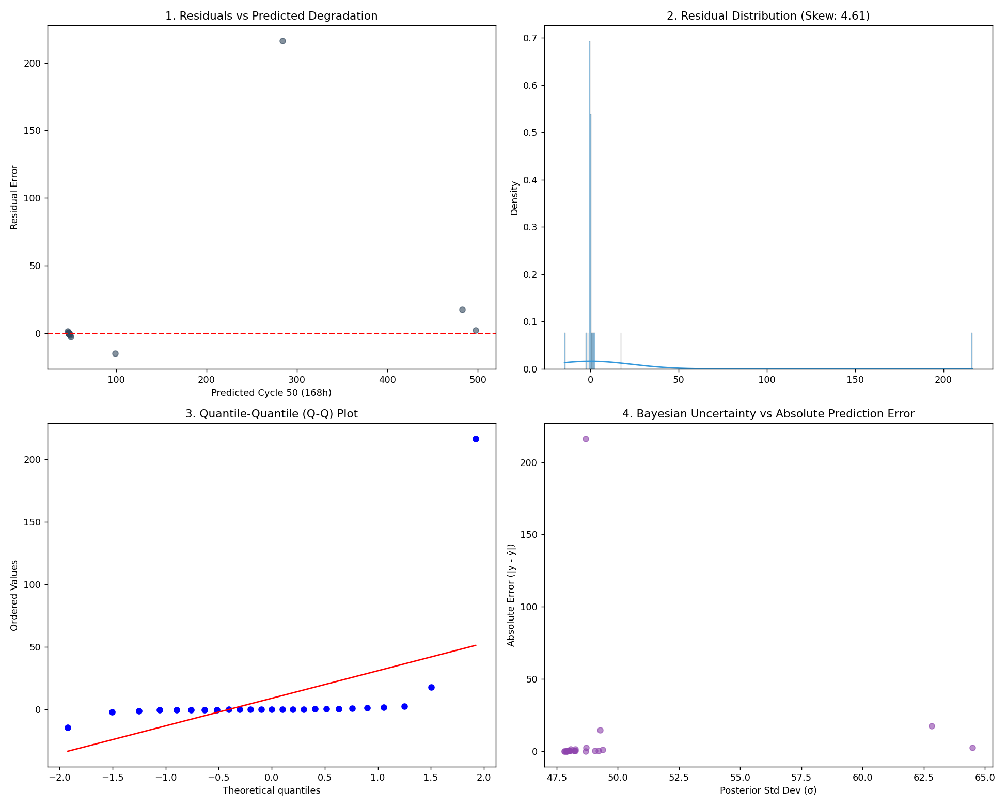
IMPACT AND BENEFITS
ISRO Reliability Analytics Team
Target audience:
• Semiconductor fabs, reliability labs, aerospace component QA teams, defense electronics producers
Benefits:
• Reduces escapes and safety-critical field failures
• Improves screening yield without sacrificing quality
• Enables early abort decisions for unstable lots
• Supports transparent engineering review and auditability

Slide 6
RESEARCH AND REFERENCES
ISRO Reliability Analytics Team
Reference sources and benchmark mapping:
• UCI SECOM semiconductor defect dataset for contextual anomaly screening
• NASA C-MAPSS turbofan degradation dataset for time-to-failure drift prediction
• Reliability engineering literature on burn-in, latent defect detection, and drift acceleration
• Project implementation: end-to-end ML pipeline for early anomaly detection and late-stage degradation forecasting

Slide 7
IMPORTANT INSTRUCTIONS
Please ensure below pointers are met while submitting the Idea PPT:
Kindly keep the maximum slides limit up to six (6). ( Including the title slide)
Try to avoid paragraphs and post your idea in points /diagrams / Infographics /pictures
Keep your explanation precise and easy to understand
Idea should be unique and novel.
You can only use provided template for making the PPT without changing the idea details pointers (mentioned in previous slides).
You need to save the file in PDF and upload the same on portal. No PPT, Word Doc or any other format will be supported.
Note - You can delete this slide (Important Pointers) when you upload the details of your idea on SIH portal.

