Slide 1

SMART INDIA HACKATHON 2026
TITLE PAGE
PS ID – ISRO-2026 | Problem Statement Title – AI-Powered Burn-In Screening for High-Reliability Semiconductor Components | Theme – AI / Quality & Reliability | PS Category – Software | Team ID – ISRO-AI-QA | Team Name – ISRO Reliability Analytics Team

Slide 2
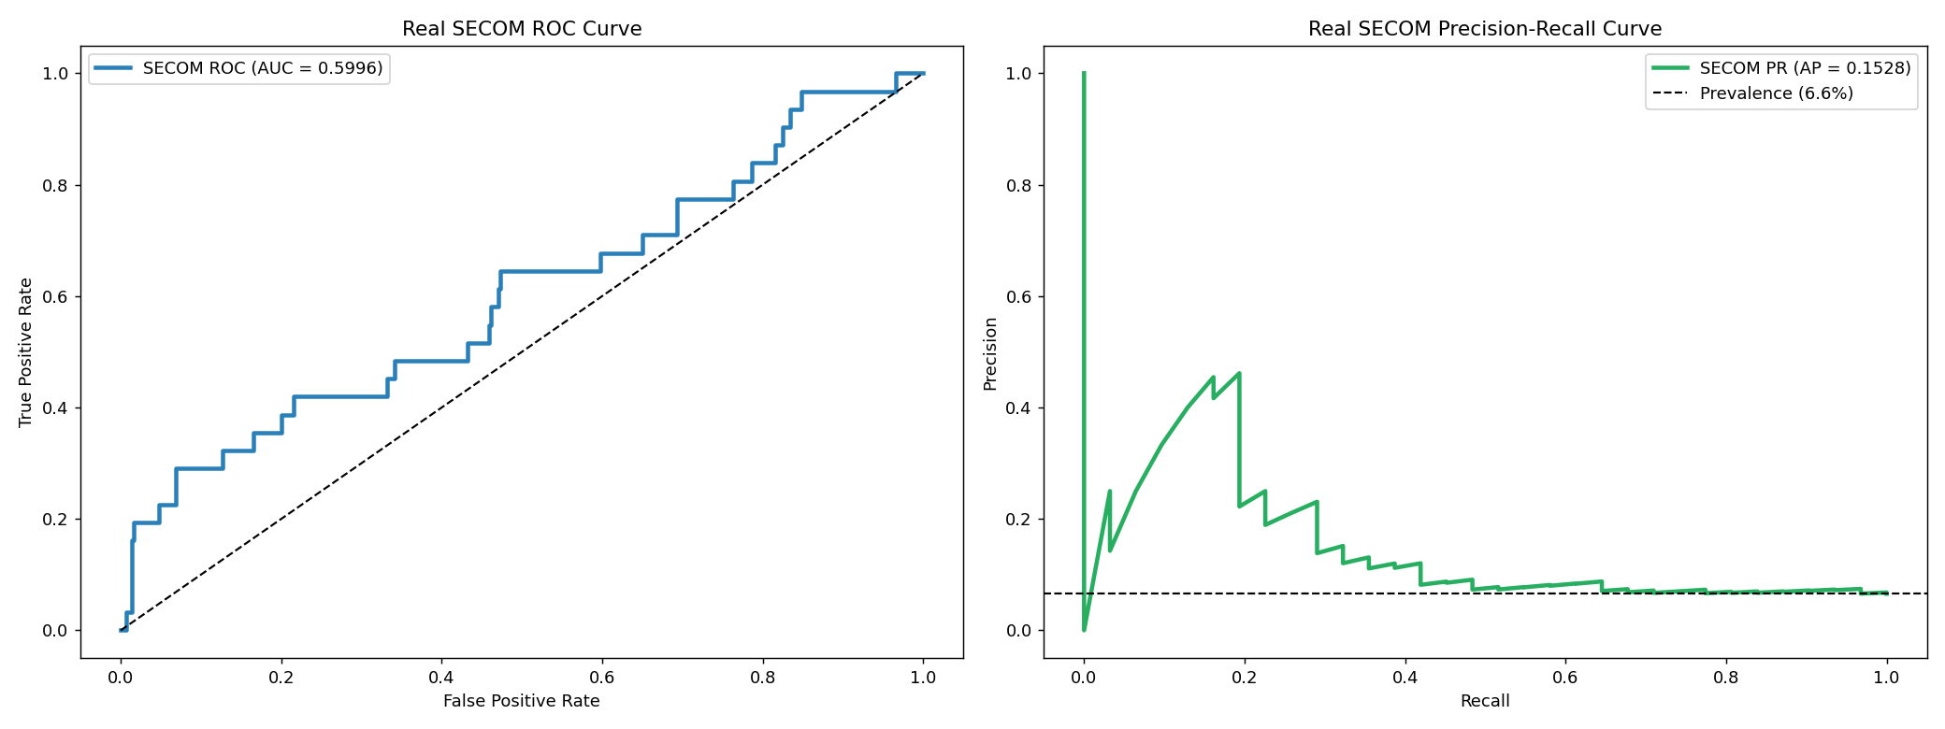
IDEA TITLE
ISRO Reliability Analytics Team
Proposed Solution: AI-driven burn-in screening system for semiconductor reliability
• Detects early lot-level anomalies and latent defects before they escape into high-risk deployment
• Combines contextual anomaly detection with predictive drift forecasting to flag unstable devices at 24h/96h stages
• Provides explainable QA outputs using SHAP and decision rules for engineering sign-off
Why it matters: conventional static limits miss defects that appear normal early but drift catastrophically later in burn-in.

Slide 3
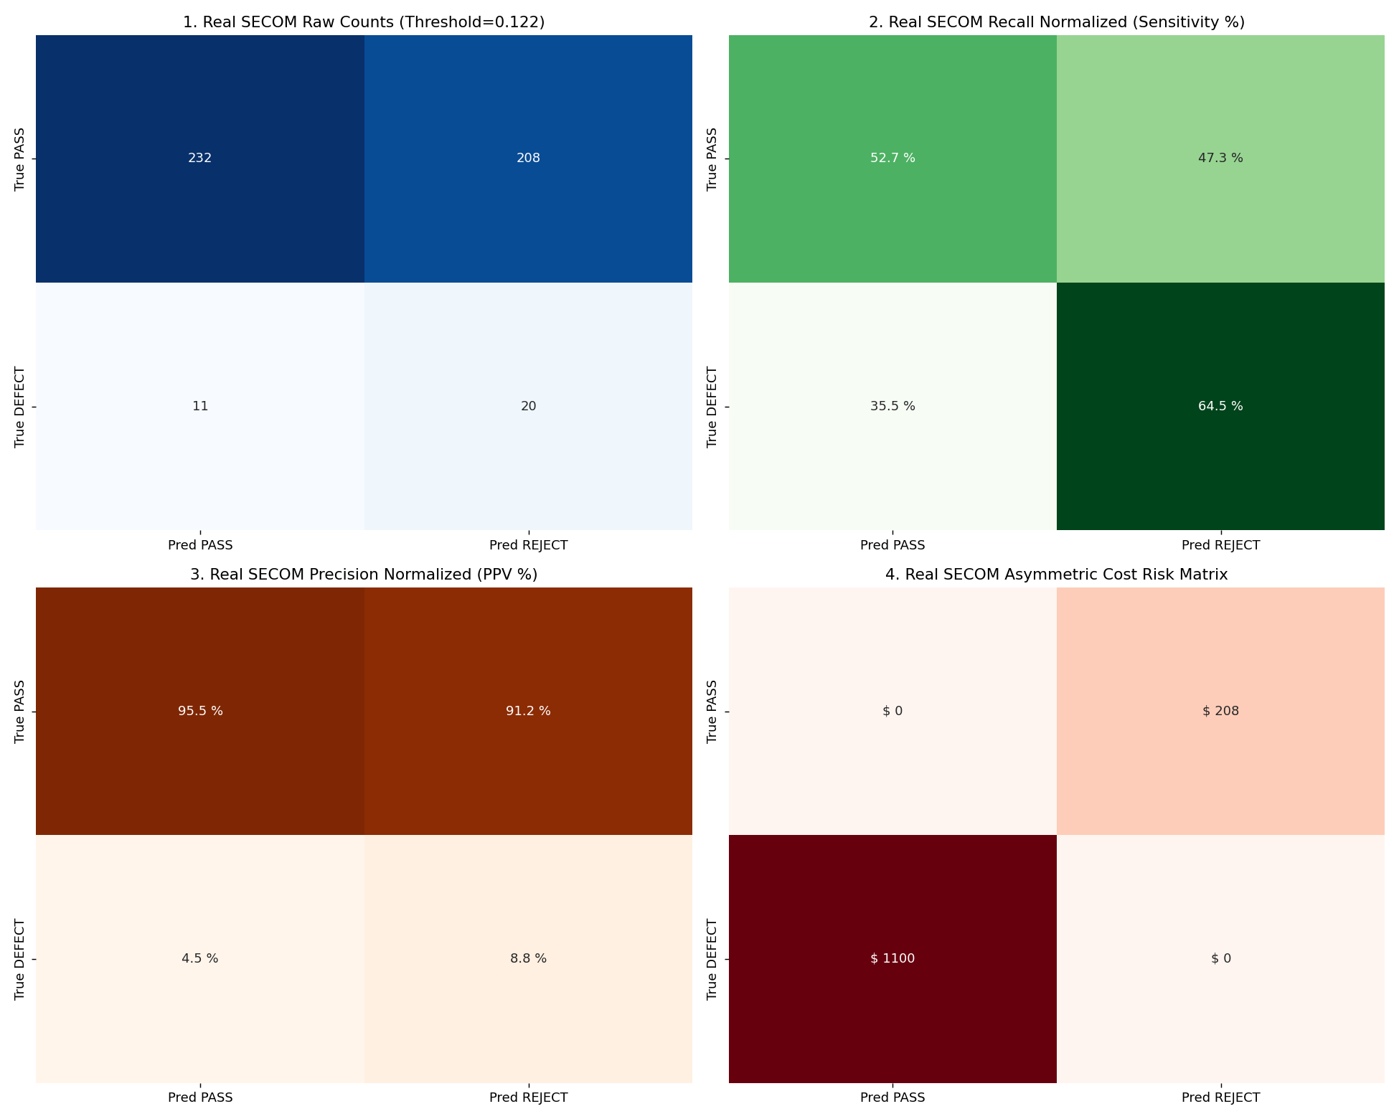
TECHNICAL APPROACH
ISRO Reliability Analytics Team
Technologies used: Python, scikit-learn, XGBoost, SHAP, Matplotlib, Seaborn, pandas, NumPy
Methodology:
• Feature engineering: Δ0–24h drift, % drift, lot-normalized Z-score, stress interaction signals
• Module A: Mahalanobis + Isolation Forest + LOF ensemble for contextual anomaly detection
• Module B: Gradient boosting with MAE + Bayesian uncertainty for 168h degradation prediction
• Decision layer: cost-sensitive Fβ thresholding and audit-ready QA disposition report

Slide 4
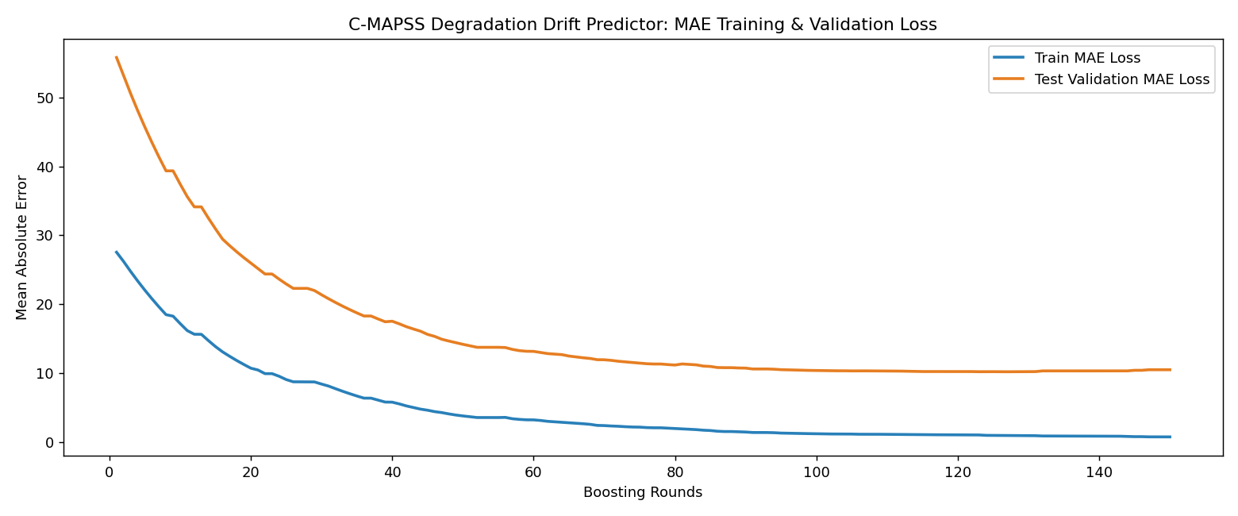
FEASIBILITY AND VIABILITY
ISRO Reliability Analytics Team
Feasibility:
• Uses standard industrial data pipelines and open-source ML libraries
• Works on burn-in production logs and wafer-level sensor data
• No special hardware required; deployment is software-based with manufacturing integration
Challenges and mitigation:
• Class imbalance → cost-sensitive scoring and recall-focused thresholding
• Lot-to-lot drift → contextual normalization and drift features
• Explainability need → SHAP + rule-based QA summaries

Slide 5
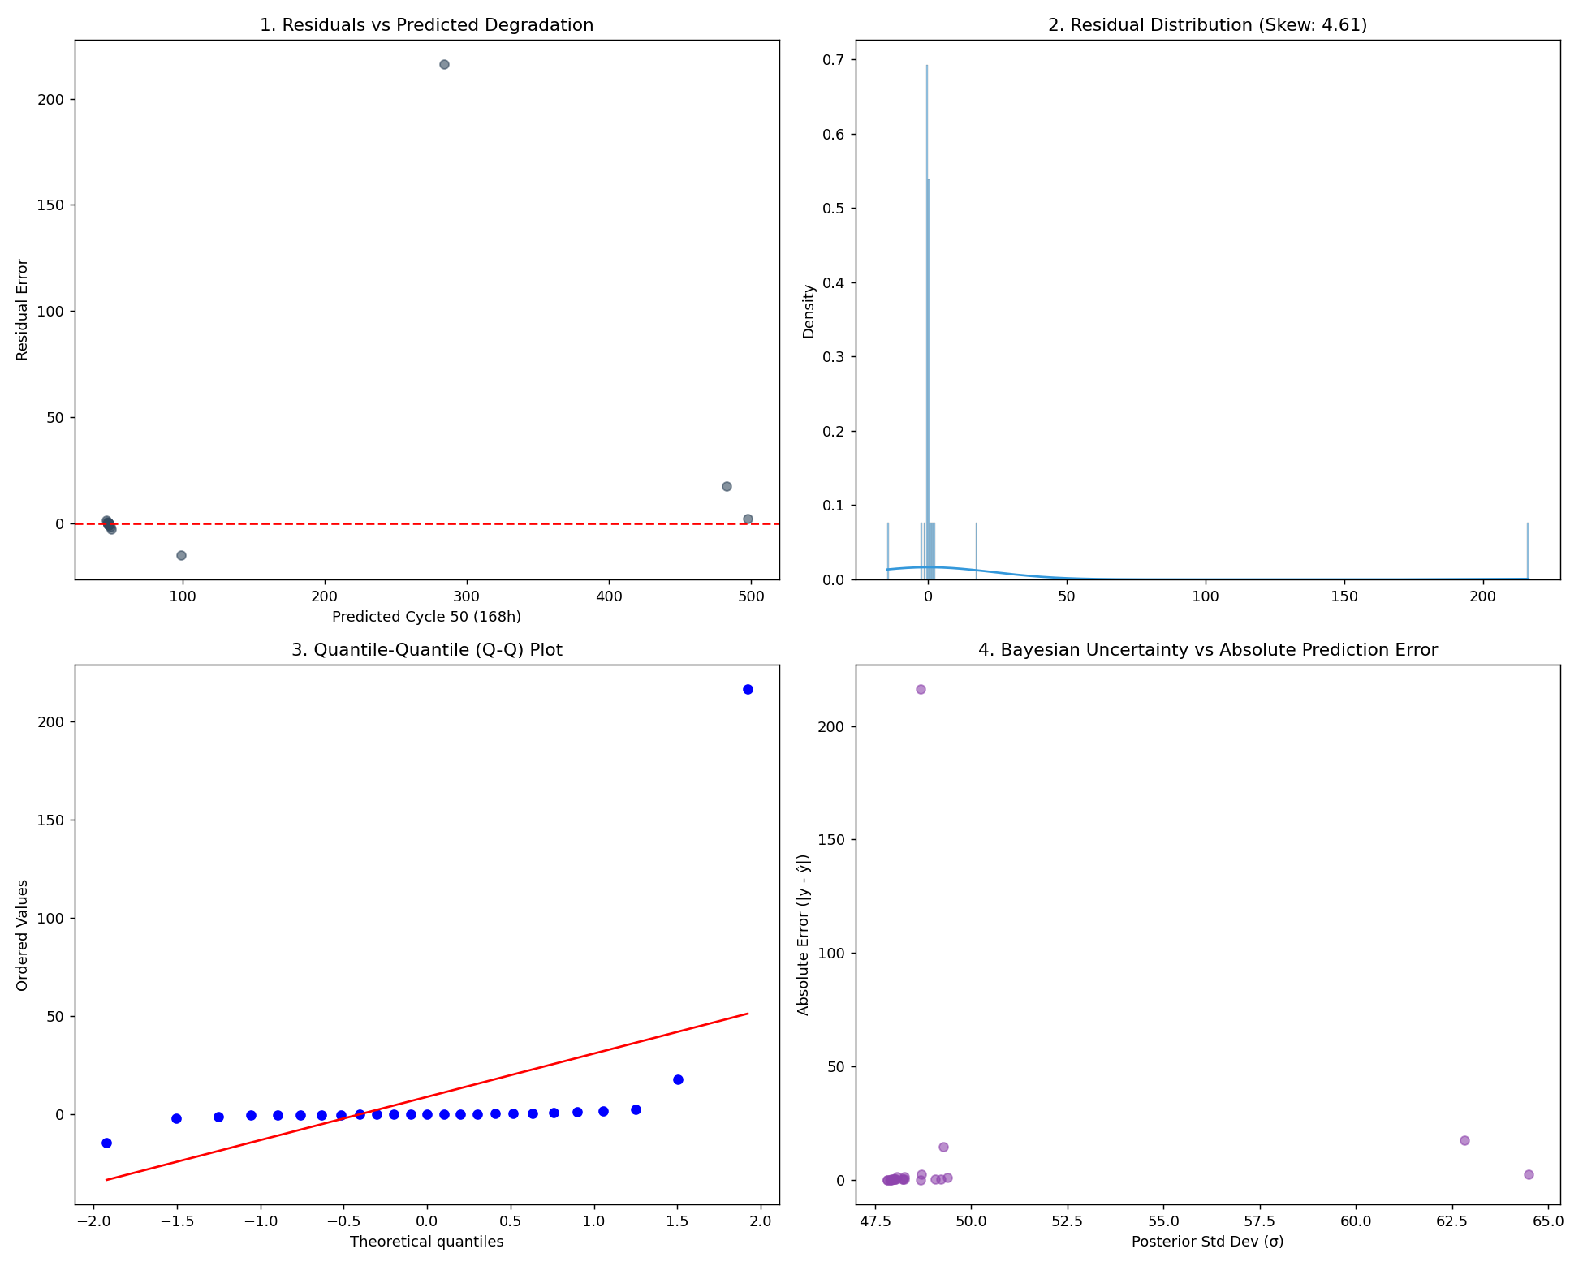
IMPACT AND BENEFITS
ISRO Reliability Analytics Team
Target audience:
• Semiconductor fabs, reliability labs, aerospace component QA teams, defense electronics producers
Benefits:
• Reduces escapes and safety-critical field failures
• Improves screening yield without sacrificing quality
• Enables early abort decisions for unstable lots
• Supports transparent engineering review and auditability

Slide 6
RESEARCH AND REFERENCES
ISRO Reliability Analytics Team
Reference sources and benchmark mapping:
• UCI SECOM semiconductor defect dataset for contextual anomaly screening
• NASA C-MAPSS turbofan degradation dataset for time-to-failure drift prediction
• Reliability engineering literature on burn-in, latent defect detection, and drift acceleration
• Project implementation: end-to-end ML pipeline for early anomaly detection and late-stage degradation forecasting

