Slide 1
JUDO DATA BASE
JUDO competition database to save battles result and manage the tournament.
Bar and gabi

Slide 2
System requirements
Welcome to the judoDB competition The competition will be done in 8 categories male/female, heavy/light ,young/old
Each country will have a team of judokas and coaches each judoka will compete against the other judoka in the same category.
There will be a winner in each category and the winning team will be with the most winners.
As part of renovation of the world the Olympic comity have decided to keep better records of the competition to help and assist the teammates that includes coaches and the judokas. This database stores and collects data from each battle and helps judges to better manage the competition.
Bar and gabi

Slide 3

Bar and gabi

Slide 4
General Description
As part of renovation of the world the Olympic comity have decided to keep better records of the competition to help and assist the teammates that includes coaches and the judokas.
This database stores and collects data from each battle and helps judges to better manage the competition.
Bar and gabi

Slide 5
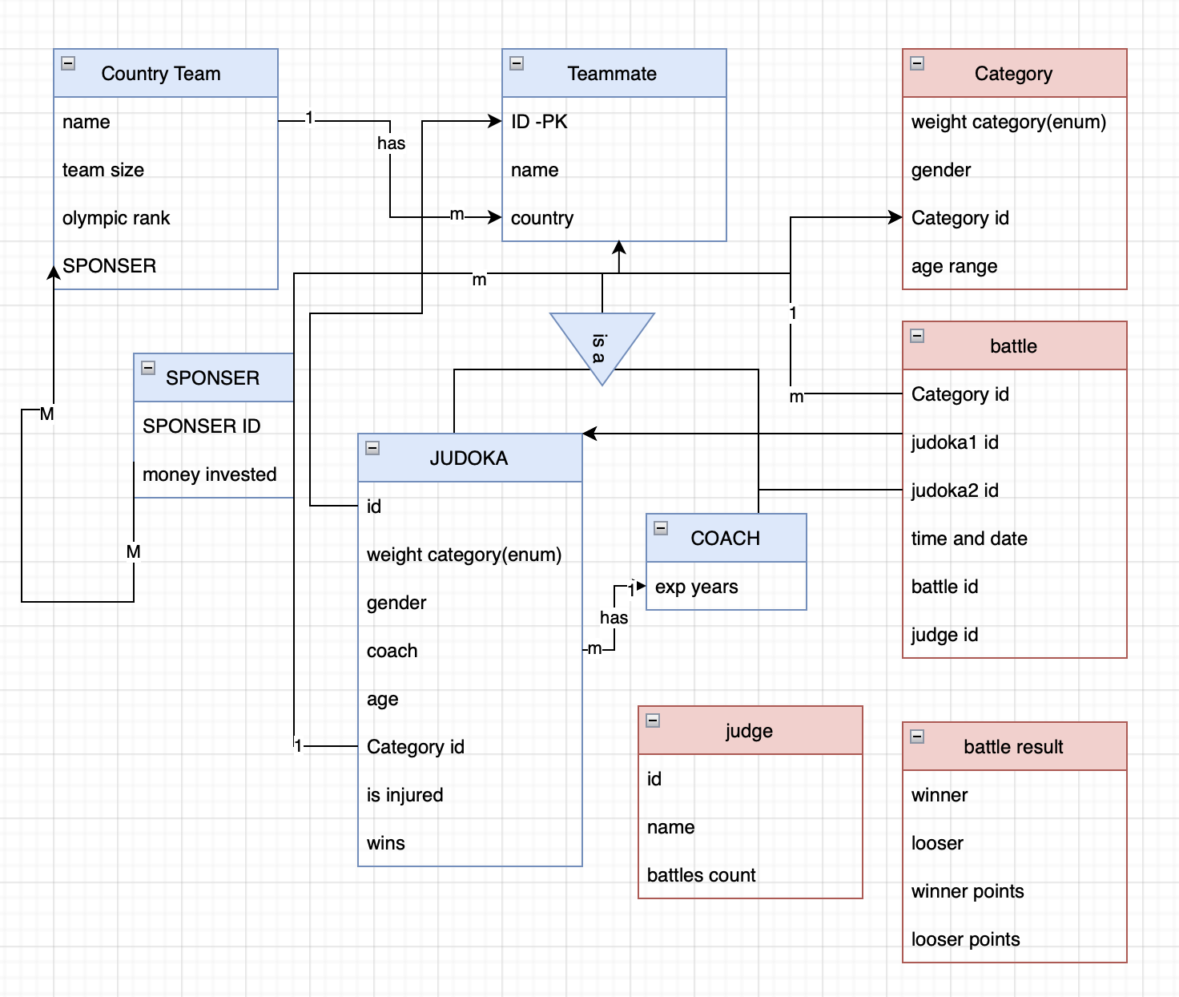
ERD
Here will be a description
Bar and gabi

Slide 6
Entities description PK, FK
Entity | Data | Description
Judge | Id, name, battle count | Judges the battles of the judokas in the competition
Judoka | Id, name, team ,gender, weight, age, coach, category, injured, wins, games played | Competitor and main entity in the system
Coach | Id, team, years of experience | Helps judokas, identifies if judoka is injured.
Team | Name, Olympic rank, sponsors | The team in the Olympics that the judoka is recognized by.
Battle | Id, judokas in battle, time, date, judge, category | Judokas participated to win the coemption
Category | Id, gender, weight, age range | Categorizes which coemption the judoka may enter such as: Heavy weight and young underage of 26 and heavy above 90 kg.
Sponsors | Id, name, money contribution, teams | Gives money for team needs.
Battle result | Id, judokas that battled, winner, win type | Identifies who is the winner how many points for each and characteristic of the win (('waza-ari', 'ippon')
Here will be a description
Bar and gabi

Slide 7
User types
Teammates- Use this database to improve and better organize his information about opponent,
the judokas and his coach can get schedule, how many points the judoka got from his last battle and even how many fouls the judge gave all to improve judokas experience of the competition.
Olympic comity - Use this database to control and overview all the participants in the coemption includes judges, coaches, judokas, and teammates in general.
Bar and gabi

Slide 8

Create tables
CREATE TABLE IF NOT EXISTS `JUDO`.`judokas` ( `id` INT NOT NULL, `weight` INT NOT NULL, `gender` VARCHAR(1) NOT NULL, `coach id` INT NOT NULL, `age` INT NOT NULL, `category` VARCHAR(3) NOT NULL, `is injured` BIT NOT NULL, `wins` INT UNSIGNED ZEROFILL NULL DEFAULT NULL, `game played` INT UNSIGNED ZEROFILL NULL DEFAULT NULL, PRIMARY KEY (`id`), INDEX `fk_judokas_coach1_idx` (`coach id` ASC) VISIBLE, INDEX `fk_judokas_category1_idx` (`category` ASC) VISIBLE, CONSTRAINT `fk_judokas_category1` FOREIGN KEY (`category`) REFERENCES `JUDO`.`categorys` (`id`), CONSTRAINT `fk_judokas_coach1` FOREIGN KEY (`coach id`) REFERENCES `JUDO`.`coaches` (`id`), CONSTRAINT `fk_judokas_teammates` FOREIGN KEY (`id`) REFERENCES `JUDO`.`teammates` (`id`)) | CREATE TABLE IF NOT EXISTS `JUDO`.`judge` ( `id` INT NOT NULL, `name` VARCHAR(30) NULL DEFAULT NULL, `battle count` INT NULL DEFAULT NULL, PRIMARY KEY (`id`));
 | CREATE TABLE IF NOT EXISTS `JUDO`.`categorys` ( `id` VARCHAR(3) NOT NULL, `gender` VARCHAR(1) NULL DEFAULT NULL, `weight category` ENUM('light', 'heavy') NULL DEFAULT NULL, `age range` ENUM('young', 'old') NULL DEFAULT NULL, PRIMARY KEY (`id`));
 | CREATE TABLE IF NOT EXISTS `JUDO`.`coaches` ( `id` INT NOT NULL, `years exp` INT NULL DEFAULT NULL, PRIMARY KEY (`id`));
 | CREATE TABLE IF NOT EXISTS `JUDO`.`teams` ( `name` VARCHAR(15) NOT NULL, `win count` INT NULL DEFAULT 0, PRIMARY KEY (`name`));
Bar and gabi

Slide 9
Create tables
CREATE TABLE IF NOT EXISTS `JUDO`.`battles` ( `id` INT NOT NULL, `judoka 1 id` INT NOT NULL, `juduka 2 id` INT NOT NULL, `date` DATE NULL DEFAULT NULL, `time` TIME NULL DEFAULT NULL, `judge_id` INT NOT NULL, `category` VARCHAR(3) NOT NULL, PRIMARY KEY (`id`, `judge_id`), INDEX `fk_battles_judge1_idx` (`judge_id` ASC) VISIBLE, CONSTRAINT `fk_battles_judge1` FOREIGN KEY (`judge_id`) REFERENCES `JUDO`.`judge` (`id`), CONSTRAINT `fk_battles_judokas1` FOREIGN KEY (`judoka 1 id`) REFERENCES `JUDO`.`judokas` (`id`), CONSTRAINT `fk_battles_judokas2` FOREIGN KEY (`juduka 2 id`) REFERENCES `JUDO`.`judokas` (`id`), CONSTRAINT `FK_category` FOREIGN KEY (`category`) REFERENCES `JUDO`.`categorys` (`id`)); | CREATE TABLE IF NOT EXISTS `JUDO`.`teammates` ( `name` VARCHAR(25) NOT NULL, `team` VARCHAR(15) NOT NULL, `id` INT NOT NULL, PRIMARY KEY (`id`), INDEX `fk_teammates_teams1_idx` (`team` ASC) VISIBLE, CONSTRAINT `fk_teammates_teams1` FOREIGN KEY (`team`) REFERENCES `JUDO`.`teams` (`name`))
 | CREATE TABLE IF NOT EXISTS `JUDO`.`battle results` ( `id` INT NOT NULL, `judoka 1 points` INT NULL DEFAULT NULL, `judoka 2 points` INT NULL DEFAULT NULL, `winner` INT NULL DEFAULT NULL, `win type` ENUM('waza-ari', 'ippon') NULL DEFAULT NULL, PRIMARY KEY (`id`), INDEX `fk_battle results_battles1_idx` (`id` ASC) VISIBLE, INDEX `fk_battle results_judokas1_idx` (`winner` ASC) VISIBLE, CONSTRAINT `fk_battle results_battles1` FOREIGN KEY (`id`) REFERENCES `JUDO`.`battles` (`id`), CONSTRAINT `fk_battle results_judokas1` FOREIGN KEY (`winner`) REFERENCES `JUDO`.`judokas` (`id`));
Bar and gabi

Slide 10
Create tables
CREATE TABLE IF NOT EXISTS `JUDO`.`fouls` ( `id` INT NOT NULL, `foul type` ENUM('hard', 'soft') NULL DEFAULT NULL, `judokas_id` INT NOT NULL, `battles_id` INT NOT NULL, `battles_judge_id` INT NOT NULL, PRIMARY KEY (`id`, `judokas_id`, `battles_id`, `battles_judge_id`), INDEX `fk_fouls_judokas1_idx` (`judokas_id` ASC) VISIBLE, INDEX `fk_fouls_battles1_idx` (`battles_id` ASC, `battles_judge_id` ASC) VISIBLE, CONSTRAINT `fk_fouls_judokas1` FOREIGN KEY (`judokas_id`) REFERENCES `JUDO`.`judokas` (`id`), CONSTRAINT `fk_fouls_battles1` FOREIGN KEY (`battles_id` , `battles_judge_id`) REFERENCES `JUDO`.`battles` (`id` , `judge_id`) ON DELETE NO ACTION ON UPDATE NO ACTION); | CREATE TABLE IF NOT EXISTS `JUDO`.`sponsers` ( `id` INT NOT NULL, `name` VARCHAR(25) NOT NULL, PRIMARY KEY (`id`));
 | CREATE TABLE IF NOT EXISTS `JUDO`.`teams_has_sponsers` ( `teams_name` VARCHAR(15) NOT NULL, `sponsers_id` INT NOT NULL, `money_contribute` INT, PRIMARY KEY (`teams_name`, `sponsers_id`), INDEX `fk_teams_has_sponsers_sponsers1_idx` (`sponsers_id` ASC) VISIBLE, INDEX `fk_teams_has_sponsers_teams1_idx` (`teams_name` ASC) VISIBLE, CONSTRAINT `fk_teams_has_sponsers_sponsers1` FOREIGN KEY (`sponsers_id`) REFERENCES `JUDO`.`sponsers` (`id`), CONSTRAINT `fk_teams_has_sponsers_teams1` FOREIGN KEY (`teams_name`) REFERENCES `JUDO`.`teams` (`name`)) ENGINE = InnoDB;
Bar and gabi

Slide 11

create TRIGGER trigger_j1 after insert on JUDO.battles for each row begin update judo.judokas set `game played` =`game played`+1 where new.`judoka 1 id`=judokas.id;
create TRIGGER trigger_judge after insert on JUDO.battles for each row begin update judo.judge set `battle count` =`battle count`+1 where new.`judge_id`=judge.id;
create TRIGGER trigger_j2 after insert on JUDO.battles for each row begin update judo.judokas set `game played` =`game played`+1 where new.`juduka 2 id`=judokas.id;
create TRIGGER trigger_win after insert on JUDO.`battle results` for each row begin update judo.judokas set `wins` =`wins`+1 where new.winner=judokas.id;
Triggers
Bar and gabi

Slide 12

CREATE PROCEDURE JUDO.set_injury (IN judokas_id INT ) BEGIN UPDATE JUDO.judokas SET judokas.`is injured`=1 WHERE judokas.id=judokas_id ; END $$
CREATE FUNCTION AVG_Every_Category(category_id varchar(3)) RETURNS FLOAT deterministic RETURN(SELECT AVG(judokas.age) FROM judokas WHERE judokas.category=category_id);
CREATE PROCEDURE JUDO.set_foul (IN id1 int,IN judokas_id INT, IN foul_type int,in battle_id int ,in judge_id int) BEGIN insert into fouls (id,`foul type`,judokas_id,battles_id,battles_judge_id) values (id1,foul_type,judokas_id,battle_id,judge_id);
CREATE PROCEDURE JUDO.set_battle_result (IN id1 int,IN judoka1_points INT , IN judoka2_points INT ,in win_type int) BEGIN declare winner1 int; declare team1 varchar(15); IF judoka1_points > judoka2_points THEN BEGIN SELECT `judoka 1 id` into winner1 FROM JUDO.BATTLES WHERE id1=judo.battles.id;end; ELSE BEGIN SELECT `juduka 2 id` into winner1 FROM JUDO.BATTLES WHERE id1=judo.battles.id;end; end if; select team into team1 from judo.teammates where teammates.id=winner1; UPDATE JUDO.teams SET teams.`win count`=teams.`win count`+1 WHERE teams.name=team1 ; insert into judo.`battle results` (id,`judoka 1 points`,`judoka 2 points`,winner,`win type`) VALUes (id1,judoka1_points,judoka2_points,winner1,win_type); END $$
CREATE FUNCTION give_category(category_id varchar(3)) RETURNS INT deterministic RETURN (SELECT judokas.id FROM judokas,`battle results`,teammates WHERE judokas.id=`battle results`.winner and judokas.id=teammates.id and category=category_id GROUP BY judokas.id,judokas.category ORDER BY count(`battle results`.winner) DESC,category DESC LIMIT 1);
Procedures and functions
Bar and gabi

Slide 13

Time for queries
Bar and gabi

Slide 14
Teammates queries
-- get all male judokas from category heavy and old order by win count select teammates.id,name,team,weight,gender,`coach id`,age,category,`is injured`,wins,`game played` from teammates inner join judokas on judokas.id=teammates.id and category ="mho" order by judokas.wins;
-- list of judokas fouls select teammates.name,count(fouls.judokas_id) as fouls from teammates,fouls where fouls.judokas_id=teammates.id group by teammates.id;
-- Highest sponsor payer in the Olympics SELECT teams_name as 'Team',sponsers.name as 'Sponsors name' ,max(money_contribute) as 'Highest payer' FROM teams_has_sponsers,teams,sponsers WHERE teams_has_sponsers.sponsers_id=sponsers.id GROUP BY teams_name,sponsers.id LIMIT 1;
-- Highest sponsor payer in the Olympics SELECT teams_name as 'Team',sponsers.name as 'Sponsors name' ,max(money_contribute) as 'Highest payer' FROM teams_has_sponsers,teams,sponsers WHERE teams_has_sponsers.sponsers_id=sponsers.id GROUP BY teams_name,sponsers.id LIMIT 1;
-- Average age in each category SELECT AVG_Every_Category(categorys.id),categorys.id FROM categorys GROUP BY categorys.id;
Bar and gabi

Slide 15
Teammates queries
-- 1All the judokas that won with 'ippon' 9 SELECT `battle results`.id,teammates.name,judge.name FROM `battle results`,teammates,judge WHERE `battle results`.`win type`='ippon' and `battle results`.winner=teammates.id GROUP BY teammates.name ,judge.name,`battle results`.id;
-- 1 Team with the most fouls 13 SELECT teams.name,sum_of_fouls(teams.name) as 'fouls commited' FROM teams ORDER BY 'fouls commited' DESC LIMIT 1;
-- 1How much money was spend for this Olympic's 14 SELECT SUM(money_contribute) FROM teams_has_sponsers;
-- 1wins of 2023-08-06 SELECT teammates.id,teammates.name,count(winner) as win_count from teammates,`battle results`,battles WHERE battles.date='2023-08-06' and battles.id=`battle results`.id and winner=teammates.id group by teammates.id order by win_count desc;
-- 1list of injured judokas select teammates.name,teammates.id from teammates, judokas where judokas.`is injured`>0 and teammates.id =judokas.id;
Bar and gabi

Slide 16
Olympic comity queries
-- Average of the USA team 12 SELECT teammates.name,AVG(judokas.age) FROM judokas,teammates WHERE judokas.id=teammates.id and teammates.team='usa' GROUP BY teammates.id;
-- get the amount of fouls each judge gave 15 select judo.judge.name,judge.id, count(fouls.battles_judge_id) as fouls from judge,fouls where fouls.battles_judge_id=judge.id group by judge.id order by fouls desc;
-- Mexico battle list SELECT * FROM battles WHERE `judoka 1 id` IN ( SELECT teammates.id FROM teammates WHERE teammates.team='mexico') or `juduka 2 id` in (SELECT teammates.id FROM teammates WHERE teammates.team='mexico');
-- win type precentage Select `win type`, (Count(`win type`)*100/battle_count() ) as win_precentage FROM `battle results` Group BY `win type`;
-- How many wins per how many money was given SELECT teams_has_sponsers.teams_name,teams.`win count`,sum(money_contribute) FROM teams_has_sponsers,teams WHERE teams_has_sponsers.teams_name=teams.name GROUP BY teams_has_sponsers.teams_name;
Bar and gabi

Slide 17
Olympic comity queries
-- 1how many games each judge judged 2 select judge.name, count(judge_id) as game_jugdged from battles,judge where judge.id=battles.judge_id group by judge.id;
-- 1how many judokas from each category. 3 select categorys.id, count(judokas.id) as amount from categorys,judokas where judokas.category=categorys.id group by categorys.id;
-- 1list of shlomy(204) battles 4 select * from battles where judge_id=204;
-- 1list of judge 207 most judged category 6 SELECT judge.name,battles.category,count(battles.category) as battles_count FROM judge RIGHT JOIN battles ON battles.judge_id=judge.id WHERE battles.judge_id='207' GROUP BY battles.category ORDER BY count(battles.category) DESC LIMIT 1;
-- 1 every category winner of the comp 7 SELECT teammates.name,categorys.id,count(`battle results`.winner) as 'Win Count' FROM categorys,teammates,`battle results` WHERE teammates.id=give_category(categorys.id) and give_category(categorys.id)=`battle results`.winner GROUP BY teammates.id,categorys.id;
Bar and gabi

Slide 18
THANKS ☺
Bar and gabi

