Slide 1
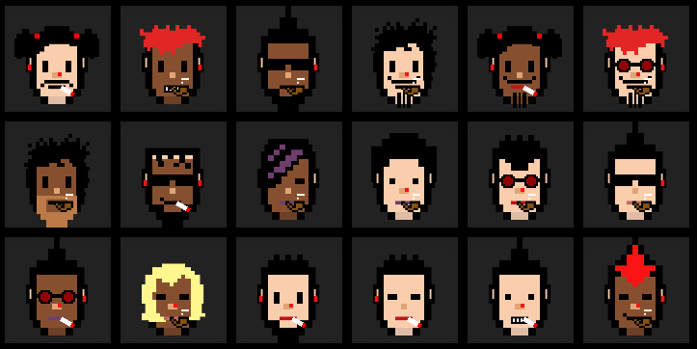
TokenNFTMarket
Written By:
Bar Ben Shabat
Yaniv Lavi

Slide 2
Known Bugs
YourCollectible tab in application doesn’t load the user’s assets.
The approaches we have taken are:
Try to change the logic in the App.jsx file.
We also tried to override the URI-related functions from version 4 of openzepellin and looked for examples on the Internet, we sat on it for a few days but without success.
Uploading to a local ipfs network, but that didn't solve the problem either.
The button to mint an item sometimes is not loading instantly.
Solution: switch between tabs (supposed to be fixed).
If you try to buy tokens and have error regarding nonce:
Solution: go to your metamask account>settings>advanced>Reset Account.

Slide 3
Setup Instructions
Required: Git, Node, Yarn and Hardhat.
Go to https://github.com/BarDAP/VendorTokenNFT to clone or extract NFTMarket.rar.
Go to the root folder and run:
Yarn (for package dependencies)
yarn upload (uploads the art to an IPFS)
To run our environment open 2 separated terminals and run:
(Terminal 1):
yarn chain (run the backend (hardhat))
(Terminal 2):
yarn deploy (deploying our contracts)
yarn start (starts the frontend (react-app))

Slide 4
Explanation of Modules
Contracts
YourToken.sol – our ERC20 Fungible Token used as a token named “YBC” to buy NFTs.
Vendor.sol – is used as a vendor for buying tokens (100YBC = 1ETH).
YourCollectiable.sol – our ERC721 token a Non Fungible Token is used for minting NFT with 1YBC.
Deploying Contracts
00_deploy_your_token.js
01_deploy_vendor.js – gets the token’s contract address.
02_deploy_your_collectible.js – gets the token’s contract address and the IPFS.
Scripts
Uplaod.js - is used to export our ‘artwork.json’ to frontend ‘assents.js’.
Publish.js – is used to take the deployed contracts ABIs and the YourCollectible.json that was generated by last step.
Watch.js – for debugging deploying of contracts.
Application
App.jsx - main file of the react application.
Components - sub script of the application that allows easy maintenance.

Slide 5
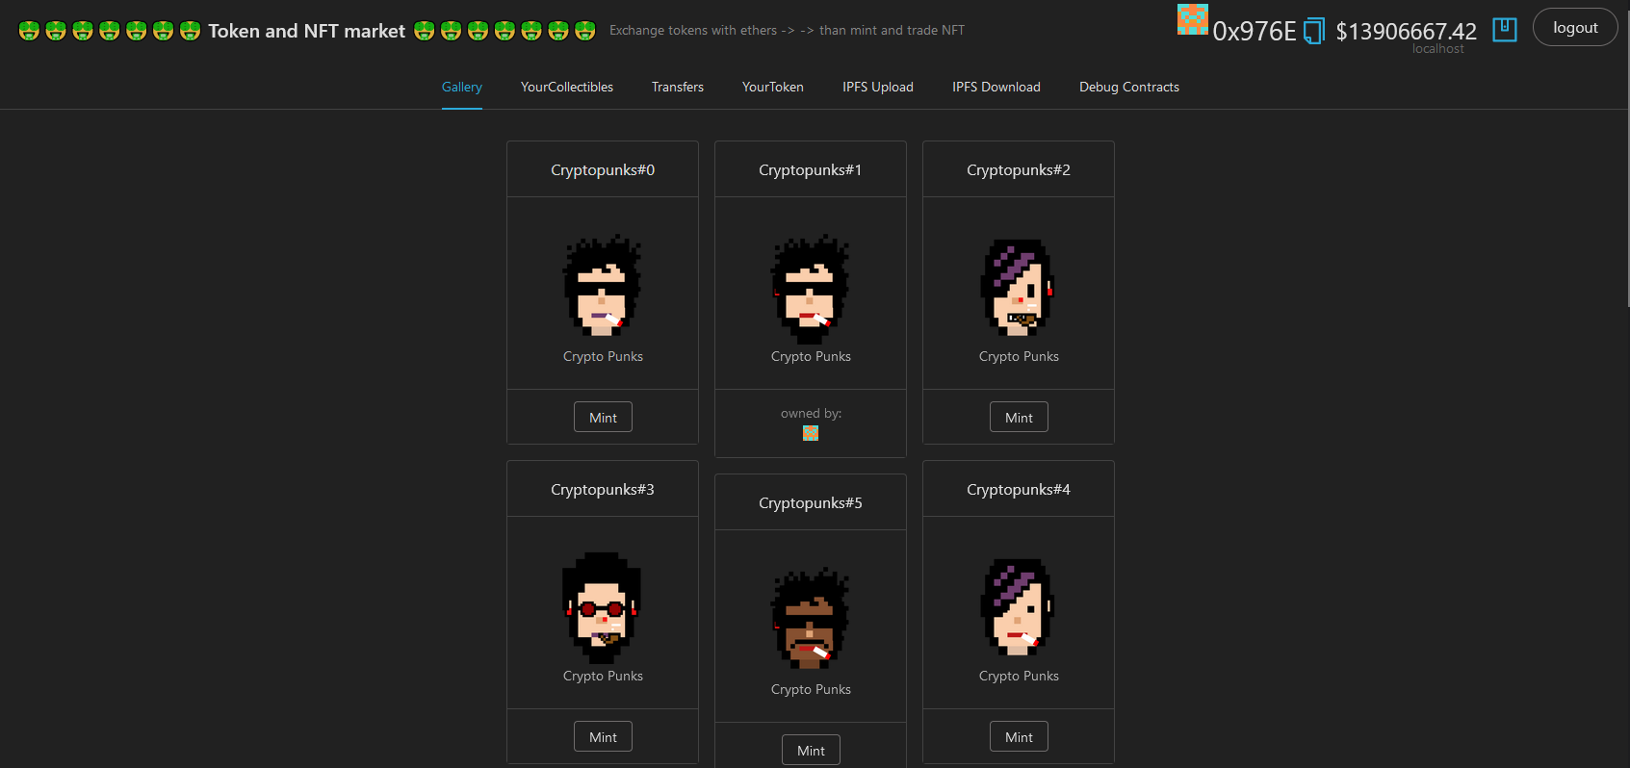
Demonstration On YouTube
https://youtu.be/AoLck5mx_PU

Slide 6
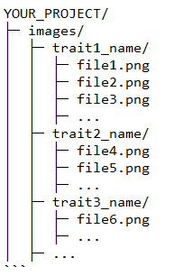
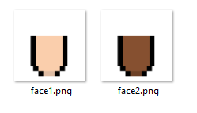
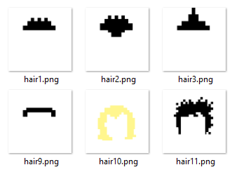
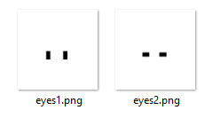
Creating NFTs
We used a tool that generates generative NFT art, based of all available traits. Each NFT is built in layers of these traits and each unique.
Before you start, make sure your file structure looks something like this:

Slide 7
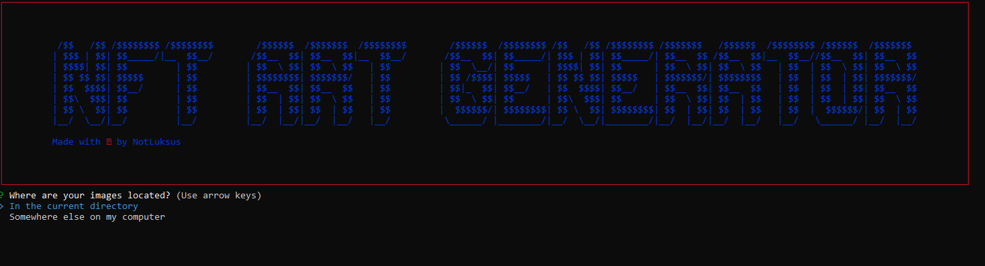
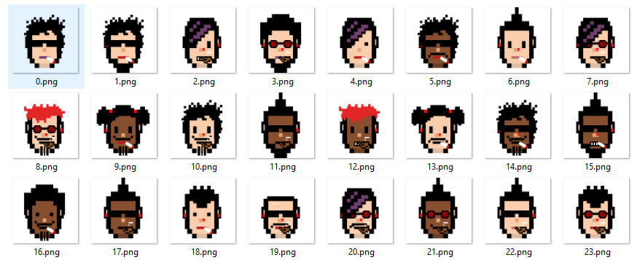
cd “./Create NFTs/cyberpunks/nft-art-generator”
run with nft-generate
Output goes to “./ouput” new directory.

Slide 8

Creating IPFS
In order upload the nft files we had to use a local IPFS node located in ./IPFS-kubo
cd to there and run:
ipfs.exe daemon
Outputs should look like this:

