Slide 1
RESEARCH & ALGORITHM EXECUTION REPORT
The Fallback Mechanism in MVH
From Dimensionality Reduction to Order Violation & The FAST3 Breakthrough
A complete, step-by-step visual trace showing why multi-value heuristics break monotonicity in primary objective g1, why truncated dominance checks fool the search, and how ArenaGcl replaces the 1.35-billion comparison flat bottleneck with O(log N) KD-tree pruning.

Slide 2
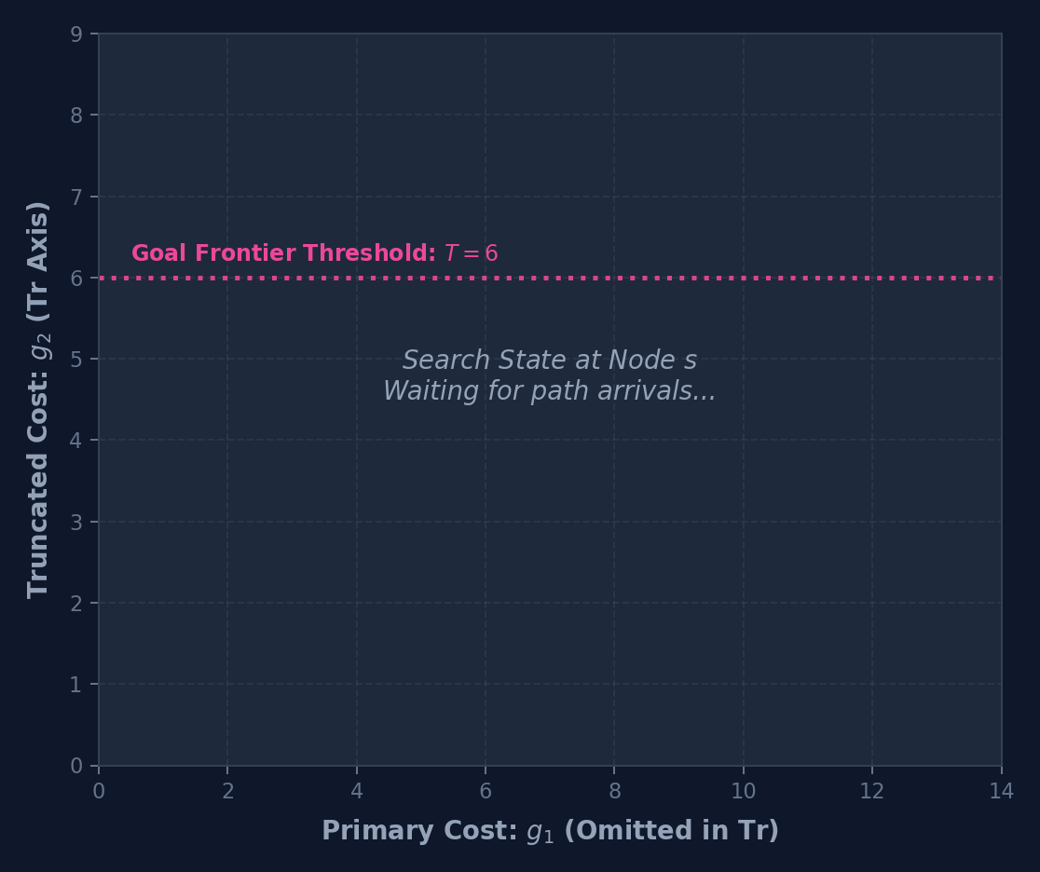
THE FALLBACK STORY • STEP 1 OF 7
Step 1: Initial Setup & Candidate Heuristics at Node s
WHAT HAPPENS AT THIS STEP:
• Multi-objective search space in 2D: g1 (primary cost) and g2 (secondary cost).
• Dimensionality reduction (Tr) drops dim 1: Tr(g) = g2. Assumes g1 arrives monotonically non-decreasing.
• A complete goal solution has already been found with cost T = 6 in dim 2.
• Candidate heuristics at state s: h(1) = (1, 3) [optimistic h1] and h(2) = (5, 1) [conservative h1].
MEMORY REGISTERS WATCH:
OPEN Heap: [ Empty ]
G_cl(s): [ Empty ]
max_g1(s): -∞
Goal Bound T: T = 6 (in dim 2)
CODE EXECUTION (L-NAMOA*dr-mvh):
Line 24: n' = new_node(s)
Line 26: h' = CHOOSEH(s, g, T)

Slide 3
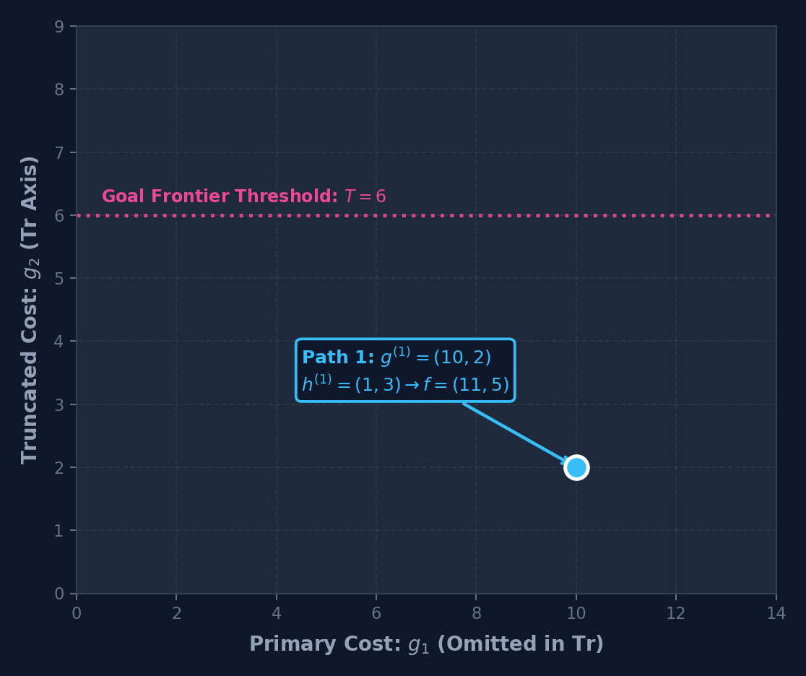
THE FALLBACK STORY • STEP 2 OF 7
Step 2: Path 1 Arrives: Evaluated in CHOOSEH and Pushed to OPEN
WHAT HAPPENS AT THIS STEP:
• Path 1 reaches state s with accumulated cost g(1) = (10, 2).
• CHOOSEH tests first heuristic h(1) = (1, 3): total estimate f = (10+1, 2+3) = (11, 5).
• Dominance test vs Goal T: Is 6 <= 5? FALSE! Not dominated by known goal.
• Heuristic h(1) is ACCEPTED! Path 1 is inserted into OPEN heap with priority key f1 = 11.
MEMORY REGISTERS WATCH:
OPEN Heap: [ { Path 1, g:(10,2), f:(11,5), key:11 } ]
G_cl(s): [ Empty ]
max_g1(s): -∞
CODE EXECUTION (L-NAMOA*dr-mvh):
Line 35: for h in H(s) -> test h(1) = (1, 3)
Line 36: f = g + h = (11, 5)
Line 37: if T <= Tr(f) -> 6 <= 5 is FALSE -> Accepted!
Line 32: OPEN.Insert(Path 1, key=f1=11)

Slide 4
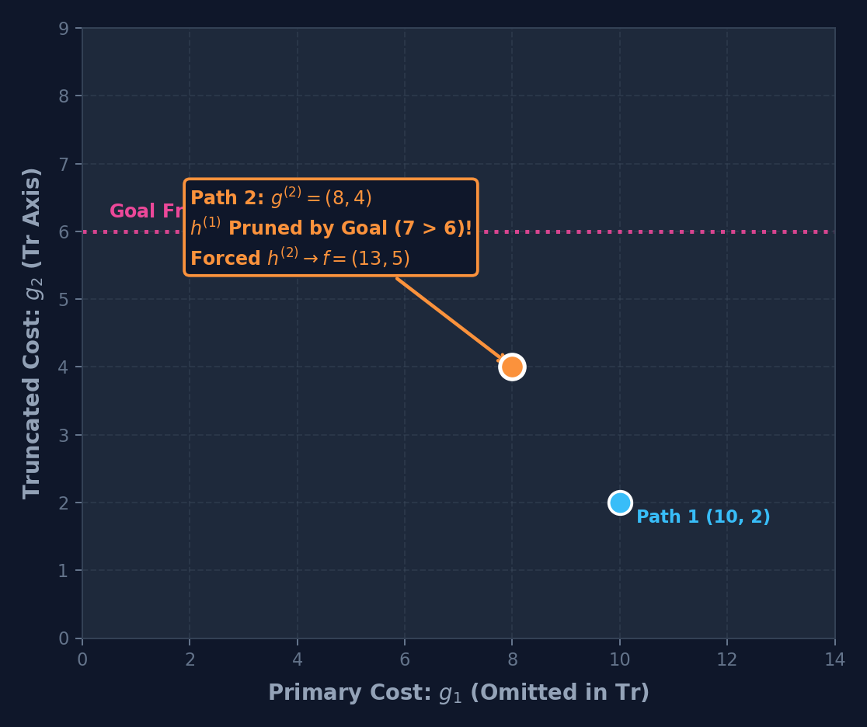
THE FALLBACK STORY • STEP 3 OF 7
Step 3: Path 2 Arrives: Heuristic h(1) Pruned, Forced to h(2)!
WHAT HAPPENS AT THIS STEP:
• Path 2 arrives at state s with cost g(2) = (8, 4). Notice: better in g1 (8 < 10), worse in g2 (4 > 2).
• CHOOSEH tests h(1) = (1, 3) first: f = (8+1, 4+3) = (9, 7). Tr(f) = 7.
• Dominance test vs Goal: Is 6 <= 7? TRUE! Dominated by the known goal solution!
• CRITICAL: h(1) is PRUNED and discarded for Path 2! It cannot be completed via h(1).
• Forced to test h(2) = (5, 1): f = (8+5, 4+1) = (13, 5). 6 <= 5 is False -> Survives!
• Path 2 enters OPEN with priority key f1 = 13.
MEMORY REGISTERS WATCH:
OPEN Heap: [ Path 1 (key:11), Path 2 (key:13) ]
G_cl(s): [ Empty ]
max_g1(s): -∞
CODE EXECUTION (L-NAMOA*dr-mvh):
Line 37: if T <= Tr(f) -> 6 <= 7 is TRUE -> CONTINUE (PRUNED!)
Line 35: test h(2) = (5, 1) -> f = (13, 5) -> ACCEPTED
Line 32: OPEN.Insert(Path 2, key=f1=13)

Slide 5
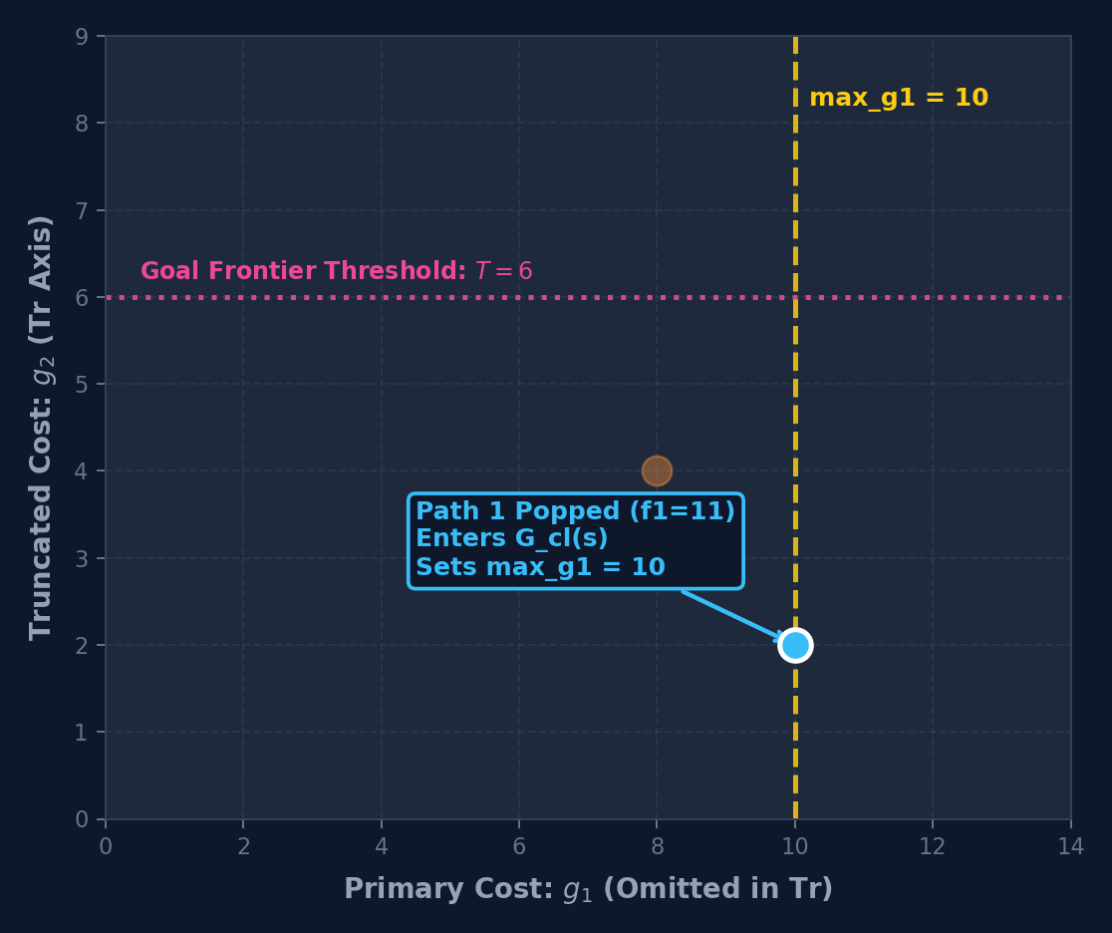
THE FALLBACK STORY • STEP 4 OF 7
Step 4: Path 1 Popped First: Records max_g1 = 10
WHAT HAPPENS AT THIS STEP:
• OPEN priority queue pops nodes by minimum f1. Because 11 < 13, Path 1 is popped first!
• Path 1 enters Closed Set G_cl(s) = {(10, 2)} and Truncated Set G_cl^Tr(s) = {2}.
• Node register records highest observed primary cost: max_g1(s) = 10.
• THE MVH PARADOX: Path 1 popped first due to low f1 (11), even though its true g1 cost is worse (10 > 8)!
MEMORY REGISTERS WATCH:
OPEN Heap: [ Path 2 (key:13) ]
G_cl(s): { (10, 2) }, G_cl_Tr(s): { 2 }
max_g1(s): 10
CODE EXECUTION (L-NAMOA*dr-mvh):
Line 8: n = OPEN.Pop() -> Path 1 (f1 = 11)
Line 18: G_cl_Tr(s) = { 2 }
Line 19: G_cl(s) = { (10, 2) } -> max_g1 = 10

Slide 6
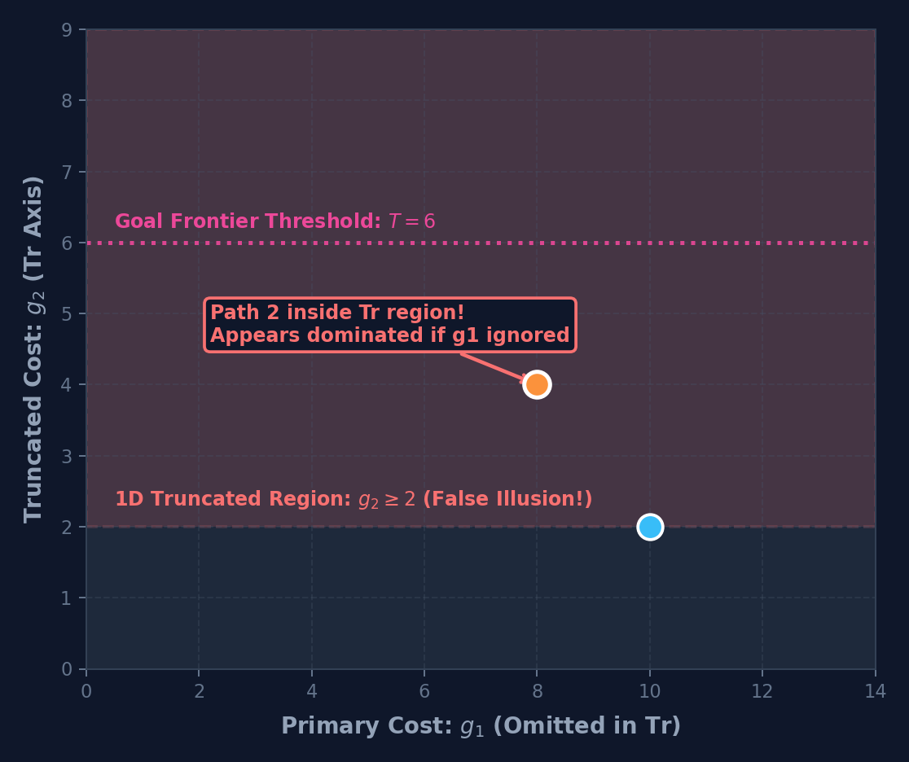
THE FALLBACK STORY • STEP 5 OF 7
Step 5: Path 2 Popped: The False Dominance Trap of Truncation
WHAT HAPPENS AT THIS STEP:
• Path 2 is popped from OPEN (f1=13) and arrives at state s with g = (8, 4).
• ORDER VIOLATION: Primary cost arriving at state s dropped from 10 to 8!
• Truncated Check (Line 42): Is Tr(g1) <= Tr(g2)? -> 2 <= 4 is TRUE!
• THE TRAP: If we blindly trust truncation, Path 1 appears to dominate Path 2!
• Blind pruning would discard a non-dominated Pareto solution and corrupt search soundness.
MEMORY REGISTERS WATCH:
Current Node: Path 2 with g = (8, 4)
G_cl(s): { (10, 2) }
max_g1(s): 10
CODE EXECUTION (L-NAMOA*dr-mvh):
Line 8: n = OPEN.Pop() -> Path 2 (g=(8,4))
Line 42: if Tr(g') <= Tr(g) -> 2 <= 4 is TRUE! (False Dominance Trap)

Slide 7
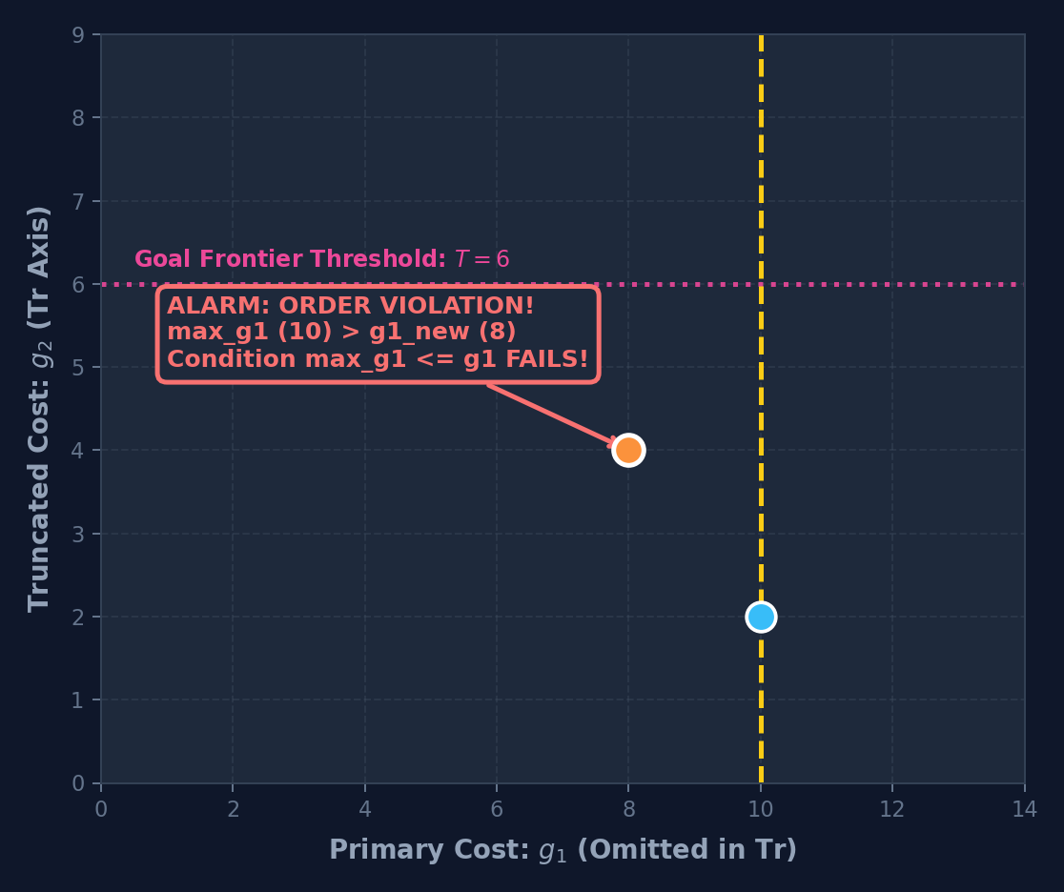
THE FALLBACK STORY • STEP 6 OF 7
Step 6: Safety Alarm: Monotonicity Guard Triggers Fallback!
WHAT HAPPENS AT THIS STEP:
• Maya's safety verification condition (Line 43): Is max_g1 <= g1_new?
• Substitute values: Is 10 <= 8? FALSE! Order violation confirmed!
• ALARM TRIGGERED: The assumption that g1 is monotonically non-decreasing has collapsed.
• The truncated check is deemed invalid and discarded.
• THE FALLBACK: Search MUST fall back to a full M-dimensional Pareto dominance check (Line 45)!
MEMORY REGISTERS WATCH:
Tr Check: INVALIDATED & DISCARDED
Status: *** ORDER VIOLATION DETECTED ***
Action: FALLBACK TO FULL M-DIMENSIONAL PARETO CHECK
CODE EXECUTION (L-NAMOA*dr-mvh):
Line 43: if max(g'_1) <= g_1 -> 10 <= 8 is FALSE!
Line 45: if ∃ g' ∈ G_cl(s) : g' <= g -> FALLBACK ENGAGED!

Slide 8
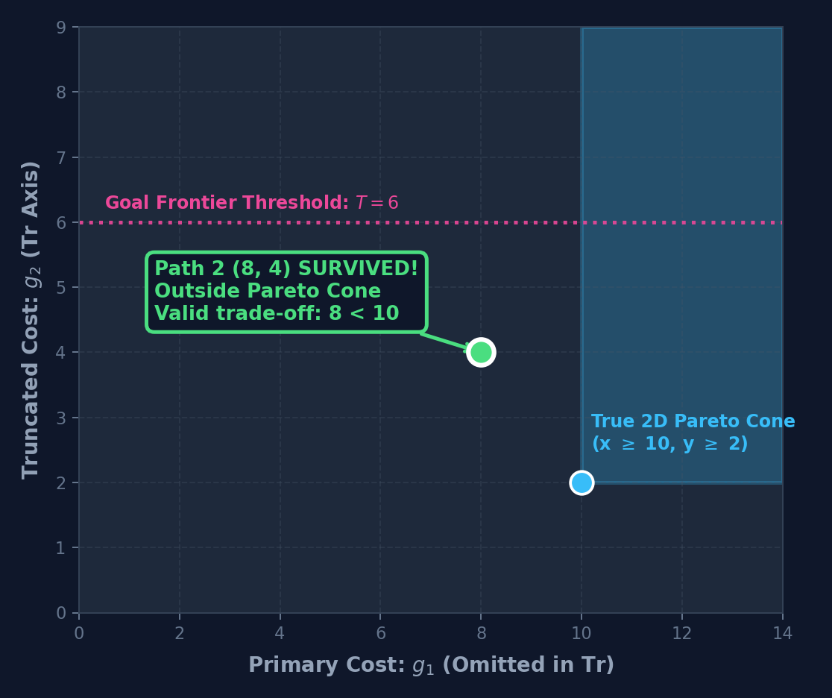
THE FALLBACK STORY • STEP 7 OF 7
Step 7: Full Dominance Check: Path 2 Saved & Pareto Soundness Preserved!
WHAT HAPPENS AT THIS STEP:
• Fallback checks both dimensions between Path 1 (10, 2) and Path 2 (8, 4):
• • Dimension 1: Is 10 <= 8? FALSE! (Path 2 is better by 2 units)
• • Dimension 2: Is 2 <= 4? TRUE (Path 1 is better by 2 units)
• VERDICT: NEITHER DOMINATES! Valid, non-dominated Pareto trade-off.
• Path 2 is SAVED from illegal pruning and committed to G_cl(s) = {(10, 2), (8, 4)}.
• Bit-identical Pareto optimality is 100% guaranteed.
MEMORY REGISTERS WATCH:
G_cl(s): { (10, 2), (8, 4) } [Both Active!]
G_cl_Tr(s): { 2, 4 }
max_g1(s): 10
Frontier: 100% Bit-Identical to Oracle
CODE EXECUTION (L-NAMOA*dr-mvh):
Line 45: check (10 <= 8) && (2 <= 4) -> FALSE (Neither dominates!)
Line 47: return false -> Path 2 is NON-DOMINATED!
Line 19: G_cl(s) = G_cl(s) ∪ { (8, 4) } -> BOTH SURVIVED!

Slide 9
ARCHITECTURAL BOTTLENECK ANALYSIS
The Engineering Dilemma: Why FAST2 Choked on Fallback
❌ THE FAST2 BOTTLENECK
• Flat std::vector for G_cl(s): In FAST2, past paths were stored in a flat sequential array.
• 98.5% Non-Dominated Rate: In 98.5% of fallback occurrences, the candidate path is genuinely non-dominated (like Path 2 in our example).
• Zero Early-Break Opportunity: To prove that NO past path dominates the candidate, the loop CANNOT break early. It must scan to the very last element.
• O(N) Scanning per Query: When a grid cell accumulates 5,000 to 10,000 paths, every fallback triggers 10,000 full vector comparisons.
• 1.35 Billion Comparisons: On instance grid_n7_m8, FAST2 performed 1,350,000,000 full comparisons, burning 85%+ of execution time purely in this loop.
🚀 THE FAST3 ARENAGCL SOLUTION
• 128-Element L1 Buffer: Keep up to 128 vectors in a flat buffer, taking advantage of hardware prefetching, SIMD, and zero pointer overhead.
• Balanced FullKDTree<M>: Once local frontier exceeds 128 elements, freeze them into a balanced M-dimensional KD-Tree.
• O(1) Spatial Rejection: Orthogonal bounding boxes (lo[k] > q[k]) reject entire subtrees of hundreds of paths in a single scalar test.
• O(log N) Query Complexity: Dominance verification collapses from linear O(N) to spatial O(log N).
• 217x Fewer Operations: Full comparisons on grid_n7_m8 dropped from 1.35 billion to 6.2 million.
• 8.97x Speedup over FAST2: Wall-clock time on grid_8x8_m6 plunged from 382s to 42s (and 53.6x faster than Maya baseline).

