Slide 1
Maya’s Fallback Algorithm
Why We Truncate Dimensions And Still Need a Full Check
A Complete, Step-by-Step Algorithmic Trace (from Ground Zero)

Slide 2
What Does Goal Frontier T = {6} Mean?
How known solutions prune future paths via CHOOSEH
1. What is stored in T?
• T is the truncated closed set at the destination: T = G_cl_Tr(s_goal).
• Truncation omits the primary coordinate g₁ and keeps the rest: Tr(g) = g₂.
• Since a complete path already reached s_goal with cost g₂ = 6, we have: T = {6}.
• Fundamental Invariant: Any solution already at s_goal represents an achievable total cost.
2. How does CHOOSEH prune using T?
• For any partial path arriving at state s with cost g, testing heuristic h gives: f = g + h.
• The projected cost in dimension 2 is: Tr(f) = g₂ + h₂.
• If t ≤ Tr(f) for any t ∈ T (here: 6 ≤ g₂ + h₂):
→ Completing this path via h will cost AT LEAST 6 in dimension 2!
→ But we already discovered a complete path to the goal with cost 6!
→ Therefore, this heuristic completion CANNOT produce an undominated solution.
→ Heuristic h is safely REJECTED.
Goal Pruning Rule:
If 6 ≤ g₂ + h₂, completing through heuristic h is strictly worse than an existing solution.

Slide 3
The Core Concept: Truncation & The Fallback
Why compare M-1 dimensions at all? And why does it break?
1. Why use Truncation at all?
• Normal Pareto dominance checks all M coordinates: g'₁ ≤ g₁ AND g'₂ ≤ g₂.
• In single-heuristic A*, OPEN pops nodes in strictly increasing order of primary cost g₁.
• If g₁ always arrives in non-decreasing order (monotonic), g'₁ ≤ g₁ is ALWAYS TRUE for past nodes!
• We can drop dimension 1 and only compare Tr(g) = g₂ → massive speedup across millions of queries.
2. Why do we still need a Full-Dimensional Check (Fallback)?
• Multi-Valued Heuristics (MVH) assign multiple lower bounds: H(s) = {h⁽¹⁾, h⁽²⁾}.
• Different paths choose different heuristics → their f₁ = g₁ + h₁ priority key shifts in OPEN!
• A path with worse actual cost (g₁ = 10) can pop BEFORE a path with better cost (g₁ = 8).
• When the second path arrives, Truncation sees only g₂ and claims Path A dominates it (FALSE DOMINANCE)!
• The Fallback catches this violation (max g'₁ ≰ g₁) and re-checks all M dimensions.
Key Insight:
Truncation is an optimistic speedup. The Fallback guarantees exact Pareto soundness.

Slide 4
Maya’s LOCALDOMCHECK Algorithm
(Wolff, Felner, Salzman, SoCS 2026)
function LOCALDOMCHECK(s, g):
// 1. Optimistic Truncated Check (in M-1 dimensions):
if exists g' in G_cl_Tr(s) such that Tr(g') <= Tr(g):
// 2. Monotonicity Guard (is g₁ order valid?):
if max_g'1 <= g1:
return TRUE // Soundly dominated via Truncation
// 3. FALLBACK: Full-Dimensional Check (all M dimensions):
if exists g' in G_cl(s) such that g' <= g:
return TRUE // Truly dominated in full space
return FALSE // Non-dominated! Saved by fallback!
return FALSE // Undominated
The 3 Steps:
1. Fast test (M-1 dims) → 2. Guard (max g'₁ ≤ g₁) → 3. Fallback (all M dims).

Slide 5
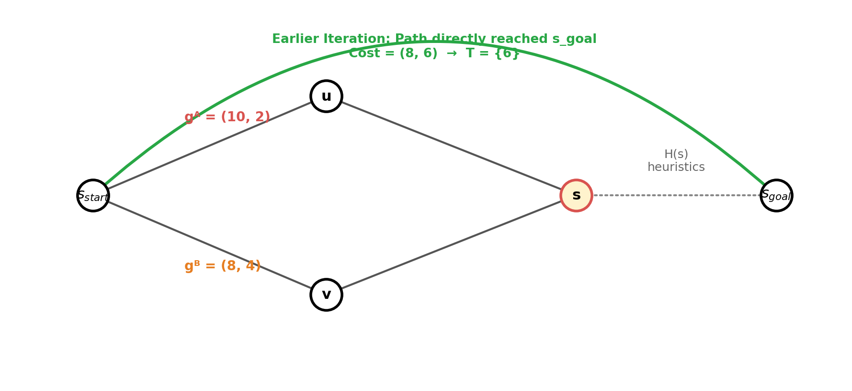
Base Graph State
Where did our previous paths and the goal frontier come from?
0: Previous search history before arriving at node s:
1. An earlier path already reached s_goal with total cost (8, 6). The truncated cost enters T = {6}.
2. Two new paths are now approaching state s: Path A with gᴬ = (10, 2) and Path B with gᴮ = (8, 4).

Slide 6
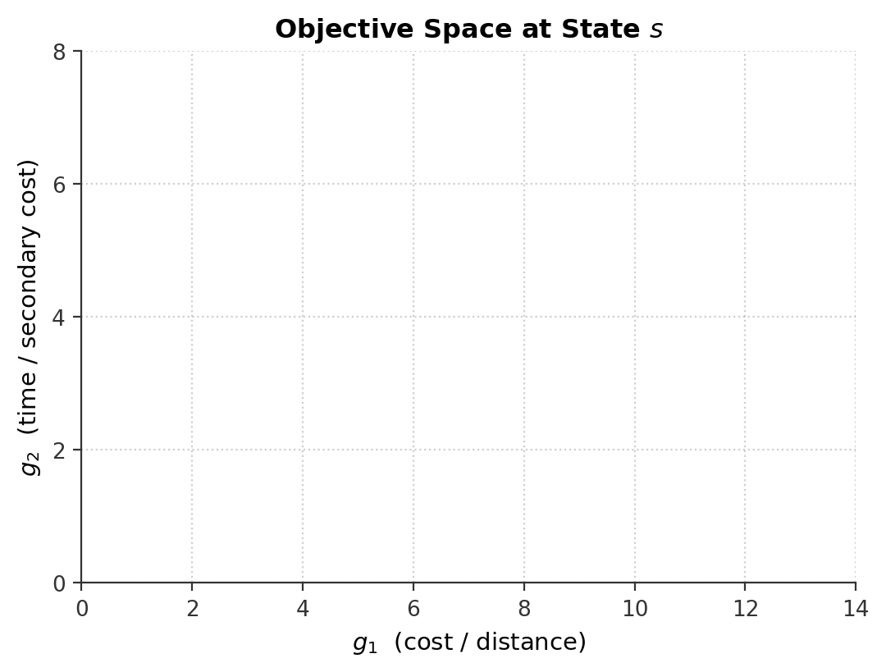
Search State at Node s
Before either path expands at node s
SEARCH STATE & VARIABLES
G_cl(s): ∅
G_cl_Tr(s): ∅
max g'₁(s): undefined
Goal T: {6}
OPEN Queue (min-heap by f₁):
[ Empty ]
Heuristics at state s (sorted ascending by h₁):
• h⁽¹⁾ = (1, 3) • h⁽²⁾ = (5, 1)
Incoming Paths to state s:
• Path A: gᴬ = (10, 2)
• Path B: gᴮ = (8, 4)
Neither dominates the other.
0: Initial state at node s. G_cl(s) is empty, Goal frontier T = {6}.
Note: Both Path A and Path B are approaching state s.

Slide 7
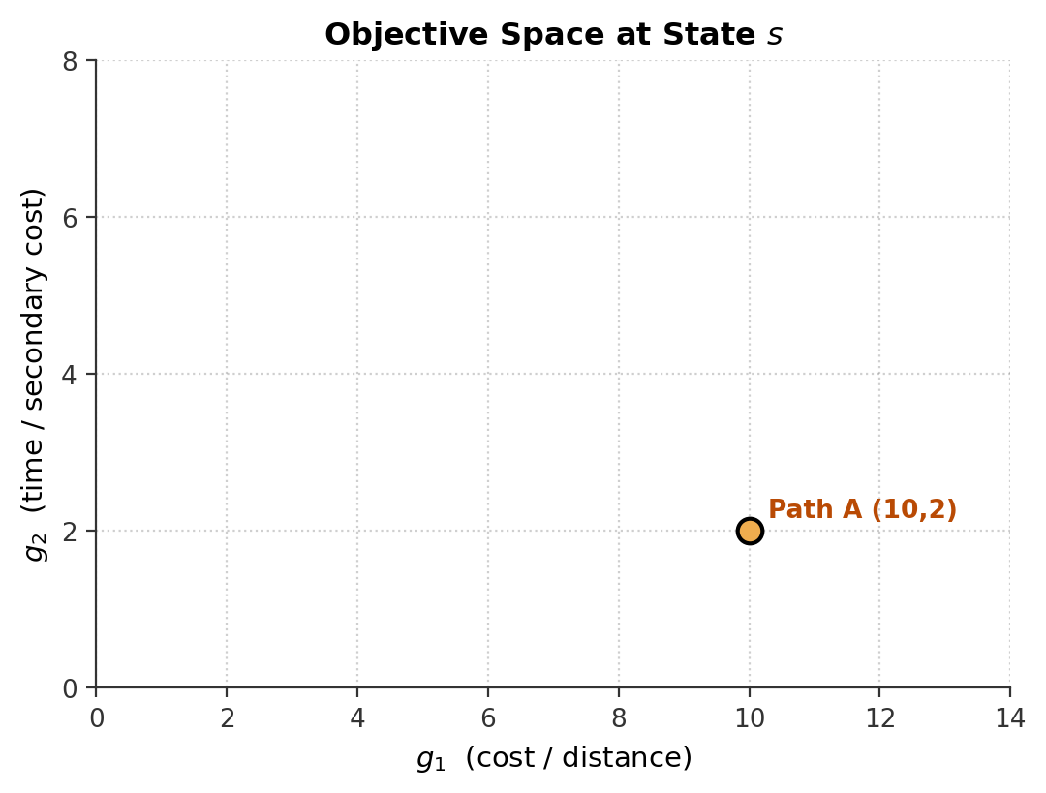
Step 1: Path A Arrives at State s
gᴬ = (10, 2) evaluates heuristics via CHOOSEH
SEARCH STATE & VARIABLES
G_cl(s): ∅
G_cl_Tr(s): ∅
max g'₁(s): undefined
Goal T: {6}
OPEN Queue (min-heap by f₁):
Path A: g=(10,2), h=(1,3) -> f₁=11
CHOOSEH for Path A:
1. Test h⁽¹⁾ = (1, 3):
f = gᴬ + h⁽¹⁾ = (10+1, 2+3) = (11, 5)
Tr(f) = f₂ = 5
2. Check vs Goal T = {6}:
Is 6 ≤ 5? → FALSE (Not dominated by goal)
3. h⁽¹⁾ is Accepted!
Path A enters OPEN with priority key: f₁ = 11.
1: Path A selects h⁽¹⁾ and enters OPEN with priority f₁ = 11.
Note: Path A has actual accumulated cost g₁ = 10.

Slide 8
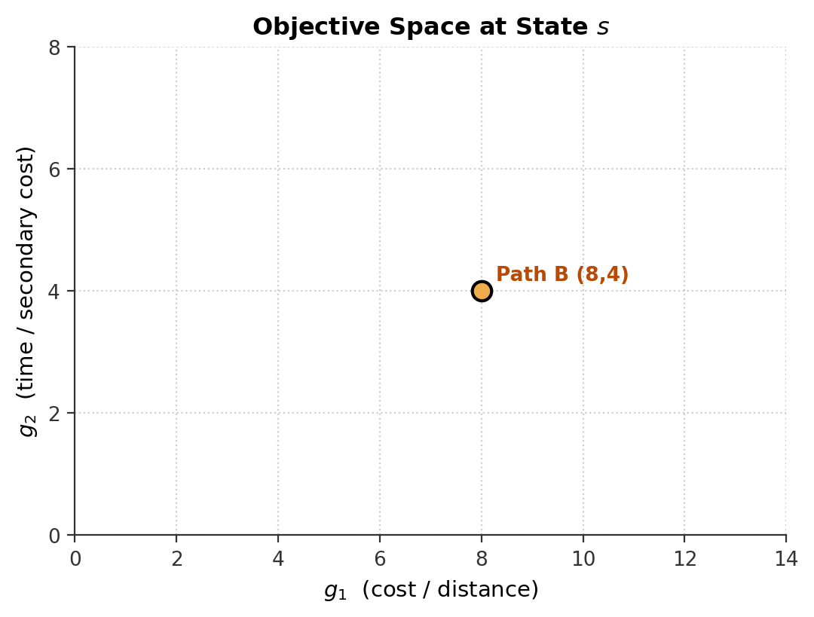
Step 2a: Path B Arrives at State s
gᴮ = (8, 4) — Why is h⁽¹⁾ refuted? Because of the GOAL, not Path A!
SEARCH STATE & VARIABLES
G_cl(s): ∅
G_cl_Tr(s): ∅
max g'₁(s): undefined
Goal T: {6}
OPEN Queue (min-heap by f₁):
Path A: g=(10,2), h=(1,3) -> f₁=11
CHOOSEH for Path B:
1. Test h⁽¹⁾ = (1, 3):
f = gᴮ + h⁽¹⁾ = (8+1, 4+3) = (9, 7) → Tr(f) = 7
2. Check vs Goal T = {6}: Is 6 ≤ 7? → TRUE -> REJECT h⁽¹⁾
★ WHY rejected even though g₁ᴮ = 8 < 10?
• It is NOT being compared to Path A!
• It is compared to the GOAL in dimension 2!
• Projected time is 7, but goal already achieved 6!
→ h⁽¹⁾ is discarded for Path B.
2a: Path B cannot use h⁽¹⁾ because projected time 7 cannot beat known goal time 6 (6 ≤ 7).
Note: Path B is forced to test its second heuristic h⁽²⁾.

Slide 9
Step 2b: Path B Accepts h⁽²⁾ & Enqueues
gᴮ = (8, 4) paired with h⁽²⁾ = (5, 1) → priority f₁ = 8 + 5 = 13
SEARCH STATE & VARIABLES
G_cl(s): ∅
G_cl_Tr(s): ∅
max g'₁(s): undefined
Goal T: {6}
OPEN Queue (min-heap by f₁):
Top: Path A | g=(10,2) | f₁=11
Next: Path B | g=(8,4) | f₁=13
CHOOSEH for Path B (cont.):
1. Test h⁽²⁾ = (5, 1):
f = gᴮ + h⁽²⁾ = (8+5, 4+1) = (13, 5) → Tr(f) = 5
2. Check vs Goal T = {6}: Is 6 ≤ 5? → FALSE
3. h⁽²⁾ Accepted! Enqueued with f₁ = 13.
★ PRIORITY INVERSION IN OPEN:
Path A has lower f₁ (11 < 13) → POPPED FIRST!
Even though Path B has BETTER actual cost (8 < 10)!
2b: Path B is enqueued behind Path A in OPEN because f₁ᴮ = 13 > f₁ᴬ = 11.
Note: ORDER INVERSION: Lower g₁ path will arrive at state s SECOND!

Slide 10
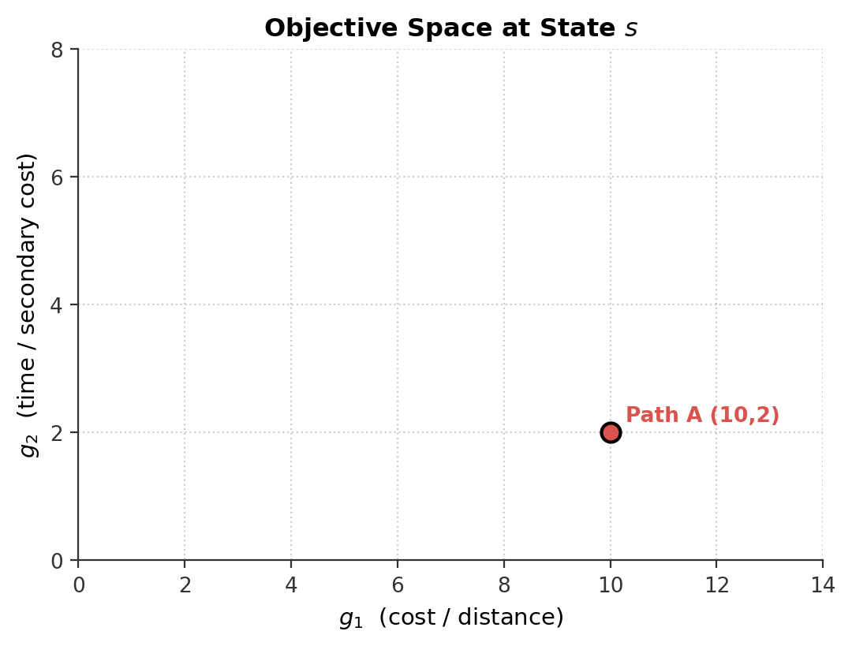
Step 3: Path A Popped & Expanded
OPEN pops min f₁: Path A (f₁ = 11) commits to state s
SEARCH STATE & VARIABLES
G_cl(s): {(10, 2)}
G_cl_Tr(s): {2}
max g'₁(s): 10
Goal T: {6}
OPEN Queue (min-heap by f₁):
Top: Path B | g=(8,4) | f₁=13
Execution Trace:
• OPEN.PopMin() returns Path A (f₁ = 11)
• LOCALDOMCHECK: G_cl is empty → FALSE
• UPDATE(s, (10, 2)):
- G_cl(s) ← {(10, 2)}
- G_cl_Tr(s) ← {2}
- max g'₁ ← 10 (recorded in state - Based on increasing order)
• Path A expanded; successors generated.
3: Path A is closed at state s. G_cl(s) = {(10, 2)} and max g'₁ = 10.
Note: Next node to pop from OPEN is Path B with gᴮ = (8, 4).

Slide 11
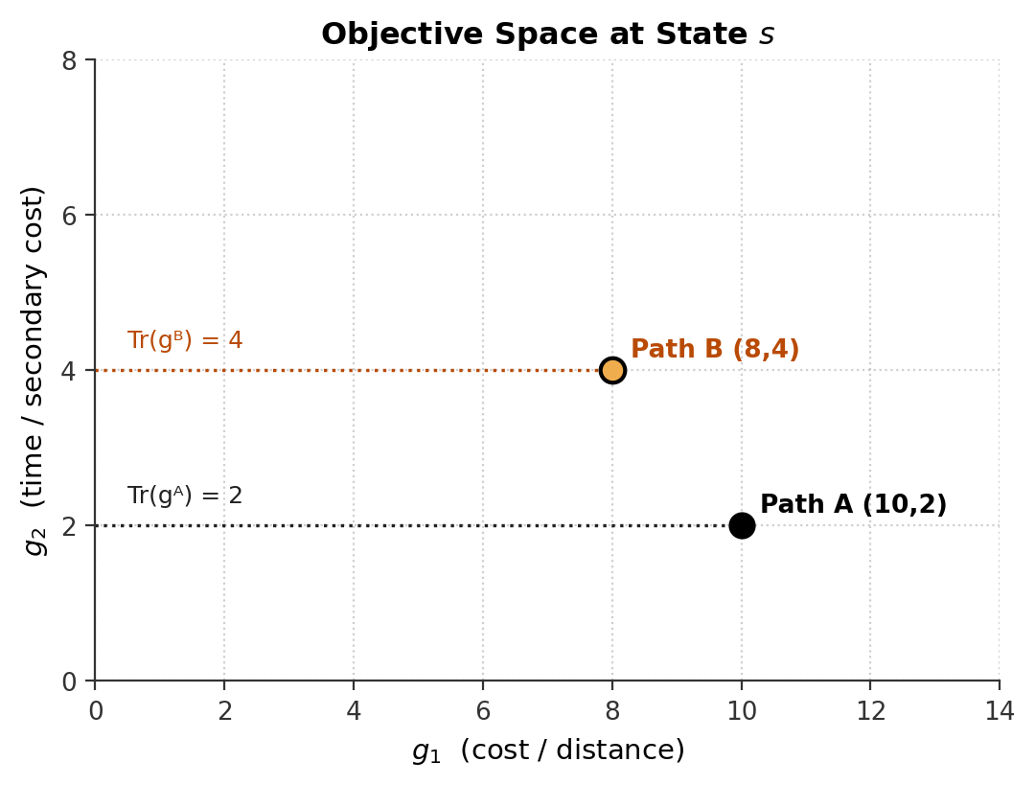
Step 4a: Path B Popped — Truncated Check
Query: Does any g' in G_cl_Tr(s) have Tr(g') ≤ Tr(gᴮ)?
SEARCH STATE & VARIABLES
G_cl(s): {(10, 2)}
G_cl_Tr(s): {2}
max g'₁(s): 10
Goal T: {6}
OPEN Queue (min-heap by f₁):
[ Empty ]
Step 1 of LOCALDOMCHECK (Truncated Check):
• Tr(gᴮ) = g₂ᴮ = 4
• Compare against G_cl_Tr(s) = {2}:
Is 2 ≤ 4 ? → TRUE!
Should we Prune?
⚠ NO!:
Looking ONLY at coordinate g₂, Path A appears
to dominate Path B! If we prune now, Path B is lost.
4a: Truncated test succeeds (2 ≤ 4). Path B appears dominated in g₂.
Note: Truncation assumes g₁ was monotonic. Is it?

Slide 12
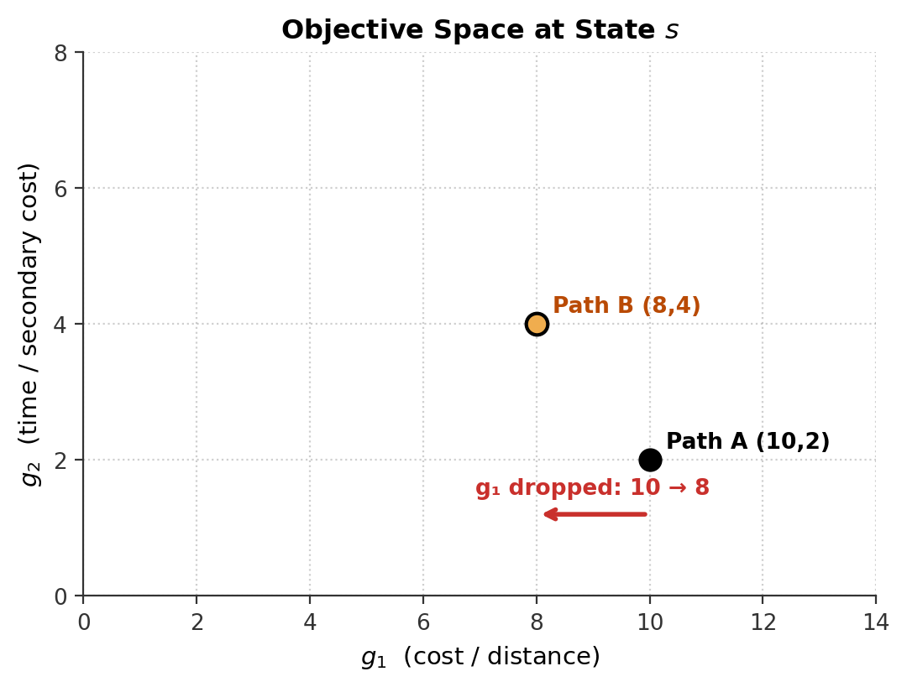
Step 4b: Monotonicity Guard Catches the Trap
Condition: Does max g'₁ ≤ g₁ᴮ hold?
SEARCH STATE & VARIABLES
G_cl(s): {(10, 2)}
G_cl_Tr(s): {2}
max g'₁(s): 10
Goal T: {6}
OPEN Queue (min-heap by f₁):
[ Empty ]
Step 2 of LOCALDOMCHECK (Monotonicity Guard):
• Recorded max g'₁ = 10 (from Path A)
• Incoming Path B has g₁ᴮ = 8
• Check: Is max g'₁ ≤ g₁ᴮ ?
Is 10 ≤ 8 ? → FALSE! (Order Violation!)
✓ Algorithm detects truncated test was misled!
→ FALLBACK TO FULL DIMENSIONS TRIGGERED.
4b: Monotonicity guard detects order violation (10 ≰ 8).
Note: Dimensionality reduction is inconclusive. We cannot safely prune.

Slide 13
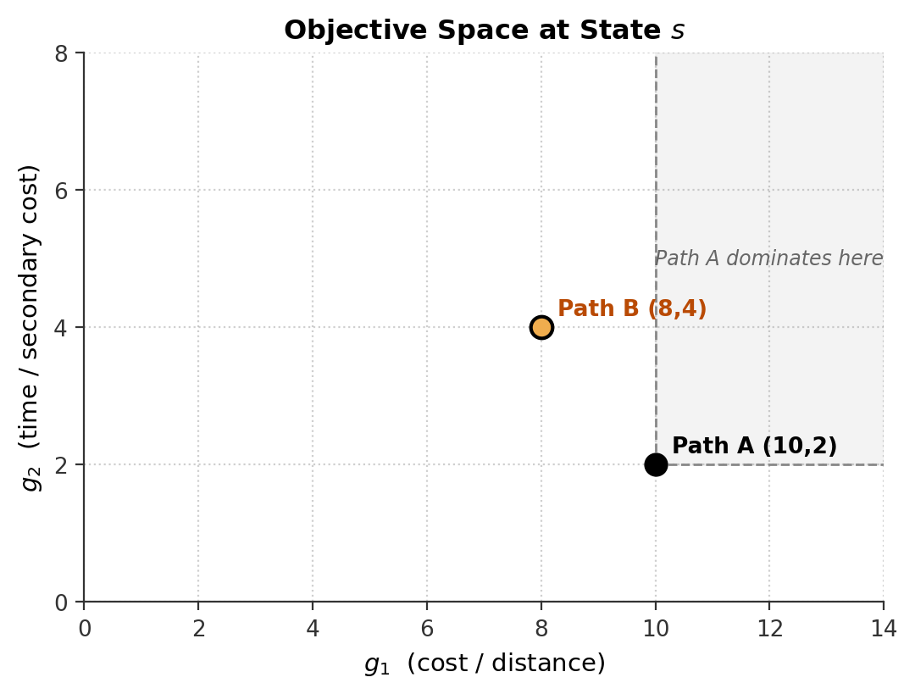
Step 4c: Fallback — Full M-Dimensional Check
Compare Path A (10, 2) vs Path B (8, 4) in all M = 2 coordinates
SEARCH STATE & VARIABLES
G_cl(s): {(10, 2)}
G_cl_Tr(s): {2}
max g'₁(s): 10
Goal T: {6}
OPEN Queue (min-heap by f₁):
[ Empty ]
Step 3 of LOCALDOMCHECK (Full Fallback):
Compare (10, 2) vs (8, 4) in full space:
• Dim 1 (g₁): Is 10 ≤ 8? → FALSE (Path B is better!)
• Dim 2 (g₂): Is 2 ≤ 4? → TRUE (Path A is better)
Decision: Path A does NOT dominate Path B!
• Genuine Pareto trade-off.
• Returns FALSE → Path B SURVIVES!
How do I do that? Optimally by K-D-Tree.
4c: Full check confirms Path B is NOT dominated. Path B is saved!
Note: Notice Path B lies outside Path A's dominance cone (shaded gray).

Slide 14
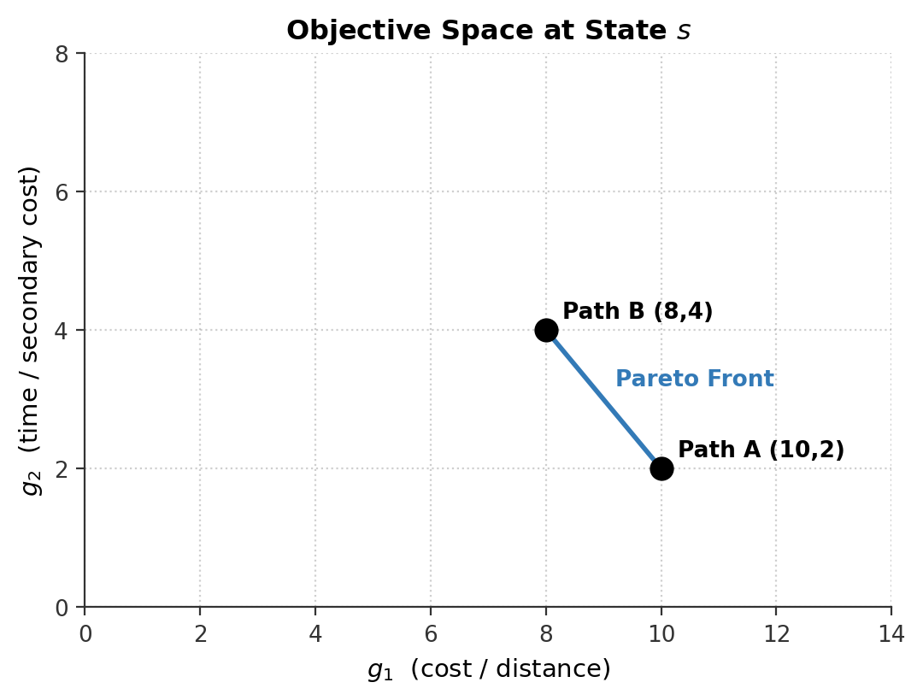
Step 4d: Both Paths on Pareto Front
G_cl(s) = {(10, 2), (8, 4)} — search soundness preserved
SEARCH STATE & VARIABLES
G_cl(s): {(10, 2), (8, 4)}
G_cl_Tr(s): {2, 4}
max g'₁(s): 10
Goal T: {6}
OPEN Queue (min-heap by f₁):
[ Empty ]
Search State Consolidated:
• UPDATE commits Path B:
- G_cl(s) = {(10, 2), (8, 4)}
- G_cl_Tr(s) = {2, 4}
• Both paths continue expanding toward the goal.
• Exact Pareto optimality is preserved bit-identically!
4d: Both Path A and Path B survive and enter the closed set.
Note: Search soundness is preserved 100% bit-identically.

Slide 15
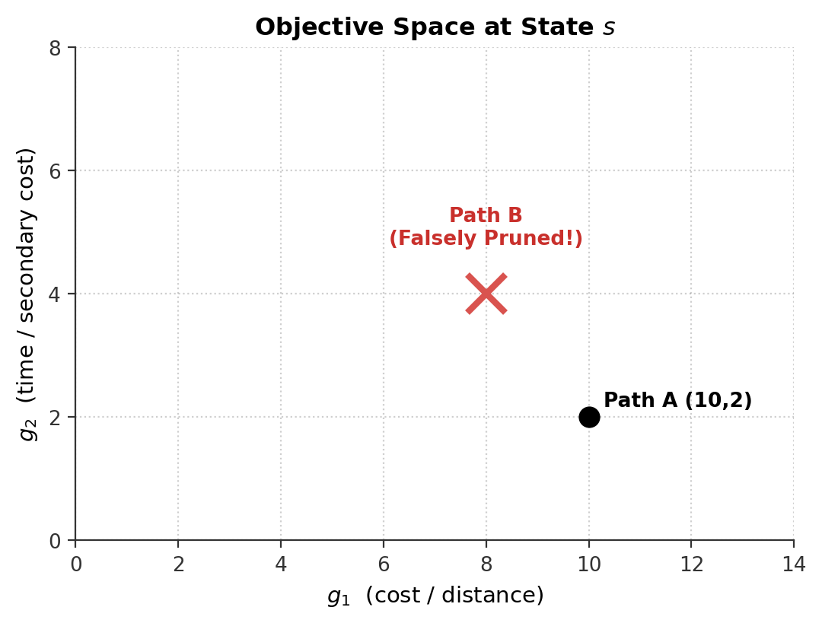
Failure Case: What If We Omit the Fallback?
Naive Truncation murders valid Pareto solutions
SEARCH STATE & VARIABLES
G_cl(s): {(10, 2)}
G_cl_Tr(s): {2}
max g'₁(s): 10
Goal T: {6}
OPEN Queue (min-heap by f₁):
[ Empty ]
Without Fallback:
1. Truncated test sees 2 ≤ 4 (True).
2. Algorithm prunes Path B immediately.
3. Path B never reaches the destination.
Consequence: Pareto front is INCOMPLETE.
• Optimal solutions in g₁ are permanently lost.
• Search algorithm is MATHEMATICALLY UNSOUND.
Fatal Error: Pruning on truncation alone discards optimal solutions.
Note: Maya's fallback is not an optimization — it is a strict correctness requirement.

Slide 16
Accelerating the Fallback: Full-Dim K-d Tree
From O(N) linear scan to O(N^(1 - 1/M)) spatial pruning
The Bottleneck in Baseline:
• The fallback re-checks all M dimensions against every vector in G_cl(s).
• In 98.5% of fallbacks, the candidate is non-dominated → must scan all N vectors!
• On 6-objective benchmarks: 1.35 BILLION comparisons, taking 85%+ of search time.
The FAST-MVH Solution (Full-Dimensional K-d Tree):
• Index G_cl(s) in a K-d Tree over all M dimensions.
• Each node stores subtree minimum bounds: lo = (min p₁, ..., min p_M).
• O(1) Bounding-Box Pruning: If lo[k] > g[k] for ANY coordinate k,
no vector in that subtree can dominate g → skip the entire branch!
• Result: 217× fewer comparisons, 9× wall-clock speedup, 100% bit-identical front.
FAST-MVH: Replaces the linear fallback scan with a K-d tree for massive speedups.
Note: Same nodes expanded, same solutions returned — pure algorithmic acceleration.

Slide 17
Summary: Why Truncate & Why Fallback?
The core intuition in three key points
1. Why Truncate? OPEN sorts by f₁ = g₁ + h₁. Checking only M-1 dimensions saves massive work whenever g₁ arrives in non-decreasing order.
2. Why Fallback? MVH evaluates paths with different heuristics, causing paths to arrive out of g₁ order. Truncation falsely flags them as dominated; the Fallback re-checks all M dimensions to preserve Pareto optimality.
3. Why K-d Tree? Linear fallback scans consume 85%+ of runtime. Spatial K-d trees prune subtrees in O(1), making the fallback fast and scalable.
End of Presentation.
Questions?

