Slide 1
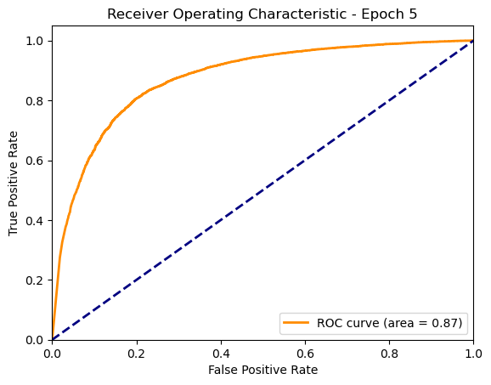
Graduate School of Natural Sciences
Explainable AI in a Radiology Scenario - INFOMXAI
2025
Nikita Aksjonov, Abhinav Atmuri, Bar Melinarskiy, and Konstantinos Zavantias
Chosen Model - A Hybrid Deep Learning Approach
Model Overview
Inspired by an article by Abhishek Jaiswal [1] our Model combines MobileNetV2 [2] and DenseNet169 [3] to leverage their strengths for enhanced feature extraction. Both models are modified to accept single-channel inputs, making them adaptable to grayscale image processing. The extracted features from both networks are concatenated and passed through a fully connected network for classification.
Key Features:
Uses MobileNetV2 for lightweight, efficient feature extraction.
Incorporates DenseNet169 for deep feature representation.
Merges outputs from both models for a more robust classification.
Fully connected layers refine the features, leading to precise predictions.
Option to freeze base model layers for transfer learning.
Model Training
Data Preprocessing and Augmentation:
Dataset Filtering:
We select only frontal chest X-ray images for consistency. Handling Missing and Uncertain Labels
Labels marked as -1 (uncertain) were replaced to 1 (true).
Image Processing:Images are resized to 224×224 pixels.Pixel values are normalized to stabilize model training.Data Augmentation (Optional):Random flipping, rotation, and brightness adjustments are applied to improve generalization.Train-Validation Split:The dataset is randomly split into 80% training and 20% validation for fair evaluation.Model Training StrategyOnce preprocessing is complete, the model is trained using the following approach:Handling Class Imbalance:Since Pleural Effusion is underrepresented, we apply weighted loss adjustment to prevent bias.BCEWithLogitsLoss with computed class weights ensures fair learning.Optimization:The Adam optimizer is used with a learning rate of 0.0001 and weight decay 1e-5 to prevent overfitting.Dynamic Learning Rate Adjustment:We implement ReduceLROnPlateau, which reduces the learning rate if validation loss stops improving.Training Process:The model is trained for 25 epochs with performance tracking on the validation set.The best-performing model is saved for final evaluation.
Model Evolution
Explanations
Saliency Map-based
Example-based
Evaluate Explanations
Ut quam rem volupta
Table heading
Text
Text
Text
Text
Table 1
Od qui aute as moditaquiae qui adit periatent liquossequi con re doluptium aut et quos repere pera pa volorit omnihit
Figure 1
Od qui aute as moditaquiae qui adit periatent liquossequi con re doluptium aut et quos repere pera pa volorit omnihit, ut etus, ium imoluptate ilictamus rempe denisti onsequo esti optatia alit ped mo volupta simus plaut expel mi, tem simolor estemostia volupta quo quat que quas andelia tinihicatus molore prorem quossequas voluptaes dolorat.
References
Analytics Vidhya. (2022, March). X-ray classification using pretrained stacked model. Analytics Vidhya. https://www.analyticsvidhya.com/blog/2022/03/x-ray-classification-using-pretrained-stacked-model/Name author
Sandler, M., Howard, A., Zhu, M., Zhmoginov, A., & Chen, L. C. (2018). Mobilenetv2: Inverted residuals and linear bottlenecks. In Proceedings of the IEEE conference on computer vision and pattern recognition (pp. 4510-4520).
Huang, G., Liu, Z., Van Der Maaten, L., & Weinberger, K. Q. (2017). Densely connected convolutional networks. In Proceedings of the IEEE conference on computer vision and pattern recognition (pp. 4700-4708).
References
Name author
Name author

