Slide 1
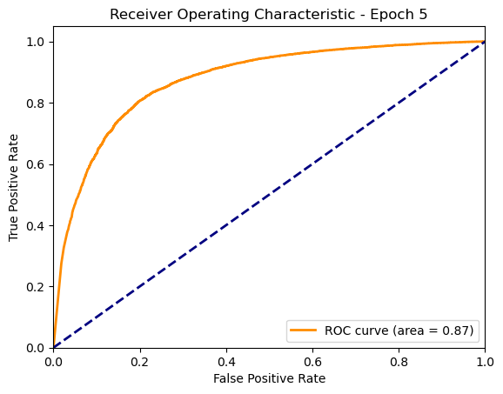
Graduate School of Natural Sciences
Explainable AI in a Radiology Scenario - INFOMXAI
2025
Nikita Aksjonov, Abhinav Atmuri, Bar Melinarskiy, and Konstantinos Zavantias
Chosen Model - A Hybrid Deep Learning Approach
Model Overview
Inspired by an article by Abhishek Jaiswal [1] our Model combines MobileNetV2 [2] and DenseNet169 [3] to leverage their strengths for enhanced feature extraction. Both models are modified to accept single-channel inputs, making them adaptable to grayscale image processing. The extracted features from both networks are concatenated and passed through a fully connected network for classification.
Key Features:
Uses MobileNetV2 for lightweight, efficient feature extraction.
Incorporates DenseNet169 for deep feature representation.
Merges outputs from both models for a more robust classification.
Fully connected layers refine the features, leading to precise predictions.
Option to freeze base model layers for transfer learning.
Model Training
Data Preprocessing and Augmentation: Dataset Filtering: We
Model Evolution
Explanations
Saliency Map-based
Example-based
Evaluate Explanations
Ut quam rem volupta
Figure 1
Od qui aute as moditaquiae qui adit periatent liquossequi con re doluptium aut et quos repere pera pa volorit omnihit, ut etus, ium imoluptate ilictamus rempe denisti onsequo esti optatia alit ped mo volupta simus plaut expel mi, tem simolor estemostia volupta quo quat que quas andelia tinihicatus molore prorem quossequas voluptaes dolorat.
Table 1
Od qui aute as moditaquiae qui adit periatent liquossequi con re doluptium aut et quos repere pera pa volorit omnihit
References
Analytics Vidhya. (2022, March). X-ray classification using pretrained stacked model. Analytics Vidhya. https://www.analyticsvidhya.com/blog/2022/03/x-ray-classification-using-pretrained-stacked-model/Name author
Sandler, M., Howard, A., Zhu, M., Zhmoginov, A., & Chen, L. C. (2018). Mobilenetv2: Inverted residuals and linear bottlenecks. In Proceedings of the IEEE conference on computer vision and pattern recognition (pp. 4510-4520).
Huang, G., Liu, Z., Van Der Maaten, L., & Weinberger, K. Q. (2017). Densely connected convolutional networks. In Proceedings of the IEEE conference on computer vision and pattern recognition (pp. 4700-4708).
References
Name author
Name author

