Slide 1


Slide 2
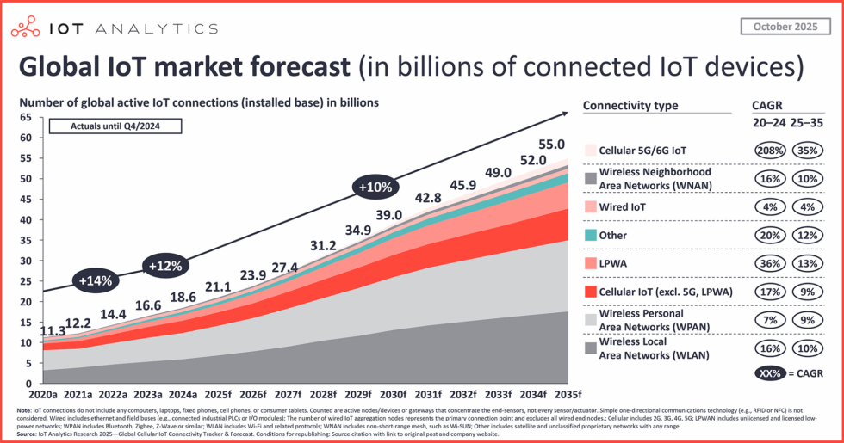
Behavior of the market
https://iot-analytics.com/number-connected-iot-devices/#:~:text=State%20of%20IoT%202022:%20Number,18%25%20to%2014.4%20billion%20globally
Notes:
In connection with rising IOT technology sector the number of wireless systems is increasing rapidly. Our measurement system allows distributors to control their devices in terms of power efficiency.

Slide 3
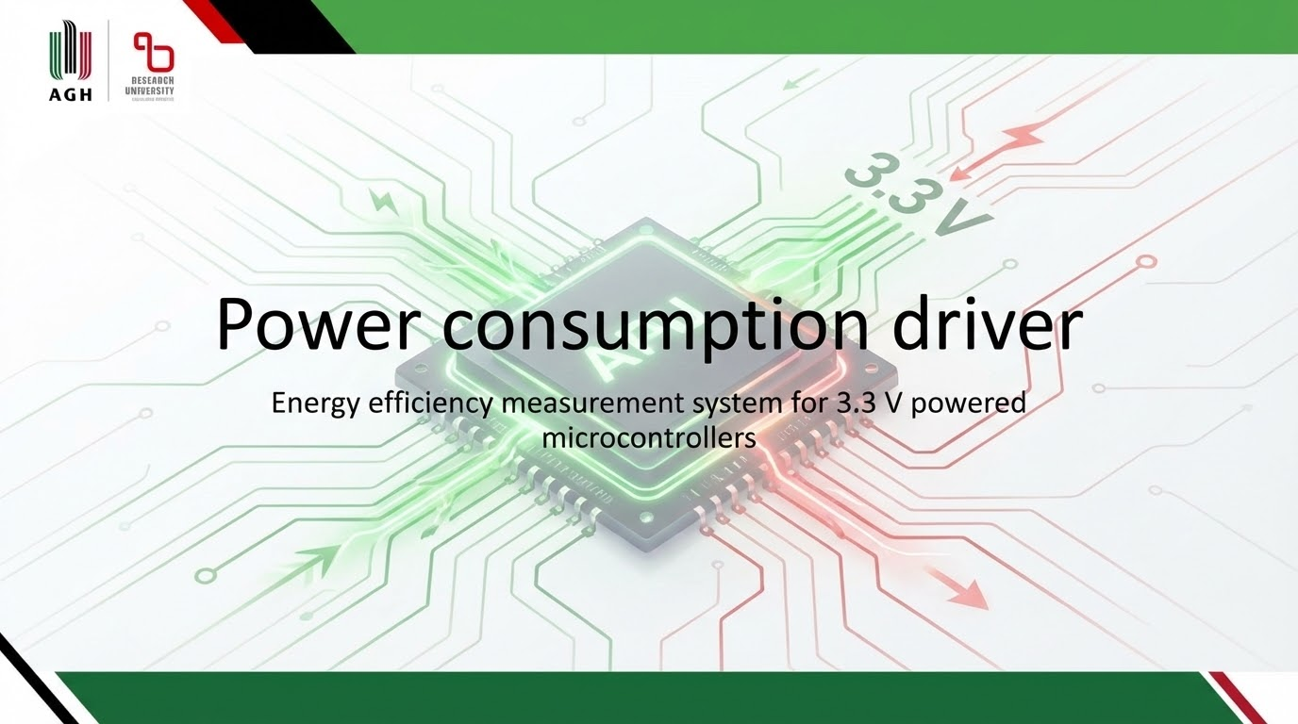

Slide 4
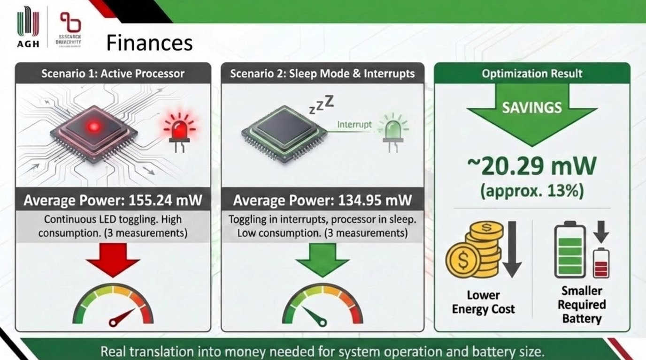
Notes:
Assume that Your company produces thousands of wireless systems whose firmware is written in a sub-optimal energy-efficient way. Your customers complain about short battery life and the competition is ruthless in the technology race. Your company is losing its market position and reputation.

Slide 5
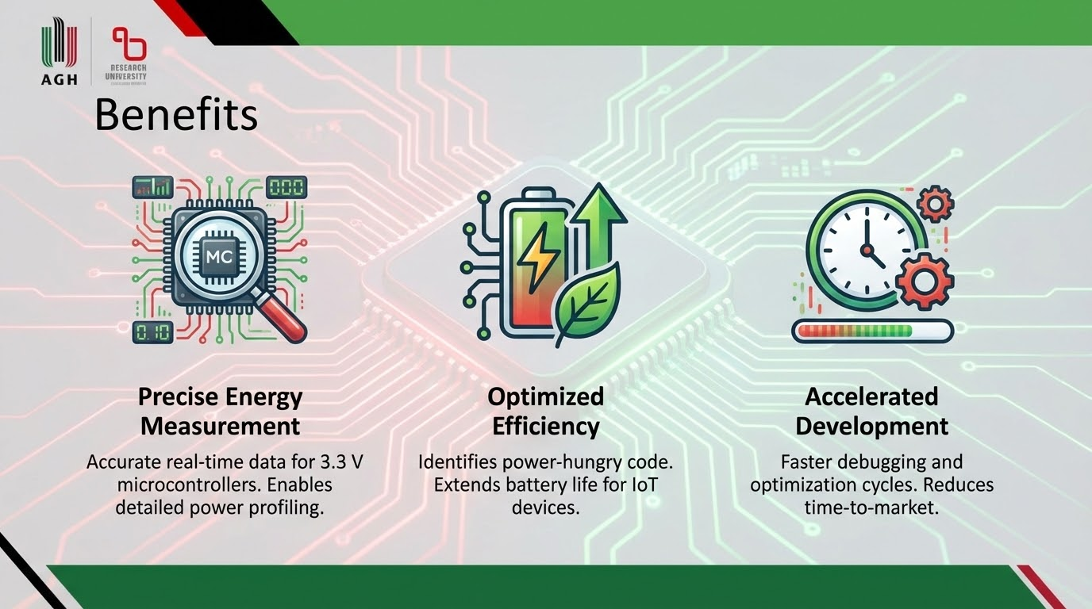
Notes:
Here our solution appears. Now you are able to monitor all of products in case of power efficiency.

Slide 6
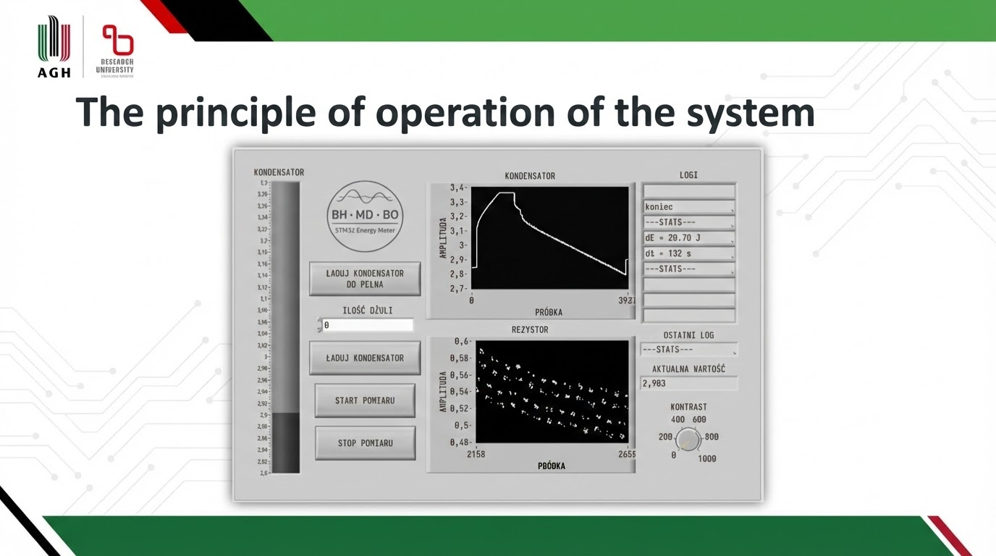

Notes:
To perform the measurement, the capacitor must first be charged to a known energy level or fully charged to 3.3 V. Then the user can start the measurement by supplying the device under test. After a certain period of time, which depends on the power consumption of the MCU under test, an energy consumption report is displayed.

Slide 7


Slide 8
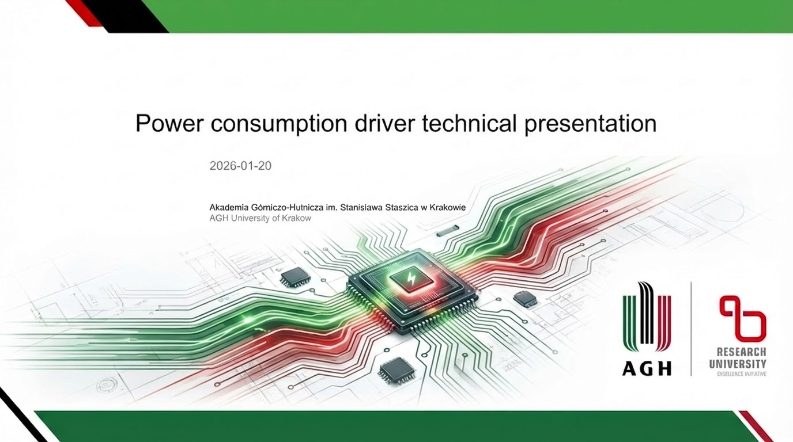

Slide 10

Notes:
To develop the Power consumption driver, we need a testing team. The team should include one electronics engineer and one software engineer. They will be responsible for testing, modernizing, supervising, and maintaining the hardware and software aspects, including PCB management, soldering and software calibration. The team must also maintain clear communication between hardware and software to ensure system integrity.

Slide 11
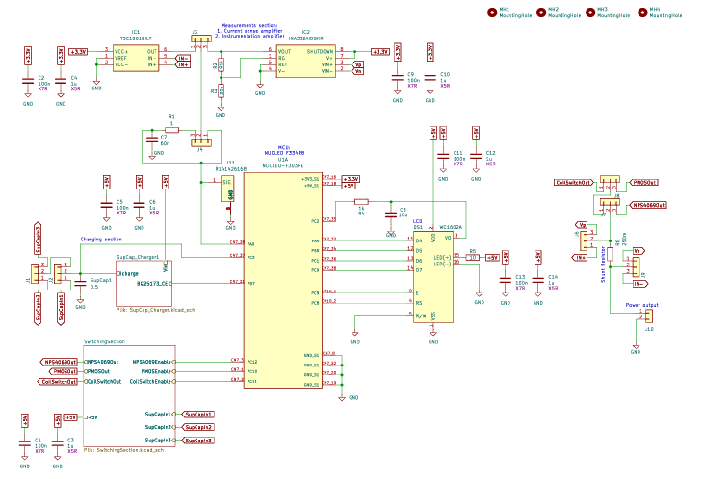
PCB - schematic
Notes:
Schematic of the Power consumption driver PCB.

Slide 12
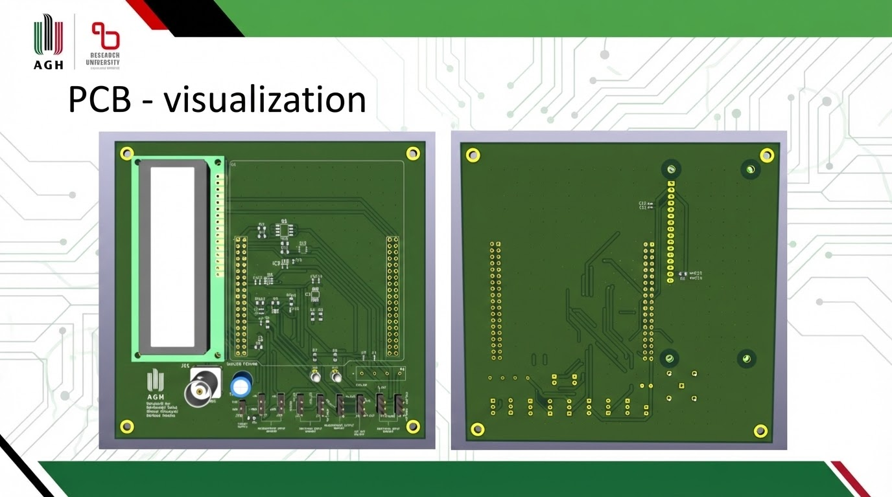
Notes:
Prototype PCB dimensions: 125 x 120 mm

Slide 13
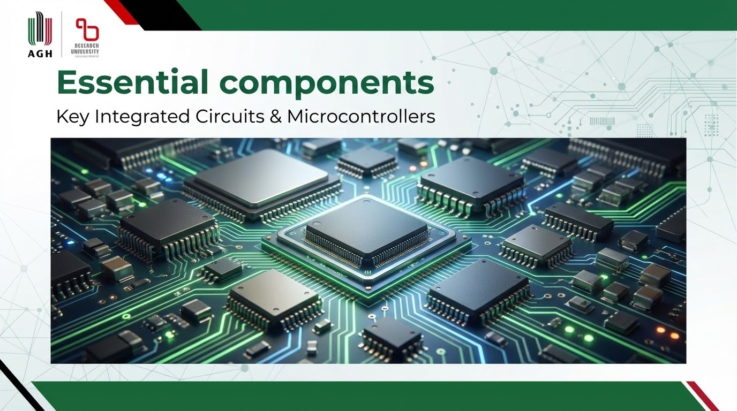
Notes:
In the prototype, we analyzed the system’s behavior depending on the load connection method (3 variants) and the device’s data sampling method (2 variants). Based on the empirically obtained results, we selected the optimal option in each category.

Slide 14
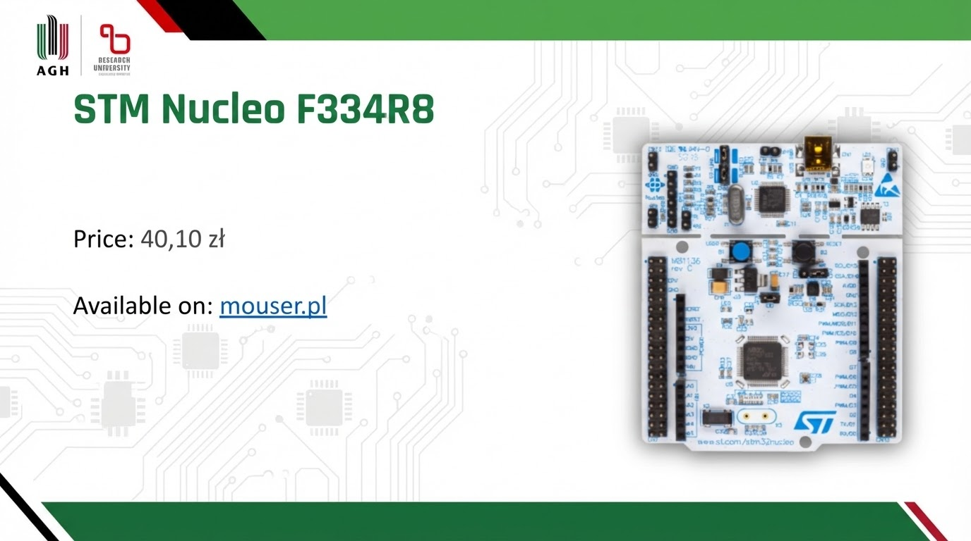
Notes:
The heart of the PCB, archiving data and managing peripherals, is the Nucleo F334R8. The chosen microcontroller is a low-cost option with a built-in programmer and peripherals designed for accurate analog signal measurements.
We use: 2x ADC
5x Timers

Slide 15
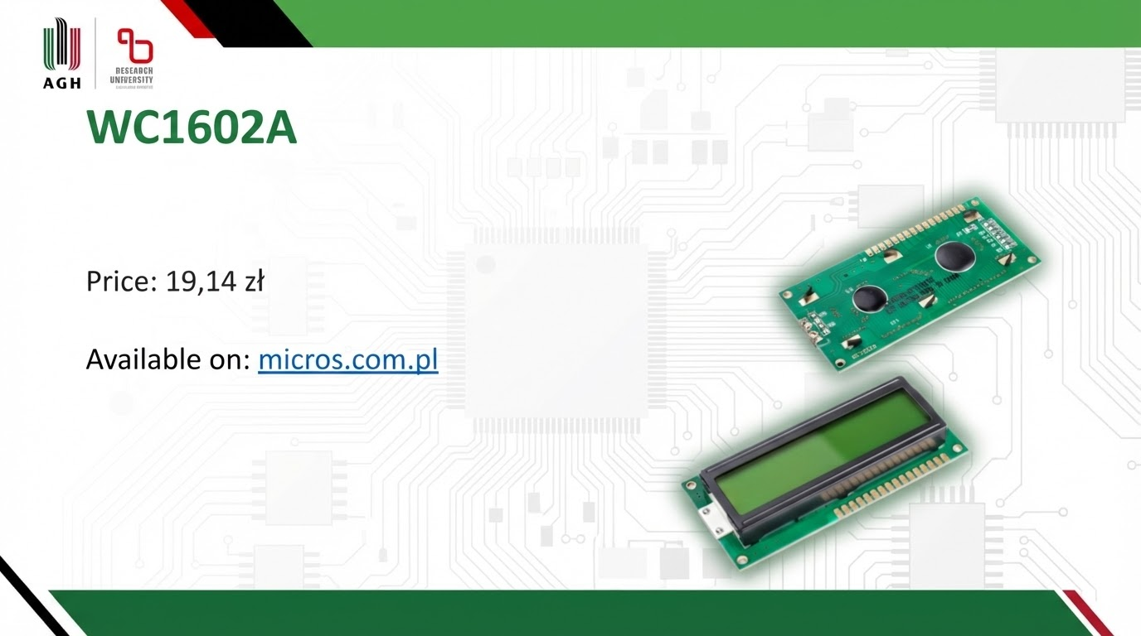
Notes:
A cheap 2x16 character display - the first contact between the machine and the user.

Slide 16
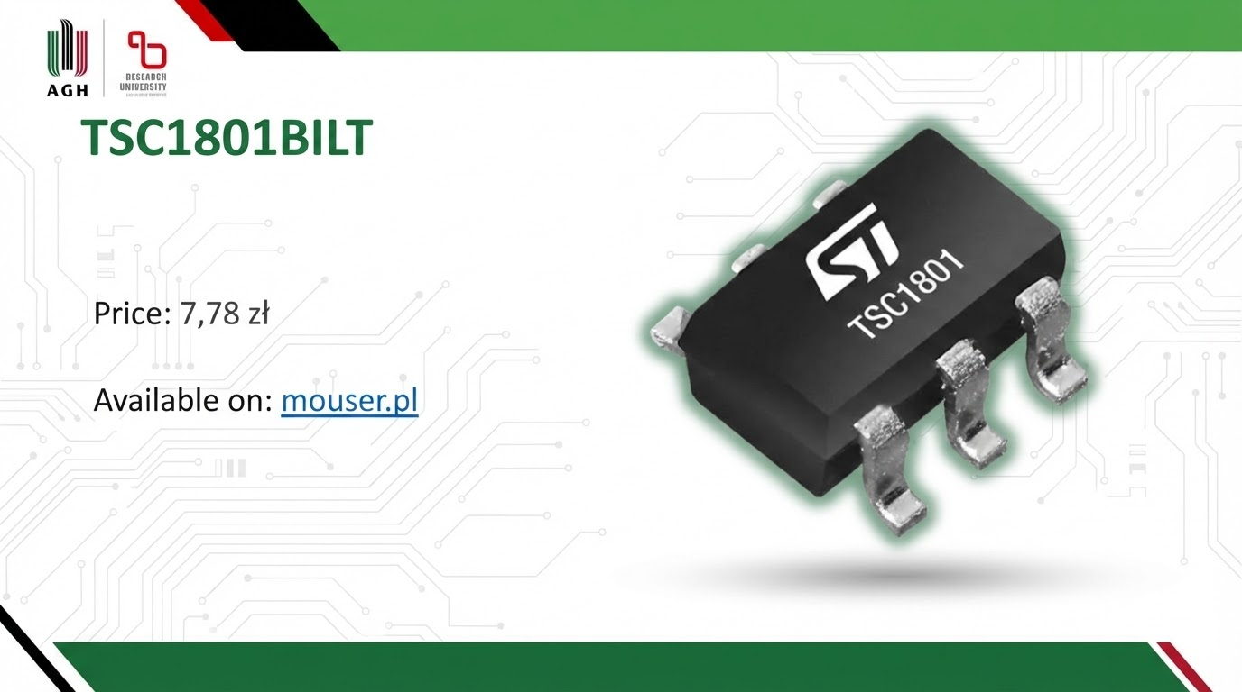
Notes:
A current sense amplifier from STMicroelectronics enables the measurement of small currents (gain ≈ 20 V/V) and allows capturing the dynamics of the supply current flowing into the MCU.

Slide 17
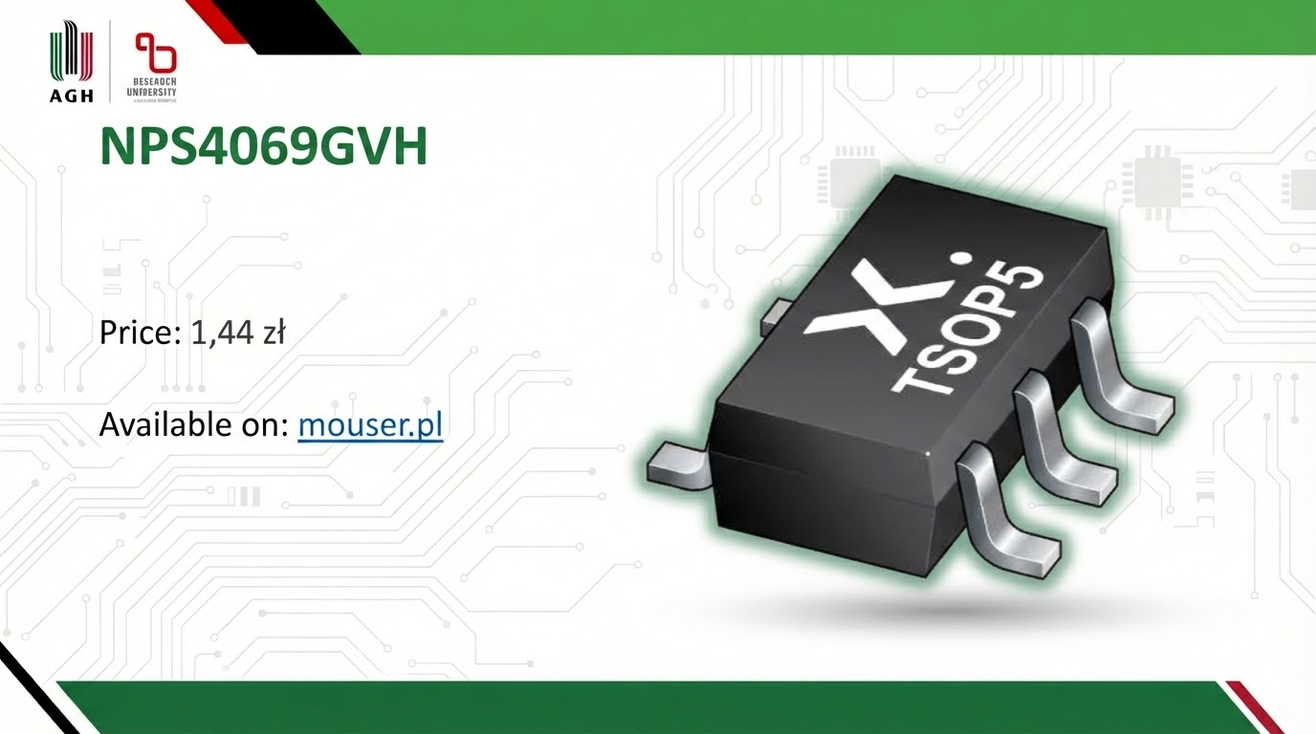
Notes:
The NPS4069 from Nexperia is current switching integrated circuit. It suits the PCB perfectly due to its purpose, cost and dimensions.

Slide 18
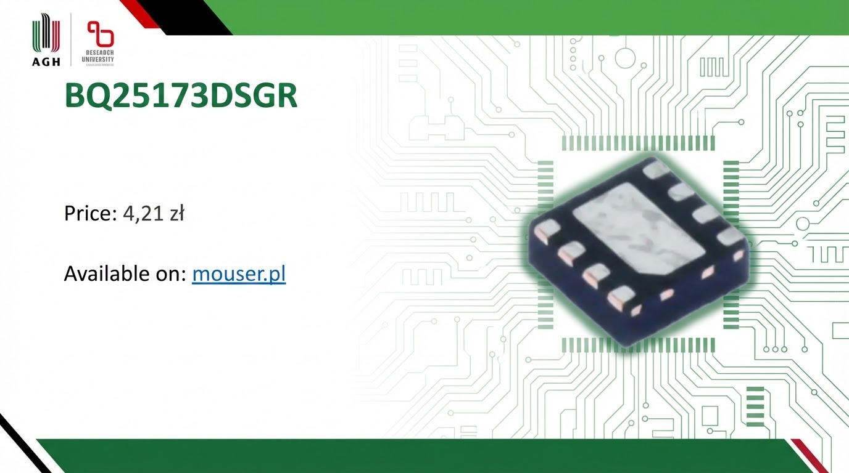
Notes:
Integrated circuit form Texas Instruments designed for charging supercapacitors, in our design the charging current was limited to 200 mA and the output voltage to 3.3 V. The element used is dedicated to work with a microcontroller, which enables easy integration on PCB design.

Slide 19
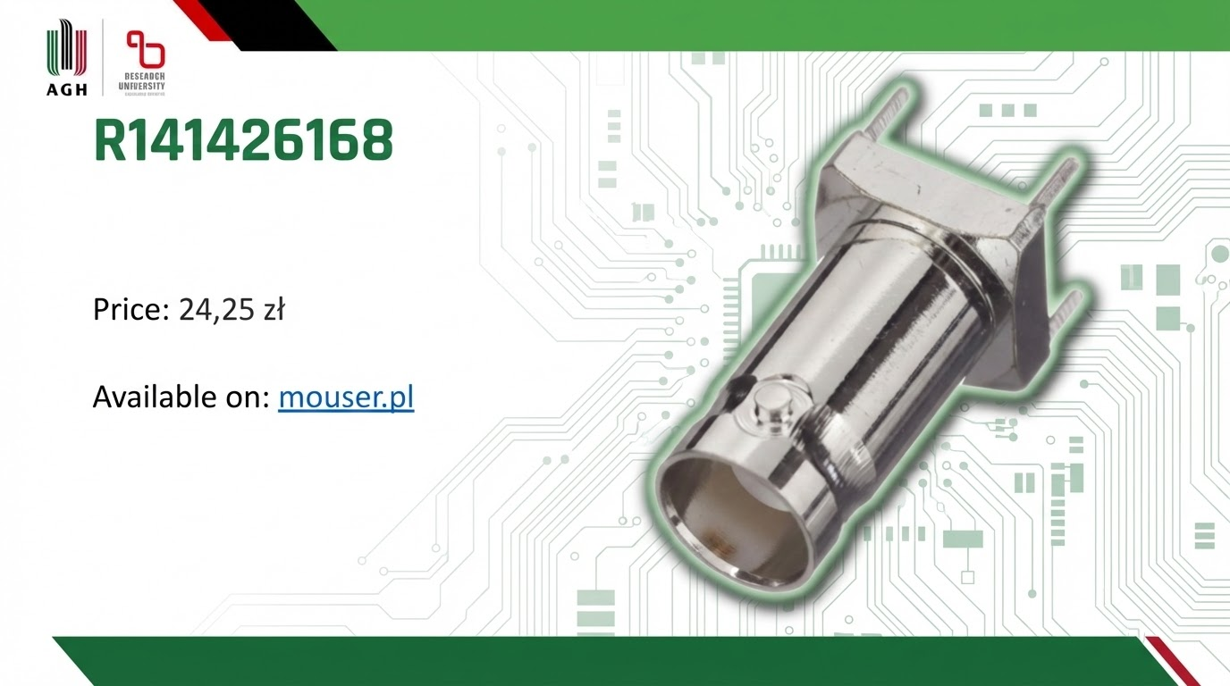

Notes:
Solid radial BNC connector for additional measurement of the current signal using an oscilloscope.

Slide 20
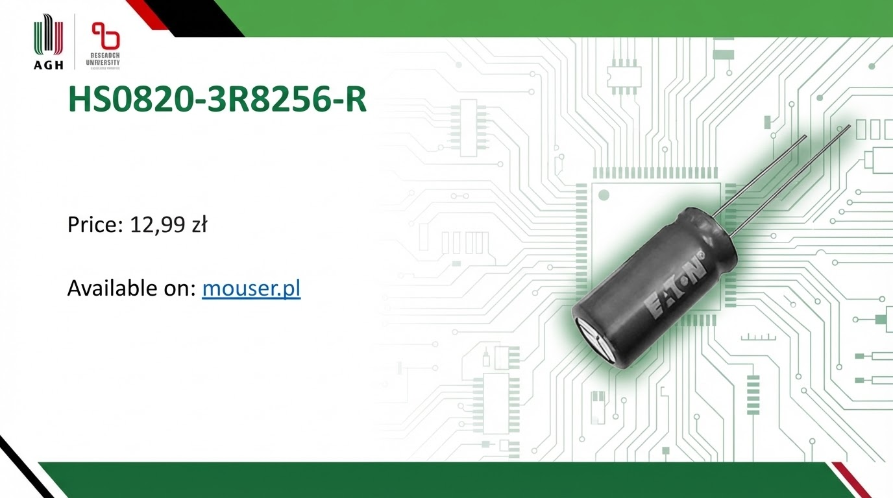
Notes:
25 farads supercapacitor, core target supplier.

Slide 21
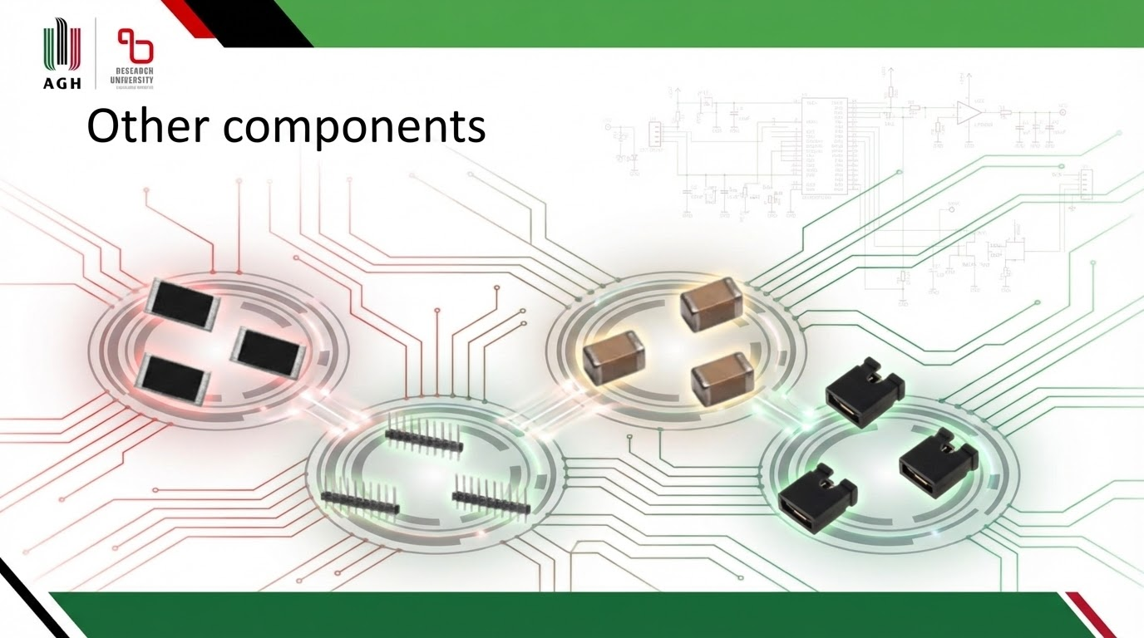
Notes:
Passive components such as E96 series SMD 0805 resistors and 0402 X5R and X7R capacitors for decoupling. Jumpers, male and female goldpins.

Slide 22
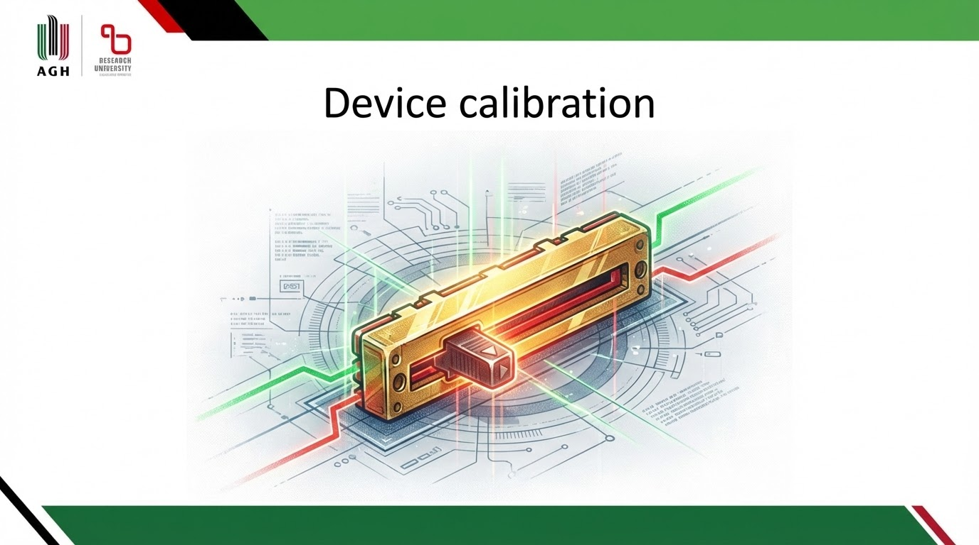
Notes:
For accurate measurement, each system instance must be calibrated individually, due to the variation in the nominal values of the components used. Calibration is performed manually - the hardware team must measure the component values, and then the programmer must set the values of the appropriate variables in the MCU source code.

Slide 23
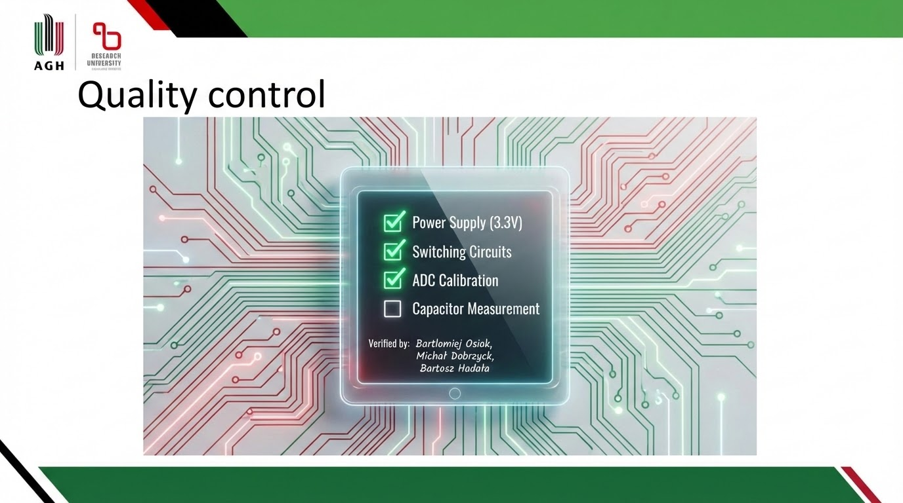

Notes:
To test the device, charge the supercapacitor to its full voltage of 3.3 V. Then discharge it to 0 V and note statistics. After these two steps, recharge the supercapacitor using exactly the same amount of energy. If the capacitor resulting voltage is 3.3 V, the device is ready and properly calibrated.

Slide 24
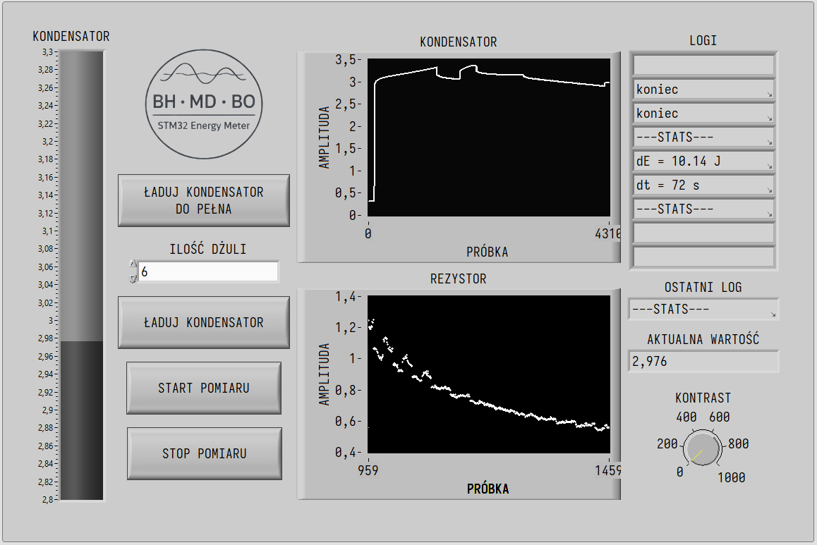


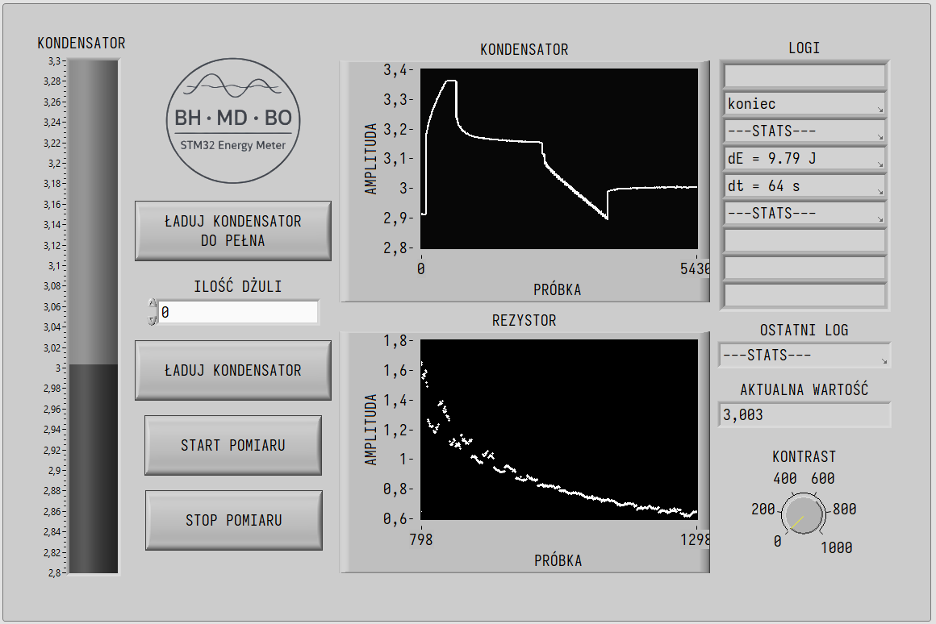
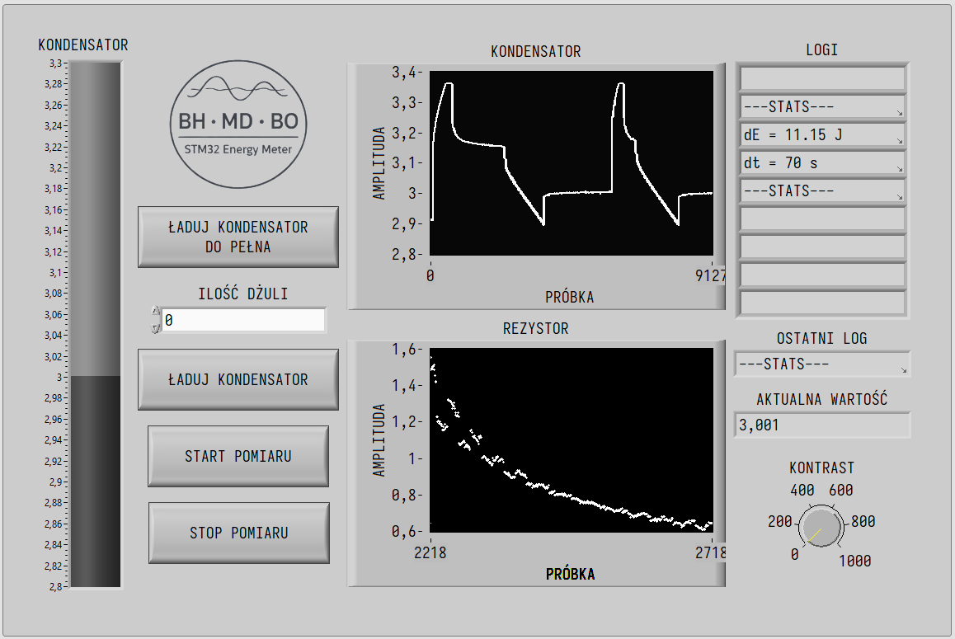
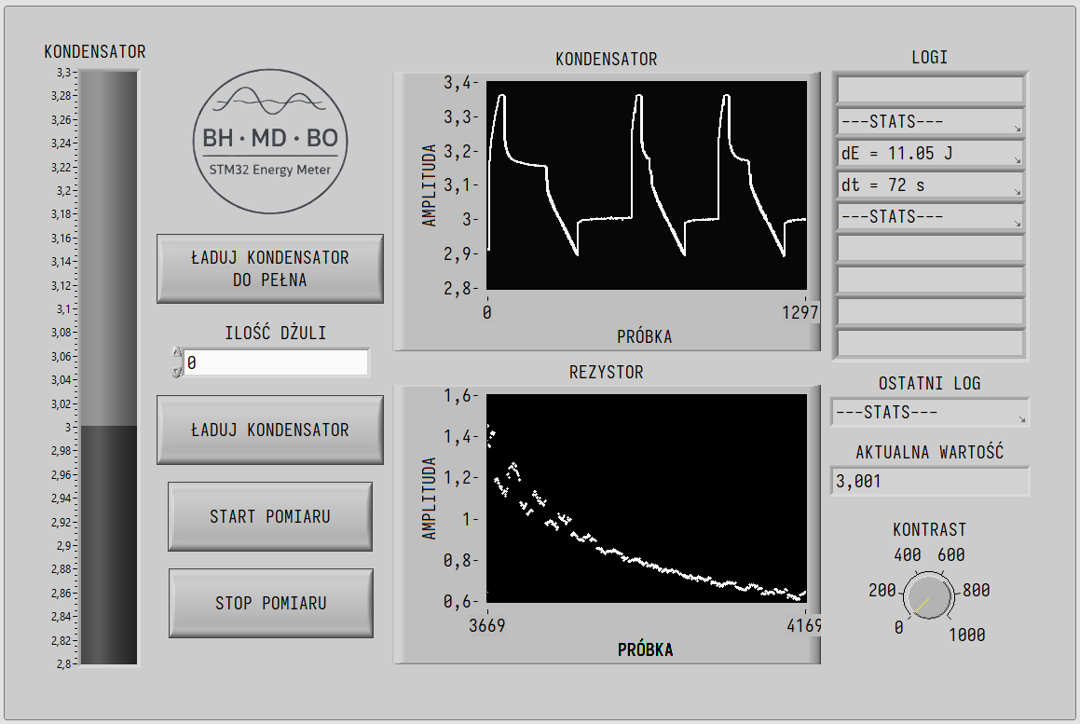
Usage
Notes:
The Power consumption driver enables stable control of the power consumption of microcontroller applications. It allows for quick diagnosis of problems in designed devices and implementation of optimizations. This allows for the dynamic development of IoT projects in a world where technological dominance in the labor market in the shortest possible time is crucial.

