Slide 1
DHCP
Dynamic Host Configuration Protocol

Slide 2
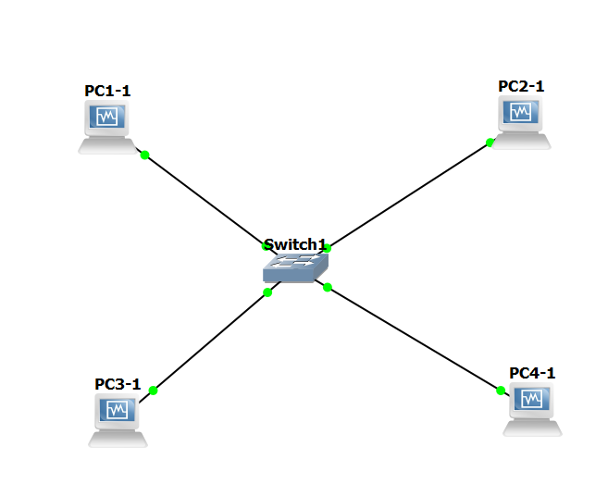
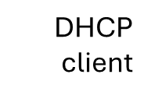
Topology
DHCP server
DHCP
client

Slide 3
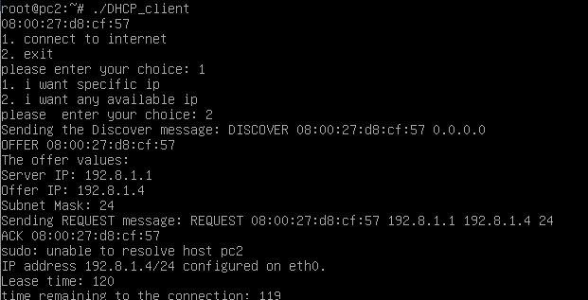
THE PROCESS (client)

Slide 4
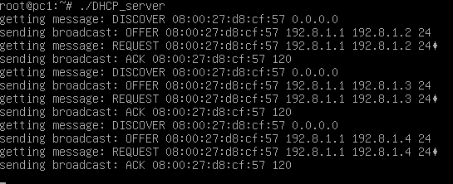
THE PROCESS (server)

Slide 5
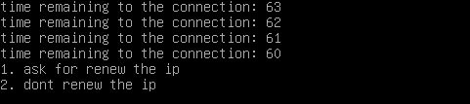
THE PROCESS (client)

Slide 6
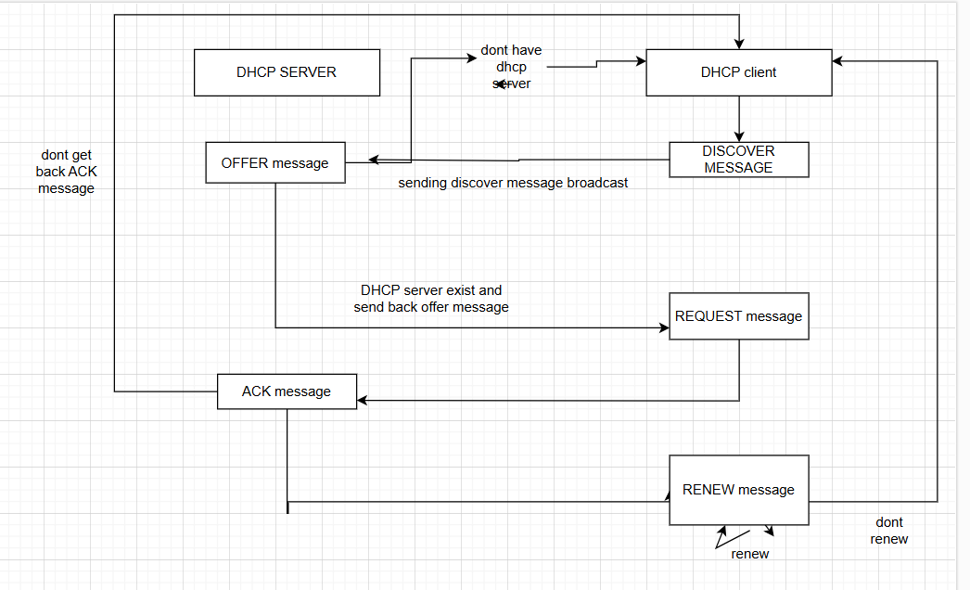
FINAL STATE MACHINE

Slide 7
MESSAGE TYPE AND TIMER
We used broadcast messages
DISCOVER message
OFFER message
REQUEST message
ACK message
RENEW message
Timers we used: lease time (2 min) and recv timer (5 sec)

Slide 8
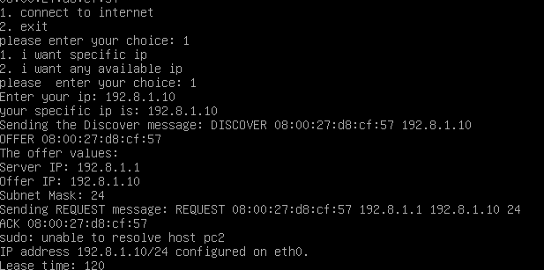
QA – specific ip

Slide 9

QA – server release ip

Slide 10
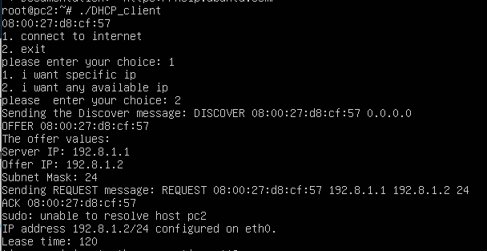
QA – getting the first available ip

Slide 11
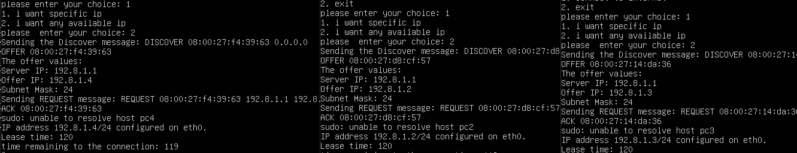
QA connecting multiple pcs

Slide 12
THE END
Thank you for your listening
Lets go to live

