Slide 1
HTTP/3 + QUIC
Bar Binyamin varsulker
ori MEIR kushnir
Lecturer: Robert Iakobashvili

Slide 2
overview
HTTP (Hypertext Transfer Protocol) is an application layer protocol in the Internet protocol suite model for distributed, collaborative, hypermedia information systems
HTTP is the foundation of data communication for the World Wide Web, where hypertext documents include hyperlinks to other resources that the user can easily access, for example by a mouse click or by tapping the screen in a web browser.

Slide 3
HTTP/1.1
HTTP/1 was finalized and fully documented (as version 1.0) in 1996. It evolved (as version 1.1) in 1997 and then its specifications were updated in 1999, 2014, and 2022.
Its secure variant, named HTTPS, is used by more than 85% of websites.
In HTTP/1.0 a separate TCP connection to the same server is made for every resource request.
In HTTP/1.1, a TCP connection can be reused to make multiple resource requests (i.e. HTML pages, frames, images, scripts, stylesheets, etc.). HTTP/1.1 communications therefore experience less latency as the establishment of TCP connections presents considerable overhead, especially under high traffic conditions.

Slide 4
HTTP HEAD-OF-LINE BLOCKING
Each browser/client has a limited number of connections to a server.
New requests over one of those connections must wait for the ones to complete before it can fire it off. The head-of-line requests block the subsequent ones.

Slide 5
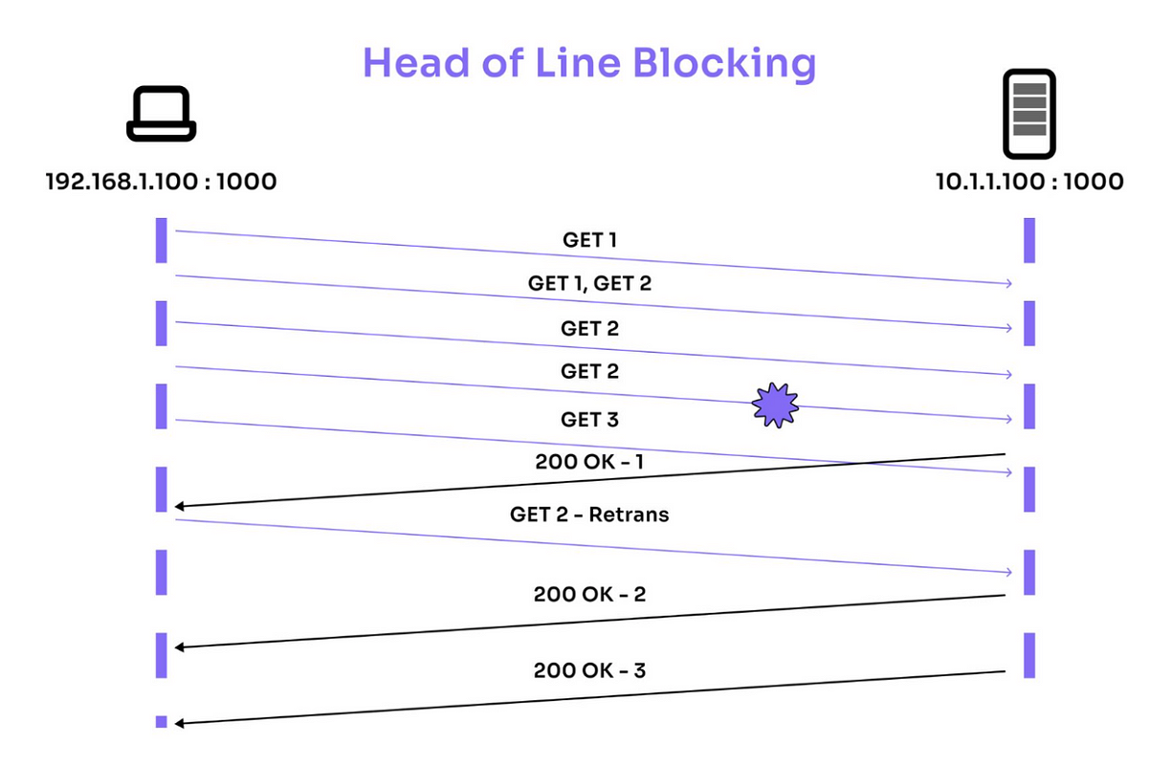

Slide 6
http/2
A revision of previous HTTP/1.1
Maintains the same client–server model and the same protocol methods, but with these differences:
Compressed binary representation of metadata (HTTP headers) instead of a textual one; headers require much less space.
A single TCP connection (usually encrypted) per accessed server domain instead of 2 to 8 TCP/IP connections;
One or more bidirectional streams per TCP connection, in which HTTP requests and responses are broken down and transmitted in small packets to almost solve the problem of HOL (head-of-line) blocking.

Slide 7
http/2
Add a push capability to allow server application to send data to clients whenever new data is available (without forcing clients to request periodically new data to server by using polling methods).
HTTP/2 communications therefore experience much less latency and, in most cases, even higher speeds than HTTP/1.1 communications.

Slide 8
http/2 main disadvantages
Most TCP flavors implemented nowadays ensure data integrity by requiring that packets be processed in order.
Regardless of the TCP flavor, the application layer won't be able to read the results being transmitted until they are received in sequence.
If a packet is lost, subsequent packets must wait until the missing packet is retransmitted and received.
This causes delays and head-of-line blocking in multiplexed connections.
Establishing a TCP connection requires a three- way handshake.

Slide 9
Quic protocol
QUIC (Quick UDP Internet Connections) is a general-purpose transport layer network protocol initially designed by Jim Roskind at Google. It was first implemented and deployed in 2012 and was publicly announced in 2013 as experimentation broadened.
QUIC improves performance of connection-oriented web applications that before QUIC used Transmission Control Protocol (TCP). It does this by establishing a number of multiplexed connections between two endpoints using User Datagram Protocol (UDP)

Slide 10
QUIC key features and aspects
Transport layer protocol, on top of UDP.
Avoids some of the overhead and latency associated with TCP.
QUIC is built to reduce latency:
0-RTT Connection Establishment: QUIC can establish a connection with zero round-trips for repeat connections, significantly speeding up connection setup times.
Multiplexing Without Head-of-Line Blocking: Unlike TCP, where the loss of a single packet can block the delivery of subsequent packets, QUIC allows multiple streams to be sent over a single connection without head-of-line blocking. Packet loss in one stream does not affect the delivery of packets in other streams.
QUIC integrates TLS directly into the protocol, ensuring that connections are encrypted from the outset. This provides enhanced security compared to TCP, which often relies on separate TLS handshakes.

Slide 11
QUIC’S 0-rtt connection establishment
First-time Connections: QUIC minimizes the number of round-trips required to establish a connection by combining the handshake process with the data exchange. The initial connection requires one round-trip to establish the connection and exchange encryption keys.
Repeat Connections: For repeat connections, QUIC supports 0-RTT connection establishment. It uses session resumption mechanisms, allowing data to be sent immediately without waiting for the handshake to complete.

Slide 12
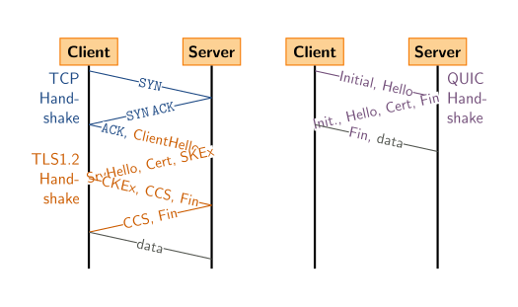
Tcp + tls1.2 vs quic handshake

Slide 13
http/3
The third major version of HTTP.
Uses QUIC protocol.
Uses the same request methods, status codes, and message fields, but encodes them and maintains session state differently.
Has lower latency and loads more quickly when compared with previous versions; in some cases, over four times as fast compared to HTTP/1.1.
As of September 2024, HTTP/3 is supported by more than 95% of major web browsers in use and 34% of the top 10 million websites.

Slide 14
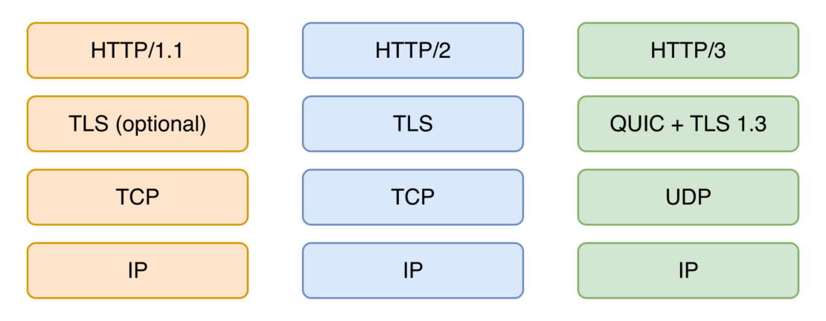

Slide 15
What make it difference from http/2?
Simplifies the TCP 3-way handshake.
Verification process between the client and the server: starts with a request from the client, is acknowledged by the server, and is responded to by the client.
Therefore, HTTP/3 is faster at establishing connections.
Instead of using TCP for each session, HTTP/3 uses QUIC, which upgrades the TCP slow start. This is huge for online gaming and video streaming.

Slide 16
What are the benefits of http/3?
Default encryption: all connections are automatically encrypted, without the traditional TCP handshake and TLS negotiation combination.
Improved performance: HOL blocking is eliminated, which, along with 0-RTT connection establishment, loss recovery simplification, and other changes, improves the connection performance.
Network migration support: connections can move across IP addresses and networks without experiencing interruptions.

Slide 17
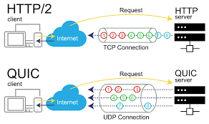

Slide 18
performance
Test methodology:
The test page's complete download time was measured, including all linked assets like fonts, images, CSS, and JS files, but excluding requests initiated by JavaScript code.
The given page was downloaded 50 times in enforced HTTP/3 mode (to ensure that even the first request used HTTP/3) and 50 times with QUIC support disabled.

Slide 19
Performance – continue…
TEST LOCATION
The website under test was hosted in a data center located in Northern Germany. The tests were executed from data centers of Hetzner Cloud (Virginia, US).

Slide 20
performance – continue…
Test results
All values are given in seconds, and they are visualized using a violin type of plot where the shape represents the actual distribution of download times data. 90th percentile means that 10% of download times were slower than the value given. 99th percentile means that 1% of download times were slower than the value given.

Slide 21
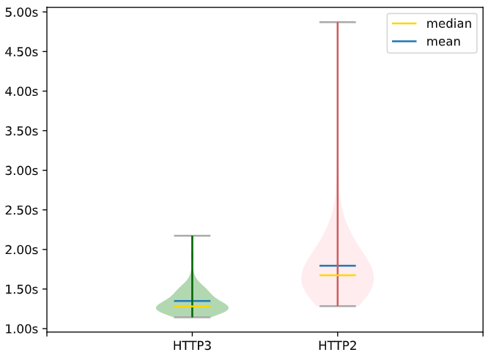
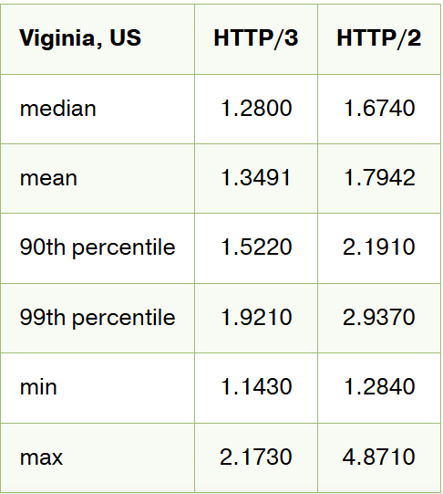

Slide 22
Lab objectives
The lab implements the HTTP/1.1, HTTP/2, and HTTP/3 protocols.
It demonstrates how the QUIC protocol works and how HTTP/3 solves the HTTP head-of-line blocking problem that exists in HTTP/2 and HTTP/1.1.
Additionally, the lab includes a section on SCTP to compare it with QUIC.

Slide 23
references
HTTP – Wikipedia
HTTP/2 – Wikipedia
QUIC – Wikipedia
What is QUIC? Everything You Need to Know | Auvik
HTTP/3 – Wikipedia
HTTP/3: An Introduction to the Next Generation Web Protocol
HTTP/3 - how it performs compared to HTTP/2?

Slide 24
Thank you for your attention!

