Slide 1
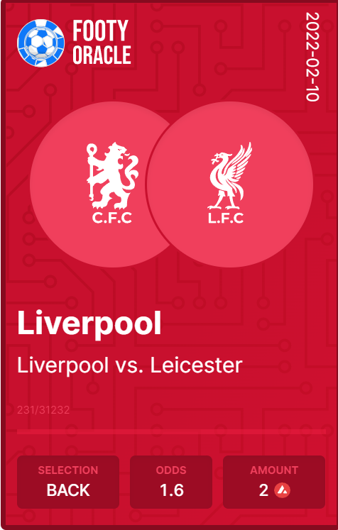
FootyOracle: Prediction Market
Team: FootyOracle
Sree Harsha R
Frank Köhn
Baraa Elalami

Slide 2
Major features
P2P Prediction market for football matches (or anything else)
Convert your bets to NFT to de-risk
DEX plugin with YieldYak
Brand new NFT design
NFT Marketplace
Market Maker for bets where users can add liquidity
Lossless Betting with staking on Benqi / Aave

Slide 3
Technologies we used
Moralis
UI hosting
Cloud functions, Event Sync, Web3 API
Wallet and User interaction
Platform Analytics
Smart contract deployed on AVAX.
YieldYak plugin for DEX.
BENQI/Aave for staking lossless betting.
Chainlink to bring football match results on-chain.
IPFS to store NFT/Bet metadata.

Slide 4
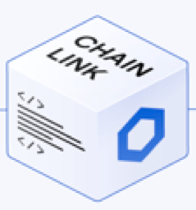

RAPID API Match Data
Moralis
Python Bot
Contract Administration
Raw match data
Bet Result
External Adapter
Match Result
Match Result
Bet Result
VUE JS UI
Raw match data
Chainlink Node
Deployed Smart Contract
Other API Match Data
Random Interface

Slide 5
Section: NFTs, De-risking bets

Slide 6

A week before the big match
FootyOracle: Liverpool vs Leicester
Bob
Place 10 AVAX
Back Liverpool
Potential win: 100 AVAX

Slide 7
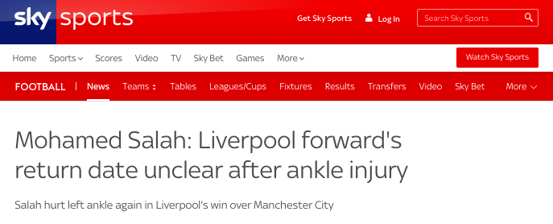
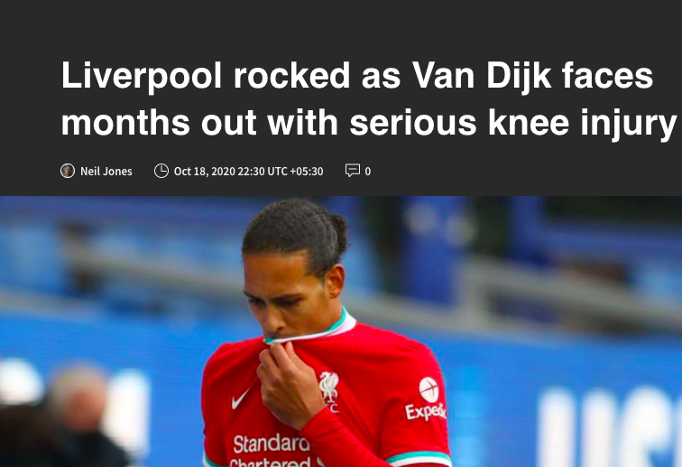
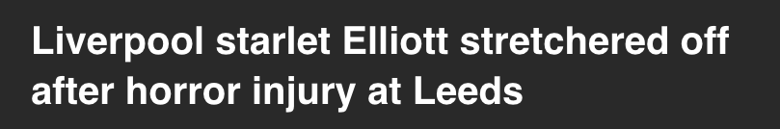
Two days before the match: Liverpool injury crisis
Bob knows Liverpool’s chances of winning are pretty low.
But he is stuck with the bet he made a few days ago
No way to de-risk himself even if he accepts some loss.

Slide 8
Convert Bet to NFT
Bob
FootyOracle Convert Liverpool Bet to NFT
List on Marketplace for 2 AVAX
Convert bet to NFT

Slide 9

Alice buys it on FootyOracle’s NFT Marketplace
2 AVAX

Slide 10
On Matchday: If Liverpool score an unlikely win
FootyOracle
Alice
Redeems NFT she bought for 2 AVAX
Wins 100 AVAX

Slide 11
On Matchday: If Liverpool don’t win
Alice
Alice still owns the NFT

Slide 12
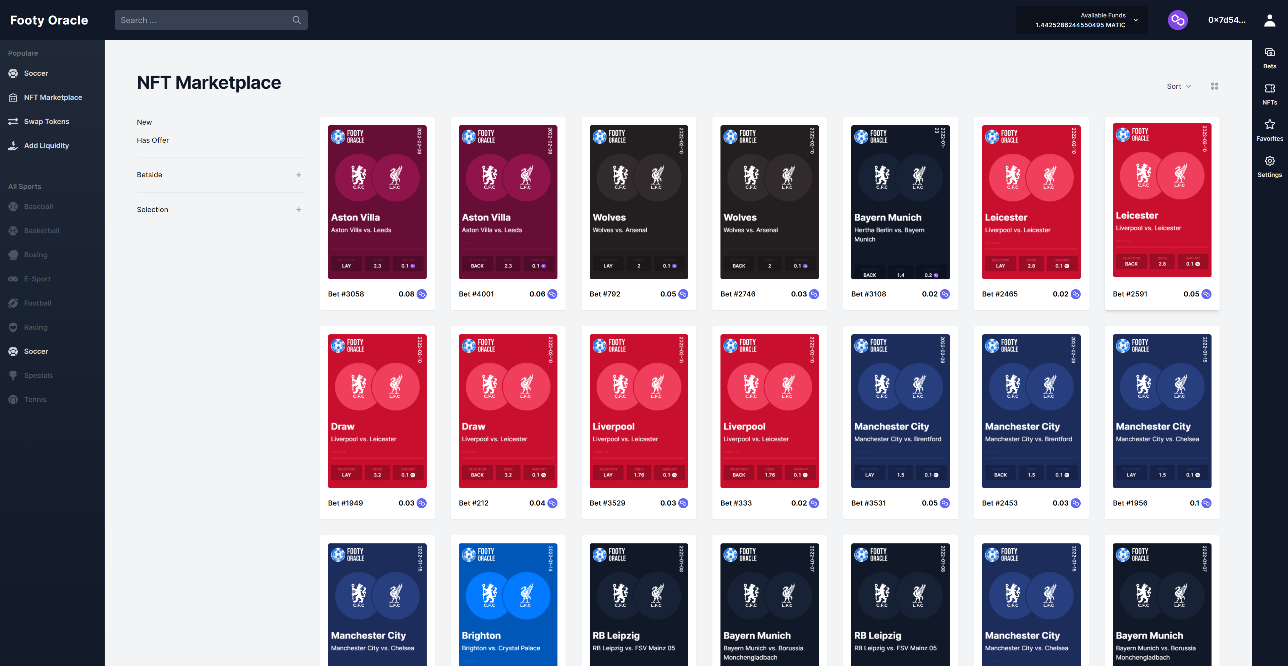
Purchases happen FootyOracle’s NFT Marketplace

Slide 13
YIELDYAK DEX PLUGIN

Slide 14
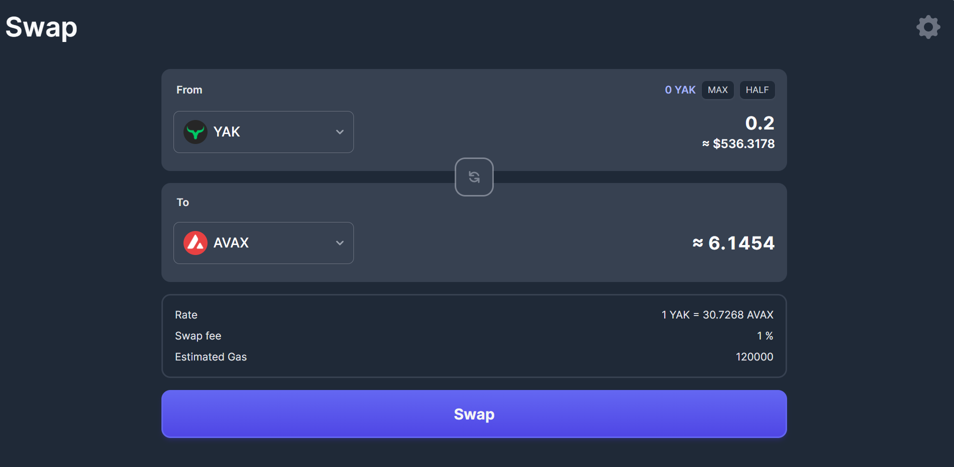
YieldYak DEX
Problem : FootyOracle accepts AVAX, but user’s funds are in USDC / WETH etc.
Solution : FootyOracle’s own YieldYak DEX plugin.
Users can exchange tokens for AVAX and use it on the platform.
Currently running on Mainnet-fork.

Slide 15
Lossless Betting with Staking on Benqi

Slide 16
Lossless Betting with Staking on Benqi
Problem: User is new to prediction markets and apprehensive about losing funds.
Solution: Lossless betting.
Deposited funds will be staked on Benqi.
One winner will get the interest from staking. (Similar to Pooltogether)

Slide 17
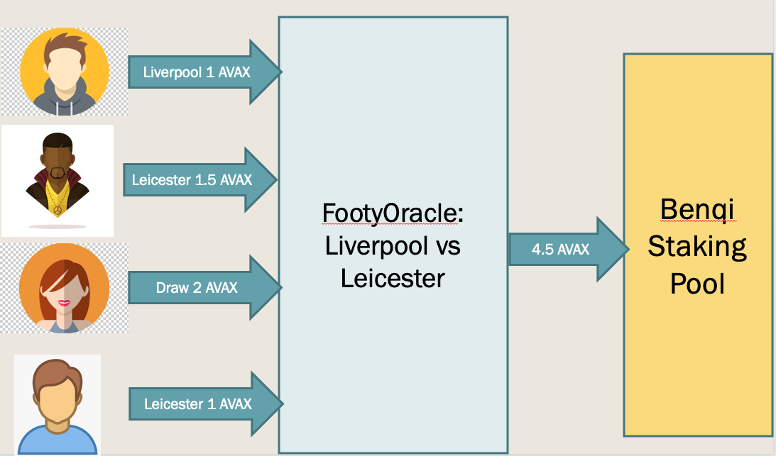
Lossless Betting: Placing Bets

Slide 18
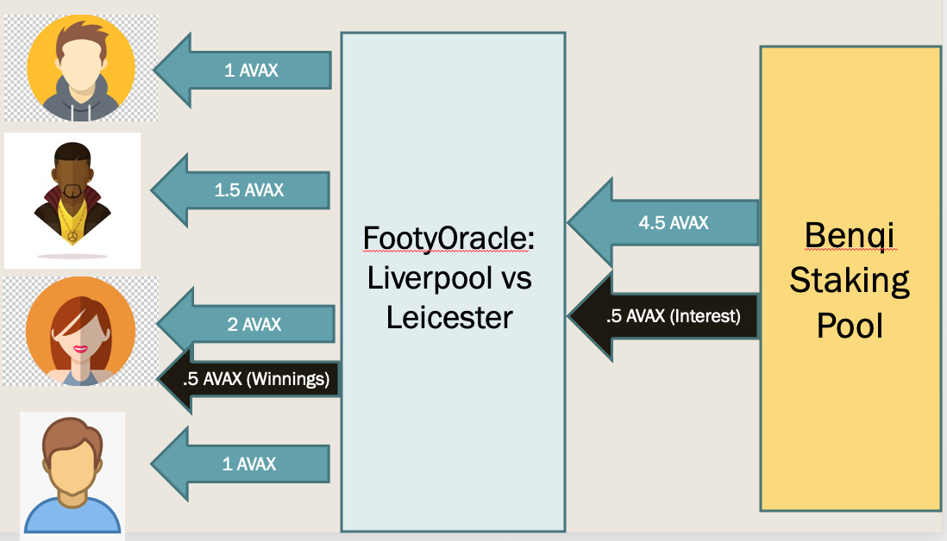
Lossless Betting: After Match Result

Slide 19
Market Maker and Liquidity Pool

Slide 20
Market Maker and Liquidity Pool
Problem: P2P Betting will have bets that are unmatched.
Solution: A Market Maker that will take the opposing side only if the odds are favorable.
Funds will come from a Liquidity Pool.
Users providing liquidity will be issue LP NFTs which can be traded.
Some portion of the funds will be deposited in Benqi to ensure minimum returns.

Slide 21
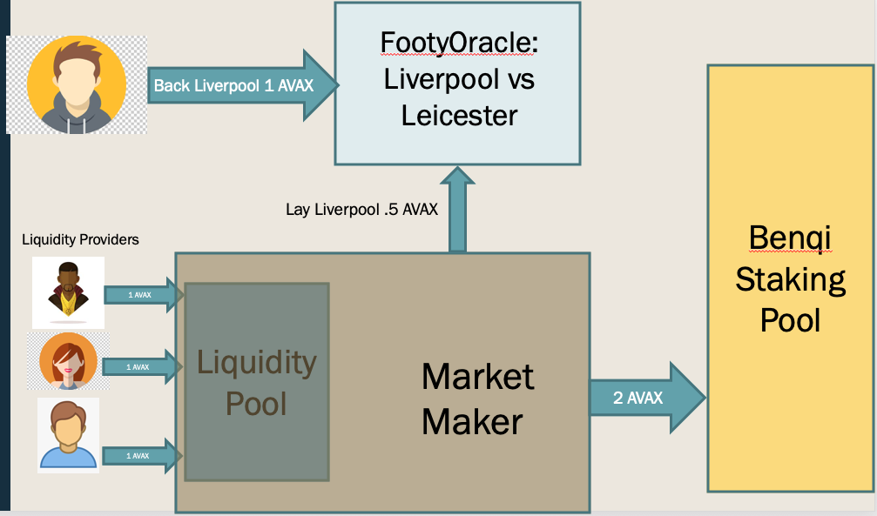
Market Maker and Liquidity Pool

Slide 22
Advantages of Market Maker
For Bettor:
No more unmatched bets (at least for some odds)
Small bets but reasonable wins
For LP token holders:
Potential for higher returns than Aave / Benqi staking.
Trade LP tokens. A secondary market on the NFT Marketplace.
For Platform:
No more unmatched bets.
LP tokens are NFTs, more potential for NFT Marketplace trading, more fees.
Completely separate contract with little or no need to change existing code.

Slide 23
Footy Token

Slide 24
Utility of Footy Token
For Exchange:
Paying less fees on trades
For Lossless betting:
Boosting chance for winning the prize
More:
Integrating with social tokens
Staking/holding FC Porto token and Footy token = Eligibility of prizes from club ( tickets, merch … )

Slide 25
Distribution of Footy Token
Yield Farming Incentives:
Earning tokens for participating in lossless betting
Earning tokens for betting ( e.g 10 footy tokens for each 1 Eth of fees paid)

