Slide 1
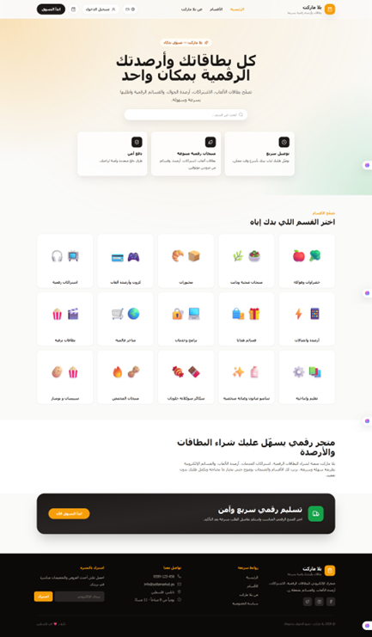
YallaMarket
Full‑Stack Digital Marketplace
Software Engineering Final Presentation
React + Vite + Tailwind
Express.js + SQLite
JWT Auth
Stakeholder | Description
Guest | Unauthenticated visitor browsing the storefront.
Registered User | Customer with an account.
Admin | Store manager/operator.
Development Team | Students building and documenting the system.
Instructor / Evaluator | Software Engineering course reviewer.
An‑Najah National University • Computer Science Apprenticeship
Team: Baraa Masri, Hamed Bizreh, Yahya Zyoud
Instructor: Dr. Firas Shakaa • Second Semester
Final storefront screenshot
YallaMarket • Software Engineering Final Presentation

Slide 2
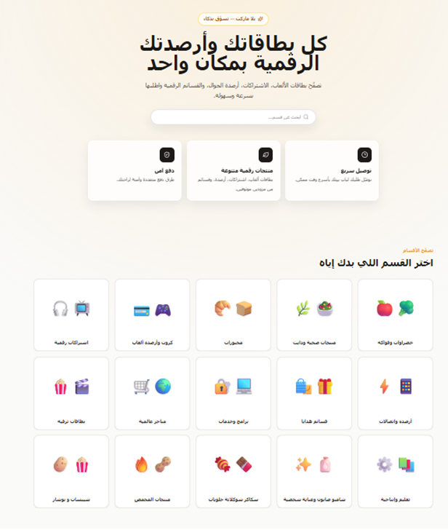
Executive Snapshot
02
WHAT WE BUILT AND DELIVERED
YallaMarket is a bilingual marketplace for digital products and online services, implemented as a complete full‑stack university Software Engineering project.
• Frontend: React, Vite, Tailwind CSS, React Router, Context API • Backend: Express.js REST APIs with SQLite persistence • Authentication: JWT-based login and protected admin endpoints • Process evidence: SRS, UML/ERD, QA report, Jira sprints, GitHub collaboration
20
5
50
11
manual test cases
documented sprints
commits shown
branches shown
Homepage and category entry points
YallaMarket • Software Engineering Final Presentation

Slide 3
Problem & Project Goals
03
WHY THE SYSTEM MATTERS
Problem
Solution
Academic Goal
Users need a simple, bilingual, and responsive way to browse and order digital products such as cards, balances, subscriptions, and online services.
YallaMarket provides a clean storefront, cart, checkout flow, authentication, and admin management supported by a real Express/SQLite backend.
Demonstrate a full Software Engineering lifecycle: requirements, design, implementation, testing, Agile tracking, version control, and final proof of work.
Final delivery focus
Scope note
• Polished implementation rather than major redesign • Professional documentation and QA evidence • Clear Jira + GitHub proof of collaboration • Reliable video demo flow for the final presentation
The project supports payment method selection, but real payment gateway integration is documented as a future enhancement.
YallaMarket • Software Engineering Final Presentation

Slide 4
Requirements Coverage
04
FUNCTIONAL AND NON-FUNCTIONAL SCOPE
✓
Browse Categories
Homepage category entry points and navigation
✓
Product Catalog
Category products, search/filter, product details
✓
Cart
Add, update, remove, totals, localStorage persistence
✓
Checkout
Customer information, delivery info, payment method, order submission
✓
Authentication
Register, login, logout, JWT-based protected APIs
✓
Admin Dashboard
Products, categories, orders, and dashboard statistics
✓
Localization
Arabic/English language switch with RTL/LTR layout
✓
Quality
Manual QA report, Jira bug tracking, GitHub evidence
Coverage message:
The implemented system matches the SRS core scope and documents remaining limitations transparently.
YallaMarket • Software Engineering Final Presentation

Slide 5
System Architecture
05
THREE-LAYER FULL-STACK DESIGN
Presentation Layer
React + Vite + Tailwind CSS + React Router
Key Architecture Decisions
UI rendering, routing, RTL/LTR, product browsing, cart, checkout
• Reusable components and service modules • Centralized cart/auth/language contexts • Server-side order total and stock validation • Admin endpoints protected by JWT and role checks • Cart remains client-side until checkout
Application Layer
Express.js + controllers + middleware
REST APIs, validation, authentication, protected admin actions
Data Layer
SQLite + relational tables
Persistent storage for users, products, categories, orders, order items
YallaMarket • Software Engineering Final Presentation

Slide 6
06
HOMEPAGE, CATEGORIES, AND PRODUCT BROWSING
Web Site Demo
Demo points: search within categories, browse products, view prices/stock, and add available items to the cart.
YallaMarket • Software Engineering Final Presentation

Slide 7
System Design Models
08
High level Architecture Diagram
YallaMarket • Software Engineering Final Presentation

Slide 8
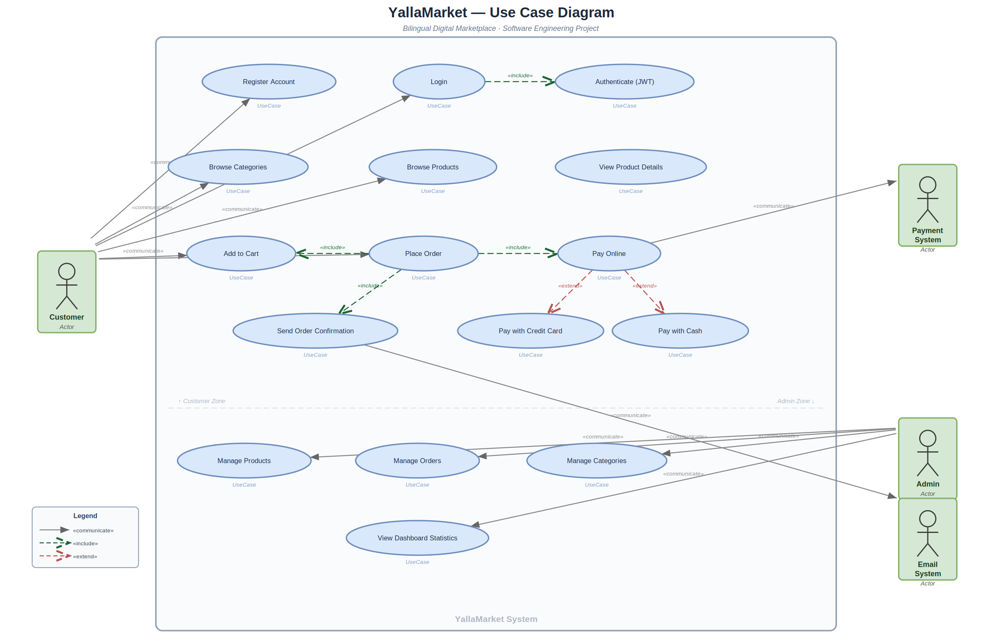
System Design Models
08
USE CASE DIAGRAM
YallaMarket • Software Engineering Final Presentation

Slide 9
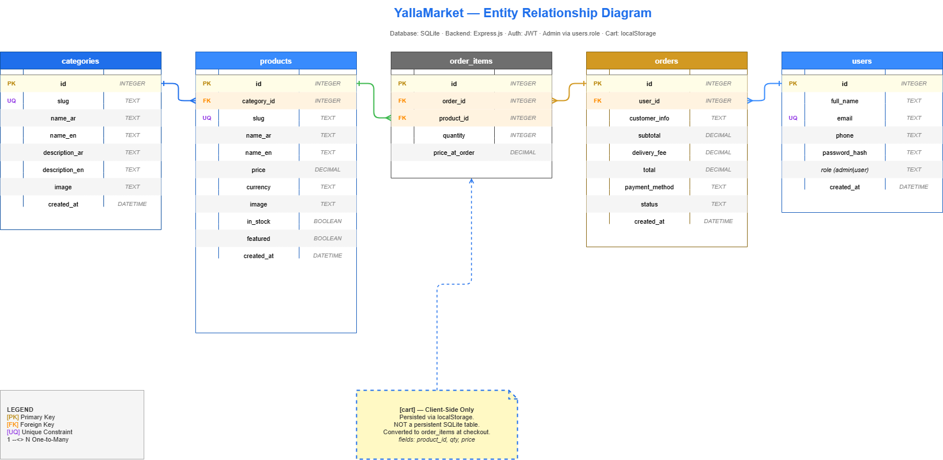
Database Design
09
ERD AND PERSISTENCE STRATEGY
Core Entities
• users: account, password hash, role • categories/products: catalog structure • orders/order_items: checkout persistence • cart: client-side only, persisted in localStorage
Design note
SQLite was selected to keep the backend lightweight, portable, and suitable for academic demonstration.
YallaMarket • Software Engineering Final Presentation

Slide 10
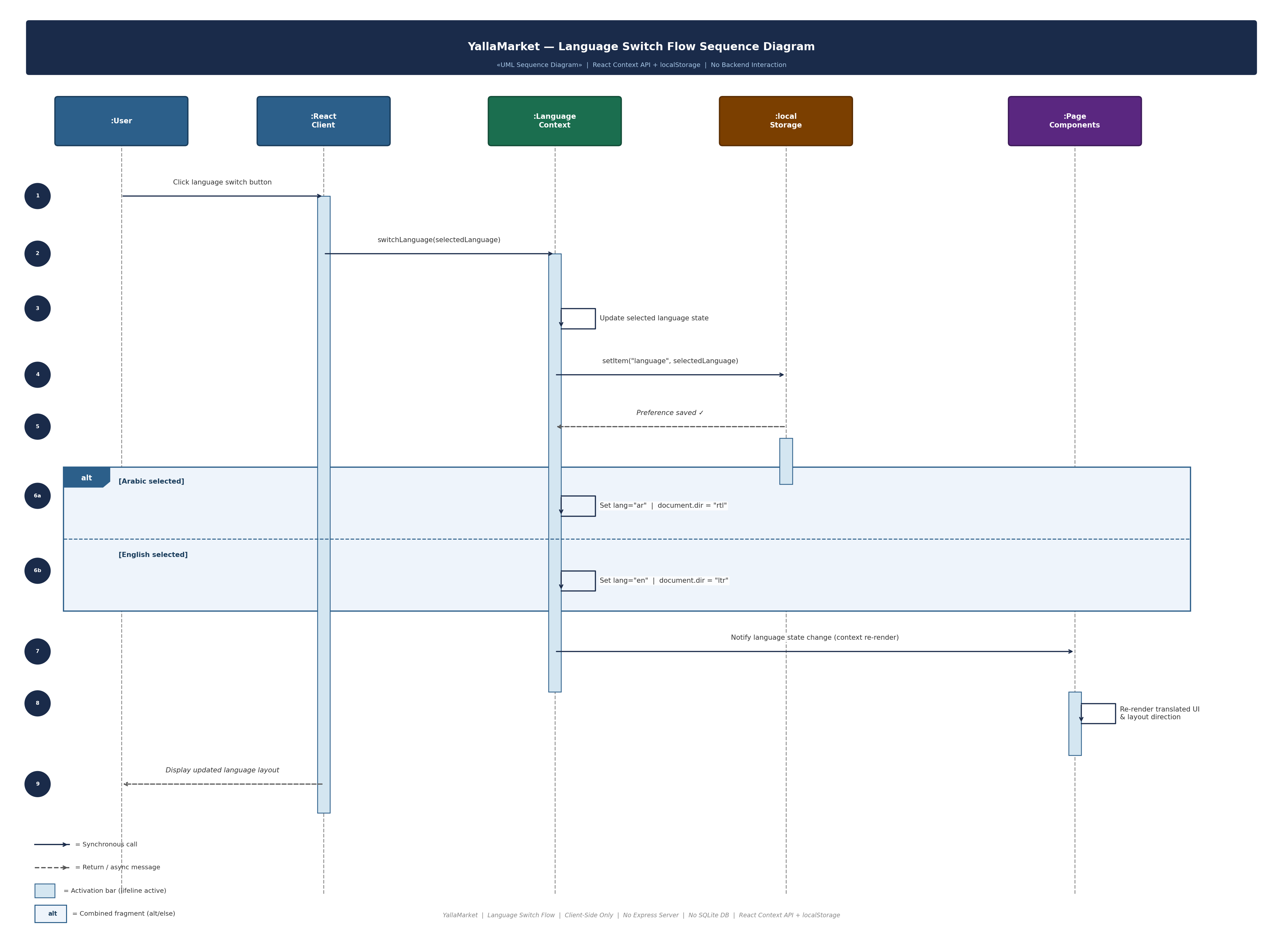
Behavioral Design
10
SEQUENCE DIAGRAMS FOR LANGUAGE SWITCH FLOW
Language switch flow
The diagram connect UI behavior to contexts, services, localStorage, Express APIs, JWT checks, and SQLite persistence.
YallaMarket • Software Engineering Final Presentation

Slide 11
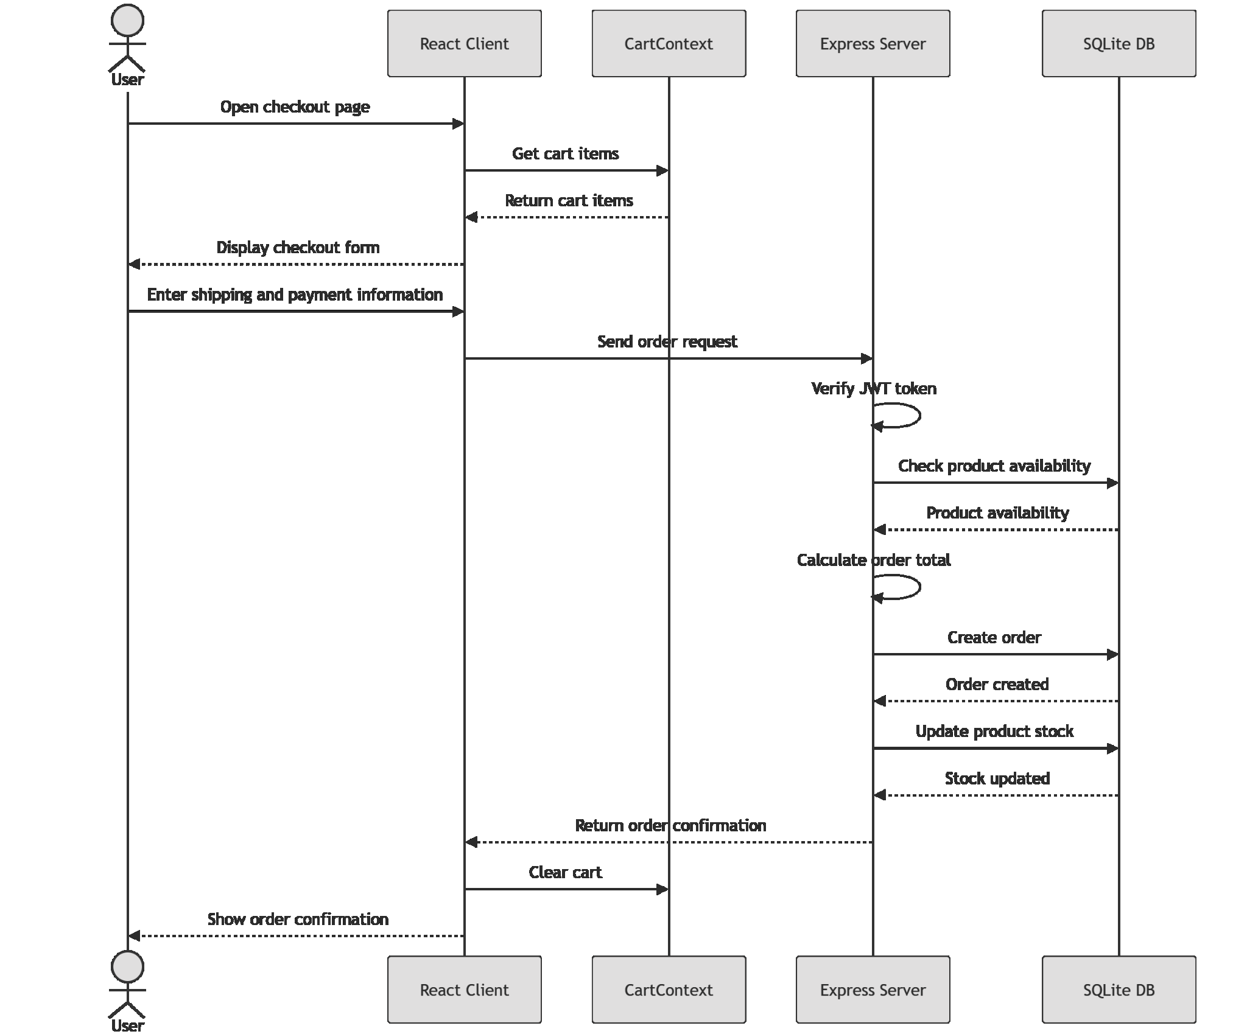
Behavioral Design
10
SEQUENCE DIAGRAMS FOR LANGUAGE SWITCH FLOW
Checkout Flow
The diagram connect UI behavior to contexts, services, localStorage, Express APIs, JWT checks, and SQLite persistence.
YallaMarket • Software Engineering Final Presentation

Slide 12
Behavioral Design
10
SEQUENCE DIAGRAMS FOR LANGUAGE SWITCH FLOW
Class diagram
The diagram connect UI behavior to contexts, services, localStorage, Express APIs, JWT checks, and SQLite persistence.
YallaMarket • Software Engineering Final Presentation

Slide 13
Implementation Highlights
11
MAIN MODULES AND API COVERAGE
Frontend Structure
Backend Structure
State & Storage
Pages for home, category, product, cart, checkout, login/register, and admin screens. Components include ProductCard, CartItem, QuantitySelector, OrderSummary, Layout, and Toast.
Express app with routes/controllers for auth, categories, products, orders, admin dashboard, and newsletter. Middleware protects authenticated and admin-only actions.
LanguageContext manages RTL/LTR; CartContext persists cart in localStorage; AuthContext stores JWT and user session information.
Representative API endpoints
GET /api/categories
GET /api/products
POST /api/auth/login
POST /api/orders
GET /api/orders
PUT /api/orders/:id/status
YallaMarket • Software Engineering Final Presentation

Slide 14
Quality Assurance
12
MANUAL TESTING AND FINAL QA SPRINT
20
4
100%
Sprint 5 Bugs Closed
manual test cases
bugs verified
final pass status
• SCRUM-127: cart total update • SCRUM-128: checkout validation clarity • SCRUM-129: RTL/LTR consistency • SCRUM-130: invalid route fallback
Test Coverage
• Home/categories/product browsing • Cart operations and persistence • Authentication and route protection • Checkout and order submission • Admin dashboard and order status updates • Localization and fallback handling
All final QA bugs were moved to Done and documented as resolved/verified.
YallaMarket • Software Engineering Final Presentation

Slide 15
We prepared a complete manual QA report including:
20 manual test cases
execution results
Jira bug tracking
requirements traceability matrix
and final QA verification. And show him the document

Slide 16
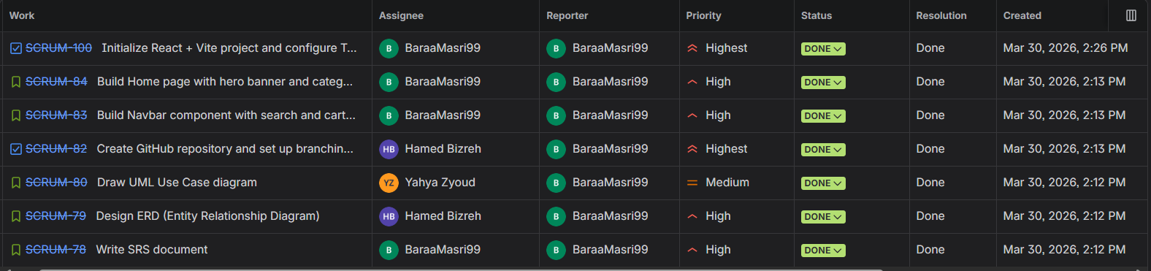
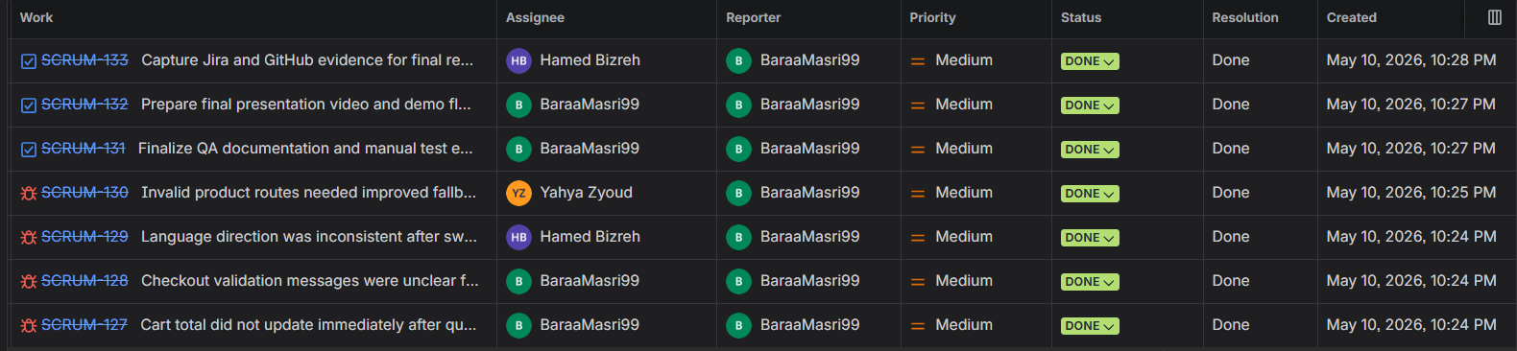
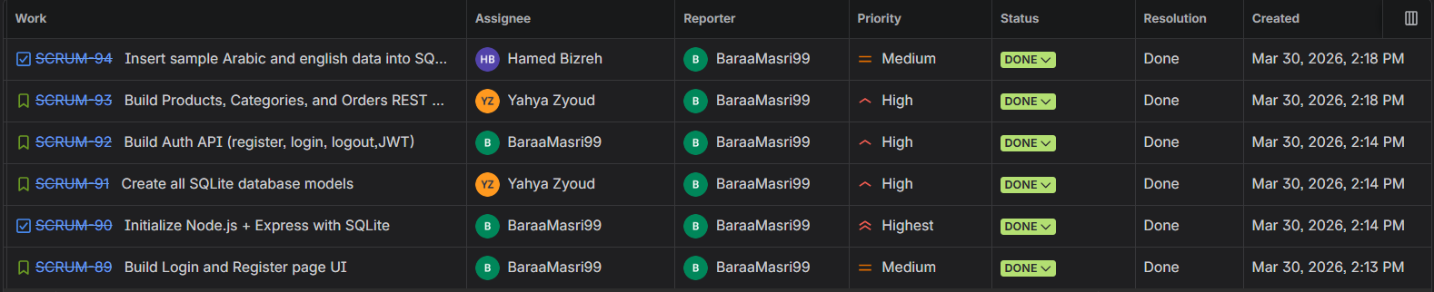
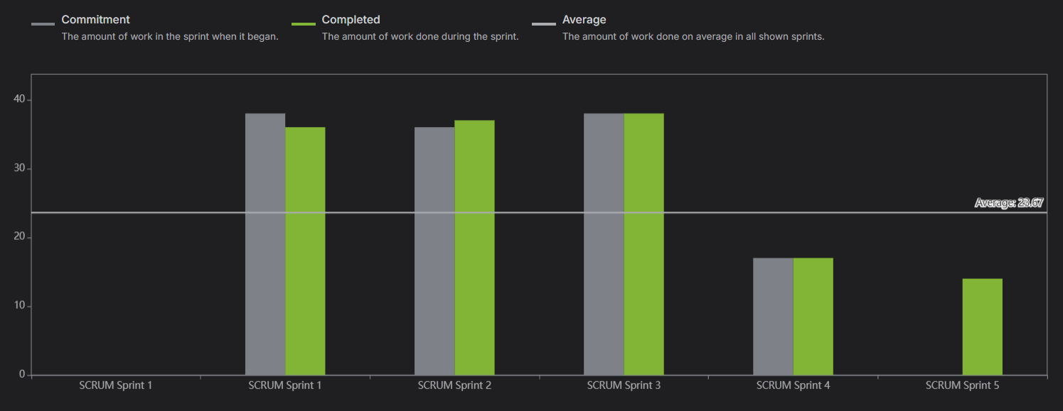
Agile Project Management
13
JIRA SPRINT EVIDENCE AND VELOCITY
Sprint 1: setup, SRS, home, navigation, diagrams
Sprint 5: final QA, bugs, documentation, evidence
Sprint 3: backend, SQLite models, auth, sample data
Velocity report: iterative delivery across sprints
Jira evidence demonstrates backlog management, sprint planning, bug tracking, task ownership, and completion status.
YallaMarket • Software Engineering Final Presentation

Slide 17
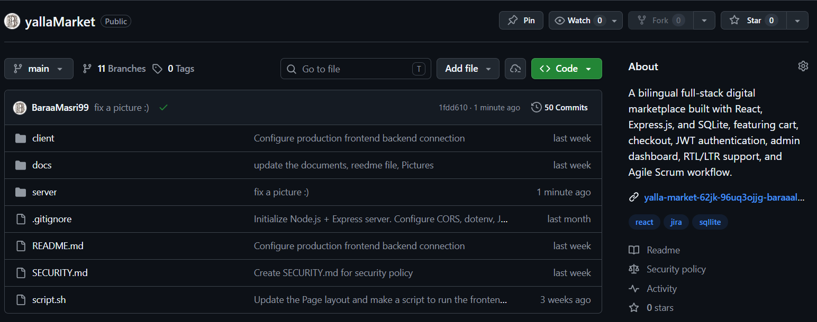
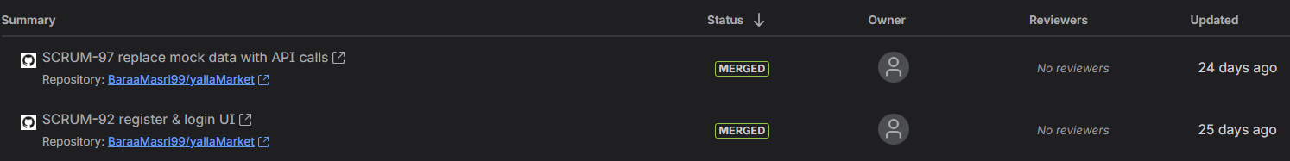
Version Control & Collaboration
14
GITHUB REPOSITORY AND JIRA-LINKED WORK
Repository
github.com/BaraaMasri99/yallaMarket
46 commits • 11 branches • final source ZIP ready
GitHub repo
Merged PRs linked with Jira issues
Collaboration message: Jira issues defined the work, GitHub branches/commits/PRs provided traceable implementation evidence.
YallaMarket • Software Engineering Final Presentation

Slide 18
Final Submission
YallaMarket demonstrates a complete software engineering process: requirements, design, implementation, QA, Agile tracking, GitHub collaboration, and proof-of-work demo.
✓
Final Report PDF
✓
QA Report
✓
PPTX Presentation
✓
Video Demo
✓
GitHub URL + ZIP
✓
Jira Evidence
Thank You Dr.Firas
Baraa Masri • Hamed Bizreh • Yahya Zyoud
YallaMarket • Software Engineering Final Presentation

