Slide 1
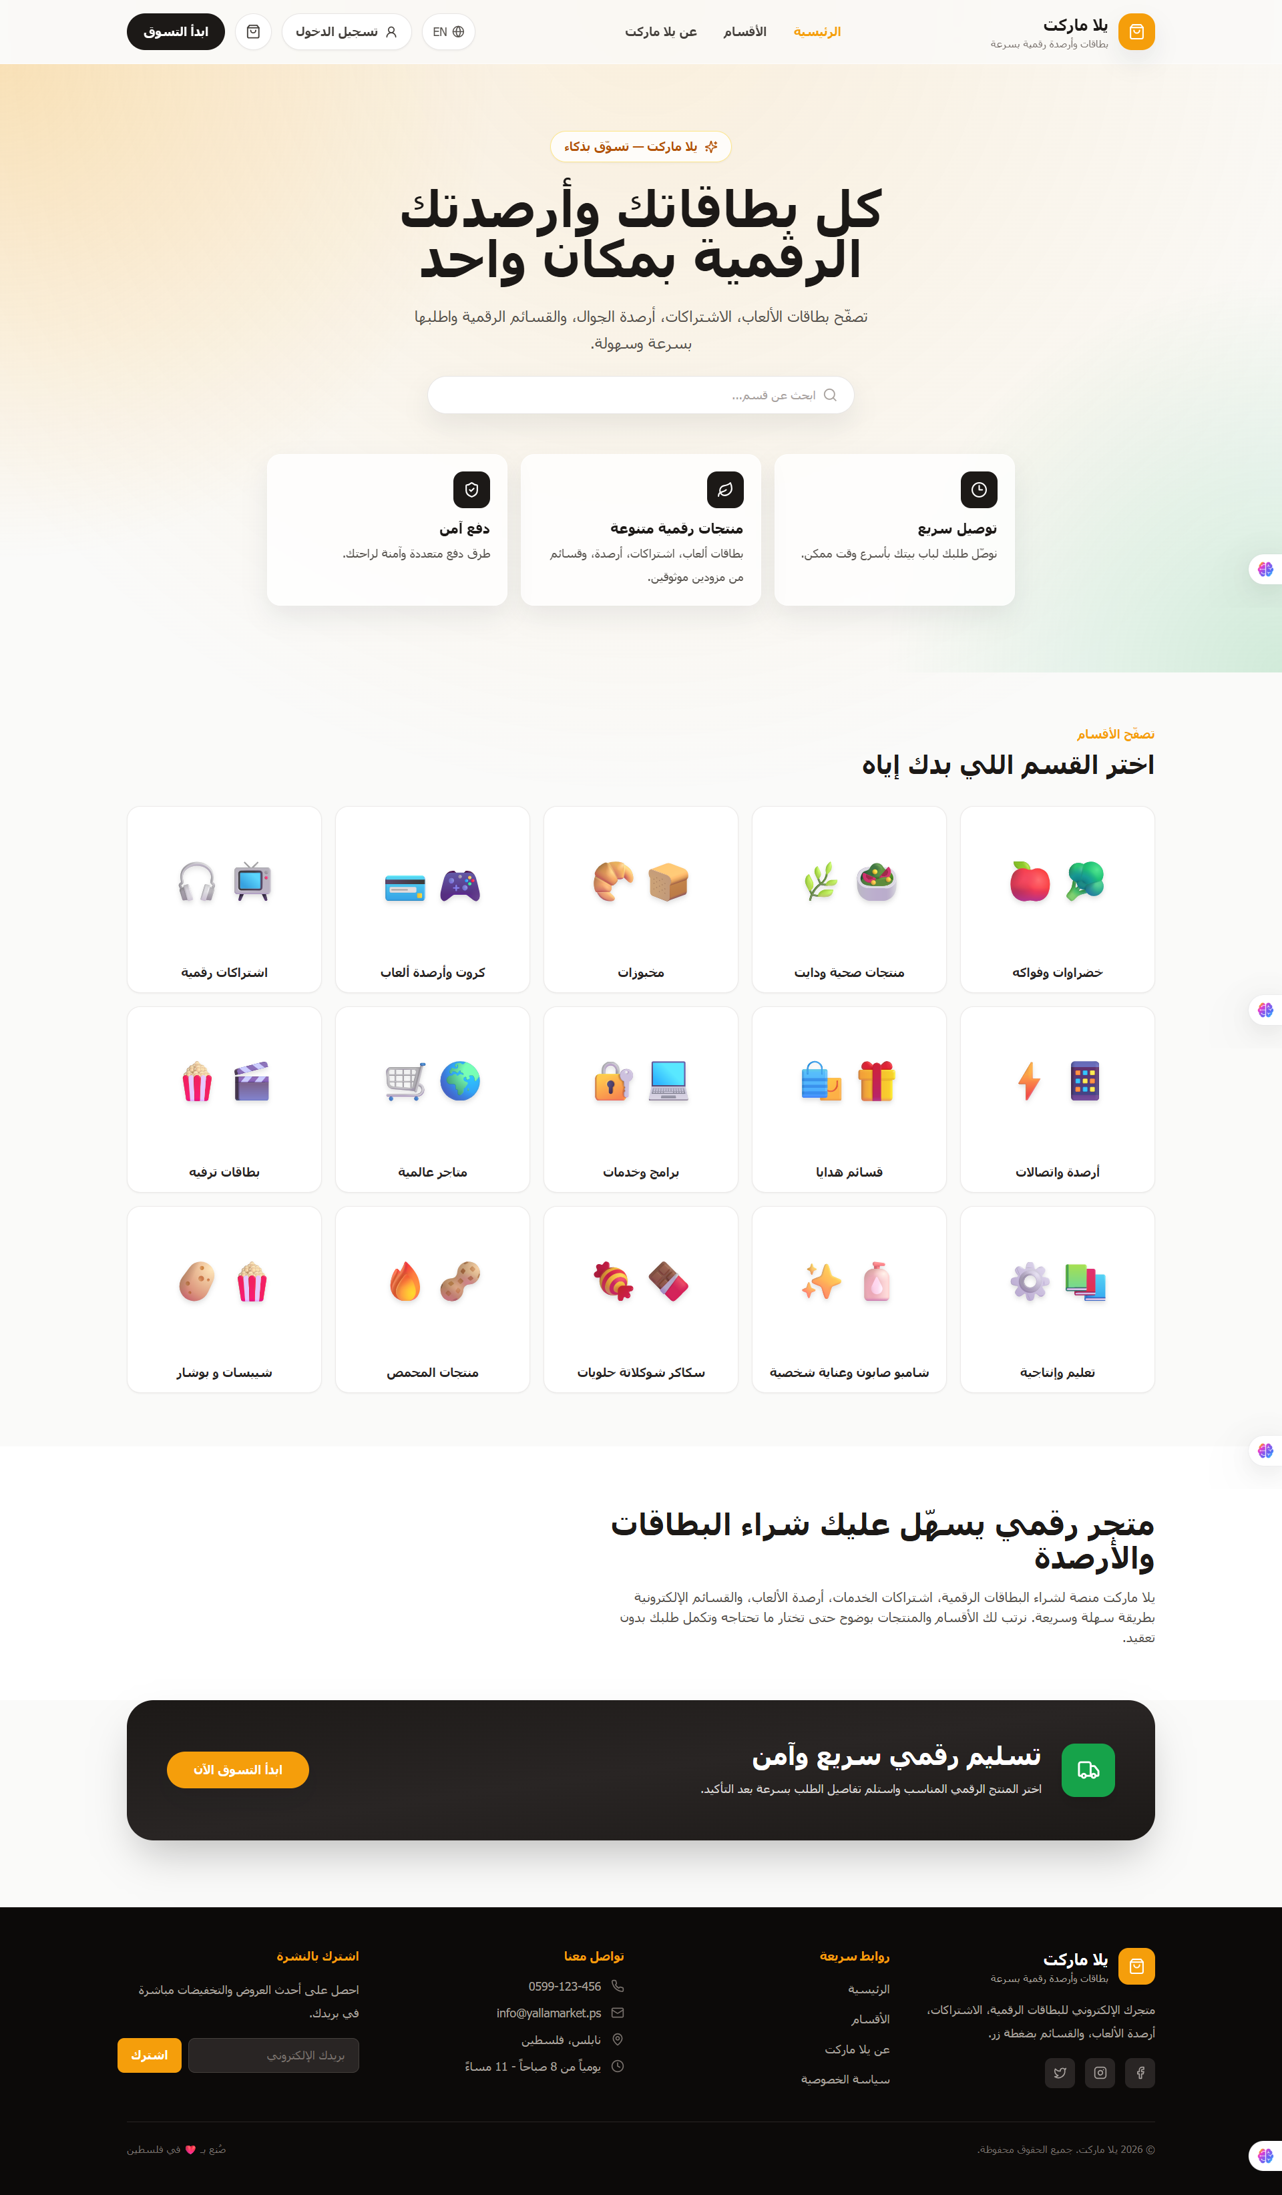
YM
SOFTWARE ENGINEERING PROJECT
YallaMarket
Digital marketplace for game cards, subscriptions & balances
Final Presentation • Agile/Scrum • React + Express + SQLite
Bilingual storefront • cart • checkout • backend-ready
YallaMarket • Software Engineering Project
01
Notes:
Open by framing the project as a complete software engineering process, not only as a web page.

Slide 2
Problem & Objective
From a real shopping need to a structured software system
The Problem
Project Objective
Users need a simple way to browse and buy digital products online.
Design, document and implement a working marketplace that demonstrates requirements engineering, UML modeling, agile planning, implementation and quality assurance.
The flow should be fast, bilingual and mobile-friendly.
The system must be documented like a real software project.
Team work must be visible through Jira, GitHub and iterations.
5
4
Core customer pages
Sprints tracked in Jira
YallaMarket • Software Engineering Project
02

Slide 3
Scope & Stakeholders
What the project delivers today and what it prepares for next
Guest
Browse categories, products, product details, cart and checkout UI
Current Scope
Bilingual storefront (AR/EN)
Registered User
Register, login and submit orders when backend flow is enabled
Category and product browsing
Product details + related items
Admin
Future catalog/order management and dashboard access
Cart with localStorage
Checkout UI + order summary
Evaluates requirements, modeling, agile process, implementation and testing
Auth/backend foundations
Instructor
YallaMarket • Software Engineering Project
03

Slide 4
Requirements Summary
Functional and non-functional requirements guided the build
Functional Requirements
Quality Attributes
FR-01
Browse categories
FR-05
Add to cart
Performance: pages load quickly
High
High
Usability: smooth shopping flow
FR-02
View products
FR-10
Checkout form
Localization: Arabic RTL + English LTR
High
High
Reliability: friendly errors and empty states
FR-03
Search/filter
FR-11
Language switch
Medium
High
Maintainability: pages/components/services/context
FR-04
Product details
FR-13
Register/Login
Security: bcrypt + JWT foundations
High
High
YallaMarket • Software Engineering Project
04

Slide 5
Core User Journey
The demo follows one clean customer flow
Home
Category
Product
Cart
Checkout
Order
Demonstrated Behaviors
Routing
Search/filter
Related products
Cart persistence
Checkout validation
Auth-ready flow
YallaMarket • Software Engineering Project
05

Slide 6
System Architecture
Layered design: frontend, backend and persistence
React Frontend
Vite + Tailwind
Express API
Routes + Controllers
SQLite
Database
Users
Browser
localStorage
Cart persistence
Key principle: services and contexts isolate UI from backend details, making future changes safer.
YallaMarket • Software Engineering Project
06

Slide 7
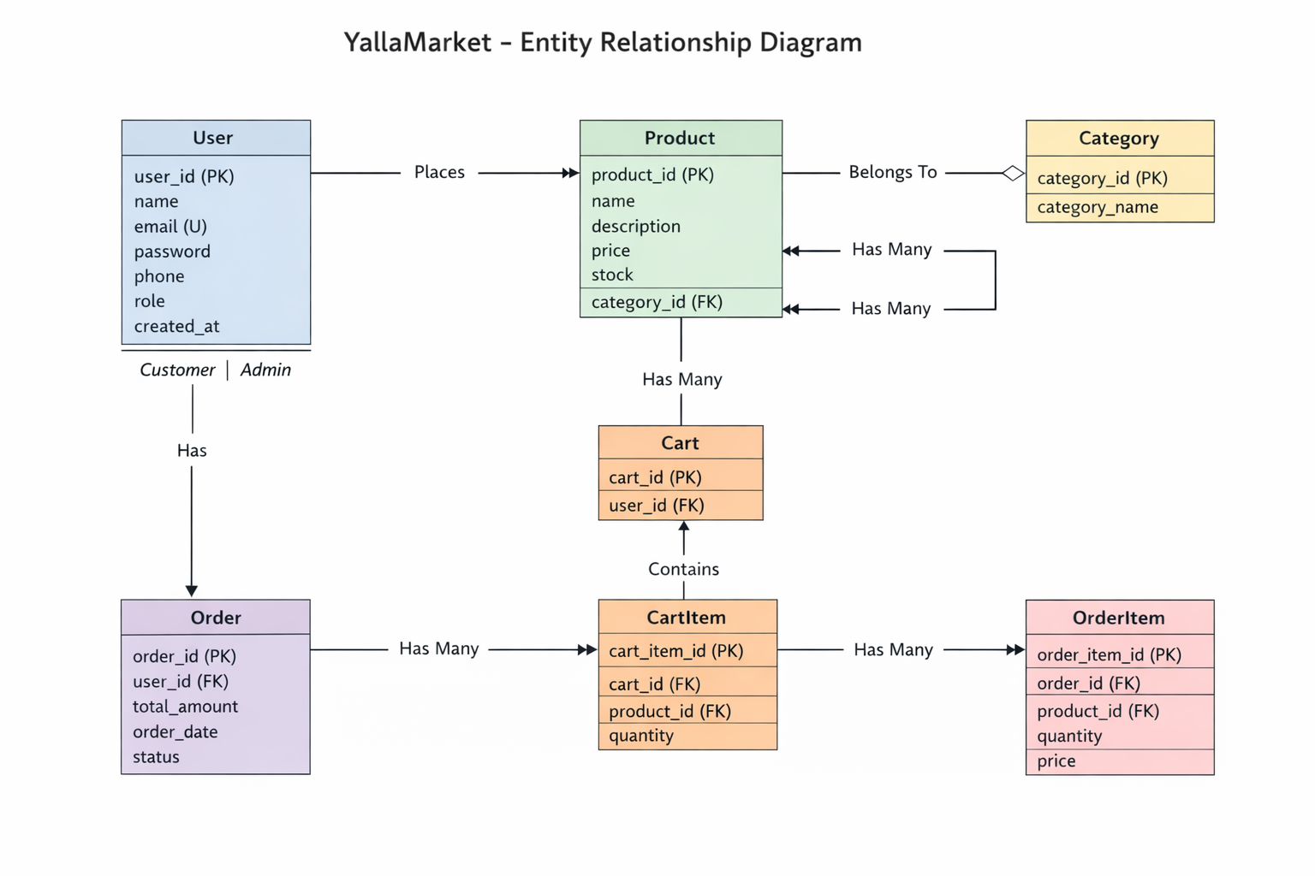
Data Modeling & ERD
Core entities were designed for relational persistence
Core Tables
Users
Categories
Products
Orders
Order Items
Design goal
Keep catalog and order data normalized so admin and analytics features can be added later.
YallaMarket • Software Engineering Project
07

Slide 8
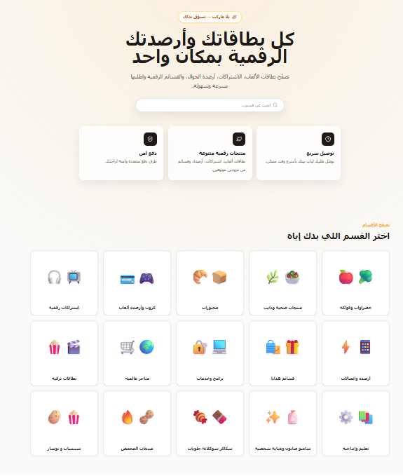
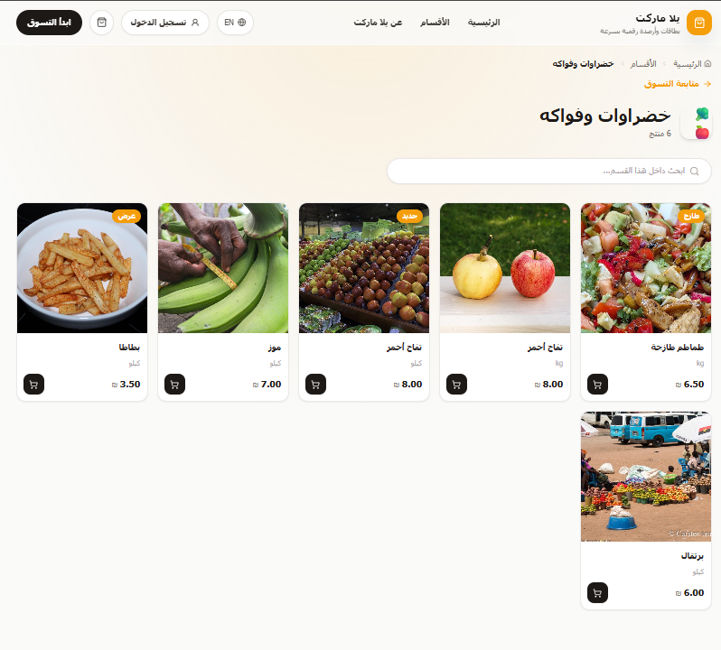
Implementation Demo: Catalog Flow
Homepage and category pages demonstrate the main browsing flow
Homepage: brand, search, highlights and categories
Category: filtered product grid and product cards
YallaMarket • Software Engineering Project
08

Slide 9
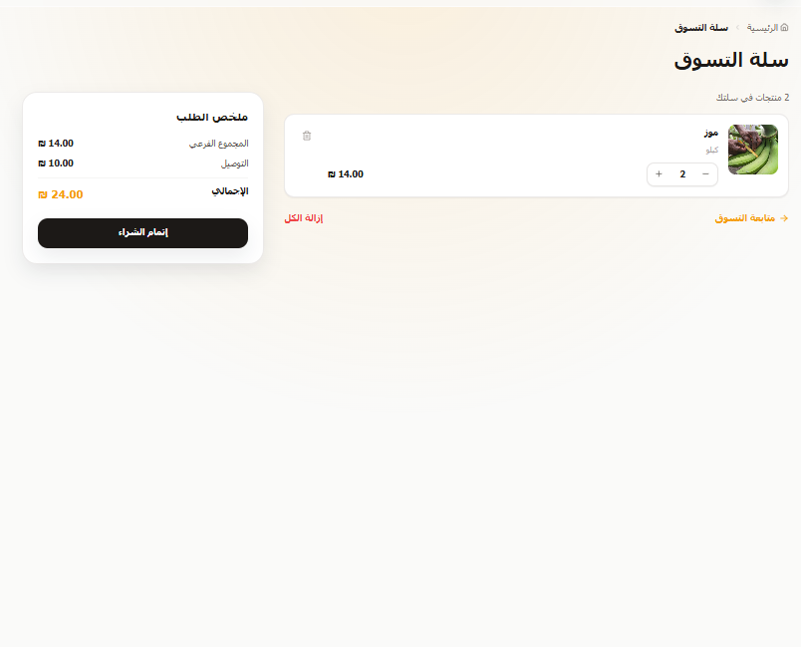
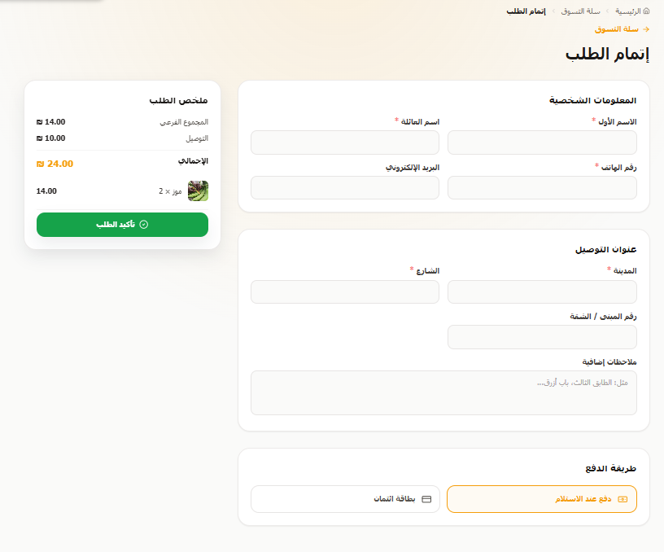
Implementation Demo: Cart & Checkout
The shopping flow continues into cart management and checkout
Cart: quantity controls, deletion and order summary
Checkout: customer info, address, payment method and totals
YallaMarket • Software Engineering Project
09

Slide 10
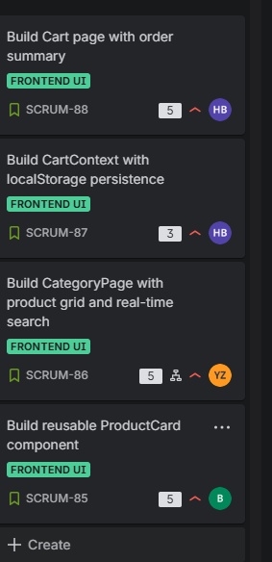
Agile Execution with Jira & GitHub
Work was tracked as stories, tasks and refinement fixes
Sprint Plan
Sprint 1
Storefront foundation
Home, Category, ProductCard, Cart UI
Sprint 2
UX & state refinement
CartContext, localStorage, error/empty states
Sprint 3
Backend foundations
Express, SQLite, auth endpoints, orders
Sprint 4
Final polish
Testing, bug fixes, docs and demo prep
Evidence: Jira backlog, sprint statuses, GitHub branches and commit history.
YallaMarket • Software Engineering Project
10

Slide 11
Testing & Quality Assurance
Submission focuses on a complete engineering process, not only running code
1
Test Plan
Define scope, environment and roles
2
Test Cases
Login, search, cart, checkout, invalid routes
3
Test Results
Record pass/fail and actual behavior
4
Bug Tracking
Document defects in Jira and link fixes
5
Fix Verification
Re-test after commits and final build
Before delivery: ensure SRS, UML diagrams, Jira, GitHub, testing documents and working demo are aligned.
YallaMarket • Software Engineering Project
11

Slide 12
Final Delivery Readiness
A complete project package for demo and submission
SRS
UML
Jira
Code
QA
Requirements document v3
Use case + diagrams
Agile tracking
Frontend + backend
Test cases + bug log
Delivered
Next Steps
Storefront flow
Admin dashboard
Cart + checkout
Payment gateway
Bilingual interface
Deployment polish
Auth/backend foundations
Expanded testing
Thank you
Questions?
YallaMarket • Software Engineering Project
12

