Slide 1
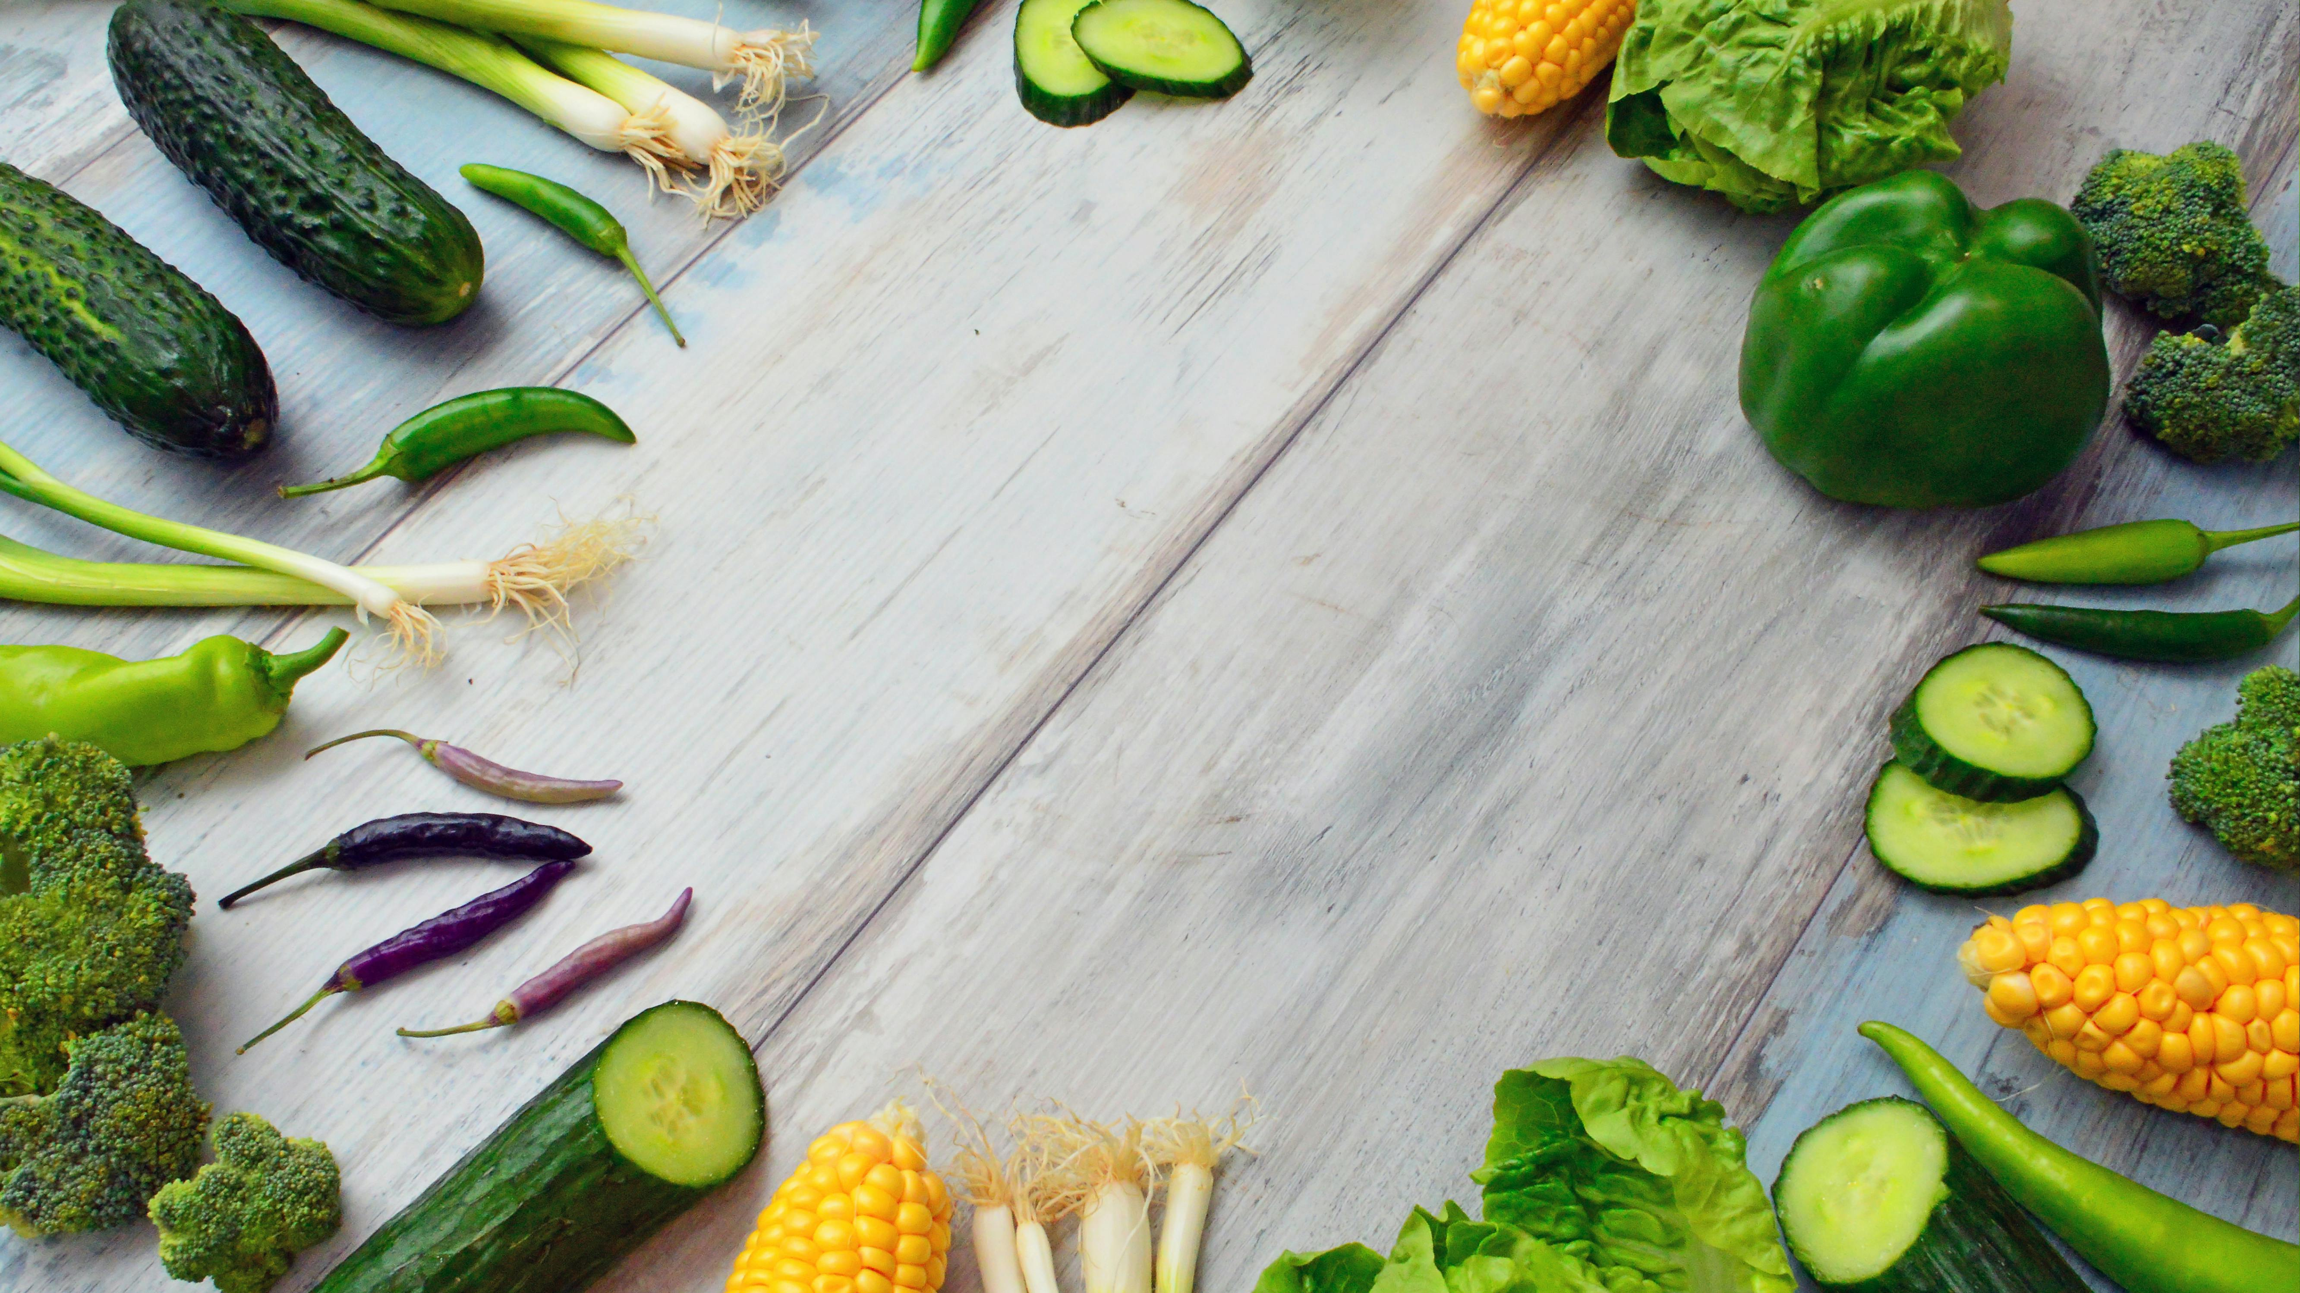

Vegefoods
A unique experience where we bring
you fresh and nutritious food. Enjoy
nature in every bite!

Slide 2
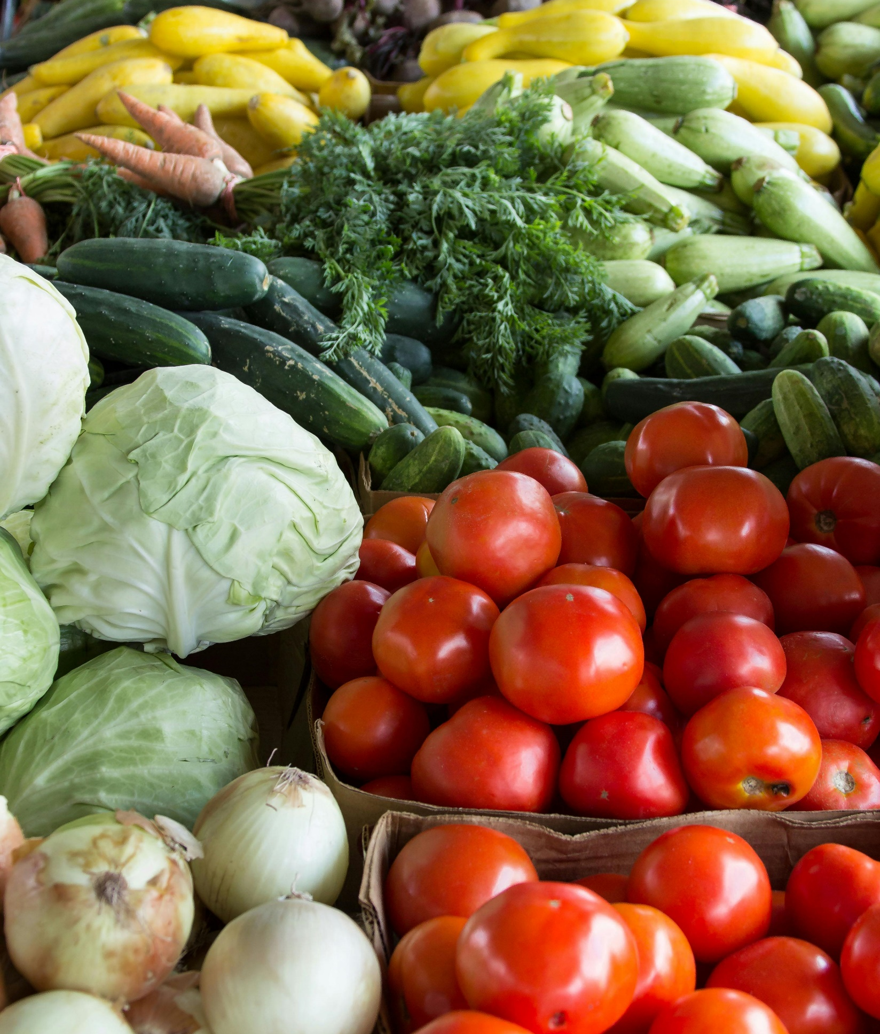
Problem
Improving healthy lifestyle
Lack of a comprehensive store
Accessing fresh, healthy products
Limited shopping time

Slide 3
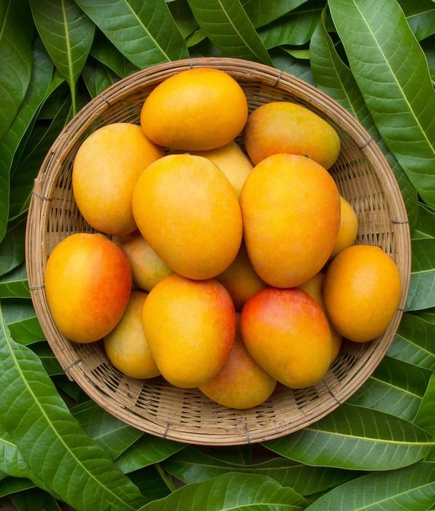
Solution
Selection of fresh, nutritious products
Convenient shopping
Product variety
Healthy lifestyle support

Slide 4


Technology
Website Application
Payment/utilization

Slide 5

How Vegefoods Works
Create an account and log in.
Browse and add products to the cart.
Review the cart and proceed to payment.
Enter payment details and confirm the order

Slide 6
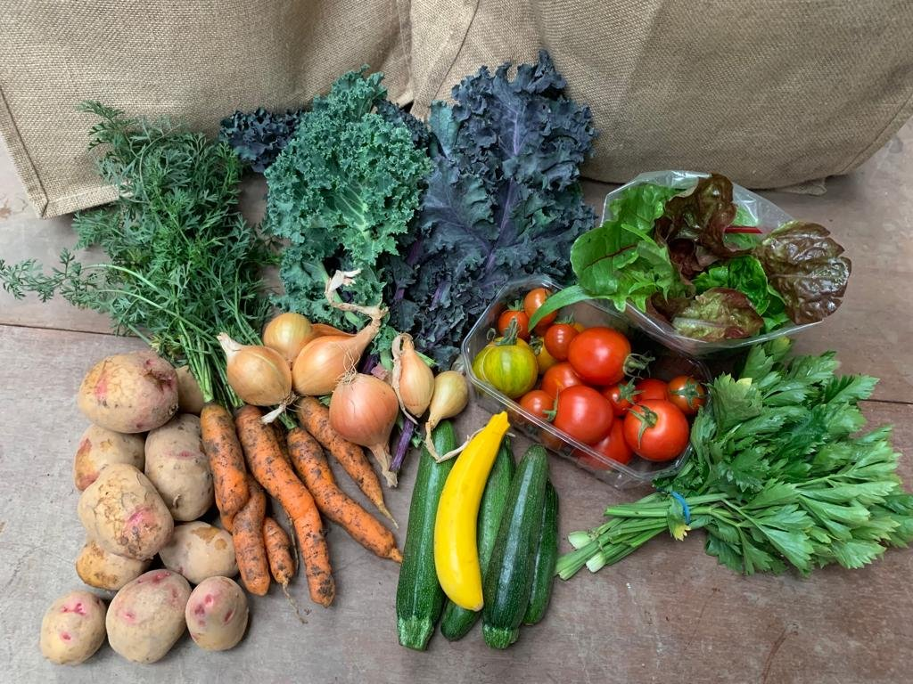
Thank You

