Slide 1
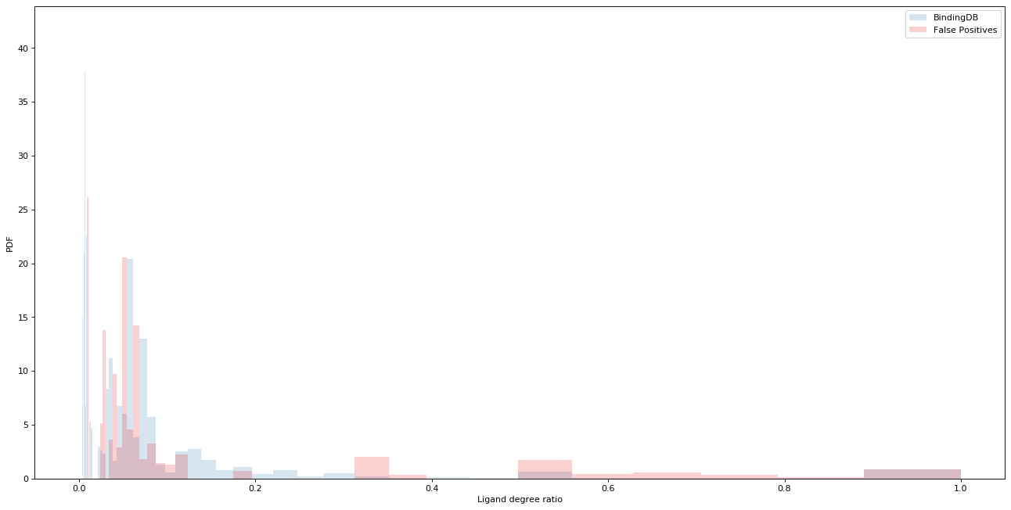
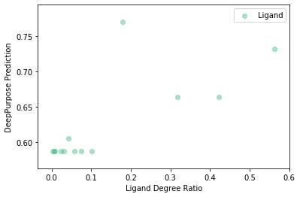
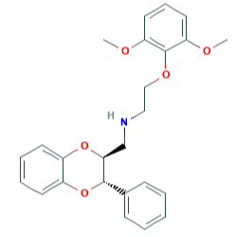
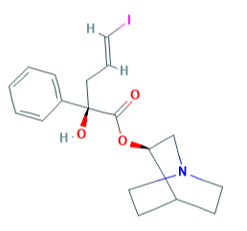
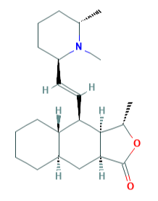
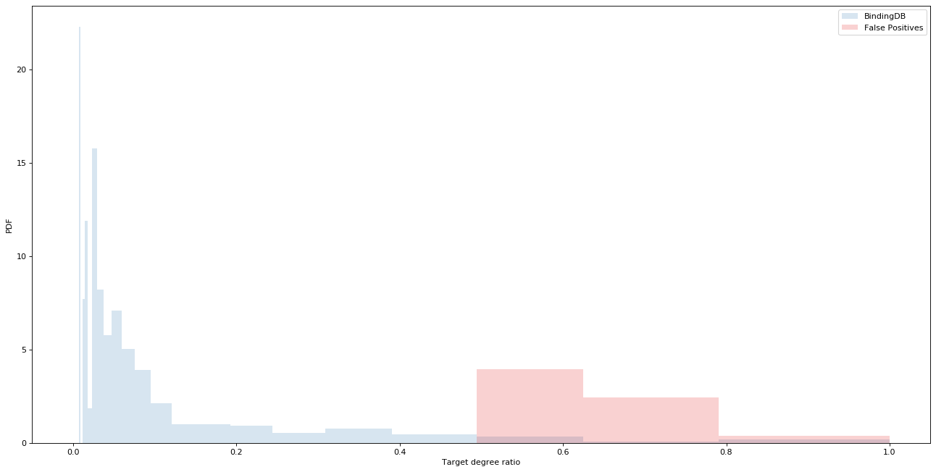
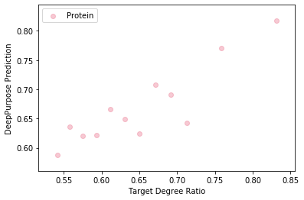
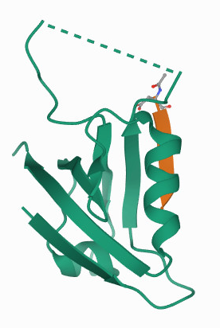
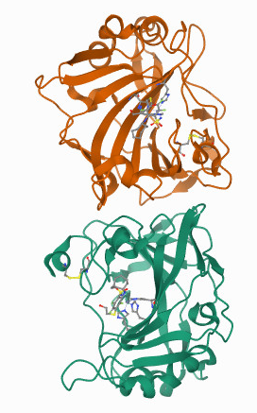
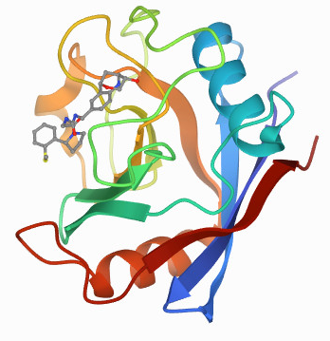



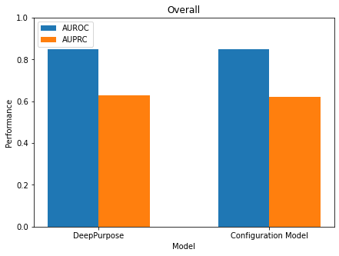
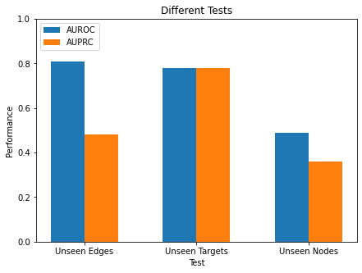






a
2-(2,6-Dimethoxyphenoxy)-N-[[(2S,3S)-3-phenyl-2,3-dihydro-1,4-benzodioxin-2-yl]methyl] ethanamine
(E)-(R)-2-Hydroxy-5-iodo-2-phenyl-pent-4-enoic acid (R)-(1-aza-bicyclo[2.2.2]oct-3-yl) ester
Himbacine
PDF
Binding annotations = 2
Nonbinding annotations = 1
Degree Ratio = 0.67
Binding annotations = 4
Nonbinding annotations = 1
Degree Ratio = 0.8
Binding annotations = 1
Nonbinding annotations = 0
Degree Ratio = 1.0
b
Ligand Degree Ratio
SSTR2
CA9
PPIF
PDF
Binding annotations = 10
Nonbinding annotations = 5
Degree Ratio = 0.67
Binding annotations = 60
Nonbinding annotations = 18
Degree Ratio = 0.77
Binding annotations = 3
Nonbinding annotations = 0
Degree Ratio = 1.0
c
Target Degree Ratio
$$\vec{m}=(1,0)$$
Entropy Maximization
$$\vec{m}=(0,1)$$
d
Binding
Non-binding
$$\vec{m}=(0,0)$$
$$\vec{m}=(0,1)$$
$$\vec{m}=(1,0)$$
$$\vec{m}=(1,1)$$
Annotation
Unknown
Positive
Negative
Not Possible
f
Assigning SMILEs and Amino Acid Sequences Randomly
e
Version | AUROC | AUPRC
Original | 0.85 | 0.63
Randomized | 0.84 | 0.61
g
BindingDB Training Data for DeepPurpose
Node Type | Has Only Positive Annotations | Has Only Negative Annotations | Has both annotations | Total Node Count
Ligand | 3,084 | 6,539 | 793 | 10,416
Protein | 168 | 556 | 667 | 1,391
Notes:
Number of false positives per degree – not for the full range – distribution of the false positives per degree

