Slide 1
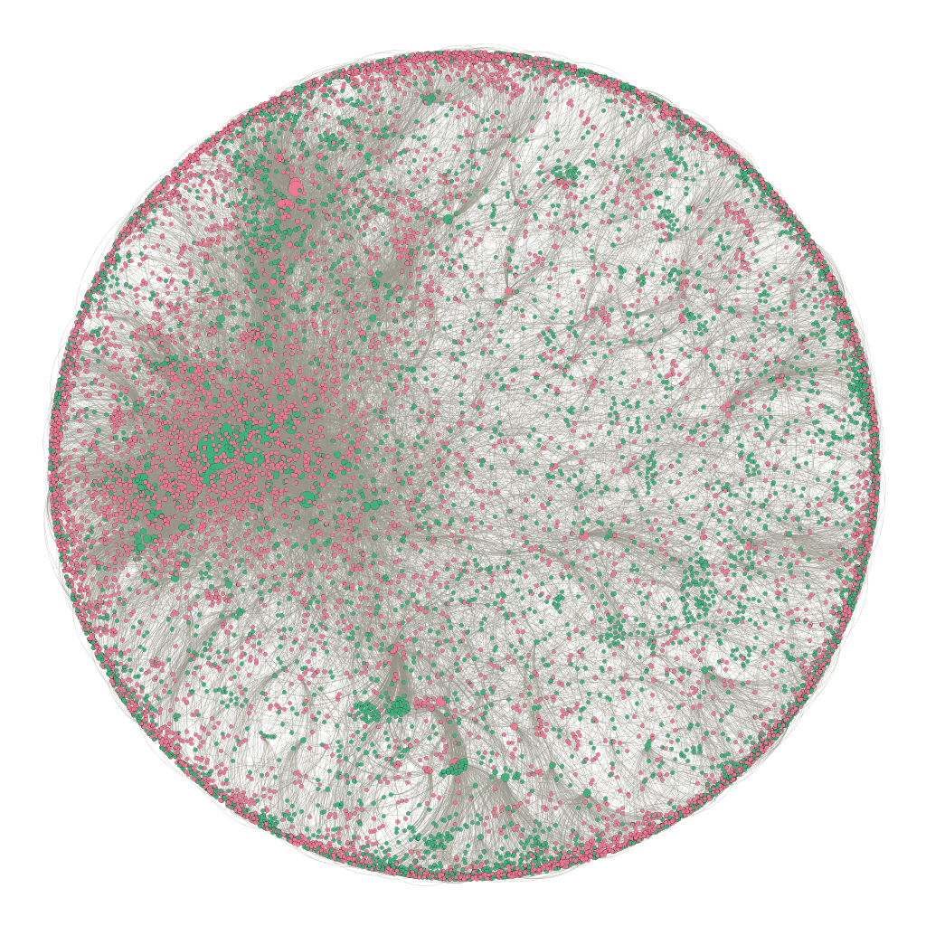
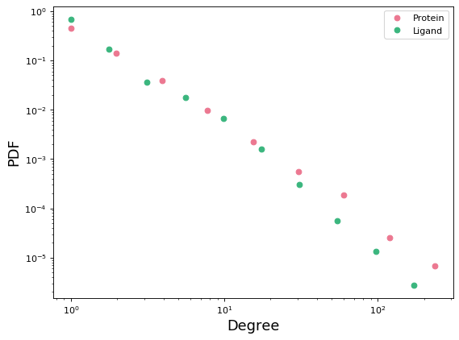
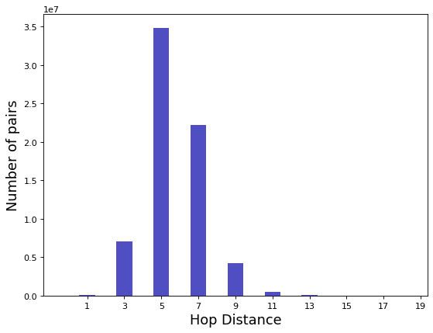
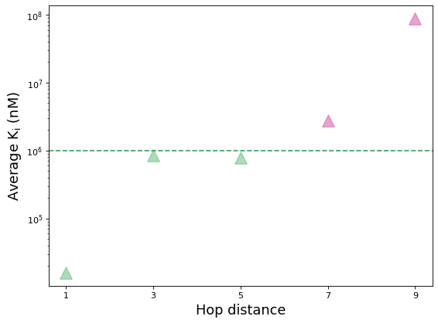
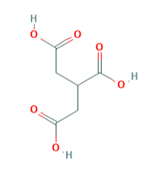
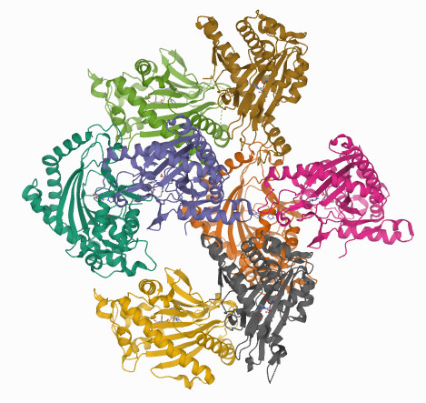
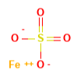
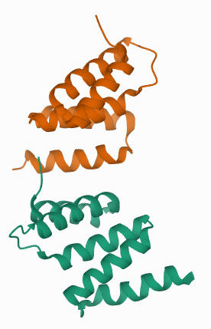
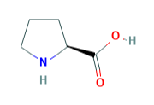
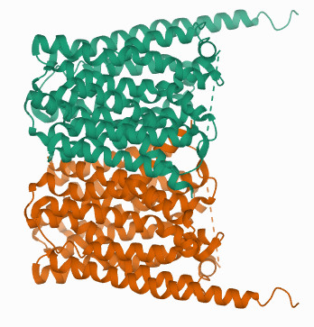
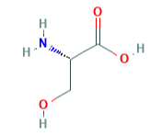
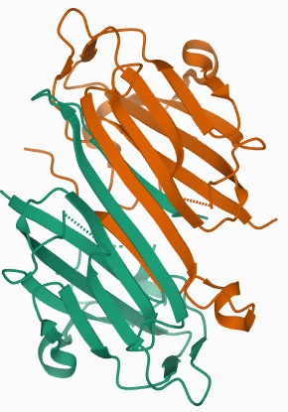
a
b
c
Used in training
Used in validation and test
d
Average over 9 pairs
Average over 82 pairs
Non-Binding
Protein
DTI Network Statistics
Nodes | 13,215
Proteins | 5,104
Ligands | 8,111
Edges | 30,813
Average over 3,808 pairs
Average over 741 pairs
Ligand
Average over 3,489 pairs
e
Tricarballylic acid
ACO2
Ferrous sulfate
P4HA1
Proline
SLC16A10
Serine
SRR
7-Hop Negative Sample
K_{i} = 1.3*10⁶ nM

