Slide 1
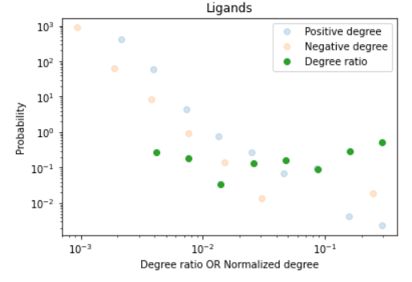
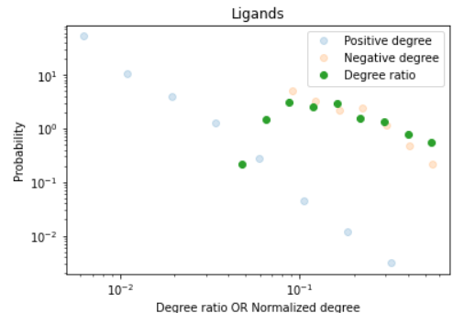
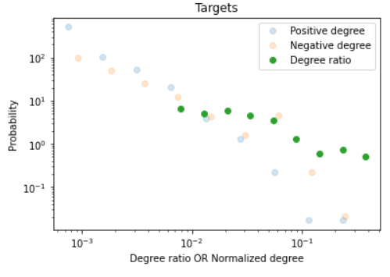
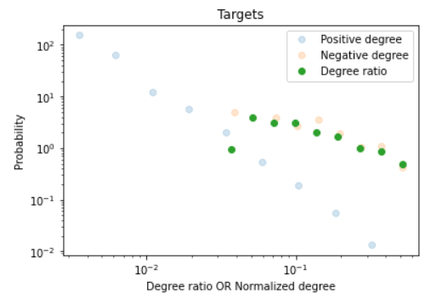
Benchmark BindingDB data
Network-Derived Negatives
Ligands
A
B
Probability
Probability
Degree ratio OR Normalized Degree
Degree ratio OR Normalized Degree
C
D
Probability
Probability
Degree ratio OR Normalized Degree
Degree ratio OR Normalized Degree

