Slide 1
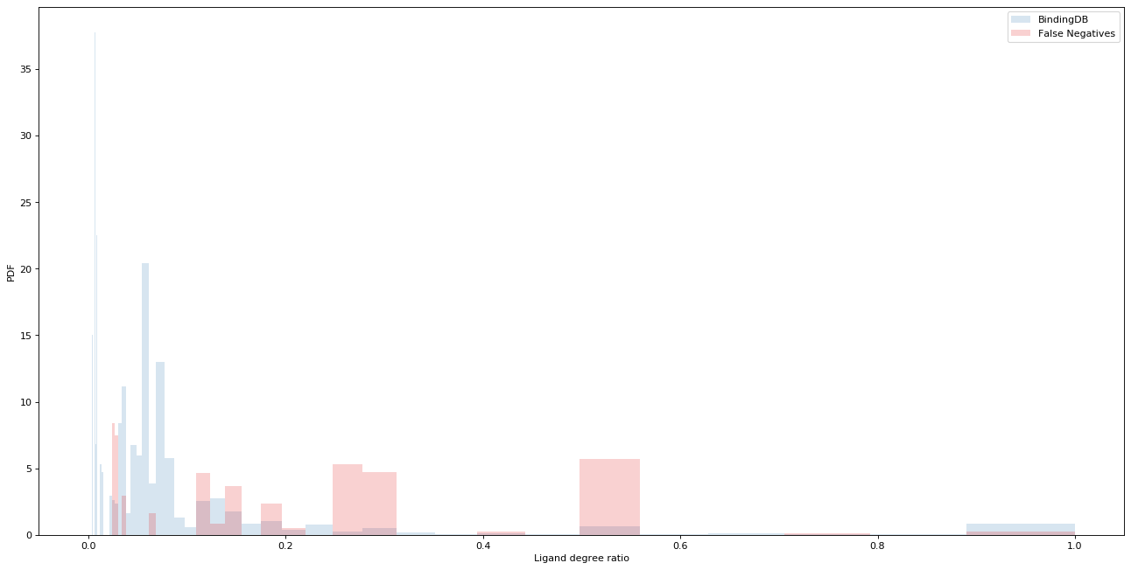
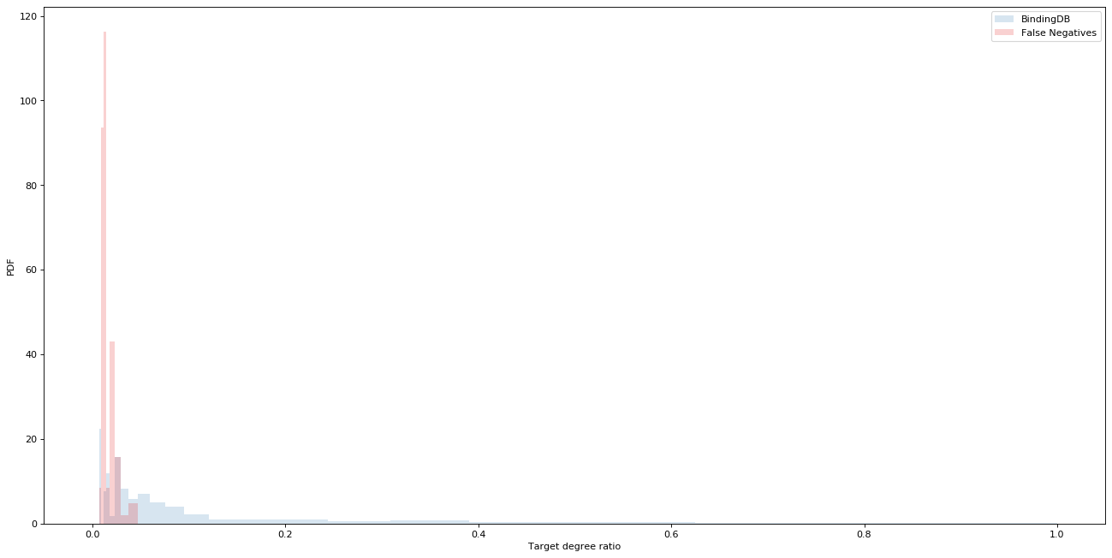
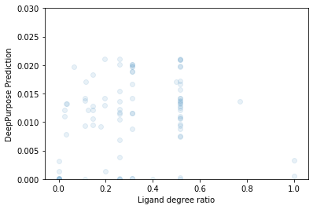
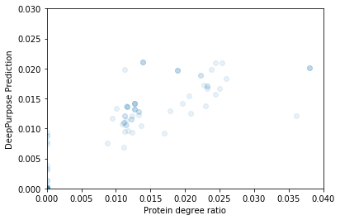
a
A
BindingDB
False Negatives
PDF
Ligand degree ratio (ρ_{i})
B
BindingDB
False Negatives
PDF
Target degree ratio (ρ_{i})
C
D
DeepPurpose Prediction
DeepPurpose Prediction
Ligand degree ratio (ρ_{i})
Protein degree ratio (ρ_{i})

