Slide 1
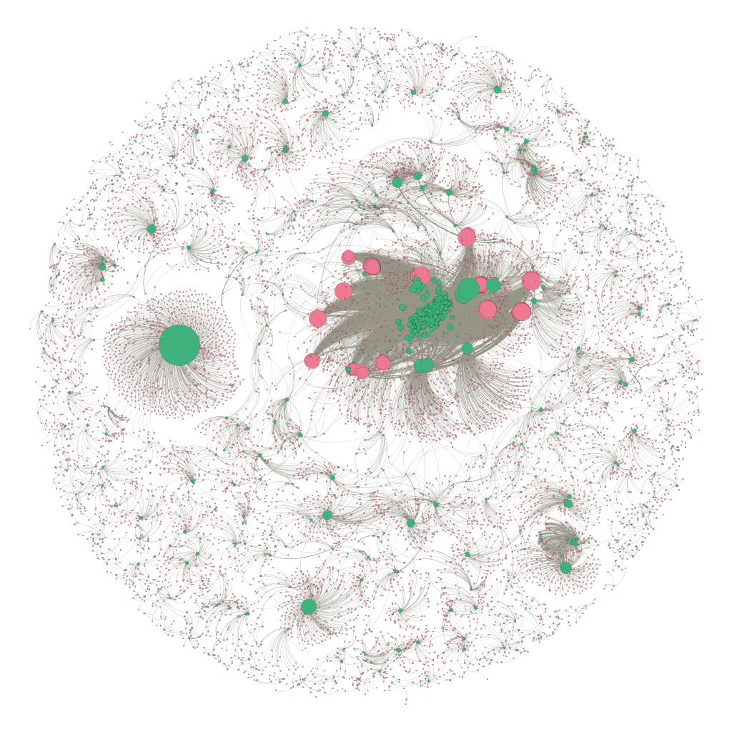
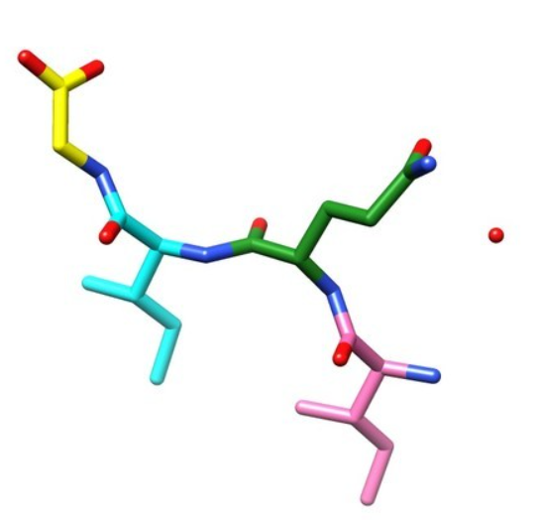
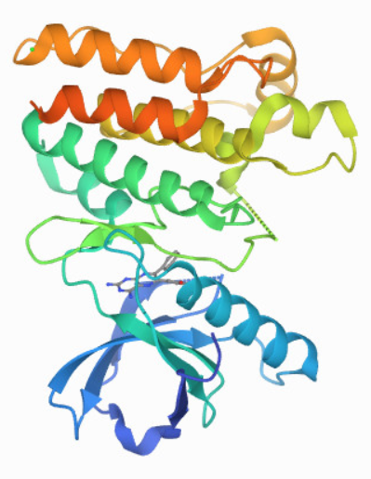
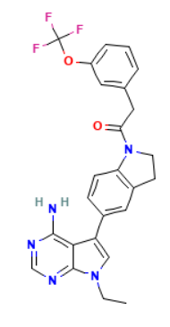
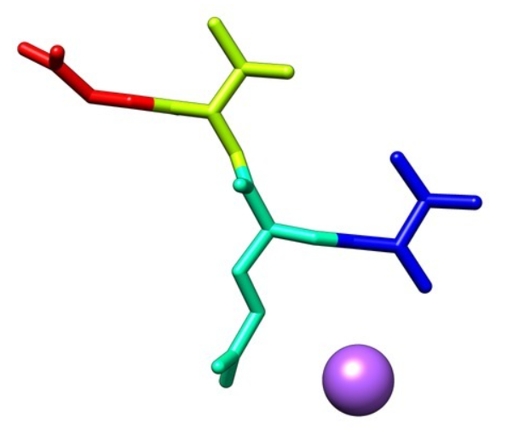
Amyloid core of RIP1
Threonine-protein kinase 4
Ripk1-IN-7
Threonine-protein kinase 3
Ligand
Protein
DTI Network Statistics
Nodes | 11,807
Proteins | 1,391
Ligands | 10,416
Edges | 37,567
Annotation
Ligand: Ripk1-IN-7
k_{i}⁺ = 1
k_{i}⁻ = 2
ρ_{i} = 1/(1+2) = 0.33
Positive/Binding
Negative/Non-binding

