Slide 1
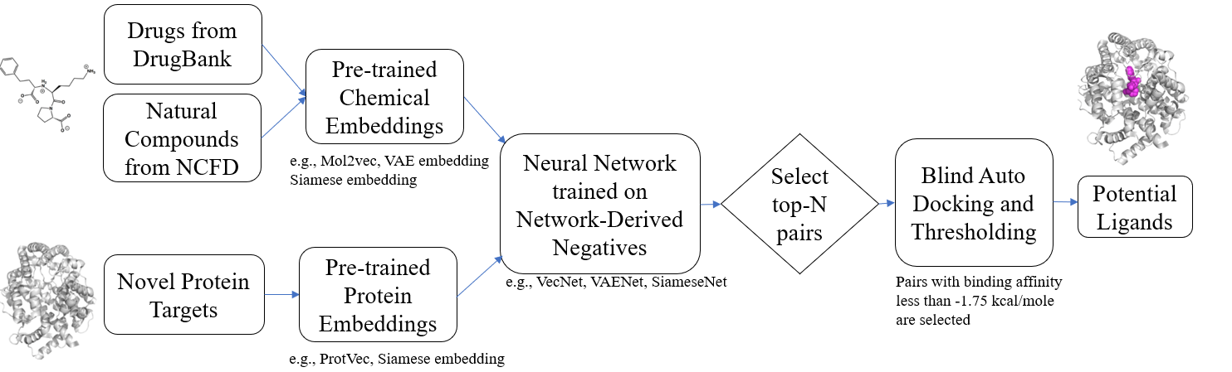
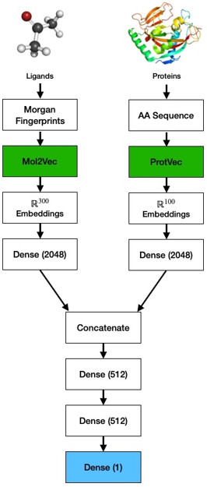
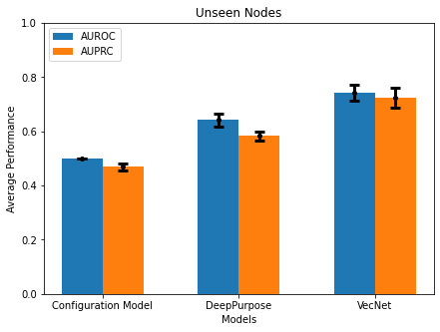
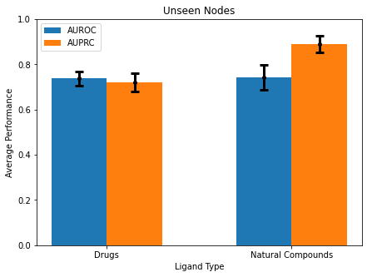
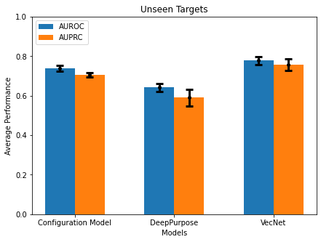
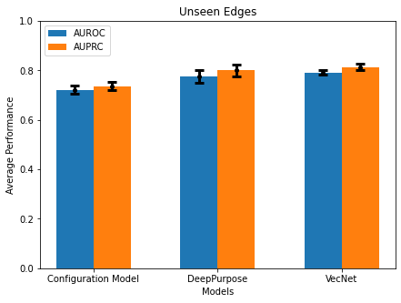
A
B
C
D
Unseen Nodes
Unseen Nodes
Unsupervised Pre-training
Deep Learning
Average Performance
Average Performance
E
Configuration Model
DeepPurpose
VecNet
F
Drugs
Ligand Type
Natural Compounds
Unseen Targets
Unseen Edges
Average Performance
Average Performance
Configuration Model
DeepPurpose
VecNet
Configuration Model
DeepPurpose
VecNet

