Slide 1



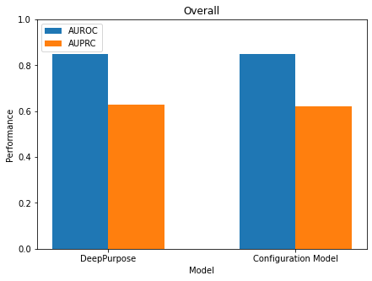
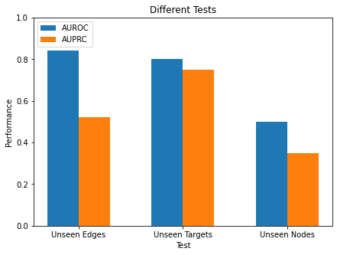






A
Layer 1
$$\vec{m}=(1,0)$$
Positive
Entropy Maximization
Layer 2
$$\vec{m}=(0,1)$$
Negative
Binding
Protein
Non-binding
Ligand
$$\vec{m}=(0,0)$$
$$\vec{m}=(0,1)$$
$$\vec{m}=(1,0)$$
$$\vec{m}=(1,1)$$
Annotation
Unknown
Negative
Positive
Not Possible
B
Overall
C
Different Tests
Performance
Performance of DeepPurpose
DeepPurpose
Model
Configuration Model
Unseen Edges
Unseen Targets
Unseen Nodes
e

