Slide 1
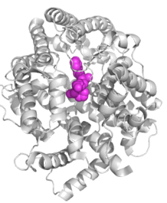
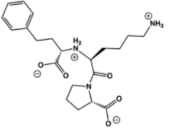
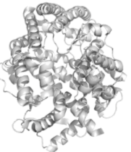
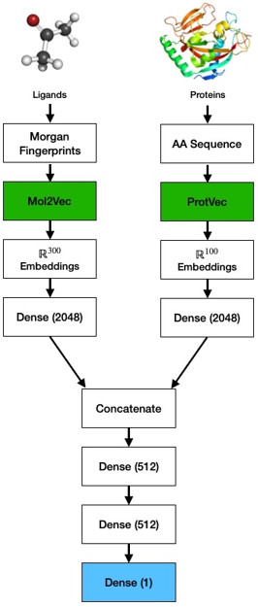
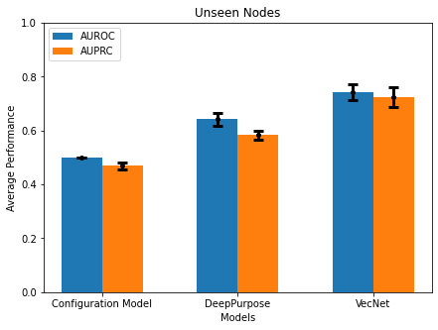
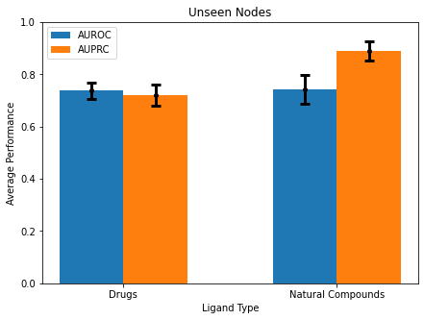
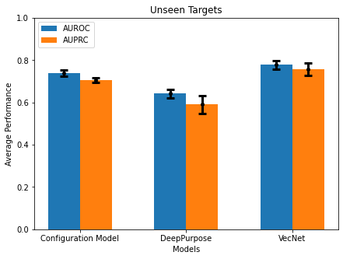
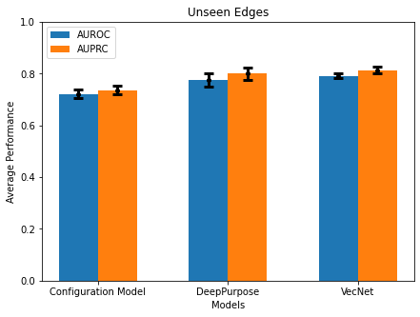
A
Drugs from DrugBank
Pre-trained Chemical Embeddings
Natural Compounds from NCFD
e.g., Mol2vec, VAE embedding
Siamese embedding
Neural Network trained on Network-Derived Negatives
Select top-N pairs
Blind Auto Docking and Thresholding
Potential Ligands
Novel Protein Targets
Pre-trained Protein Embeddings
e.g., VecNet, VAENet, Siamese Model
Pairs with binding affinity less than -1.75 kcal/mole are selected
e.g., ProtVec, Siamese embedding
Unsupervised Pre-training
Supervised Learning
B
C
D
Unseen Nodes
Unseen Nodes
Unsupervised Pre-training
Deep Learning
Average Performance
Average Performance of VecNet
E
Configuration Model
DeepPurpose
VecNet
F
Drugs
Ligand Type
Natural Compounds
Unseen Targets
Unseen Edges
Average Performance
Average Performance
Configuration Model
DeepPurpose
VecNet
Configuration Model
DeepPurpose
VecNet

