Slide 1
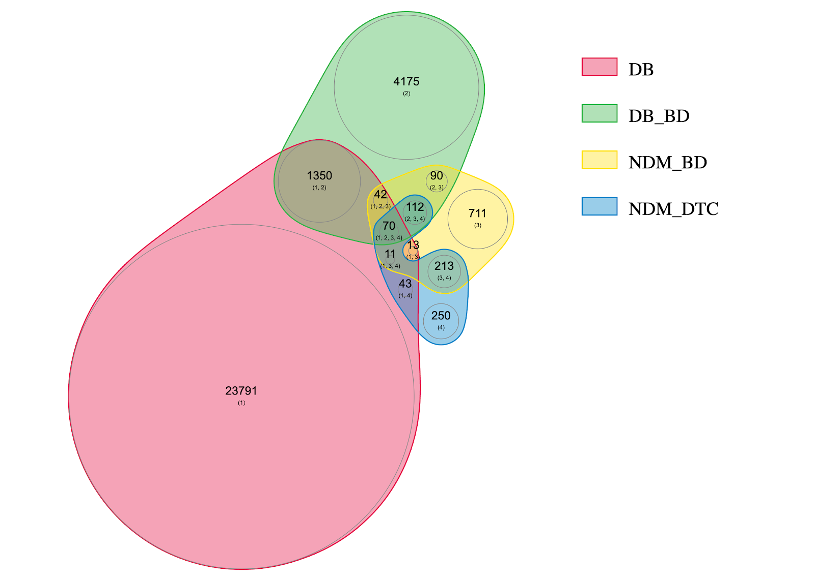
DrugBank (1)
DrugBank in BindingDB (2)
NCFD in BindingDB (3)
NCFD in DTC (4)

