Slide 1
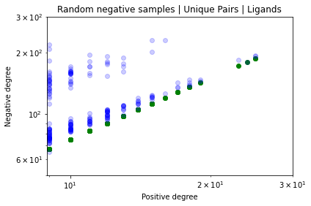
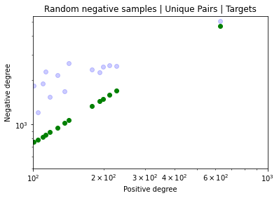
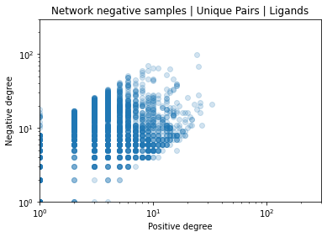
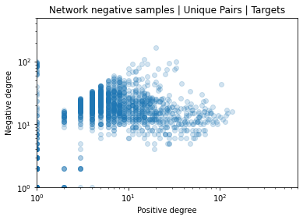
A
B
Ligands in Random Negatives
Targets in Random Negatives
Negative degree
Negative degree
Positive degree
Positive degree
C
D
Ligands in Network-Derived Negatives
Targets in Network-Derived Negatives
Negative degree
Negative degree
Positive degree
Positive degree

