Slide 1
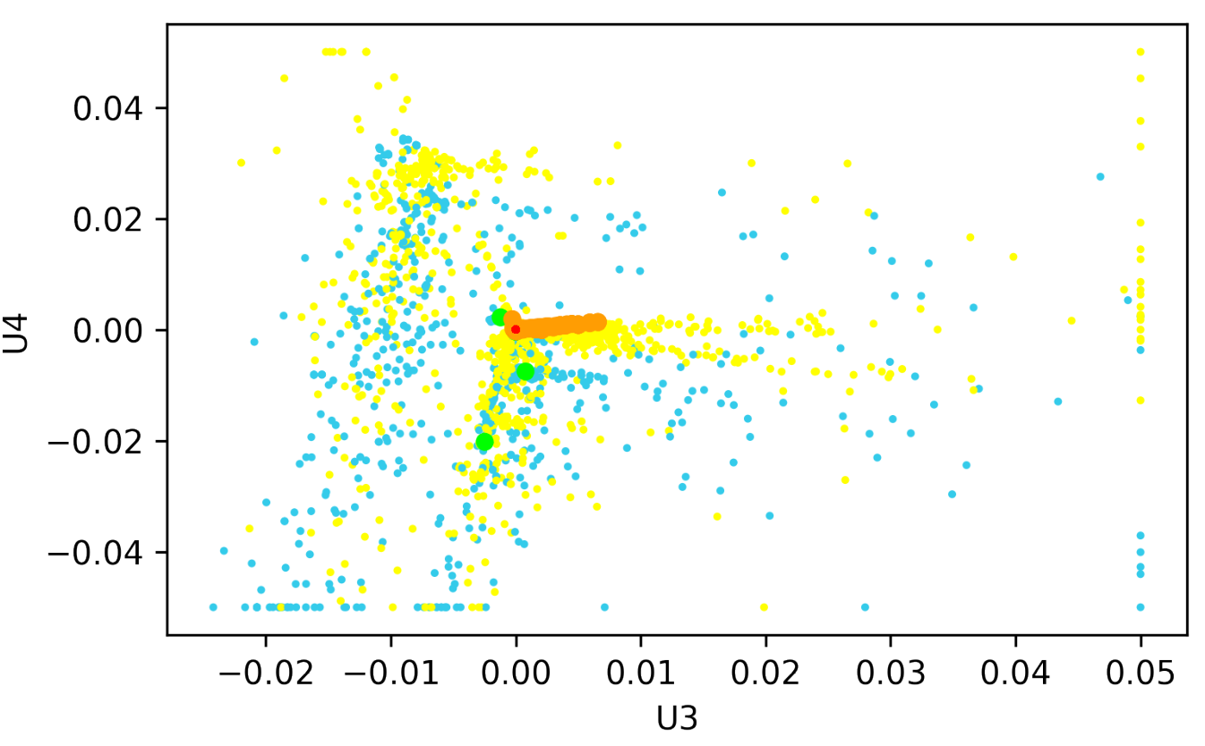
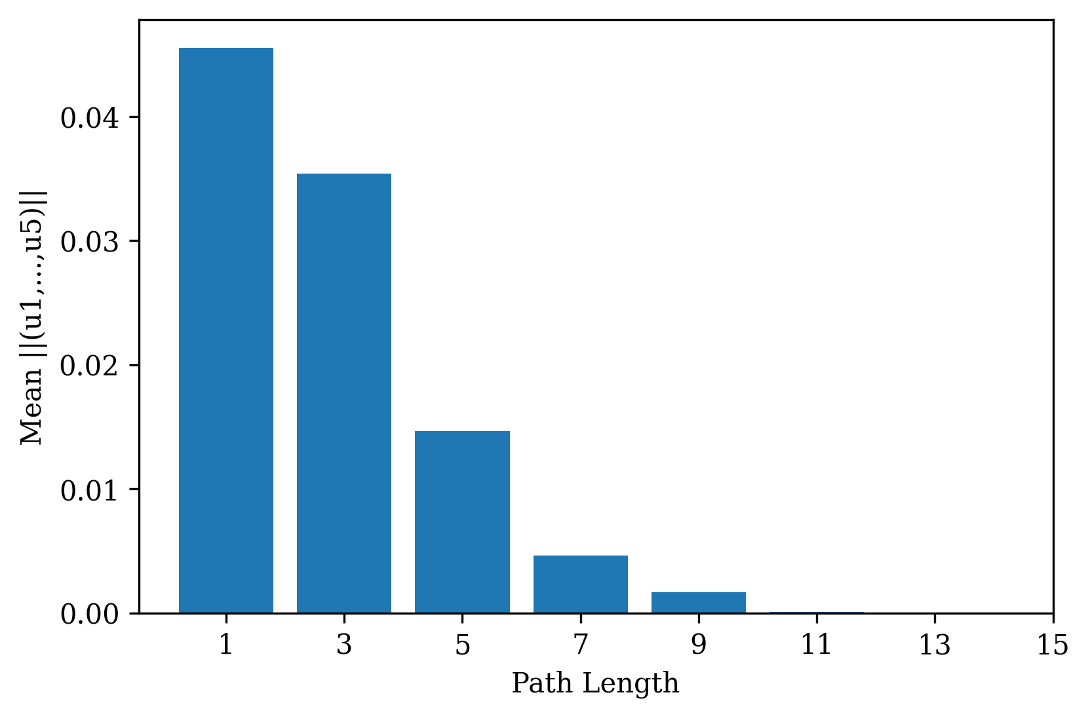
A
B
Mean ||(u1, …, u5)||
U4
U3
Shortest Path Length

