Slide 1
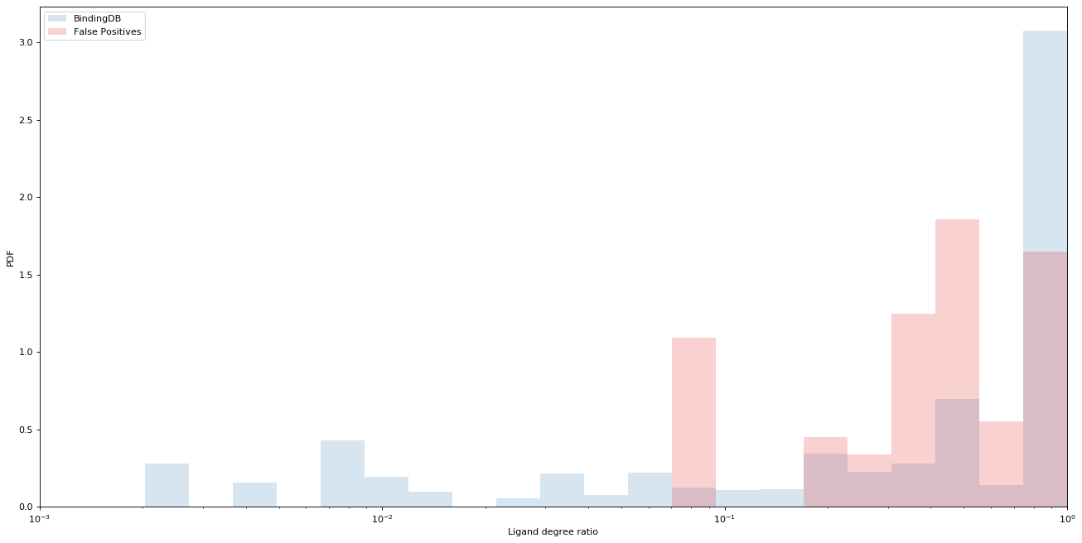
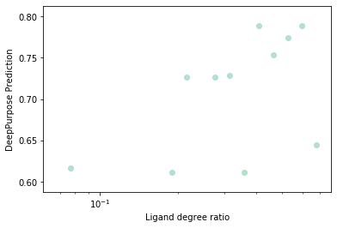
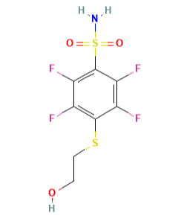
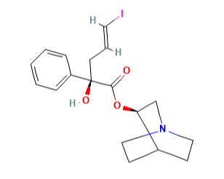
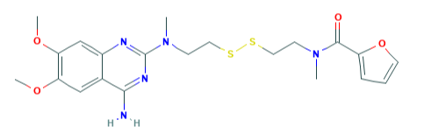
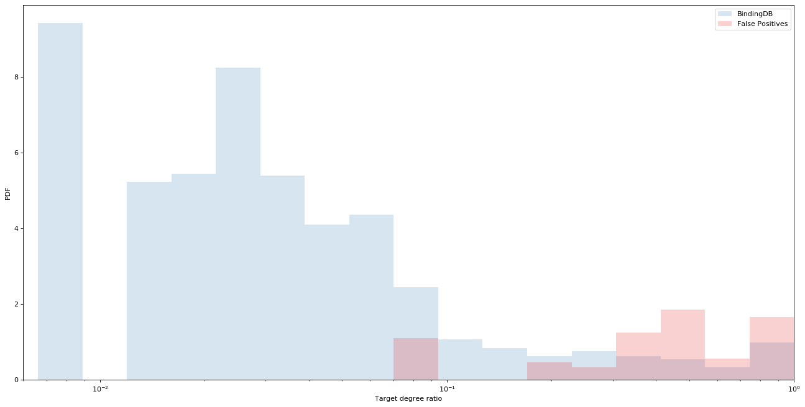
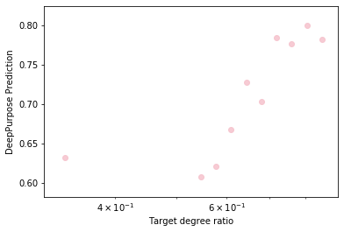
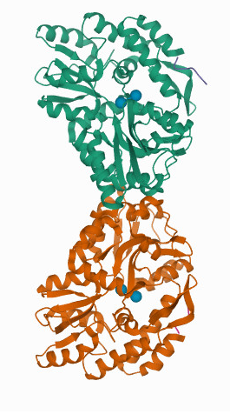
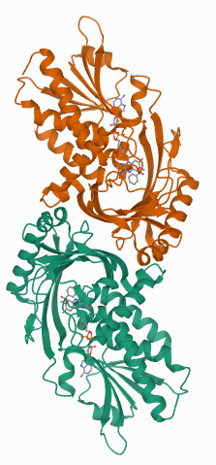
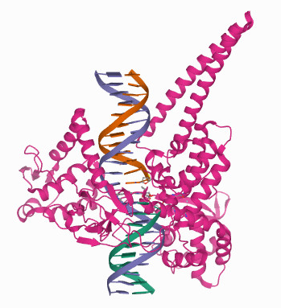
a
A
CHEMBL2333416
CHEMBL127587
Cystazosin
DeepPurpose Prediction
PDF
Ligand degree ratio (ρ)
k_{i}⁺ = 20
k_{i}⁻ = 11
ρ_{i} = 0.64
k_{i}⁺ = 3
k_{i}⁻ = 1
ρ_{i} = 0.75
k_{i}⁺ = 1
k_{i}⁻ = 0
ρ_{i} = 1.0
Whole BindingDB
False Positives
B
Ligand Degree Ratio
AVPR1A
DAO
TOP1
DeepPurpose Prediction
Target degree ratio (ρ)
k_{i}⁺ = 32
k_{i}⁻ = 10
ρ_{i} = 0.76
k_{i}⁺ = 9
k_{i}⁻ = 2
ρ_{i} = 0.82
k_{i}⁺ = 3
k_{i}⁻ = 0
ρ_{i} = 1.0
PDF
Whole BindingDB
False Positives
Target Degree Ratio
Notes:
Number of false positives per degree – not for the full range – distribution of the false positives per degree
Phendioxan -> 2-(2,6-Dimethoxyphenoxy)-N-[[(2S,3S)-3-phenyl-2,3-dihydro-1,4-benzodioxin-2-yl]methyl] ethanamine
3. IQNP -> (E)-(R)-2-Hydroxy-5-iodo-2-phenyl-pent-4-enoic acid (R)-(1-aza-bicyclo[2.2.2]oct-3-yl) ester

