Slide 1
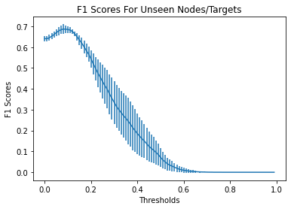
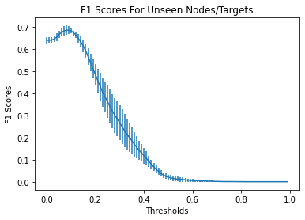
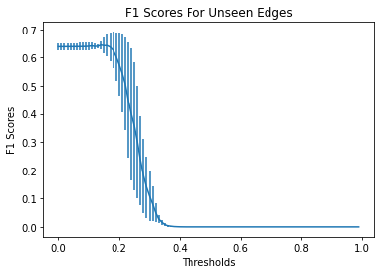
A
Inductive Test
Optimal Threshold
F1-Score
B
Threshold
F1-Score
C
Threshold
F1-Score
Threshold

