Slide 1
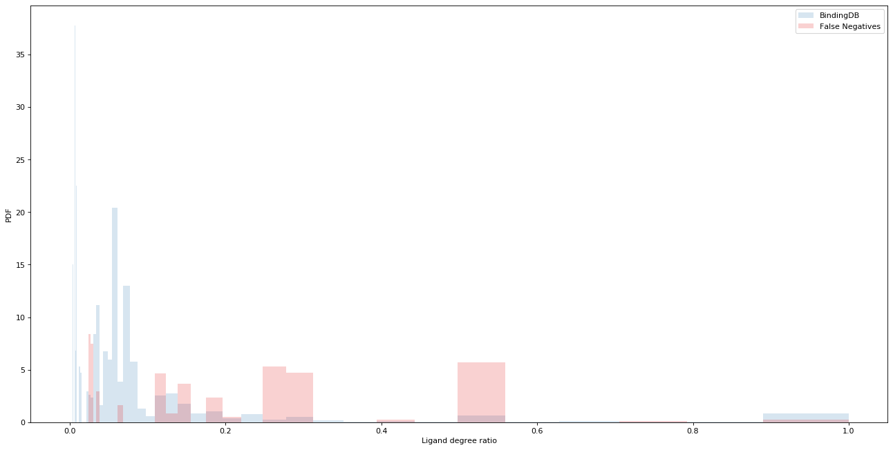
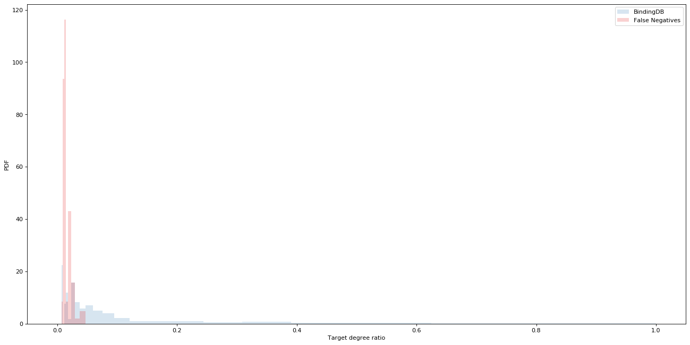
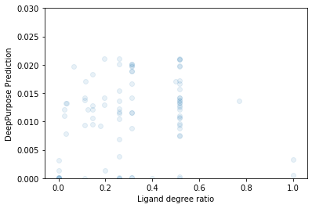
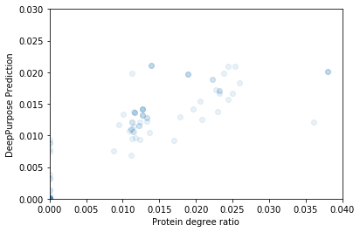
a
a
BindingDB
False Negatives
PDF
Ligand degree ratio (ρ_{i})
b
BindingDB
False Negatives
PDF
Target degree ratio (ρ_{i})
c
DeepPurpose Prediction
DeepPurpose Prediction
Ligand degree ratio (ρ_{i})
Protein degree ratio (ρ_{i})

