Slide 1
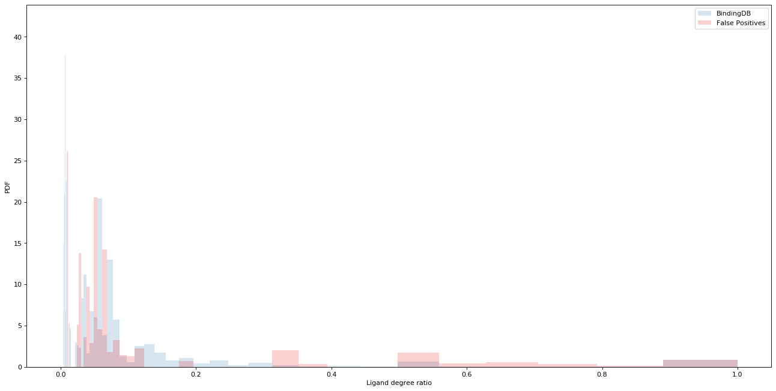
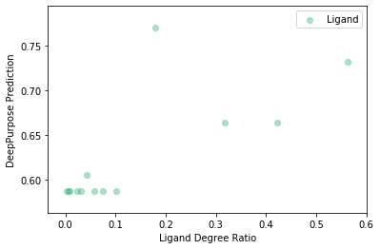
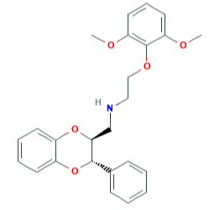
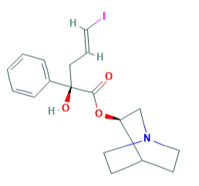
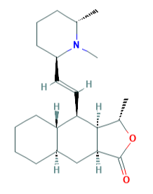
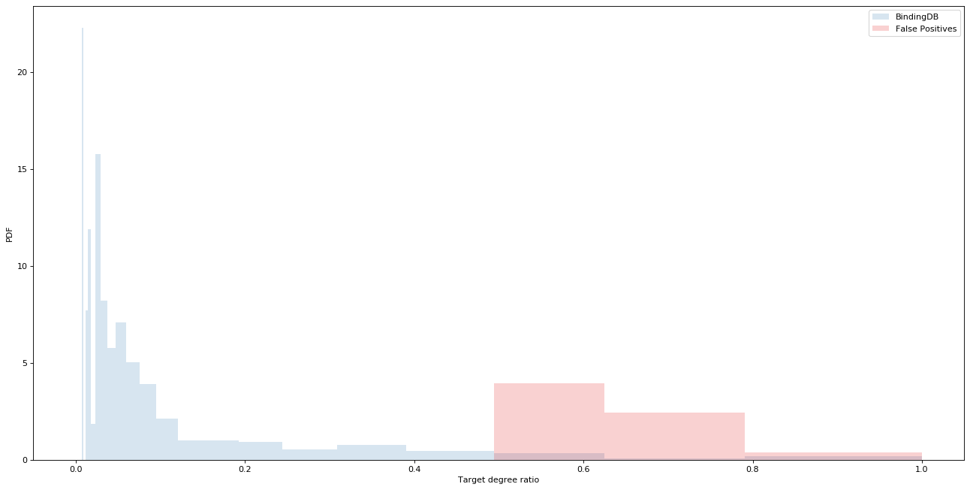
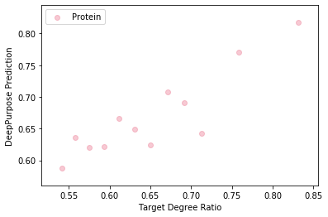
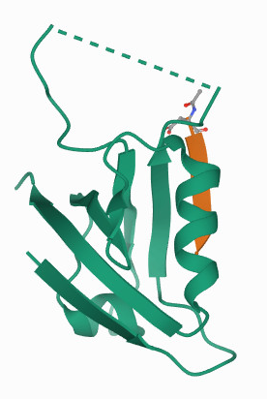
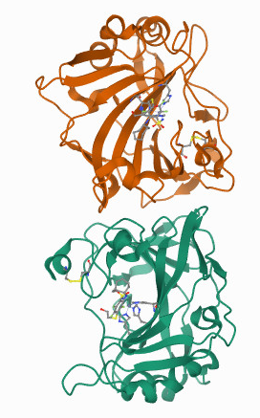
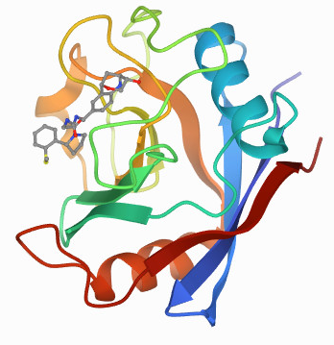
a
a
BindingDB Training Data for DeepPurpose
Node Type | Has Only Positive Annotations | Has Only Negative Annotations | Has both annotations | Total Node Count
Ligand | 3,084 | 6,539 | 793 | 10,416
Protein | 168 | 556 | 667 | 1,391
b
b1
BindingDB
False Positives
Phendioxan
IQNP
Himbacine
DeepPurpose Prediction
PDF
Ligand degree ratio (ρ)
k₊= 2
k₋ = 1
ρ = 0.67
k₊= 4
k₋ = 1
ρ = 0.8
k₊= 1
k₋ = 0
ρ = 1.0
c
Ligand Degree Ratio
c1
BindingDB
False Positives
SSTR2
CA9
PPIF
DeepPurpose Prediction
PDF
Target degree ratio (ρ)
k₊= 10
k₋ = 5
ρ = 0.67
k₊= 60
k₋ = 18
ρ = 0.77
k₊= 3
k₋ = 0
ρ = 1.0
d
Target Degree Ratio
Assigning SMILEs and Amino Acid Sequences Randomly
Version | AUROC | AUPRC
Original | 0.85 | 0.63
Randomized | 0.84 | 0.61
Notes:
Number of false positives per degree – not for the full range – distribution of the false positives per degree
Phendioxan -> 2-(2,6-Dimethoxyphenoxy)-N-[[(2S,3S)-3-phenyl-2,3-dihydro-1,4-benzodioxin-2-yl]methyl] ethanamine
3. IQNP -> (E)-(R)-2-Hydroxy-5-iodo-2-phenyl-pent-4-enoic acid (R)-(1-aza-bicyclo[2.2.2]oct-3-yl) ester

