Slide 1



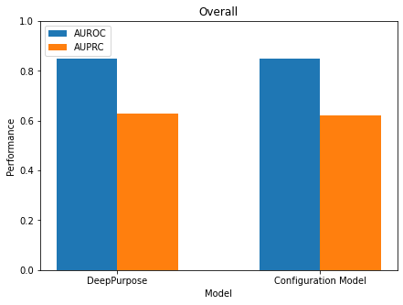
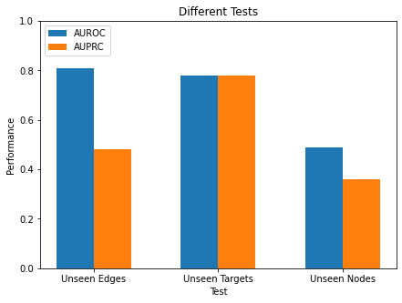






a
$$\vec{m}=(1,0)$$
Entropy Maximization
$$\vec{m}=(0,1)$$
Binding
Protein
Non-binding
Ligand
$$\vec{m}=(0,0)$$
$$\vec{m}=(0,1)$$
$$\vec{m}=(1,0)$$
$$\vec{m}=(1,1)$$
Annotation
Unknown
Positive
Negative
Not Possible
b
Overall
Different Tests
Performance
Performance
DeepPurpose
Model
Configuration Model
Unseen Edges
Unseen Targets
Unseen Nodes
e

