Slide 1
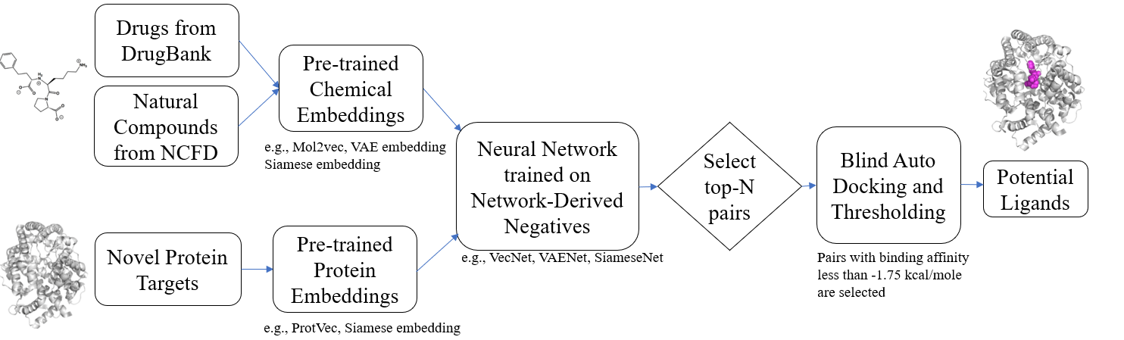
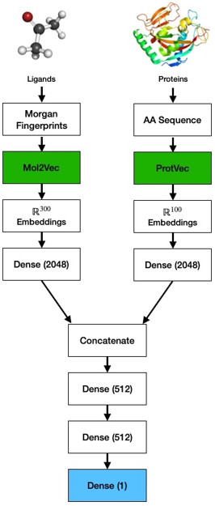
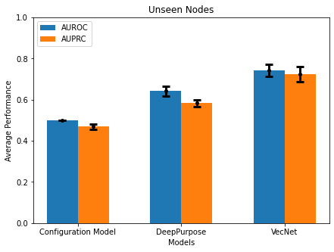
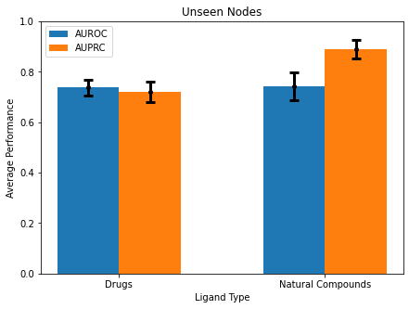
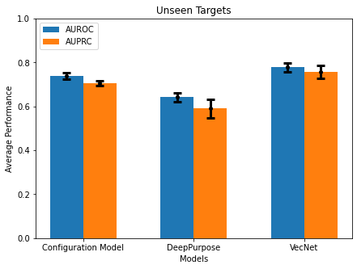
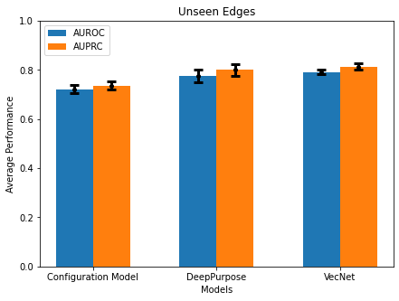
a
b
c
Unseen Nodes
Unseen Nodes
Unsupervised Pre-training
Deep Learning
Average Performance
Average Performance
Configuration Model
DeepPurpose
VecNet
Drugs
Ligand Type
Natural Compounds
Unseen Targets
Unseen Edges
Average Performance
Average Performance
Configuration Model
DeepPurpose
VecNet
Configuration Model
DeepPurpose
VecNet

