Slide 1
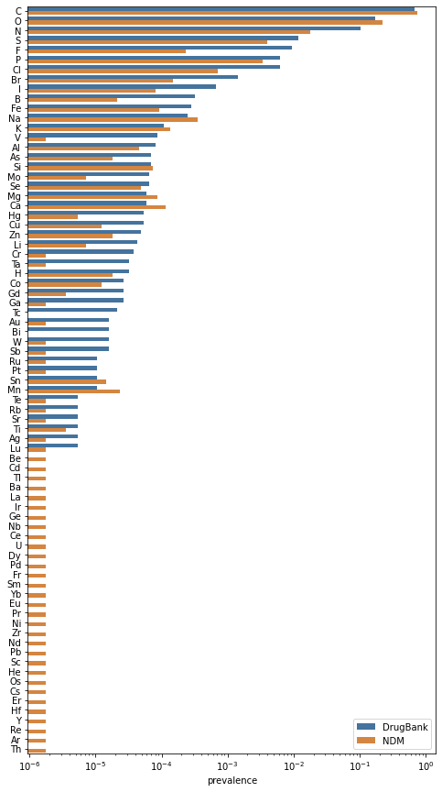
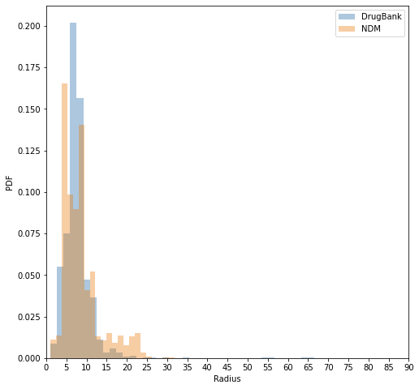
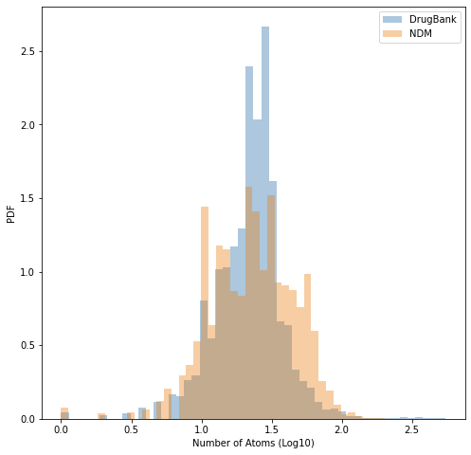
A
B
DrugBank
NCFD
C
DrugBank
NCFD
DrugBank
NCFD

