Slide 1
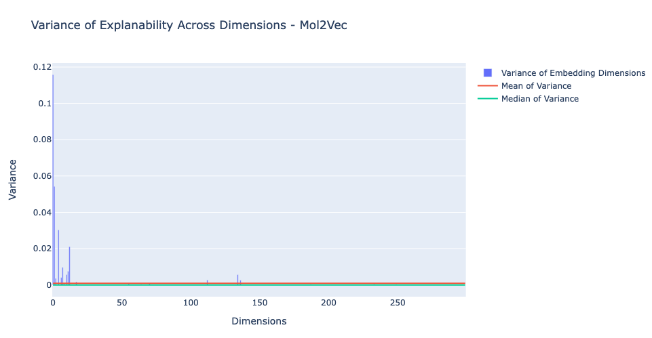
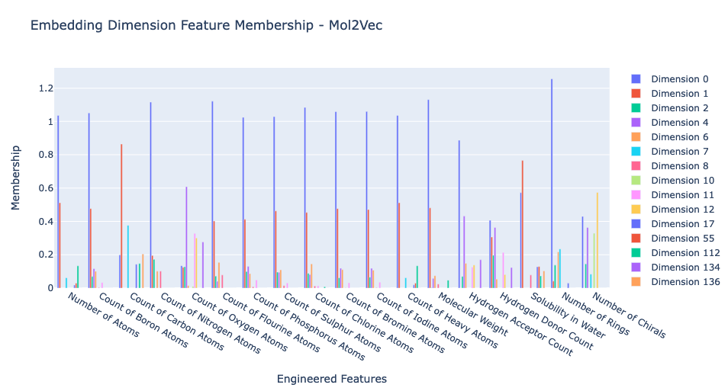
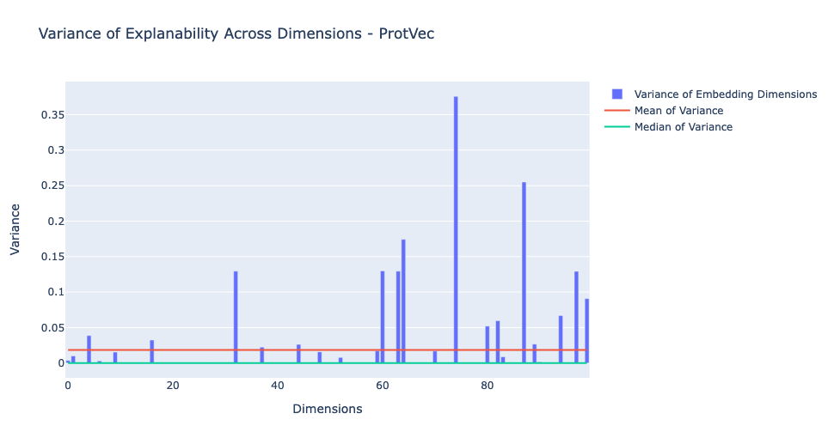
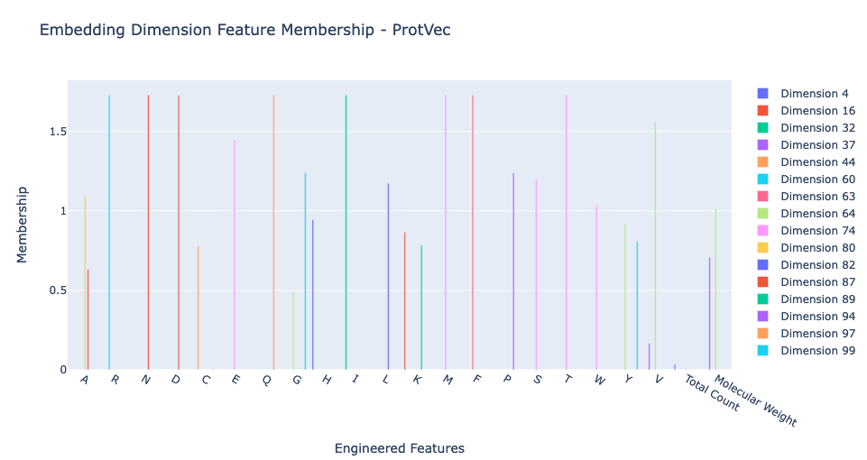
A
B
Embedding dimension feature membership – Mol2vec
Variance of Explainability across dimensions – Mol2vec
Variance
Membership
Dimensions
D
C
Engineered Features
Variance of Explainability across dimensions – ProtVec
Embedding dimension feature membership – ProtVec
Variance
Membership
Dimensions
Engineered Features
Notes:
Mol2vec is also learning the engineered features and the above are the dimensions of Mol2vec which encode the information in the engineered features

