Slide 1
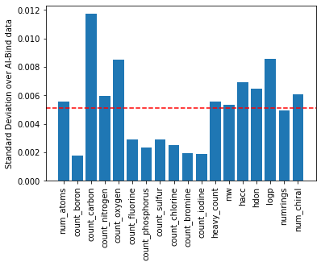
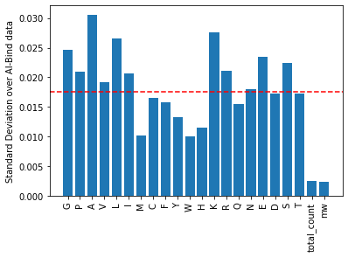
A
B
Standard Deviation over AI-Bind data
Standard Deviation over AI-Bind data
Engineered Features
Engineered Features

