Slide 1
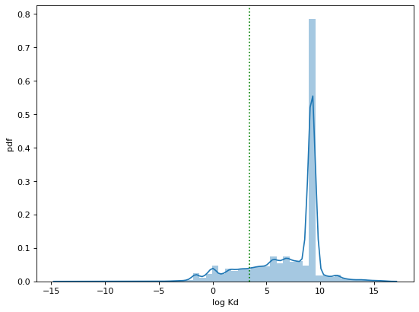
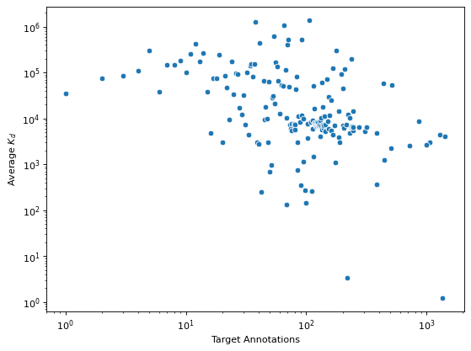
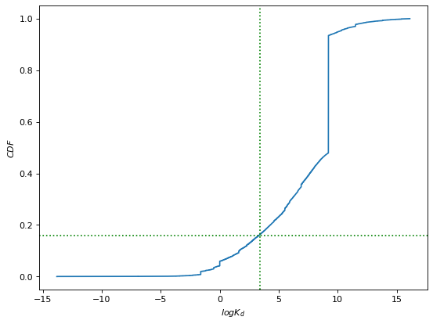
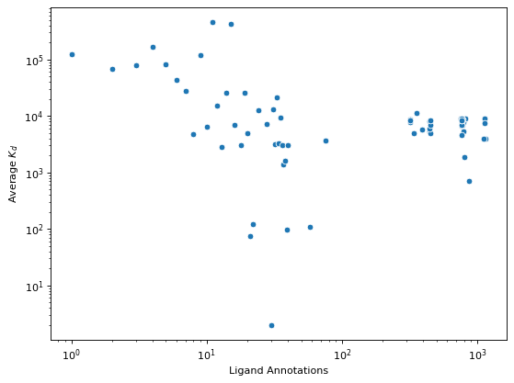
A
C
< K_{d} >
PDF
c_{Spearman}(k,<K_{d}>) = -0.47
log K_{d}
Protein annotations (k)
B
D
< K_{d} >
CDF
p_{bind} = 0.16
Threshold = 30 nM
c_{Spearman}(k,<K_{d}>) = -0.29
log K_{d}
Ligand annotations (k)

