Slide 1
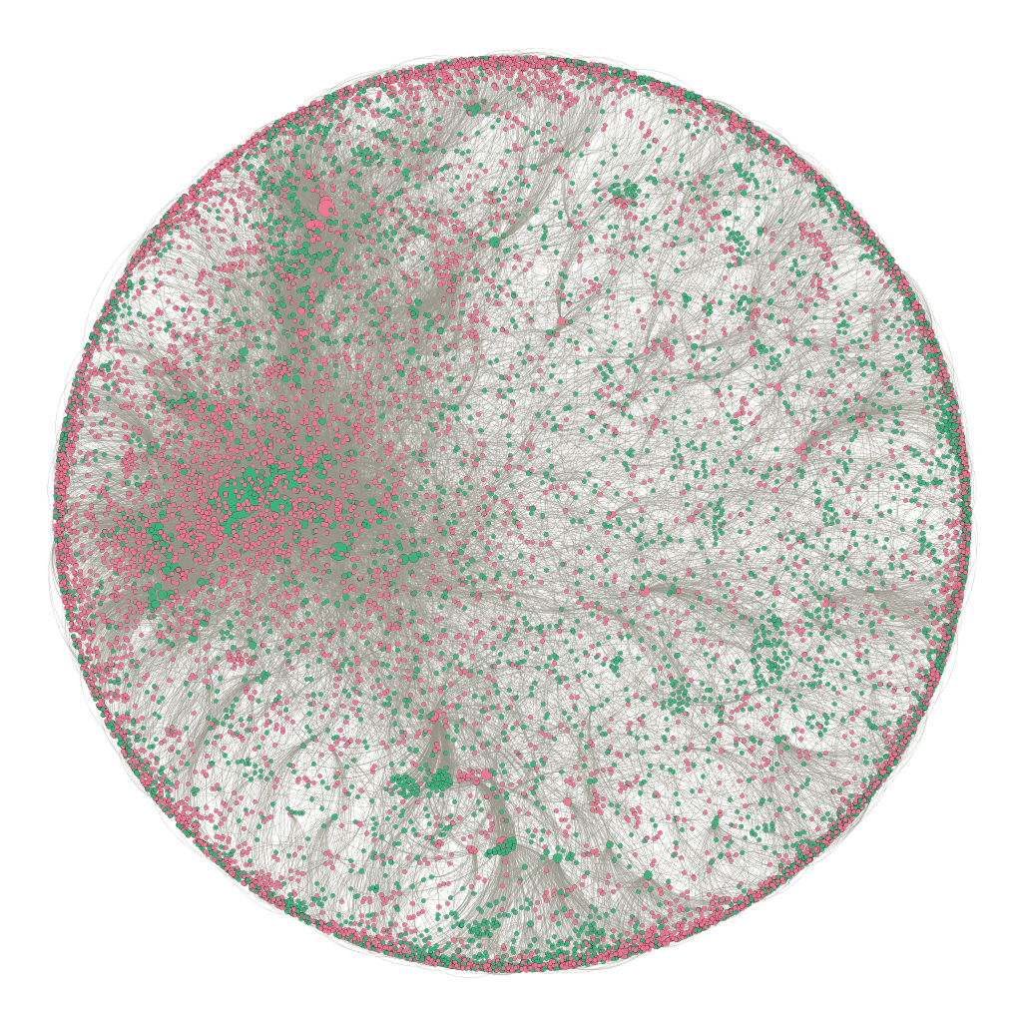
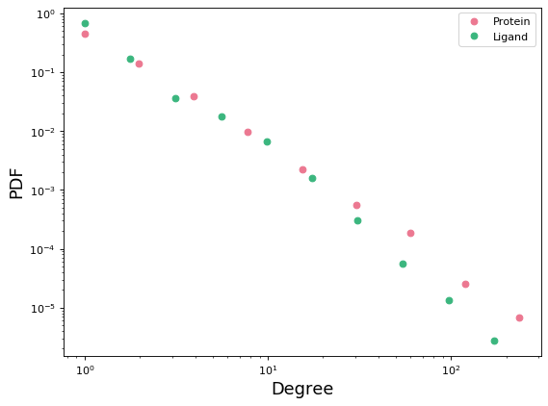
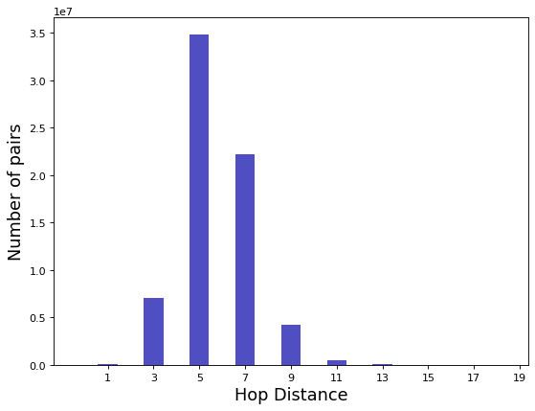
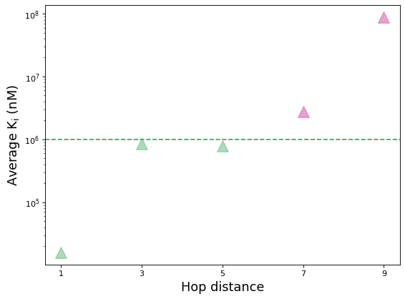
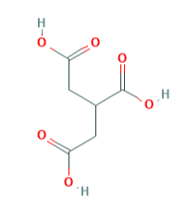
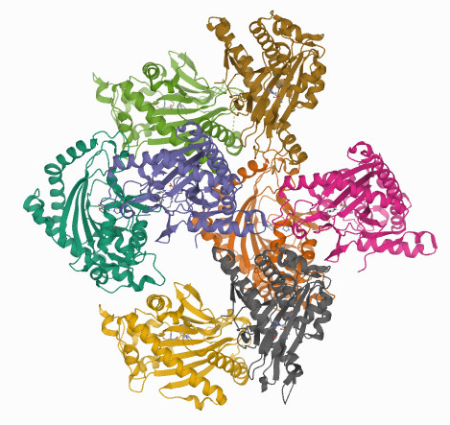
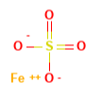
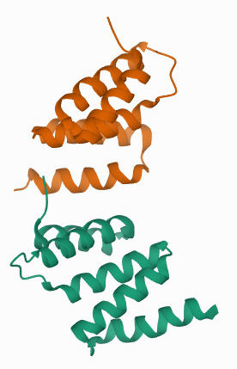
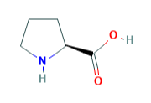
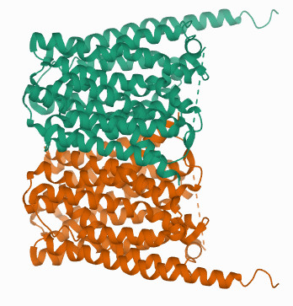
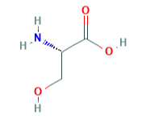
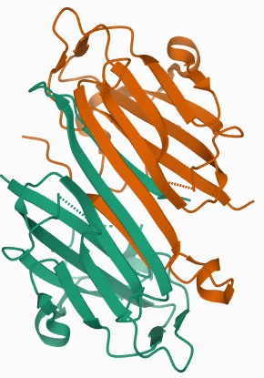
A
B
PDF
C
Degree
Used in training
Number of pairs
Used in validation and test
D
Hop distance
Average over 9 pairs
Average over 82 pairs
Non-Binding
Protein
Protein-Ligand Network Statistics
Nodes | 13,215
Proteins | 5,104
Ligands | 8,111
Positive Edges | 30,813
Average K_{i} (nM)
Average over 741 pairs
Ligand
Average over 3,808 pairs
Average over 3,489 pairs
E
Tricarballylic acid
ACO2
P4HA1
SLC16A10
Hop distance
SRR
Ferrous sulfate
Proline
Serine
7-Hop Negative Sample
K_{i} = 1.3*10⁶ nM

