Slide 1
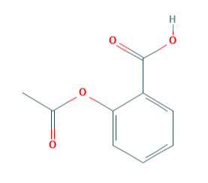
A
B
Molecule
Protein 1
Encoder Neural Network
Protein 2
Maximize the similarities between proteins 1, 2, and 3
Ligand A
Protein 3
Latent Representation (Embeddings)
Maximize the dissimilarities between proteins (1, 2, 3) and (4,5)
Binding Pairs
Protein 4
Decoder Neural Network
Maximize the similarities between proteins 1, 2, and 3
Ligand B
Protein 5
Reconstructed Molecule

