Slide 1
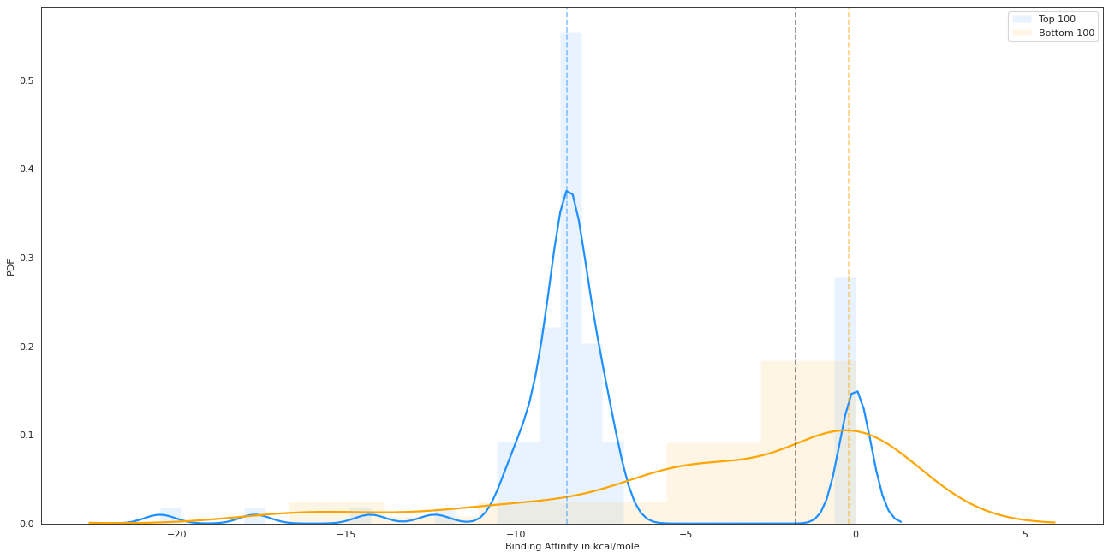
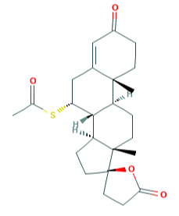
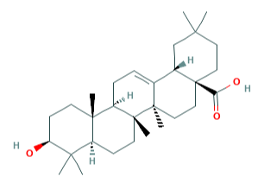
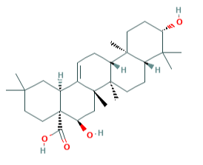
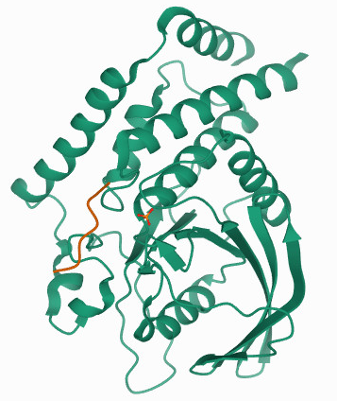
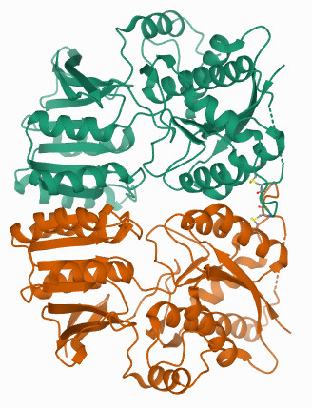
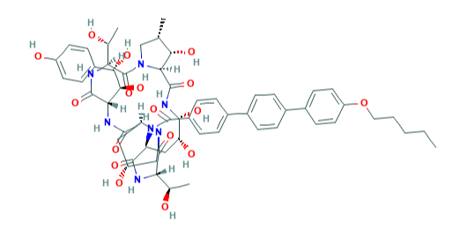
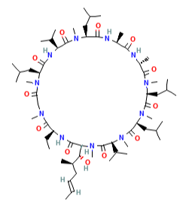
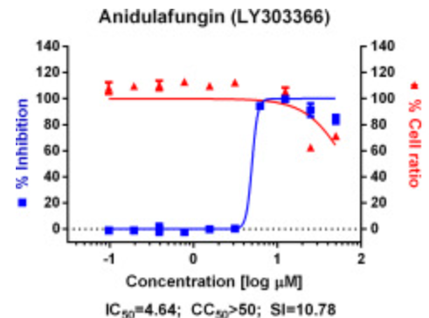
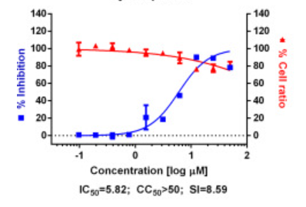
A
Threshold of
-1.75 kcal/mole
Top 100
Bottom 100
PDF
Binding Affinity in kcal/mole
B
Spironolactone
Oleanolic acid
Echinocystic acid
-9 kcal/mole
-8.3 kcal/mole
-8.3 kcal/mole
-10 kcal/mole
PTPN22
GRIA2
PTPN22
PTPN22
C
Anidulafungin
Cyclosporin

