Slide 1
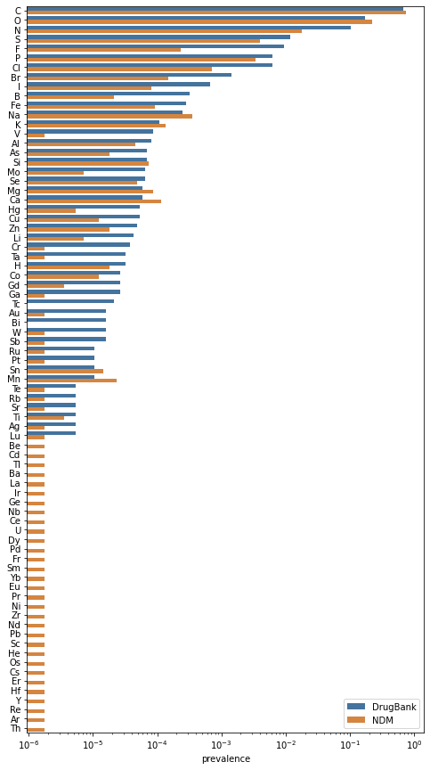
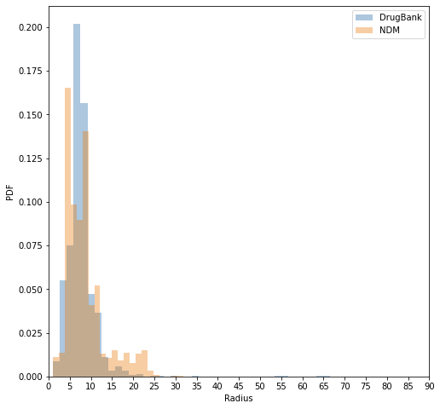
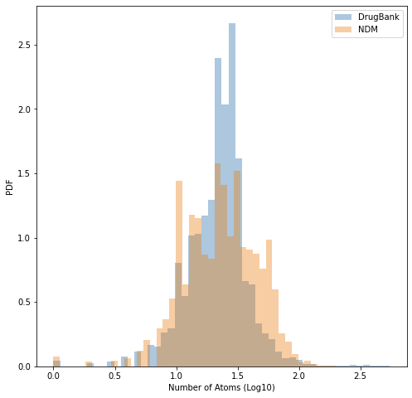
a
b
DrugBank
NCFD
DrugBank
NCFD
c
DrugBank
NCFD
DrugBank
NCFD

