Slide 1
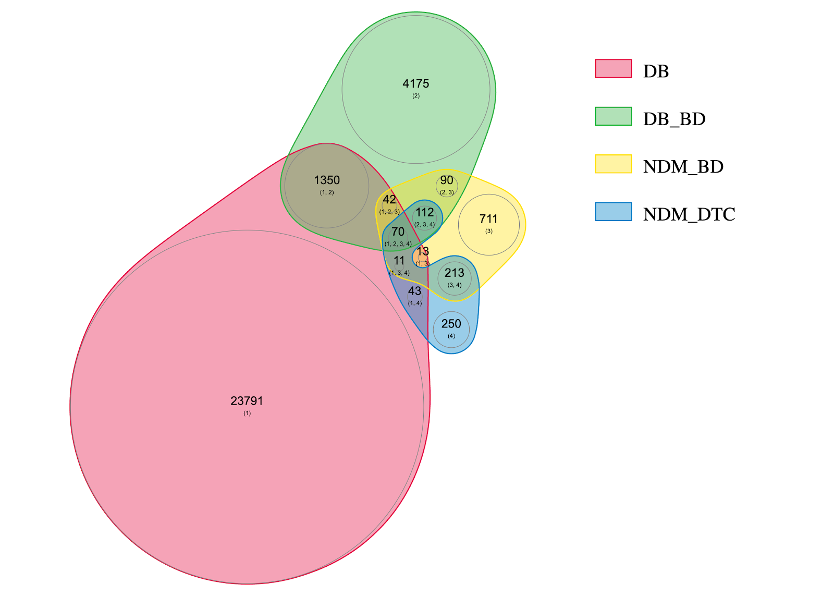
DrugBank
DrugBank in BindingDB
NCFD in BindingDB
NCFD in DTC

