Slide 1
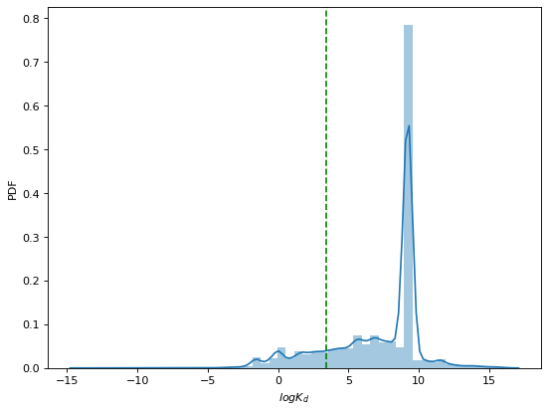
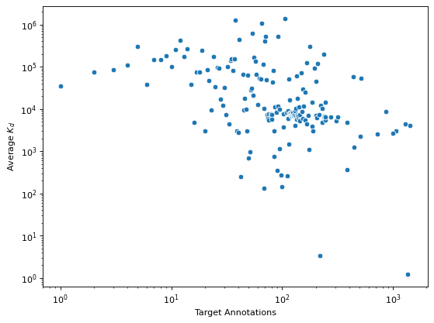
A
Threshold = 30 nM
PDF
p_{bind} = 0.16
log K_{d}
B
Rank-correlation = -0.47
< K_{d} >
Target annotations (k)

